Slide 1
L1: The Federalists Consolidate National Authority
(1776-early 1800s)
Striving for Balance Between Democracy and Authority
Agenda
Objective:
To understand the tension between Federalists and Republicans over the role and purpose of federal authority.
Schedule:
Intro to Unit
Lecture & Discussion on Democracy and Authority in the Founding Period
Homework:
Reading by Schwartz on Marshall Court
Due L2:
Yellow = Mon 9/17
Tan = Tues 9/18
Purple = Tues 9/18

Slide 2
US History Pre-Test

Slide 3
Democracy and Authority Unit One
What is this Theme About?
This unit examines the tension between the increasing power of the federal government and the rights of the people in the United States.
Essential Question:
How effectively has the federal government maintained its authority while protecting the rights of the individual and the states?
Review Lesson Topics & Schedule

Slide 4
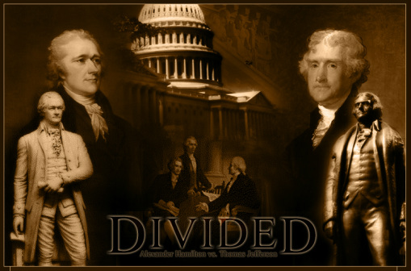
Tension Between Democracy and Authority in the Wake of the Founding
Schism over the nature of federal authority produces two political parties following the ratification of the Constitution:
Federalists
Democratic-Republicans

Slide 5
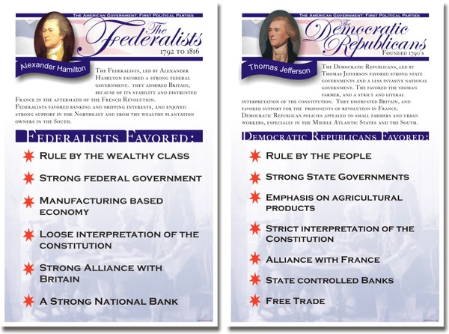
Federalists
Advocated a strong national government as the best instrument to protect individual rights and freedom
Genuine liberty required “a proper degree of authority, to make and exercise the laws”
Believed the Constitution called for such a strong national government
Demographics:
Northerners
Urban
Bankers & Merchants
Key Figures:
George Washington
Alexander Hamilton
John Adams

Slide 6
Democratic-Republicans
Feared that too much power in the hands of a national government could lead to tyranny
Wanted to concentrate power in the hands of state governments, not the federal government, because states were believed to be closer to the needs/wants of the people
Demographics:
Southern
Rural
Farmers
Key Figures:
Thomas Jefferson
James Madison

Slide 7
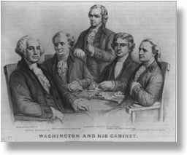
Federalists Take Power
While Washington wasn’t technically a Federalist (he had no party affiliation) he surrounded himself with Federalist Party members:
Vice President: John Adams
Treasury Secretary: Alexander Hamilton
But…Secretary of State: Thomas Jefferson
Federalist John Adams was our second president
From 1789-1801 Federalists were in charge of the government, and this sent the
US on an important path towards
increased federal authority
Much to the horror and virulent
protest of Thomas Jefferson and
James Madison (who switched
sides!!)

Slide 8
Expansion of National Government Under the Federalists
The creation of the First National Bank (1790)
Whiskey Rebellion (1794)
Alien and Sedition Acts (1798)
The Marshall Court
Judicial Review
Implied Powers Doctrine Affirmed
Federal Power Supreme Over States

Slide 9
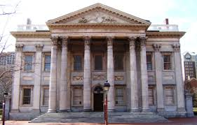
The First National Bank 1790 Story
Hamilton proposed the creation of a central bank
Hamilton believed a national bank was necessary to handle the complexity of the financial matters of the new nation
Hamilton argued that the creation of such a bank was Constitutional under the “necessary and proper clause” (AKA “the elastic clause” AKA “the implied powers doctrine”) of the U.S. Constitution (Article One, Section 8, Clause 18)
“The Congress shall have Power…To make all Laws which shall be necessary and proper for carrying into Execution the foregoing Powers, and all other Powers vested by this Constitution in the Government of the United States, or in any Department or Officer thereof.”
Hamilton took a liberal reading of the
clause and said that Congress should
do anything it felt was necessary to
carry out national responsibilities.

Slide 10
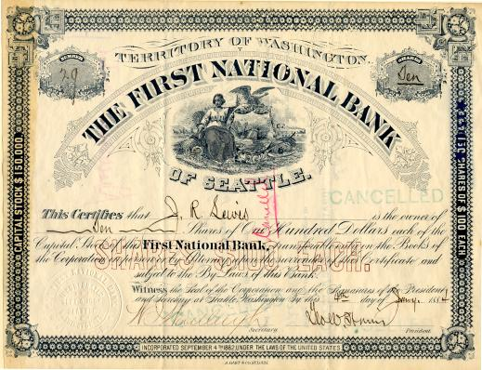
The First National Bank 1790 Story
Jefferson held that the clause meant that Congress should only take actions that were absolutely necessary, and no more
He believed that the creation of a national bank, was an over-reach of government authority and not at all authorized by the necessary and proper
clause
Ultimately, Washington
sided with Hamilton and
the bank was created in
1790

Slide 11
The First National Bank 1790 Significance
Hamilton’s interpretation of the “necessary and proper clause” ( The elastic clause; The Implied Powers Doctrine)– becomes the accepted/dominate interpretation of the clause
Implied Powers Doctrine codifies expanded Federal Authority

Slide 12
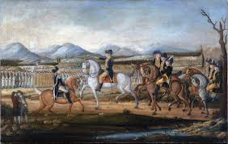
Whiskey Rebellion (1794) Story
Pennsylvania farmers refused to pay a tax on alcohol and started rebelling
Washington sends in troops (and leads them himself!) to put down the uprising

Slide 13
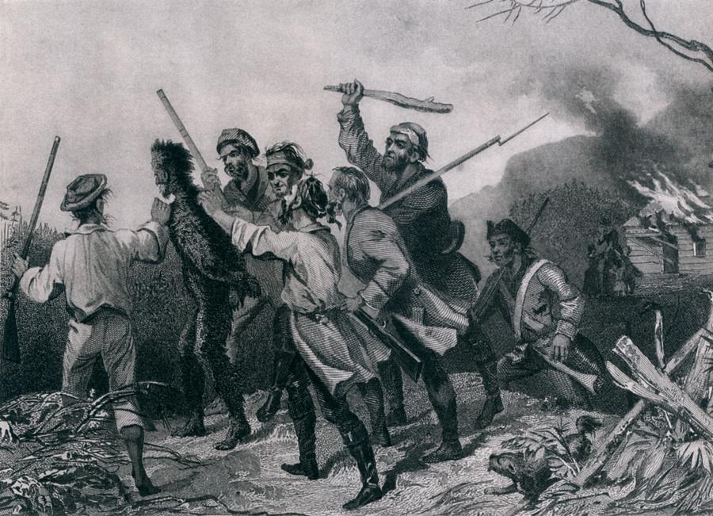
Whiskey Rebellion (1794) Significance
Demonstrated and proved the strength of the new federal government
Opposite of Shay’s Rebellion!
While Shay’s Rebellion proved that the government created by the Articles of Confederation was too
weak to successfully
put down insurrection,
the squashing of the
Whiskey Rebellion
demonstrated the efficacy
of the federal government
established by the
Constitution

Slide 14
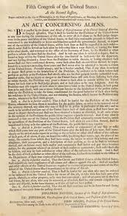
Alien and Sedition Acts (1798) Story
Tension between the United States and France during the French Revolution led to a wide-spread anti-French sentiment and the fear that France might go to war with the United States
Congress passed the Alien and
Sedition Acts in response to this fear
Allowed the president to imprison or
deport foreigners considered “dangerous
to the peace and safety of the United
States”
Restricted speech which was critical of
the federal government

Slide 15
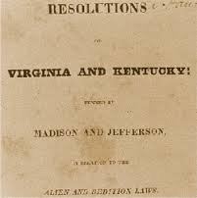
Alien and Sedition Acts (1798) Story
Outraged by their belief that the Alien and Sedition Acts were tyrannical, Republicans Jefferson and Madison secretly wrote the Kentucky and Virginia Resolutions
Acts passed by Kentucky and
Virginia that declared the
Alien and Sedition Acts
unconstitutional
Acts argued that states had the
power to nullify federal laws

Slide 16
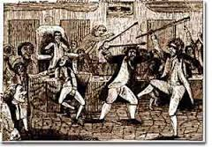
Alien and Sedition Acts (1798) Significance
Demonstrates tremendous unilateral federal authority—authority which may violate the First Amendment
Acts were never challenged in the Supreme Court
Sedition Act largely seen as unconstitutional today
Begins to plant the seeds for “nullification”
Legal theory that a state has the right to nullify or invalidate any federal law which that state has deemed unconstitutional
Based on the view that the States formed the Union by a compact among them. As creators of the federal government the States have a final authority to determine the limits of the power of that government.
Efforts to restrict federal authority
between 1798 and the outbreak of Civil
War in 1861, will tend to rely on
nullification to argue that states’ have
greater powers than the federal
government.

Slide 17
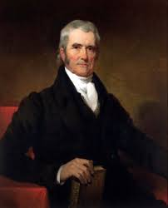
Marshall Court (1801-1835) Story
John Marshall appointed Chief Justice of SCOTUS by John Adams
Federalist Party leader and Secretary of State under John Adams
His rulings dramatically elevated the power of SCOTUS
Made SCOTUS a coequal branch of government along with the legislative and executive branch
Established SCOTUS as the final arbiter of constitutionality (judicial review)
Does all of this very inconspicuously
From an appointed position…in the basement of the Capitol

Slide 18
Marshall Court (1801-1835) Story
Judicial Review
Marbury v. Madison (1803)
Established SCOTUS as the final arbiter of constitutionality (Judicial Review)
Implied Powers Doctrine Affirmed
McCulloch V. Maryland (1819)
Confirmed Hamilton’s notion of implied powers
Expansive understanding of federal power
Federal Power Supreme Over States
Gibbons v. Ogden (1835)
Confirmed the supremacy of federal law over state law

Slide 19
Marshall Court (1801-1835) Significance
Dramatically expands federal authority because:
Grows federal authority by making SCOTUS an equal branch
Gives SCOTUS tremendous power
SCOTUS—not the people, not the states, not the president—decides if something is constitutional
Federal law is superior to state law
Federal government is more powerful than states

Slide 20
Federalists Expand Federal Authority in all Branches!
Legislative Branch
Implied Powers Doctrine (Interpretation of the Necessary and Proper Clause) Gives Congress Lots of Power
National Bank
McCulloch v. Maryland
Federal Laws supreme over State Laws
Gibbons v. Ogden
Judicial Branch
Judicial Review
Marbury vs. Maryland
Executive Branch
Presidential Powers expanded through role as Commander-in-Chief
Whiskey Rebellion
Alien and Sedition Acts

