Slide 1
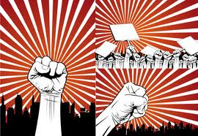
L3: Andrew Jackson: Understanding Jacksonian Democracy (1829-1837)
Striving for Balance Between Democracy and Authority
Agenda
Objective:
To evaluate Jacksonian Democracy
Schedule:
Intro to Jackson & Jacksonian Democracy
Evaluating Jackson as Democrat or Authoritarian
Whole Class Closing Discussion
Homework:
None

Slide 2
Federal Power Gets its First Big Check
The Federalists held the office of the Presidency from 1789-1801
Between 1801 and 1829, power rested with the Democratic-Republicans
Thomas Jefferson
James Madison
James Monroe
John Quincy Adams
These presidencies were largely consumed with foreign policy questions (Louisiana Purchase, the War of 1812) and economic concerns (the start of the Industrial Revolution) and did little to shrink the federal authority established by the Federalists

Slide 3
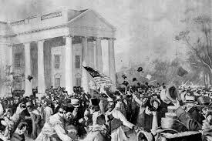
Andrew Jackson Comes to Office
All of that changes with the election of Andrew Jackson in 1829
The story of Jackson’s inauguration best illustrates this change
While inaugurations had been small, dignified events. Jackson’s inauguration was before a crowd of about 20,000 people, who poured into the White House after, ruining furniture, and destroying china and glassware?
So…what changed with the election of Jackson?

Slide 4
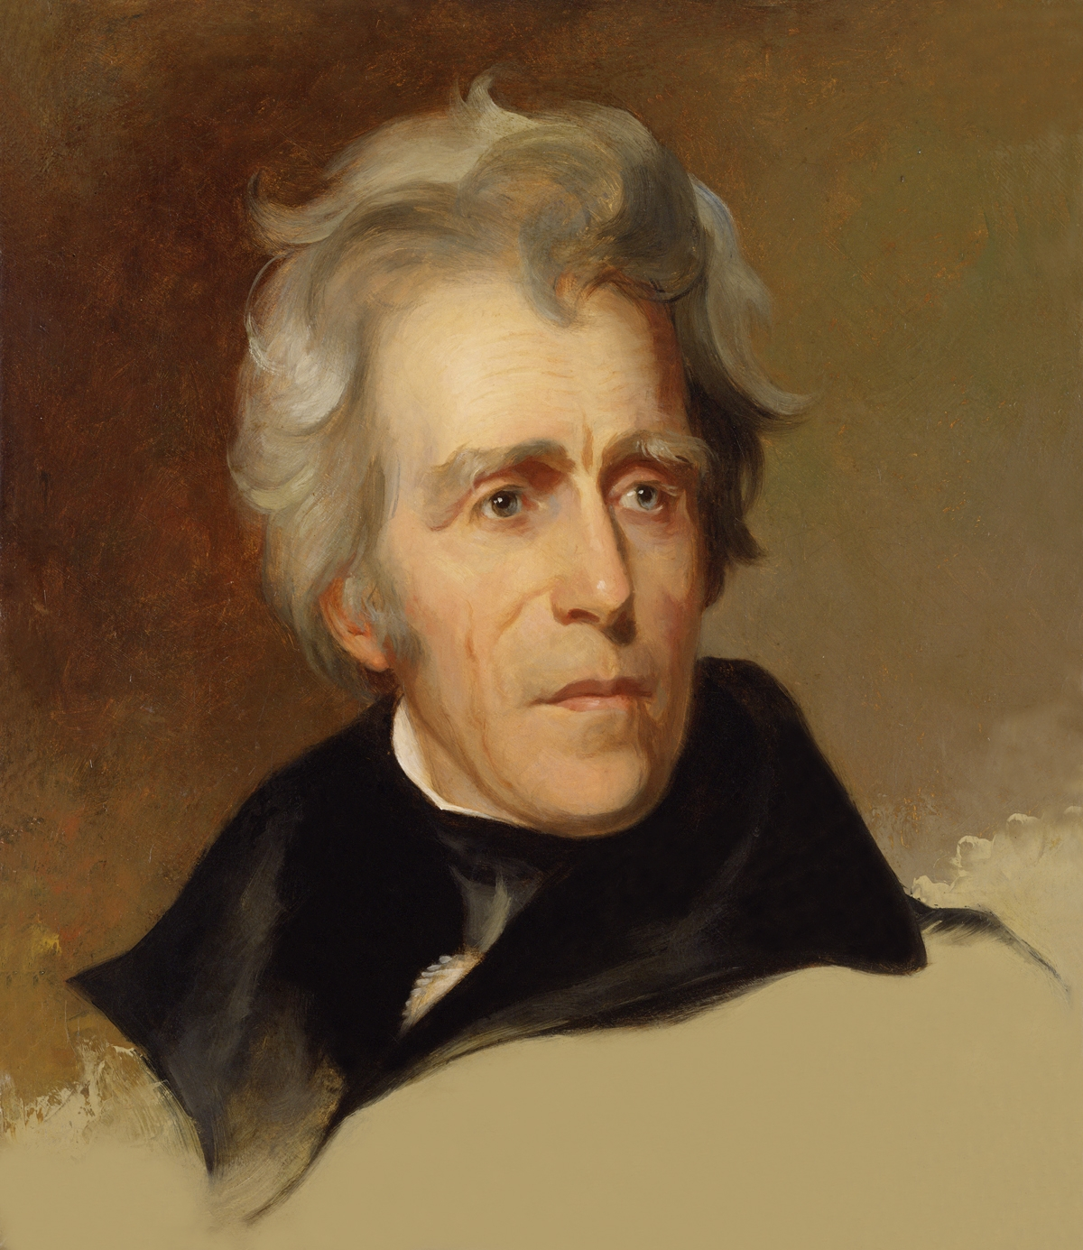
Andrew Jackson
1767-1845
Born to a poor farming family on the North Carolina/South Carolina border
Became a lawyer and a plantation owner in Tennessee
Oversaw decisive victories in the War of 1812
Didn’t go to college, chewed tobacco, and dueled with pistols
Was the first president
From the “West”
Born in a log cabin
Not from a prominent/wealthy family
Two term president from 1829-1837

Slide 5
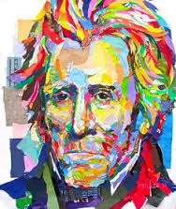
What Did Jackson Believe?
Self-proclaimed champion of the common man
Believed that Native Americans should be excluded from the democratic process and pushed further and further west
Believed the market revolution was a source of moral decay rather than progress; Feared the country was losing its agrarian roots
Slaveholder who supported slavery, but not dogmatically
Advocated a view of racial minorities known as paternalism

Slide 6
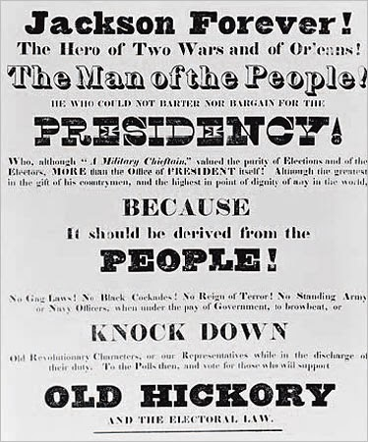
What accounts for Jackson’s Election?
Jackson came to power after many states reduced their property qualification for voting.
By 1840, more than 90% of adult white men were eligible to vote
As a result, with more “common men” voting, it isn’t surprising that they would gravitate to a candidate who also considered himself to be a “common man.”

Slide 7
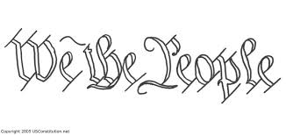
Jacksonian Democracy
The democratization of the vote represented a profound political transformation.
It ushered a new idea about democracy…

Slide 8
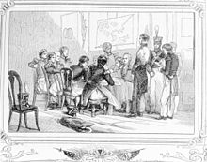
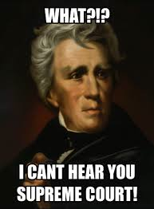
What is Jacksonian Democracy?
Our goal for today: To understand Jacksonian Democracy – What is it?

Slide 9
Was Jackson “The Common Man President”?
Task:
You will learn about four of Jackson’s actions while president:
The Creation of the Spoils System 1829
The Indian Removal Act 1830
The Vetoing of the Second Bank of the United States 1832
The Nullification Crisis 1832
For each action:
Develop a 1-2 sentence summary statement of what happened
Using the events, devise a definition of Jacksonian Democracy
Whole Class Discussion:
What is Jacksonian Democracy?
How does it compare to Federalist conceptions of democracy?
How does it compare to Jeffersonian conceptions of democracy?
Where does this leave the United States with respect to democracy/authority by 1837?

Slide 10
Understandings of Democracy 1787-1837
Group/Ideology | Thinking on Democracy
Federalists Hamilton Marshall | There is a nation – USA is an entity with a will independent of states that comprise it National power exists and should be used to promote the interest of the nation SCOTUS is the final say on what is constitutional (Marbury v. Madison 1803)
Jeffersonian-Democrats (Democratic-Republicans; Strand of Democrats) Jefferson Calhoun | Eschews national power for the sake of the people State power for the sake of the people There is no nation, just “states united” (Calhoun) States are final say on what is constitutional VA&KY Resolutions 1798 Nullification Crisis 1832 Succession
Jacksonian Democrats (Democrats of the Jackson Era) Andrew Jackson | National power should be used for the people Where the people = white, male, rural/farmer Especially executive branch (informally has “final say”) Believes in the USA as a nation But that it doesn’t have a will independent of the people Its sovereignty lies with the people The nation should be an expression of the people’s will

