Slide 1
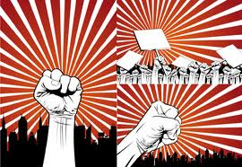
L4&L5: Slavery, Federalism, and States’ Rights: From Compromise to Conflict (1776-1861)
Striving for Balance Between Democracy and Authority
Agenda
Objective:
To understand the narrative of the relationship between slavery, federalism, and states’ rights between the founding and the Civil War.
Schedule:
Lecture on the compromises and clashes over slavery, federalism, and states’ rights
Homework:
1. Foner, Lincoln, and Wills for L6
Yellow = Thurs 9/27
Tan =Fri 9/28
Purple = Fri 9/28
2. Drake, Calhoun, McCurry for L7
Yellow = Fri 9/28
Tan – Mon 10/1
Purple = Mon 10/1

Slide 2
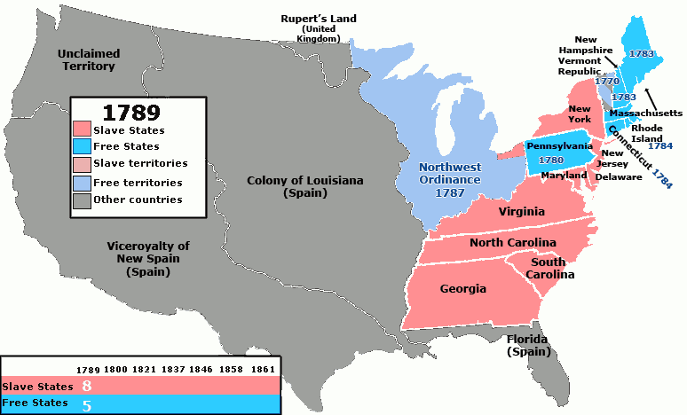
The Slavery Question (1776-1829)
Between the
Founding and
Jackson taking
office (1776-1829)
the United States
government did
their best to
ignore the slavery question.
The nation reached the uneasy (and unstable) solution that the north would be free and that the south would be slave and that the two regions would do their best to live side by side.

Slide 3
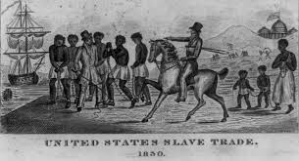
The Slavery Question (1776-1829)
But this “live and let live”
perspective, was far more
ideal than real.
Over-time the two regions
began to look very different
(see next slide)
More intervention was needed to keep them together
The fact that both regions were bound together by a national government, meant that the national government did have to weigh in on the slavery issue from time to time—even if they didn’t want to.
And, in order to maintain the tenuous union, made decisions that in the end enabled slavery
Enabler? Promoter? Prohibitor?
Debate over the North’s intent with slavery…

Slide 4
North and South: Sectionalism
The North:
Primarily industrial
Mostly urban and small farms
Supported tariffs and internal improvements
For strong central government
Relied on free labor
Wanted to limit spread of slavery in West
The South:
Primarily agricultural
Mostly small farms and plantations
Generally opposed tariffs and internal improvements
For “states’ rights”
Relied on slavery due to smaller population
Supported extending slavery in West

Slide 5
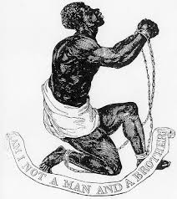
The Slavery Question (1776-1829)
Federal Government as Enabler
Enabling (psychology): Dysfunctional behavior that is intended to help resolve a specific problem but in fact may perpetuate or exacerbate the problem.
As a result of their desire to placate the south, the Federal Government engaged in a series of actions that permitted slavery.

Slide 6
The Slavery Question (1776-1829)
Federal Actions that Enabled Slavery
Constitution
3/5th Clause
Abolishing the importation of slaves in 1808
Fugitive Slave Clause
Congressional Powers to suppress insurrection
Northwest Ordinance 1787
Prohibit slavery in new territories northwest of the Ohio River, permit slavery in territories south of the river
Compromise of 1820
Following Louisiana Purchase, Missouri admitted as a slave state and Maine admitted as a free state in order to preserve an equal balance of slave and free states
Slavery allowed to move West, but sought a balance in the total number of slave/non-slave states

Slide 7
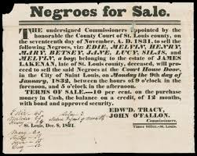
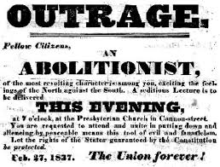
The Slavery Question Takes Center Stage (1829-1861)
During Jackson’s presidency slavery issues start to come to the center (mechanisms that had quieted slavery no longer work).
The new center focus on slavery is a product of:
Jacksonian Democracy
Expands notion of democracy/equality to the “common man”
Northern Abolitionist: Can we expand the notion of democracy to blacks? Women?
Southerners: Democracy is fine for whites, but if we expand it to women and non-whites we are upsetting the natural order of things.
Western Expansion
Means slavery has the potential to expand out of the south. Can’t just adopt live and let live…we are going to have to decide if slavery is going to be allowed to grow and expand.
Both of these radically reshape abolitionist and pro-slavery thought and practice…

Slide 8
The Slavery Question Takes Center Stage (1829-1861)
Jacksonian Democracy
Western Expansion
New Currents in Abolitionist Thought
*Argue for equality between blacks and whites*
*Slavery is a moral evil because blacks are people not property*
*Slavery should not expand*
New Currents In Pro-Slavery Thought
*Blacks and whites are not equal, and saying so violates natures’ order*
*Slavery should be free to expand as an issue of states rights and morality*
*The federal government is trying to enforce a view of equality on us*
Abolitionist Strategy
Immediate end to slavery
Violence/Protest
Elect Radical Republicans
Pro-Slavery Strategy
Vocalize our States’ Rights View Through Politicians (e.g. Nullification, Dred Scott)
Conflict 1854
Kansas-Nebraska Act
Dred Scott v. Sanford

Slide 9
Jacksonian Democracy
Greater incorporation of the common man into the electorate and the political system more broadly.
Expansive definition of political equality

Slide 10
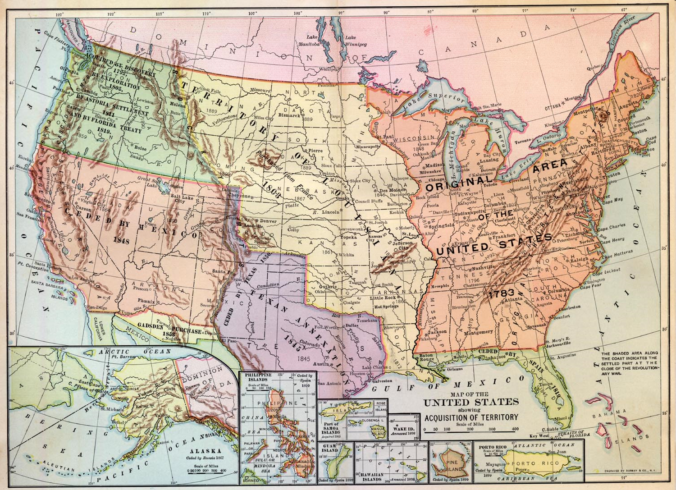
Western Expansion
America grew significantly as a territory between 1829 and 1861.
The Louisiana Purchase and Mexican-American War all brought new lands into the United States
Western Expansion and the Slavery Question went hand in hand
Southerners wanted
to grow and expand
slavery into the West
Northerners wanted
new territories to
enter in as free states

Slide 11
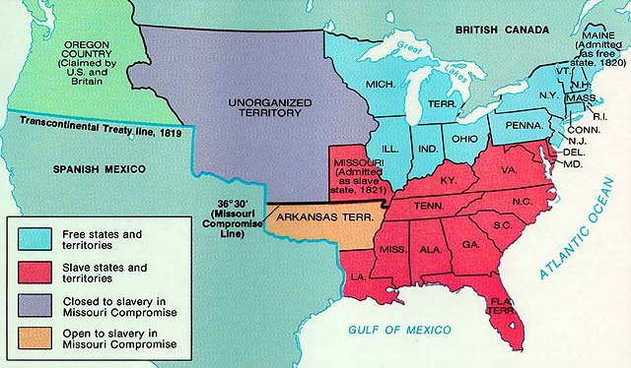
The Missouri Compromise of 1820 quieted the slavery debate for a while

Slide 12
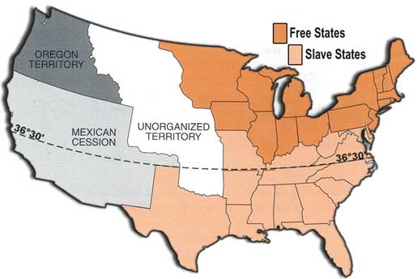
Mexican-American War of 1848 brings the question up again…
Would the new land won in the war with Mexico become slave states or free states?

Slide 13
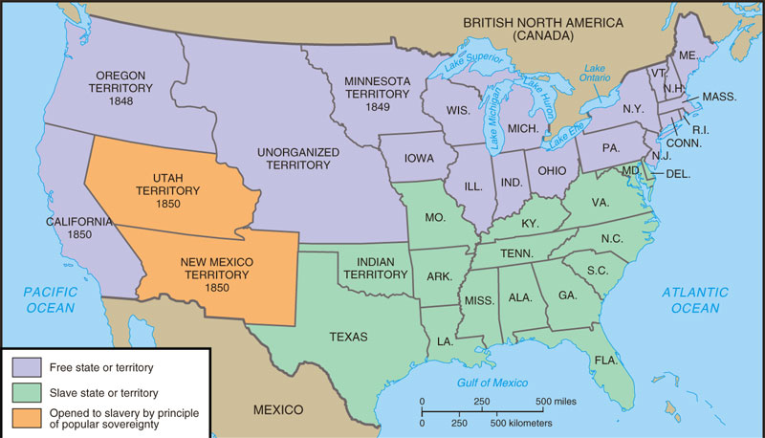
The Compromise of 1850 mitigates the dispute between North & South
The people of Utah & New Mexico could vote to allow or ban slavery (popular sovereignty)
The slave trade ended in Washington DC
A stronger Fugitive Slave Law was created that allowed Southerners to recapture slaves in the North
California entered as a free state

Slide 14
“Compromises” Drive Conflict
Each time a dispute over the slavery question threatened the nation, a compromise was proposed
But these compromises were not stable, because neither abolitionists nor slavery supporters viewed them as compromises because of their increasingly immutable views of the morality of slavery as shaped by Jacksonian democracy as well as conflicting Constitutional interpretations
Abolitionists:
Slavery is immoral, thereby permitting it in a way is immoral
The expansion of slavery can be regulated by Congress
Slavery Supporters:
Slavery is moral, therefore it should not be restricted by any federal laws
The expansion of slavery can’t be regulated by Congress, as slavery is a question of individual property

Slide 15
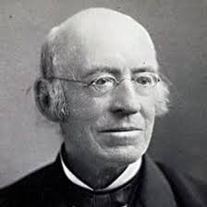
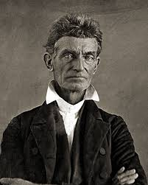
New Currents in Abolitionist Thought
Inspired by Jacksonian democracy, Abolitionists begin to agitate for the expansion of democracy even further—if all white men were equal, what about all white and black men?
Conception of universal human equality starts to emerge for the first time
Beginning in the 1830s, abolition takes on a radical tone.
Calls for the immediate end to slavery
Previously had called for a gradual decline
Declares slavery a moral evil
Calls for complete equality between black and white men
Key Figures
William Lloyd Garrison
John Brown

Slide 16
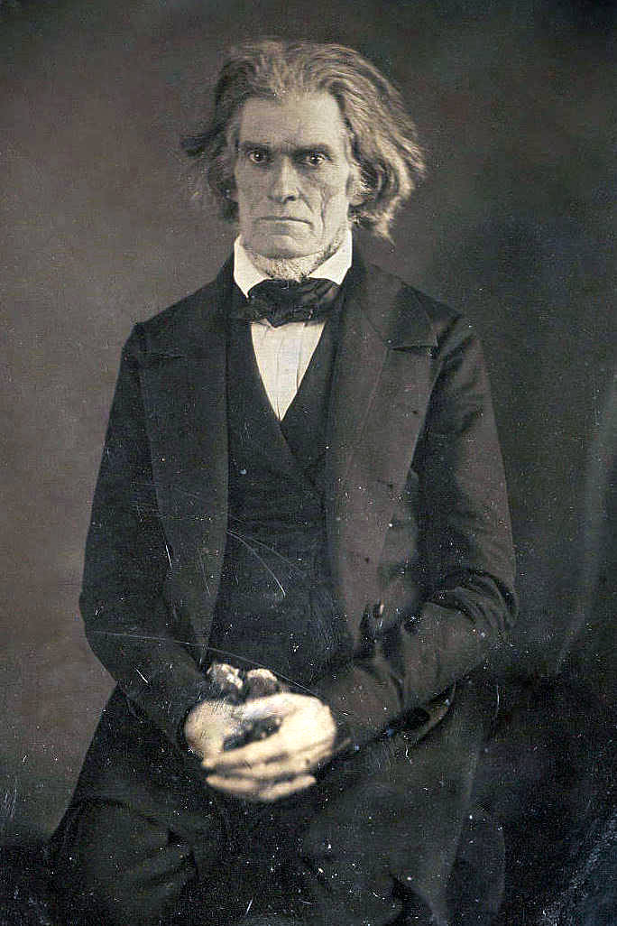
New Currents in Pro-Slavery Thought
Jacksonian Democracy Leads to Southern Redefinition of Liberty
The language of the DOI—that all men were created equal and entitled to liberty—was the “most false and dangerous of all political errors” said John C. Calhoun
Hierarchy, not equality, was the natural order of things
Doling out equality too broadly—was dangerous and threatened to give a voice in democracy to those who were, by nature, not equipped to handle it. This would hurt society over all, weaken, lower its potential
The freedom of whites, rested on the slavery blacks
New Definition of Liberty, leads to new
justification for slavery: Paternalism
During the founding many slaveholders thought of
slavery as “necessary evil.”
Now slavery was defined as a benevolent, giving
institutions in which kind generous whites
sacrificed to provide for those who couldn’t care
for themselves.
Key Figures:
John C. Calhoun

Slide 17
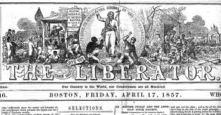
Abolitionist Strategy
When abolitionists declare slavery an absolute moral evil, they begin to call for an immediate end to slavery
Suddenly, compromises are not OK; it is all or nothing. There must be an immediate end to slavery.
You don’t bargain with the Devil!
To achieve this immediate
end:
Protest/Violence
Bloody Kansas
Harper’s Ferry
Elect Radical Republicans
Faction of the Republican Party who strongly opposed slavery

Slide 18
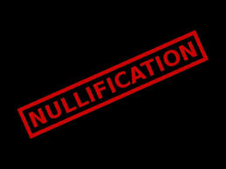
Pro-Slavery Strategy
If slavery is a moral necessity, then slavery must be allowed to persist
Like the abolitionist movement, the pro-slavery movement also took an all or nothing approach.
Slavery must persist
To secure the perpetuation
of slavery:
Endorse and practice
nullification where slavery is
threatened by law

Slide 19
Two Actions Bring Abolitionists and Pro-Slavery Advocates into Direct Conflict
Kansas-Nebraska Act 1854 / Bleeding Kansas / Harper’s Ferry
Dred Scott v. Sanford (1854)

Slide 20
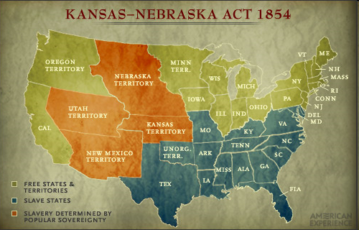
The Kansas-Nebraska Act 1854
The K-N Act (1854) created two new territories
The act left it up to settlers to decide whether to become slave states or free states
“Popular Sovereignty”

Slide 21
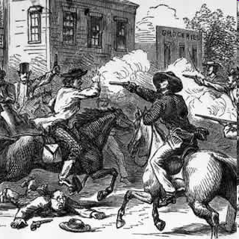
Bleeding Kansas 1854
Northern and Southern settlers both flooded into Kansas
Supporters of slavery invaded an abolitionist town, burned a hotel, looted home and destroyed newspaper presses
Anti-slavery forces retaliated. Led by John Brown, they invaded a pro-slavery town, dragged five men from their homes killed them
Southerners were outraged by a speech Senator Sumner made criticizing Southern congressmen for supporting the Kansas- Nebraska Act. Rep. Preston Brooks savagely beat Sumner with a cane to defend Southern honor

Slide 22
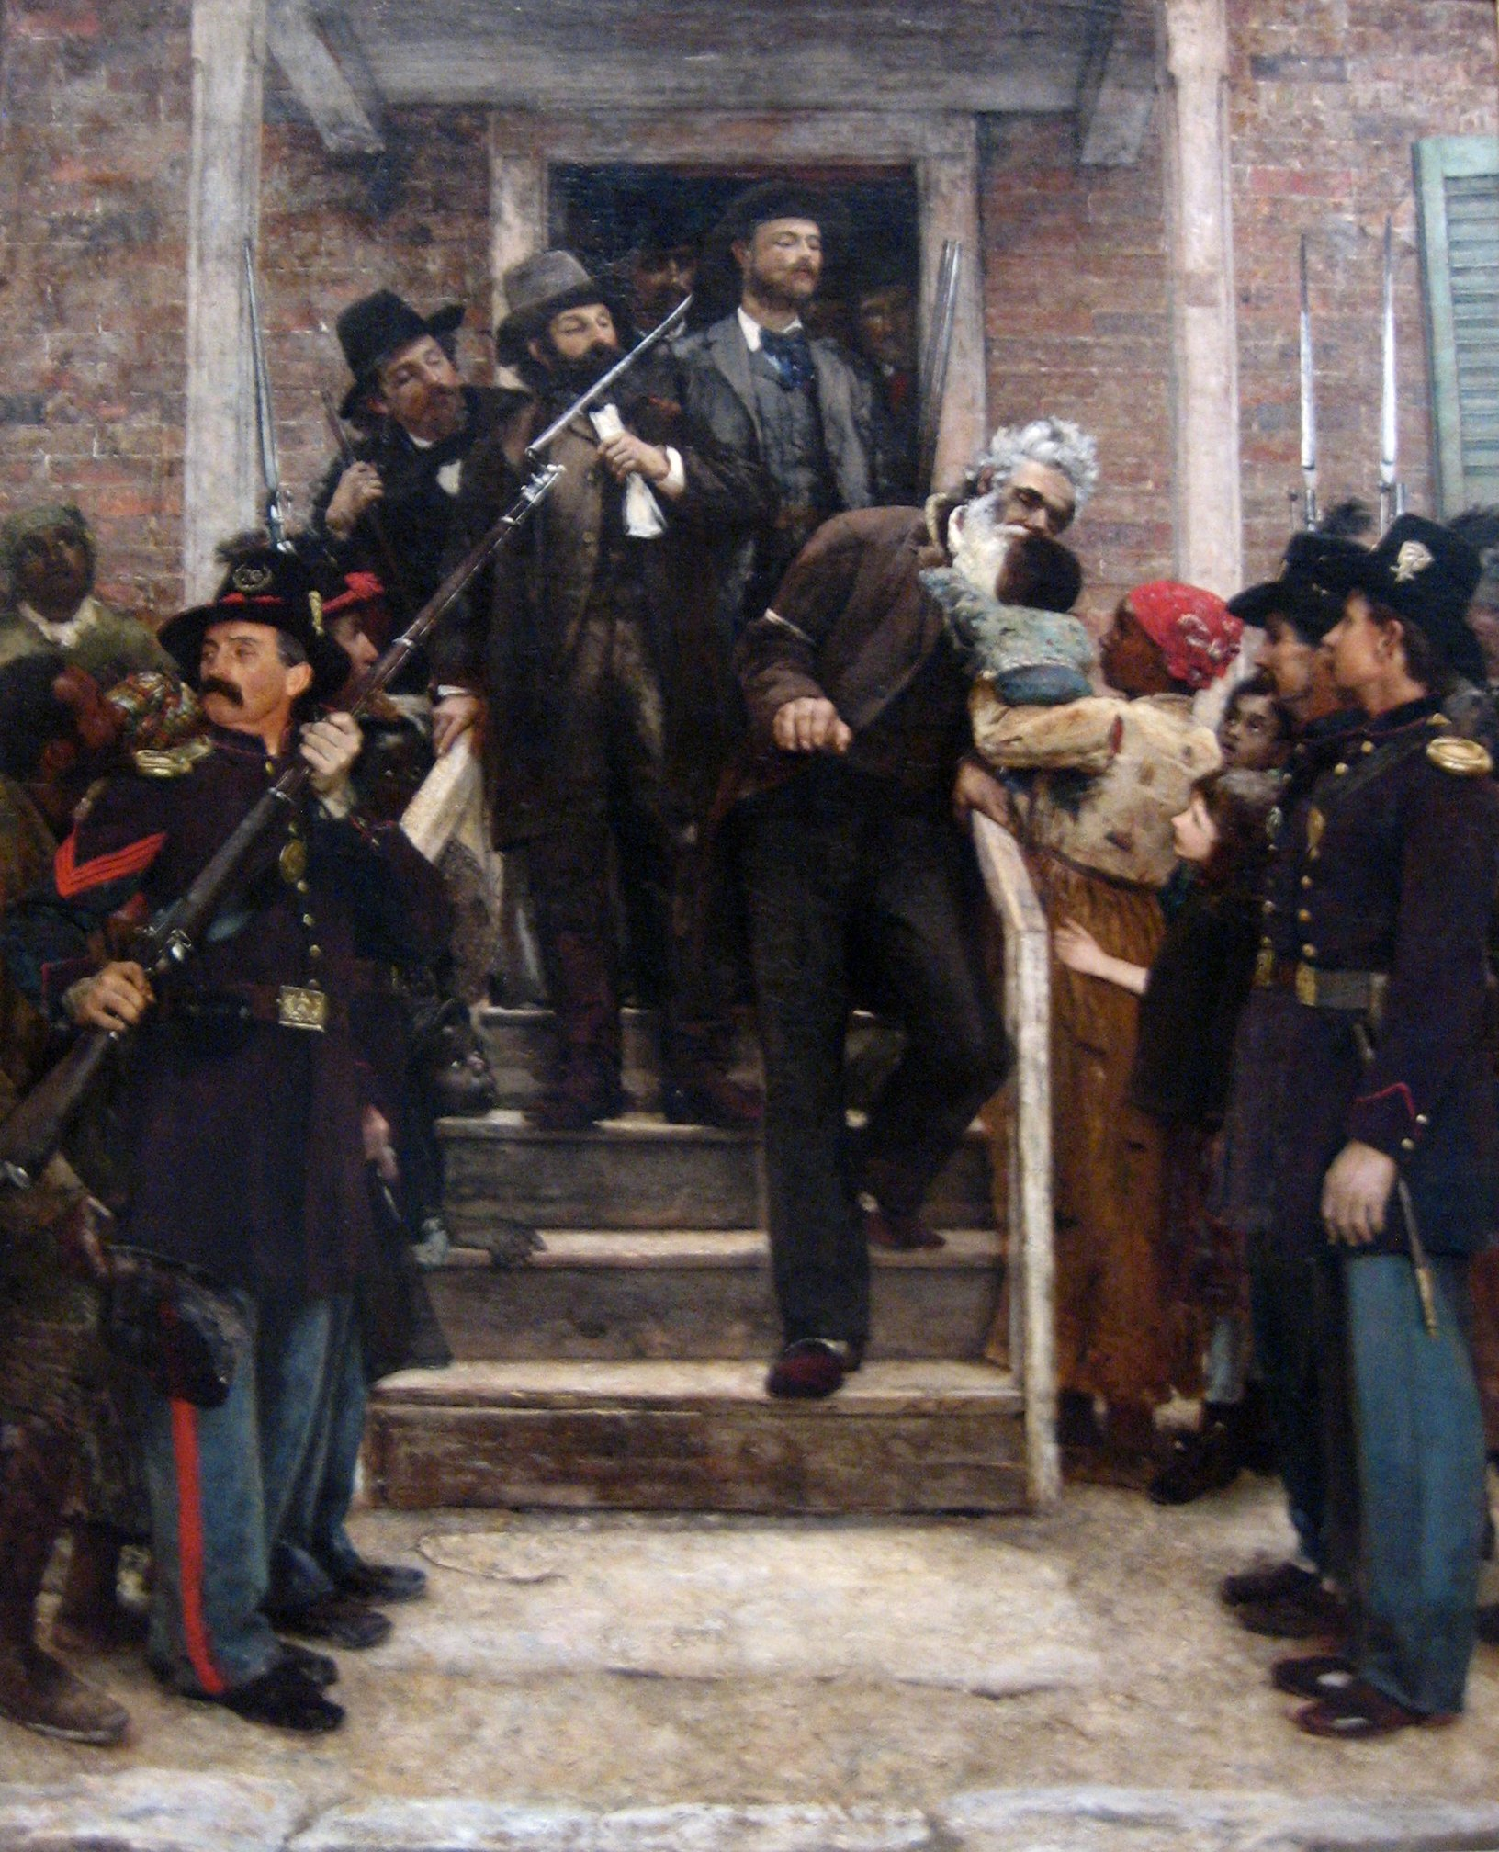
Harper’s Ferry 1859
Attempt by John Brown to start an armed slave revolt by seizing weapons from a United States arsenal at Harper’s Ferry, Virginia
Plan fails
Brown is hung
Significance:
Stirs fears of slave rebellions
in the South
Makes John Brown a martyr
for the abolitionist
movement

Slide 23
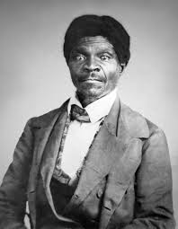
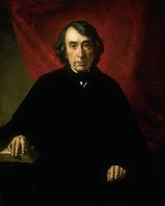
Dred Scott v. Sanford 1854
Facts of the Case:
Dred Scott was a slave who had accompanied his master to live in Illinois where slavery was illegal.
When they moved back to Missouri, Scott sued for his freedom, claiming that his residence in a free soil state had made him free
Issues at Hand:
Could a black person be a citizen and therefore sue in federal court?
Did residence in a free state make Scott free?
Did Congress possess the power to prohibit slavery in a territory?
Ruling:
Chief Justice Roger Taney wrote the majority.
Taney famously wrote, believed that blacks "had no rights which the white man was bound to respect; and that the negro might justly and lawfully be reduced to slavery for his benefit. He was bought and sold and treated as an ordinary article of merchandise and traffic, whenever profit could be made by it."”
Scott remained a slave
Congress possessed no power under the Constitution to bar slavery from a territory.
Significance:
Taney’s assertion that Congress did not have the authority to regulate slavery was HUGE!!
All past compromises & popular sovereignty were illegal!
Victory for states’ rights!!
President Buchanan announced that slavery existed in all of the territories “by virtue of the Constitution”

Slide 24
Impending Crisis: The Election of 1860
Republicans nominate Abraham Lincoln
Democrats fracture over views of slavery
As a result, Lincoln wins, but…
Has less than half of the popular vote
Did not receive any Southern votes

Slide 25
South Prepares for Secession
View Lincoln’s election as the beginning of Republican dominance in the federal government, and the start of the slow death of slavery and southern power
Rather than accept permanent minority status, they advocated for their regions independence.

