Slide 1
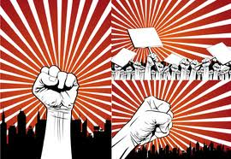
L6&L7: Democracy and Authority in the Civil War
Striving for Balance Between Democracy and Authority
Agenda
Objective:
To evaluate the shifting definitions of democracy and authority during the Civil War.
To assess the differences in these definitions between the Union and the Confederacy.
Schedule:
Two days of whole class discussions
Homework:
1. Read Drake, Calhoun, McCurry for L7
Yellow = Fri 9/28
Tan = Mon 10/1
Purple = Mon 10/1

