Slide 1
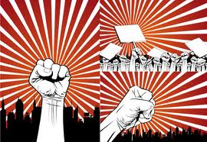
L13: The Gilded Age: The Corruption of Democracy
1870s-Early 1900s
Striving for Balance Between Democracy and Authority
Agenda
Objective:
To understand..
The nature of freedom and democracy in the Gilded Age
The way in which democracy was corrupted during the Gilded Age
Schedule:
Lecture & Discussion
Homework
Read Foner chapter “Progressive Freedom” for L13
Yellow = Mon 10/15
Tan = Mon 10/15
Purple = Tues 10/16

Slide 2
Understandings of Democracy Civil War and Reconstruction
Group/ Ideology | Thinking on Democracy
Abraham Lincoln | There is a nation USA is an entity with a will independent of states that comprise it The nation exists to aspire to a higher calling of spreading liberty The nation exists to aspire to a higher calling of exemplifying liberty for other nations The will of the nation is not the “the nation” (Federalists) or “the people” (Jackson) but the ideal of human liberty/freedom National power should be used to promote liberty (defined as freedom to labor) View of the Presidency Whitman on Lincoln: “Oh Captain, My Captain!”…He is at the helm…steering the ship of liberty and can do what is right in pursuit of it Democracy requires the citizenship of blacks (but they not have to be fully equally to whites in the package of rights they possess)
Radical Republicans | There is a nation National power should be used widely and heavily to promote full and complete equality between blacks and whites National power should be used to actively promote civil rights through legislation Reconstruction Amendments enforces that the national government (Congress in particular) have the authority to enforce Civil Rights issues/legislation Democracy requires complete equality between blacks and whites Democracy necessitates civil rights Democracy requires all races be equal in the package of rights they possess With Reconstruction Amendments, Constitution is re-written to serve as a tool to attain/achieve equality Recognizes the vote as a basic component of all male citizenship

Slide 3
Reconstruction ends not with a bang but with a whimper
Reconstruction fizzles out with the goals of the Radical Republicans accomplished in law, but not in practice
With an unmotivated President, a fatigued American public, and the forces of white supremacy still strong in the south, we enter into after Reconstruction where there is:
No effort made to secure black civil rights
Rampant abuse of black civil rights with the passing of the Jim Crow Laws and a government that is complacent in their implementation in the Plessy v. Ferguson (1896) case
A string of “do nothing” Presidents who seek to reverse the trend of federal intervention brought about by the Radical Republicans

Slide 4
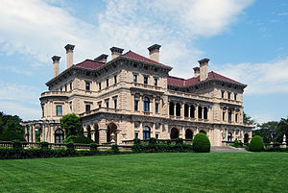
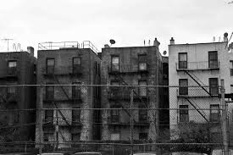
The Gilded Age 1877-mid 1900s
After Reconstruction ends in 1877, America enters a period known as the Gilded Age.
What do you think this time period is going to be all about?

Slide 5
Important Gilded Age “Happenings” that impact American Democracy in this period
Firm Linking of Freedom to Economic Liberty
Deepening connection between the definition of human freedom and laissez-faire economics
Change in American Demographics via Immigration
Influx of immigrants (mainly Irish, Italian, and Russian Jews) which effects the composition of the electorate and political parties
Rejection of Strong Federal Power
Revitalized belief in limited executive power following the presidency of Andrew Johnson

Slide 6
Freedom as Economic Liberty

Slide 7
Freedom as Economic Liberty
How was freedom defined by Lincoln and the moderate wing of the Republican party?
We thus the link between freedom and economic liberalism—what does this mean?
In the Gilded Age, this link gets taken to an extreme

Slide 8
Freedom as Economic Liberty
Personal freedom was complete and total economic freedom (Freedom = Economic Liberty)
Complete freedom of contract
Complete freedom from government intervention in the economy
Complete freedom over your earnings and wealth
Complete freedom in how you ran your corporation
Evolves out of Lincoln and the Republican’s ”Free Labor” definition of freedom
Enter into a period of complete laissez-faire economics in American life, which leads to massive economic inequality…and no effort to stop it, because that was seen as infringing on freedom

Slide 9
Change in American Demographics Via Immigration

Slide 10
Immigrants change the American electorate
The Gilded Age saw a tremendous increase in the number of immigrants coming to America, overwhelmingly these immigrants were Irish, and then Italian
Influx of immigrants during this time, changes:
American social life:
Cities overcrowded, new cultures and religions, new languages, new exploitable workforce
American electorate:
Parties become increasingly competitive to win the vote of these new immigrants
Democrats are more successful in this process, and achieve a new base of support from Irish and Italian immigrants

Slide 11
Party Lines Begin to Cement
Democratic Bloc
Republican Bloc
White southerners (preservation of white supremacy)
Catholics
Recent immigrants (esp. Irish—in part saw the possibility of using white supremacy to their advantage)
Farmers
Northern upper-class whites (pro-business)
African Americans
Northern Protestants
Old WASPs (support for anti-immigrant laws)

Slide 12
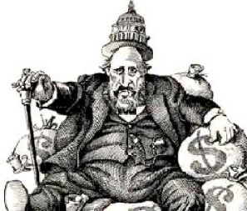
But…Competition creates and opportunity for Corruption: Political Machines
As urban populations swelled during this time, both the Democrats and the Republicans between to establish “political machines” at the local level
Political Machines
An organized group of people that controlled the activities of a political party
Here’s who they worked.
The Machine decides which candidates they want to put up for a range of offices.
The Machine comes to you/your community (especially immigrants) and ask you what services you need.
The Machine promise them that if you vote for their candidates they will provide these services
The Machine candidates get into office
The Machine then fills the local appointment offices with loyal supporters ($$$ donors)
City Boss was head of Political Machines
Political machines used power to
Rig elections
Become wealthy from kickbacks-illegal
payments
Illegal payments in exchange for government
contracts/licenses
Control police force to stay out of trouble
Put friends in position of power throughout
the government.

Slide 13
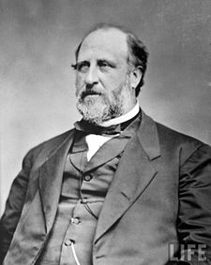
Political Machines Corrupt Local Politics
Example: Tammany Hall & Boss Tweed
William “Boss” Tweed is a politician who runs a political machine in NYC called Tammany Hall
Kept the Democratic Party in power in NYC
Bought votes, encouraged corruption, controlled NYC politics
Milked the city with false leases, padded bills, false vouchers, unnecessary repairs and over-priced goods

Slide 14
Rejection of Strong Federal Power

Slide 15
President as Symbolic Office
Can you name a President who served between 1877 and 1900?

Slide 16
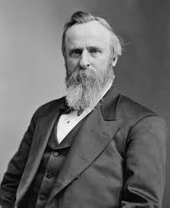
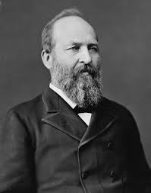
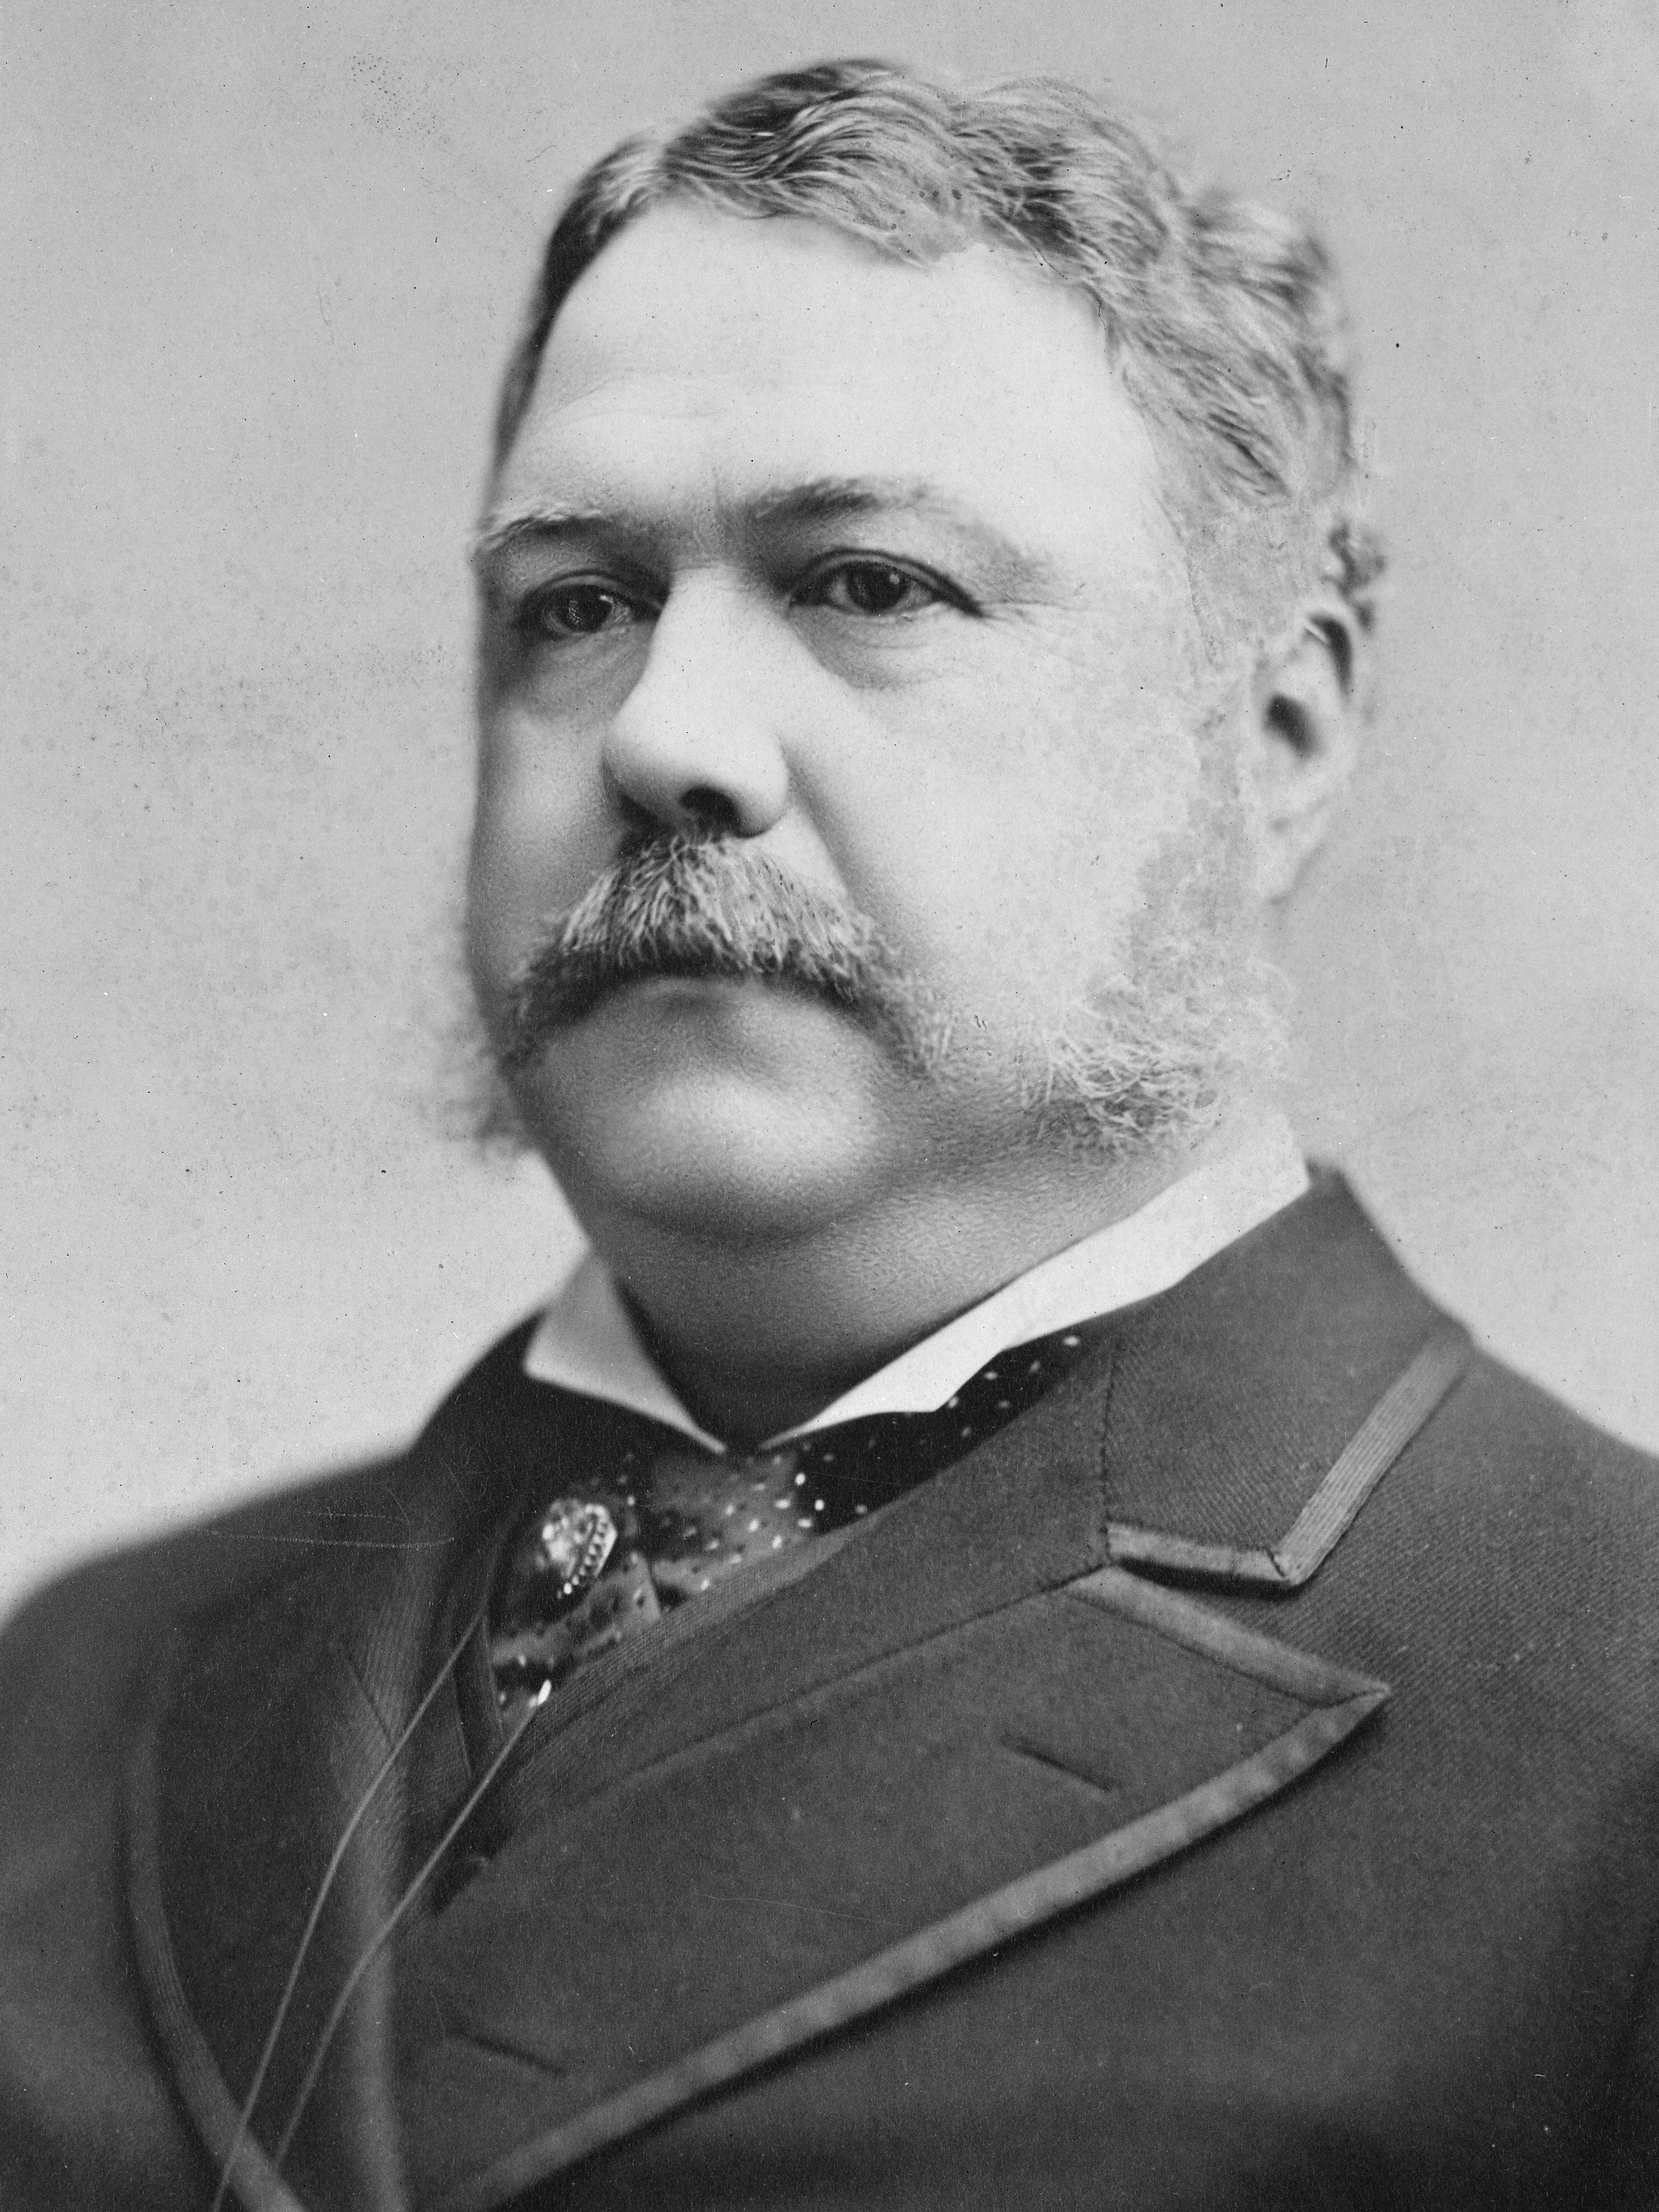
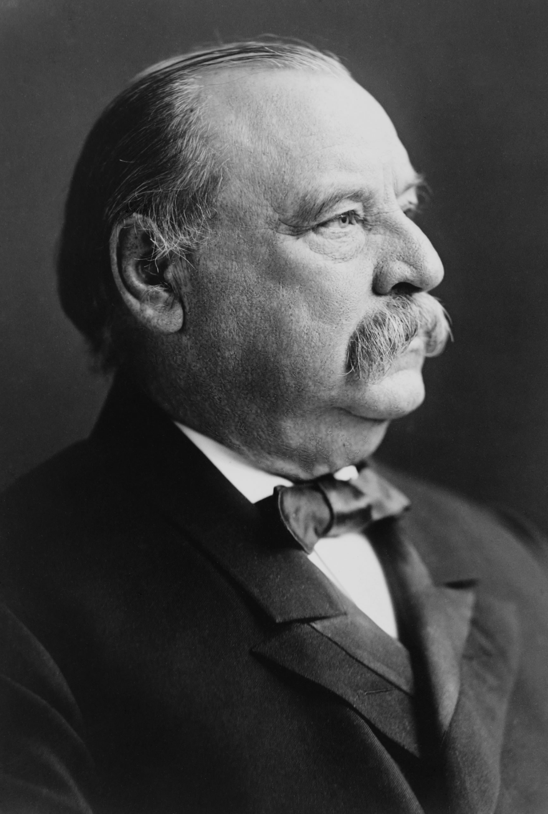
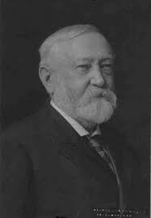
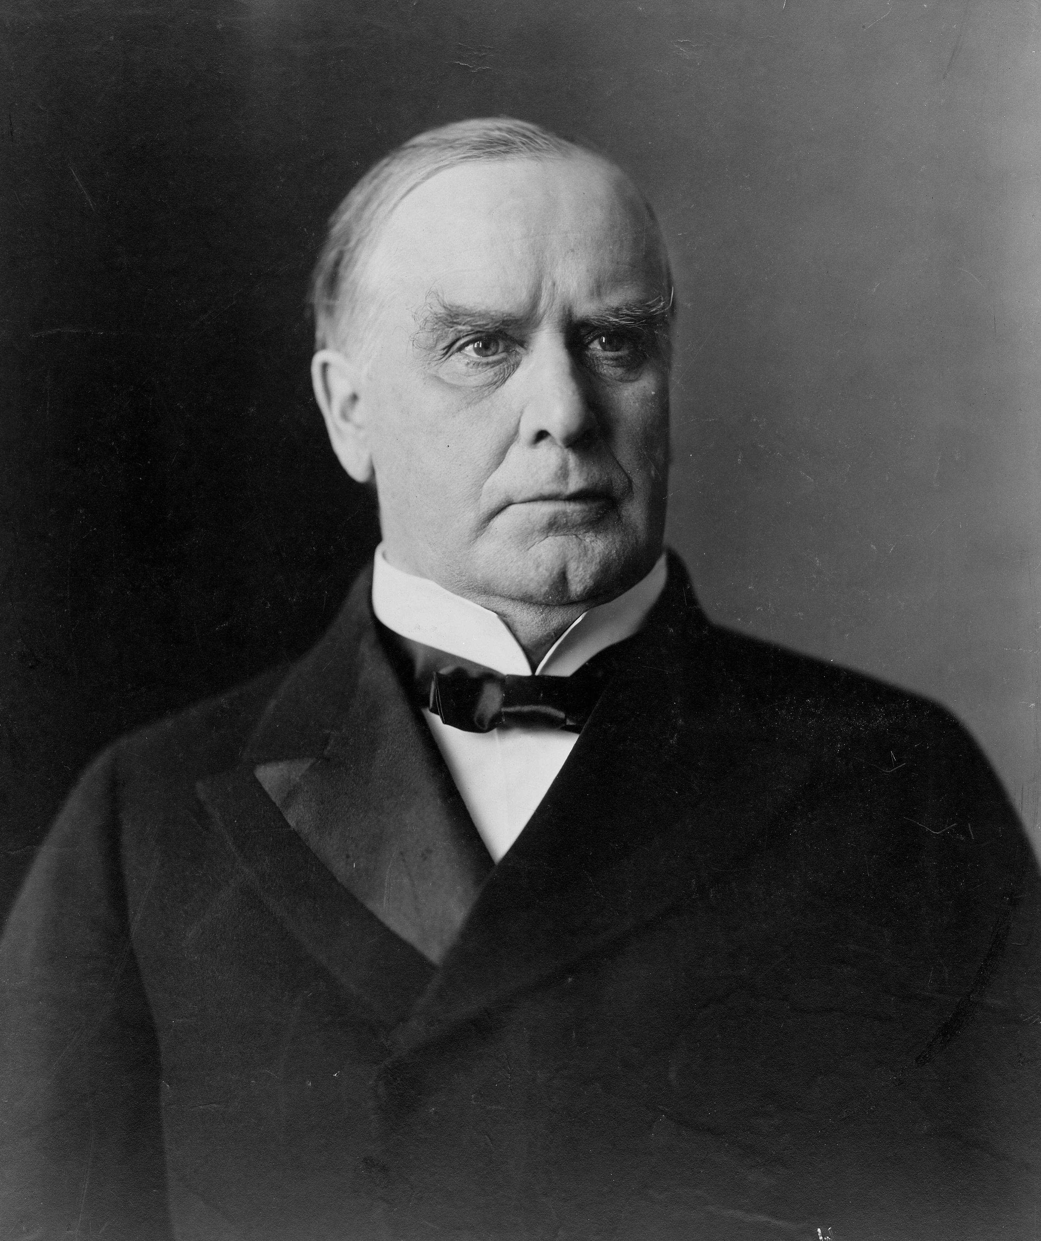
American Presidents 1877-1901
Rutherford B. Hayes 1877-1881
James Garfield 1881
Chester A. Arthur 1881-1885
Grover Cleveland 1885-1889 and 1893-1897
Benjamin Harrison 1889-1893
William McKinley 1897-1901

Slide 17
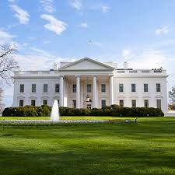
President as Symbolic Office
Probably not…This is because during this period, presidents do nothing.
“Strict Constructionist”
President as caretaker of Government
Commander in Chief
Enforcer of laws passed by Congress
Head of political party
Big contrast from Jackson & Lincoln

Slide 18
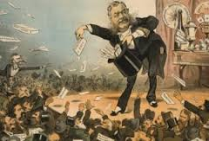
Spoils System Linked to Political Machines Develops in the National Government
Presidents would appointment people from political machines into their office/cabinet as a “thank you” for helping them get elected.
These people are often given position of power they are not qualified for.
Extension of Jackson’s spoils system…
Effect on Presidential Politics?
The Executive Branch is filled
with inept cronies
Shifts the meaning of the office
of the Presidency…

Slide 19
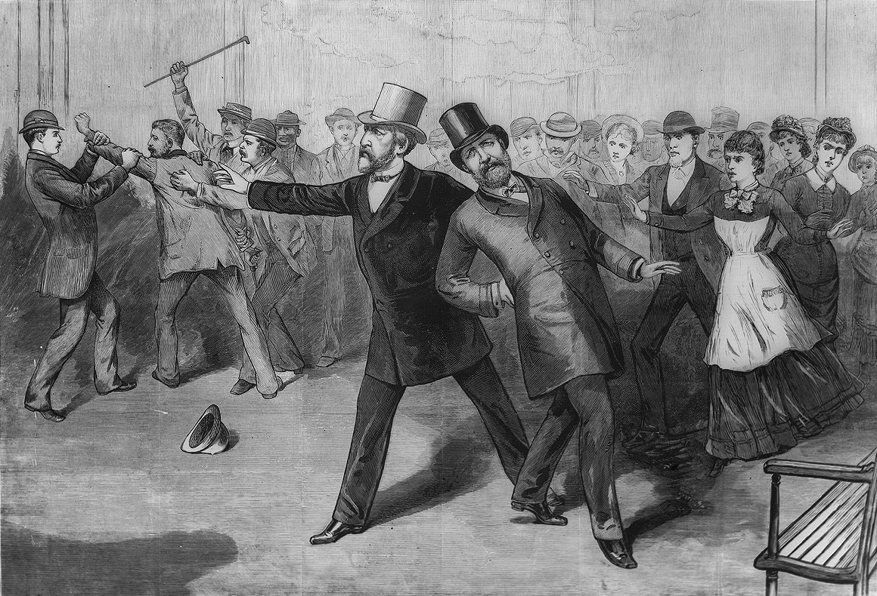
The Public Starts to Question the Spoils System
In 1881, President Garfield is assassinated by disappointed office seeker favoring Spoils System
Public begins to call for civil service reform
Pendleton Act 1883
Certain government jobs could only be held after someone took a test to see if they were qualified
Federal jobholders could not make campaign contributions to their party
Federal employees could not be fired for political reasons

Slide 20
Bottom Line: Democracy & Authority in the Gilded Age
Democracy
Freedom is defined as complete economic liberty
Democracy means the government staying out of the way of your economic liberty
Democracy means voting (for whites…for men...)
Authority
Federal government should be small
Presidents should be caretakers
Federal government should get out of the way of economic freedoms

