Slide 1
L20: The Expansion of Executive Power: Executive Orders and the Unitary Executive Theory
Striving for Balance Between Democracy and Authority
Agenda
Objective:
To understand…
What executive orders are and how they have been use historically.
How executive orders expand the power of the presidency
What the unitary executive theory is
How the unitary executive theory expands the power of the presidency
Schedule:
Lecture & Discussion
Homework
Unit Test
Yellow = Mon 11/5
Tan = Fri 11/2
Purple = Fri 11/2
Please turn in any missing discussion notes, or these grades are going to turn to zeros…
I will be out on Wed, yellow block cancelled

Slide 2
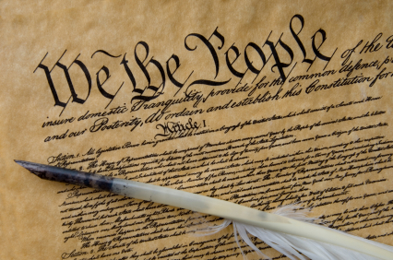
Article II of the United States Constitution
The Vesting Clause of Article II: “The executive Power [of the United States] shall be vested in a President of the United States of America.
The Take Care Clause: “The President shall take care that the laws be faithfully executed…”
What is the Article laying
out as the powers of the
President?
Is this a clear or vague
definition of power?

Slide 3
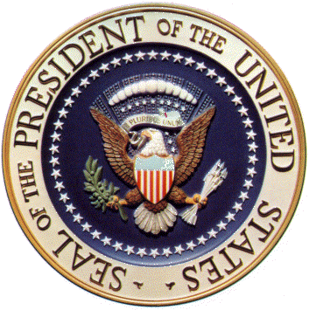
Ambiguity about the Role of the Executive
How strong is the office of the President?
What powers does he have?

Slide 4
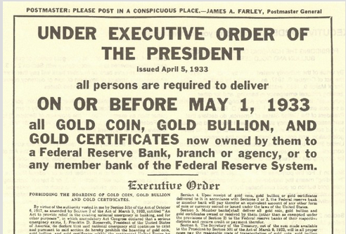
Executive Orders
A rule or order issued by the president to an executive branch of the government and having the full force of law
No constitutional provision that explicitly permits executive orders
Has emerged by practice as a legitimate exercise of presidential power under the “Take Care” Clause
There has been no SCOTUS challenge to the use of executive orders as a blanket practice; though individual executive orders
have been challenged
All presidents have used
executive orders

Slide 5
Famous Executive Orders
Suspension of Habeas Corpus (Lincoln, 1861)
Emancipation Proclamation (Lincoln, 1863)
Executive Order 9066 – Japanese Internment (Roosevelt, 1942)
Executive Order 9981 – Desegregation of the US Military (Truman, 1948)
National Guard Integrates US Schools (Eisenhower, 1957)
Richard Nixon is Pardoned (Ford, 1974)
Creation of Department of Homeland Security (Bush, 2001)

Slide 6
Why Do Presidents Use Executive Orders?
Need for expediency of action during times of war
Need for expediency of action during times of domestic crisis
Need to “side step” the legislature when the legislature is opposed/hostile to a president’s agenda

Slide 7
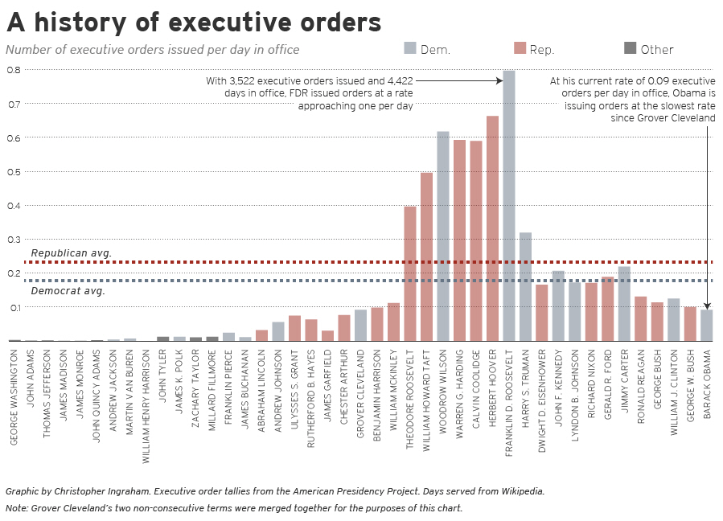

Slide 8
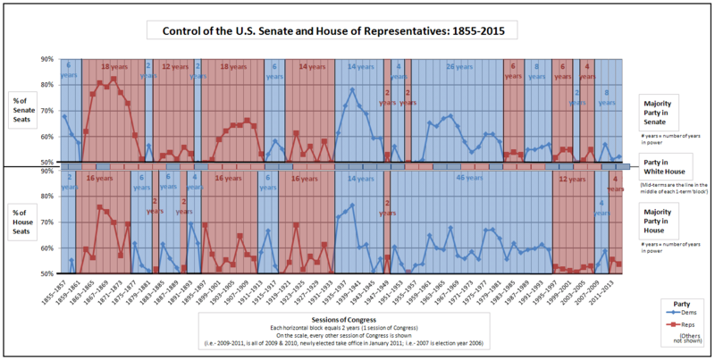

Slide 9
Executive Orders and Presidential Power
Executive orders expand the power of the president by…
Giving the president broad powers during times of war
Giving the president the power to unilaterally make decisions that have the effect of legislation

Slide 10
Executive Orders, Conservatives, and the Unitary Executive
The 1970s are a very contentious time in American government.
Nixon administration finds itself in a hostile relationship with Congress
Threat of impeachment
Nixon’s resignation in 1974
Conservatives start to think…how are we ever going to get anything done when tensions are this bad…
Answer: A new take on executive orders…

Slide 11
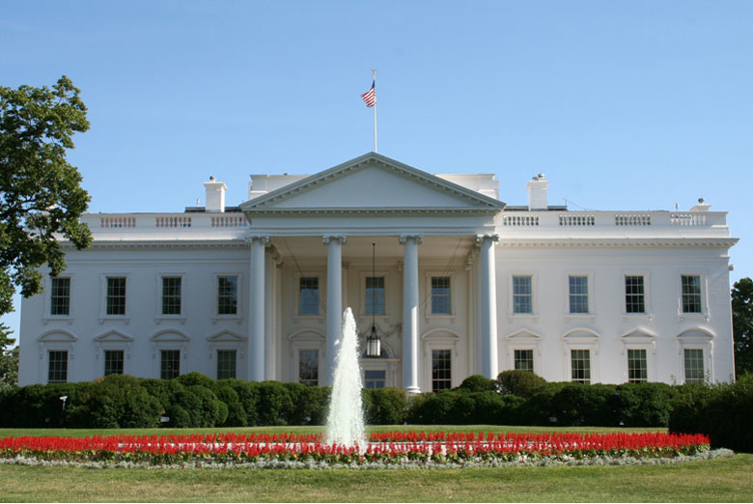
Unitary Executive Theory
Theory of American
constitutional law
holding that the President
controls the entire
executive branch.
Championed by founding
members of the Federalist
Society, “a group of conservative lawyers who nearly all worked in the Nixon, Ford, and Reagan White Houses and who understood the type of political climate the president operated in” and wanted to protect presidential prerogatives.
Kelly, Rethinking Presidential Power

Slide 12
Meese’s 3 Part Strategy for Strengthening the Unitary Executive
Reagan’s Attorney General, Edwin Meese proposed a 3 part strategy that advised Reagan to use in order to build up the power of the executive branch.
Became a blue print for future conservative presidents.
Three Steps:
Presidents should use executive orders to issue decrees that in effect (though maybe not in direct intent) expand the power of the presidency
Appoint judges who support expanded executive powers
Challenge intrusions of presidential authority in the court system (and win…thus making the expansion of presidential power ‘permanent’)

Slide 13
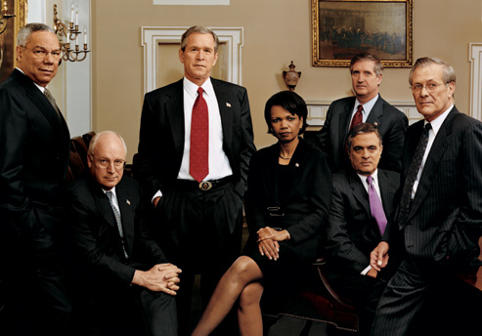
Bush Administration
Under the Bush Administration we see an incredible expansion in the power of the executive branch through the application of the unitary executive theory, making this the decade some scholars have said has grown governmental authority in new and more powerful ways.

Slide 14
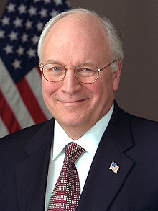
Unitary Executive Theory and Dick Cheney
Cheney was Bush’s Vice President
Also worked for Nixon and Ford
Nixon Administration
Worked in the Office of Economic Opportunity
Ford Administration
Assistant to the President
White House Chief of Staff
“I have repeatedly seen an erosion of the powers and the ability of the president of the United States to do his job.”
Cheney to the Washington Post

Slide 15
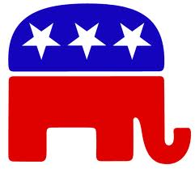
The Unitary Executive Theory and Conservatives view of the Role/Purpose of Government
Princeton Professor Julian Zelizer argues that “since [the] 1980s, we’ve seen a real acceleration in the expansion of executive authority as a means to circumvent the legislative branch, particularly with regards to national security.”
Zelizer believes that conservatives, though initially skeptical of government and its reach, have found in
executive power a convenient tool to achieve their goals.
Using executive orders to create
legislative-like actions that enlarge
the power of the presidency has become a mainstay of conservative governing

Slide 16
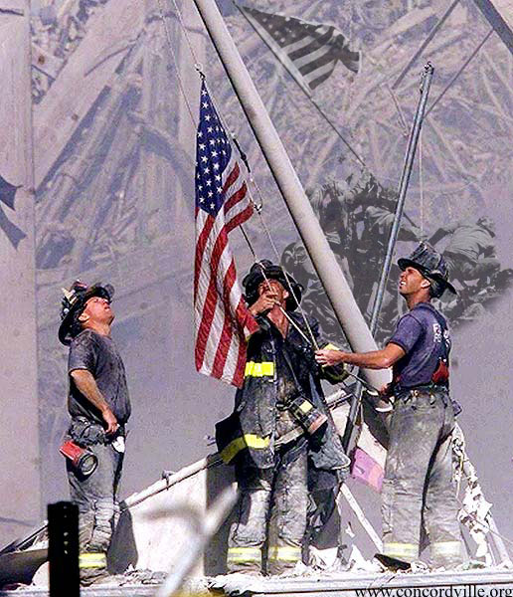
September 11 as an Opportunity to Grow Executive Power
Terrorist attacks of 9/11 provide an opportunity to expand the power of the executive branch
The “War on Terror” was a war with no battlefield, no end, no clear enemies, and most importantly no clear boundaries for how to fight the war.
As a result, anything and everything could be argued as a necessary presidential war time power as part of the war.

Slide 17
Warrantless Wiretapping
As part of the War on Terror, the Bush administration issued an executive order to monitor, without search warrants, the phone calls, Internet activity, email, text messaging, or any other communication involving any party in the United States who was communicating with a party outside of the United States believed to be involved in terrorist activity.
The Bush administration claimed that “the NSA activities are supported by the
President’s well-recognized
inherent constitutional authority
as Commander-in-Chief and sole
organ for the Nation in foreign
affairs to conduct warrantless
surveillance of enemy forces for
intelligence purposes to detect and
disrupt armed attacks on the United
States.”

Slide 18
Summary: How Executive Orders Expand Power
Executive Order (Action)
Expands Presidency by Making the President a Pseudo-Legislator
Conventional Use
Executive Order
(Action) & (Content that Promotes Presidential Power)
Expands Presidency by
1. Making the President a Pseudo-Legislator
2. Actually Giving the President Power
Use Under the Unitary Executive Theory

Slide 19
President Obama and Executive Orders
Obama issued 277 executive orders during his eight years in office, or 35 per year.
That’s slightly fewer than the 36 per year that George W. Bush issued and the lowest average since Grover Cleveland, who issued 32 per year during his eight nonconsecutive years in office
Overall, Obama ranks 16th among presidents in total number of executive orders issued and 21st in the average number issued per year.

Slide 20
Examples
Immigration: DACA Program
Fighting Climate Change
Raise Minimum Wage for Federal Workers
Adding Info about Mental Health to Federal Background check database for gun ownership

Slide 21
Trump on Obama’s Executive Orders
“The country wasn’t based on executive orders,” said Trump at a town hall in South Carolina in February 2016. “Right now, Obama goes around signing executive orders. He can’t even get along with the Democrats, and he goes around signing all these executive orders. It’s a basic disaster. You can’t do it.”
“Right now, we have an executive-order president. He just keeps signing.”
“I want to not use too many executive orders, folks. Executive orders sort of came about more recently. Nobody ever heard of an executive order. Then all of a sudden Obama, because he couldn’t get anybody to agree with him, he starts signing them like they’re butter. So I want to do away with executive orders for the most part.”

Slide 22
Trump and Executive Orders
“White House aides said that Trump will have signed 32 executive orders by Friday, the most of any president in their first 100 days since World War II. That’s a far cry from Trump’s heated campaign rhetoric, in which he railed against his predecessor’s use of executive action late in his tenure as President Barack Obama sought to maneuver around a Republican Congress. Trump argued that he, the consummate deal maker, wouldn’t need to rely on the tool.” –Washington Post

Slide 24
Executive Orders in Comparison
https://www.presidency.ucsb.edu/statistics/data/executive-orders

