Slide 1
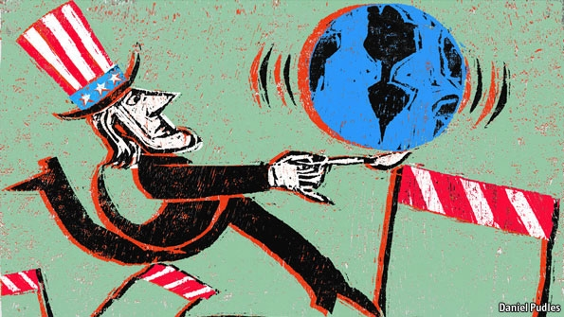
L1: Foreign Policy at the Founding Period
American Foreign Policy
Agenda
Objective:
To explore the themes/trends in American foreign policy at the founding
Schedule:
Intro to Unit
Discussion & Document Exploration
Homework:
Work on Paper
Due Wed 11/14
(submit both a paper copy and on “turn it in” through canvas)

Slide 2
What is American Foreign Policy?
This is the question we will be grappling with this unit.
Today we want to see how the founders thought about American foreign policy and the legacy that this created for later foreign policy engagements.

Slide 3
Plan for Today
Part One: Evaluate how the founders thought about American foreign policy using key founding documents
Break up into small groups and analyze the Constitution, Washington’s “Farewell Address,” and Winthrop’s “Model of Christian Charity.”
How did the founders think about American foreign policy?
Part Two: Analyze how this early thinking created a set of frameworks for American foreign policy that remain with us throughout our history
Come back together as a whole group and list some of the foreign policy frameworks established at the founding

Slide 4
“Model of Christian Charity” John Winthrop 1630
For we must consider that we shall be as a city upon a hill. The eyes of all people are upon us. So that if we shall deal falsely with our God in this work we have undertaken, and so cause Him to withdraw His present help from us, we shall be made a story and a by-word through the world…. But if our hearts shall turn away, so that we will not obey, but shall be seduced, and worship other Gods, our pleasure and profits, and serve them; it is propounded unto us this day, we shall surely perish out of the good land whither we pass over this vast sea to possess it.

Slide 5
“Farwell Address” George Washington 1796
The great rule of conduct for us in regard to foreign nations is in extending our commercial relations, to have with them as little political connection as possible. So far as we have already formed engagements, let them be fulfilled with perfect good faith. Here let us stop. Europe has a set of primary interests which to us have none; or a very remote relation. Hence she must be engaged in frequent controversies, the causes of which are essentially foreign to our concerns. Hence, therefore, it must be unwise in us to implicate ourselves by artificial ties in the ordinary vicissitudes of her politics, or the ordinary combinations and collisions of her friendships or enmities.
Our detached and distant situation invites and enables us to pursue a different course. If we remain one people under an efficient government. the period is not far off when we may defy material injury from external annoyance; when we may take such an attitude as will cause the neutrality we may at any time resolve upon to be scrupulously respected; when belligerent nations, under the impossibility of making acquisitions upon us, will not lightly hazard the giving us provocation; when we may choose peace or war, as our interest, guided by justice, shall counsel.
Why forego the advantages of so peculiar a situation? Why quit our own to stand upon foreign ground? Why, by interweaving our destiny with that of any part of Europe, entangle our peace and prosperity in the toils of European ambition, rivalship, interest, humor or caprice?
It is our true policy to steer clear of permanent alliances with any portion of the foreign world; so far, I mean, as we are now at liberty to do it; for let me not be understood as capable of patronizing infidelity to existing engagements. I hold the maxim no less applicable to public than to private affairs, that honesty is always the best policy. I repeat it, therefore, let those engagements be observed in their genuine sense. But, in my opinion, it is unnecessary and would be unwise to extend them.

