Slide 1
History Writing Workshop
Agenda
Objective:
To learn how to do historical writing
Work on our first paper in class
Schedule:
Elements of a history paper
How to do footnotes
Time to work on our paper
Homework

Slide 2
History Writing Workshop
We are going to spend the next 5 days working on our first paper!
About 2 days learning how to write a history paper
About 3 days writing our paper in class ( you will need to work on your paper for homework as well)

Slide 3
Tenth Grade Writing Goal
What will our writing center on this year?
EVIDENCE!
Specifically…using evidence to make essays more complex and concise
Using varied sources to offer
more and better evidence in
an essay

Slide 4
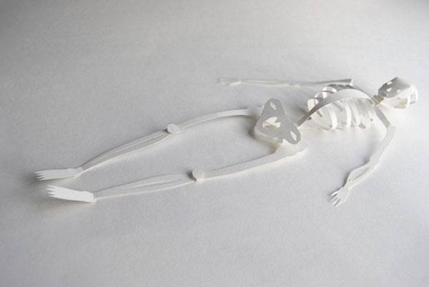
Anatomy of a History Paper
Central Claim
Sub-claims (Claim Team)
Evidence
SPARC
Reasoning
Introduction
Conclusion
Footnotes
Bibliography

Slide 5
Central Claim
What is a central claim?
What you will argue in your paper!
What will your central claim have to do?
Have an argument
Have a single line of reasoning
What will your central claim not do?
No lists
Where does your central claim go in your paper?
The last sentence of your introduction

Slide 6
Sub-Claims (Body Paragraph Ideas and the Topic Sentences that Capture Them)
What are sub-claims claims?
The components of your argument.
Each sub-claim has its own body paragraph
The idea of each sub-claim is said in each corresponding topic sentence
Sub-claims do two things:
Address an aspect of the central claim
Manage the transition across paragraphs
What do the topic sentences that correspond to each sub-claim do?
Are one sentence
Have an argument that ties to the central reasoning
Have a single line of reasoning
The “claim team”
When put together, all of the sub claims address the whole central claim
Work as a team to prove the argument

Slide 7
Anatomy of a History Paper
Central Claim
(Last sentence of your introduction)
Sub-Claim 1
(Body Paragraph 1; Articulated in Topic Sentence 1)
Sub-Claim 2
(Body Paragraph 2; Articulated in Topic Sentence 2)
Sub-Claim 3
(Body Paragraph 3; Articulated in Topic Sentence 3)

Slide 8
Evidence
What is evidence?
The facts (who, what, where, when) of history
The happenings that support what you argue in your paper
SPARC Evidence
Specific
Precise
Accurate
Relevant
Credible

Slide 9
Evidence
SPARC Evidence
Specific
Enough to be convincing and support all parts of the claim
Not repeated/recycled
Varied
Precise
Specific/detailed
Used in the right place
Accurate
True and responsible
Based on an effective reading and understanding of the source
Written/conveyed accurately
Relevant
Connected to the central claim and/or sub-claim
Well-chosen from what is available; you have selected the best evidence you have available
Credible
Is this evidence of what I am trying to prove?
Is the author credible (scholarly)?
What is the perspective of the primary source and how does this condition what I can use it as evidence of?

Slide 10
Evidence
Where can you find evidence?
Textbooks
Primary Sources
Secondary Sources (books & documentaries)
Only happenings recorded by the author, not interpretation of happenings
Interpretations of the happenings can be used to support our reasoning…more on that later…
Caution:
We must be careful of what our happenings provide evidence of

Slide 11
Anatomy of a History Paper
Central Claim
Sub Claim 1
Evidence 1.1
Evidence 1.2
Sub Claim 2
Evidence 2.1
Evidence 2.3
Evidence 1.3
Evidence 2.2
Sub Claim 3
Evidence 3.1
Evidence 3.2
Evidence 3.3

Slide 12
Body Paragraph Reasoning
What is it?
Sentences that explain how your evidence is proof of your sub-claim
Reasoning explains the connection between the evidence and the sub-claims
Your reasoning should be detailed and explicit
Use your “back up dancers” to add depth to your reasoning
Use scholars’ reasoning on historical evidence to support your own reasoning

Slide 13
Anatomy of a History Paper
Central Claim
Sub Claim 1
Evidence 1.1
Evidence 1.2
Sub Claim 2
Evidence 2.1
Evidence 2.3
Evidence 1.3
Evidence 2.2
Sub Claim 3
Evidence 3.1
Evidence 3.2
Evidence 3.3
Reasoning
Reasoning
Reasoning
Reasoning
Reasoning
Reasoning
Reasoning
Reasoning
Reasoning

Slide 14
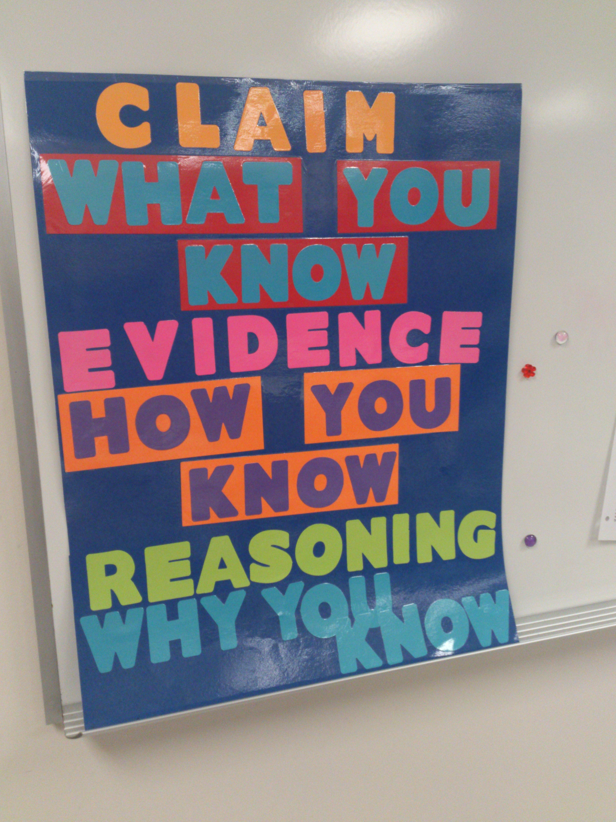

Slide 15
Introduction
Provides the information necessary to understand the central claim and its importance
Includes multiple sentences of context (time and place and key concepts in the central claim) and and outline of the ideas of the body paragraph
Last sentence(s) should be the central claim

Slide 16
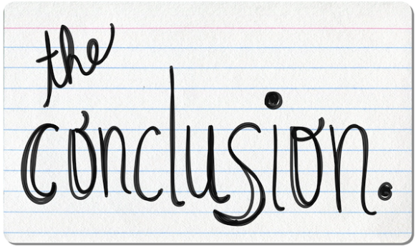
Conclusion
Five sentence formula:
Restate central claim
Restate subclaim 1
Restate subclaim 2
Restate subclaim 3
Closing sentence: If what you have just proven is true, what does this lead us to conclude about this topic/time period?

Slide 17
Footnotes
For ALL of your papers you need to reference specific ideas/facts/arguments from class discussion and/or course readings.
These references must be cited (in other words, you need to give credit to your sources).
The method you will use
to cite these references
is footnotes.

Slide 18
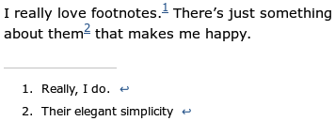
Footnotes: What Are They?
Citations to credit sources.
Footnotes are indexed within the text using a superscripted numeral that refers to an expanded note presented at the bottom of the text which gives the full citation information for a source.
Footnotes should go at the end (after the period) of the sentence(s) to which a reference is made.
Sample…

Slide 19
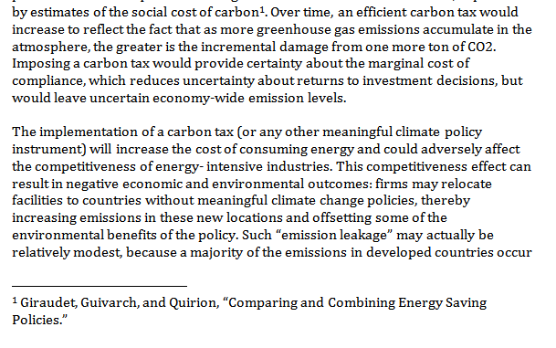

Slide 20
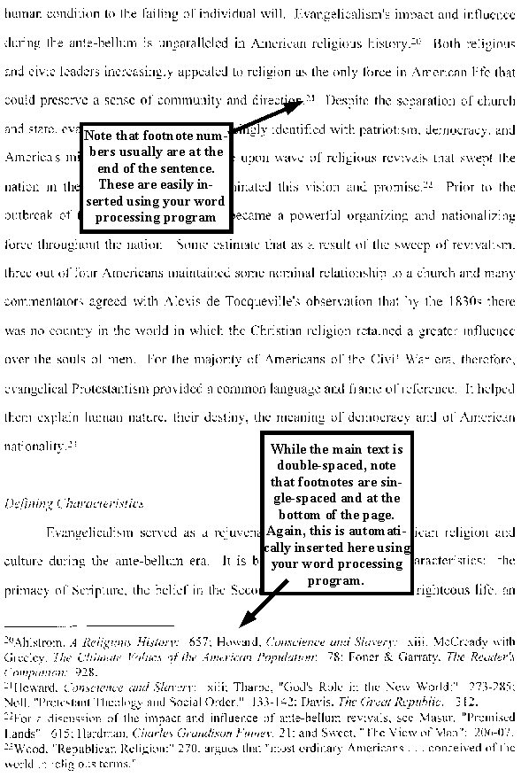

Slide 21
Footnotes: How Do I Properly Cite My Sources in Footnote Form?
http://www.chicagomanualofstyle.org/tools_citationguide.html
NoodleTools
EasyBib

Slide 22
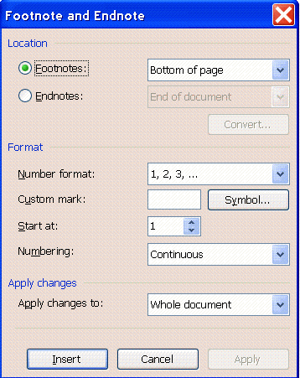
Footnotes: How Do I Insert a Footnote into My Paragraph?
In Word go to the “insert” menu. From there you will select “footnote” or “reference” and then “footnote.”
A footnote dialog box will open.
Leave the defaults as you see them and hit “insert.”

Slide 23
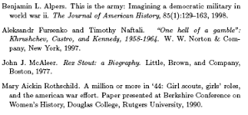
Bibliography
All papers should end with a Chicago style bibliography
See:http://www.chicagomanualofstyle.org/tools_citationguide.html

