Slide 1
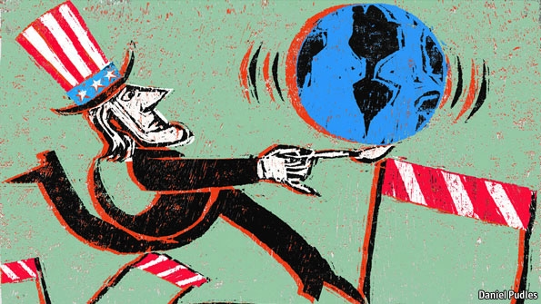
L4: The Civil War and America in the World
1861-1865
American Foreign Policy
Agenda
Objective:
To understand…
How both the north and the south conceived of the civil war as a nationalist revolution.
How the Civil War was received by the rest of the world
The effect the Civil War had on America’s understanding of itself as a nation.
Schedule:
Discussion
Homework:
Paper Due by Next Wednesday!!

