Slide 1
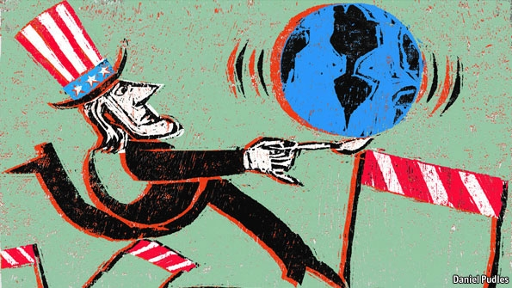
L6: American Imperialism in Latin America and in the Pacific (1898-1914)
American Foreign Policy
Agenda
Objective:
To explore the links between race, masculinity, and nationalism during the period of American imperialism
Schedule:
Whole Class Discussion
Homework:
Work on paper due tomorrow!!

