Slide 1
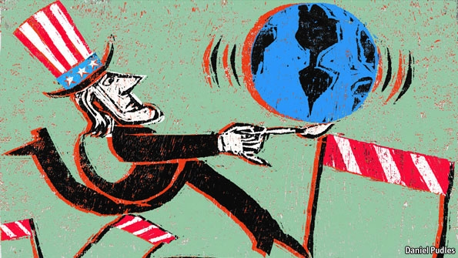
L11&L12: World War Two War in Europe
American Foreign Policy
Agenda
Objective:
To understand U.S. engagements in the European Theater of World War Two
Schedule:
Lecture
Video (?)
Homework:
Reading on the decision to drop the atomic bomb. Due L12
Tan = Wed 12/12
Yellow = Tues 12/11
Purple = Tues 12/11
Test
Yellow = Thurs 12/13
Tan =Thurs 12/13
Purple = Wed 12/12

Slide 2
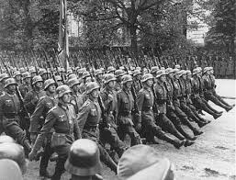
World War Two: War in Europe
War in Europe starts on September 1, 1939 when Hitler invades Poland
Immediately, Germany and Italy are involved in a continent wide conflict against the French, Russians, and the British
Axis has a string of successes in the war that last until 1942

Slide 3
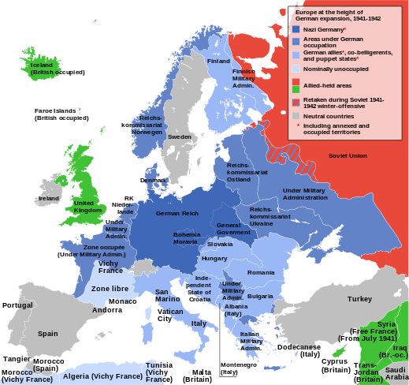

Slide 4
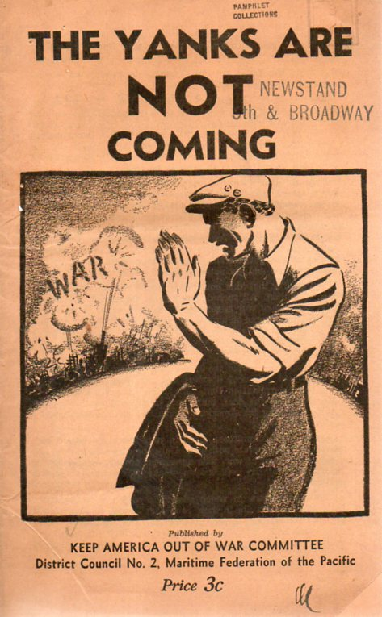
Meanwhile, back in America…
Public opinion against Hitler, as well as Japan’s actions in China, was high when the war broke out in 1939
There was limited support for America to enter the war however.
America officially declared neutrality

Slide 5
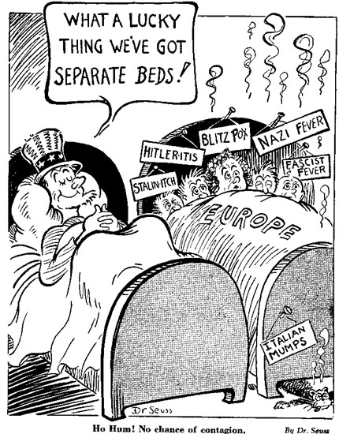
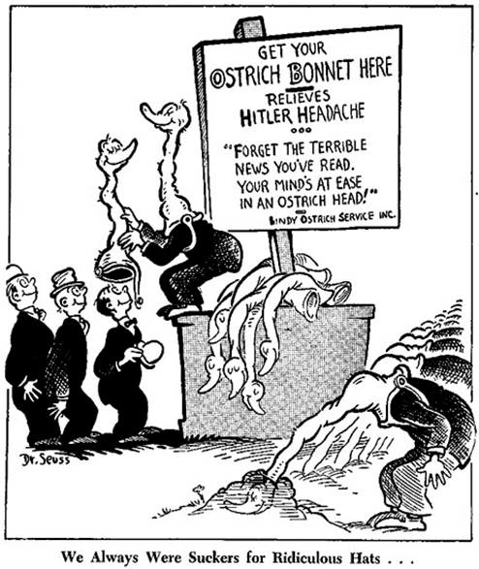

Slide 6
Arsenal of Democracy: Lend-Lease Act 1941
American attitudes toward the war began to change in 1940
Nazi victories in Poland, France, and their narrow loss in the Battle of Britain led many Americans to start advocating for greater US involvement in the war
Lend Lease Act 1941
America began shipping money, oil, weapons, and food to Britain and Free France (the Nazi’s main enemies) and China (Japan’s main enemy)
When the Nazis invaded the USSR that summer, they too became a recipient of Lend-Lease funds
The aid was given in exchange for leases on army and naval bases in Allied territory during the war.

Slide 7
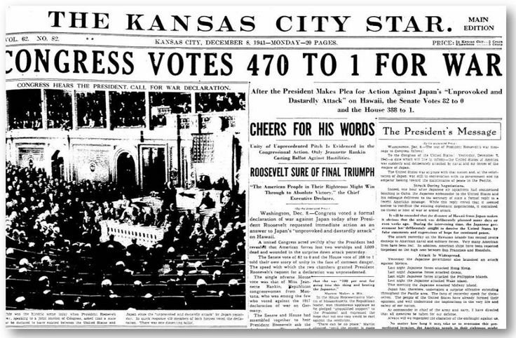
America Enters the War
With the bombing of Pearl Harbor, the United States enters the war in December 8, 1941
Hitler declares war on the United States December 11, 1941

Slide 8
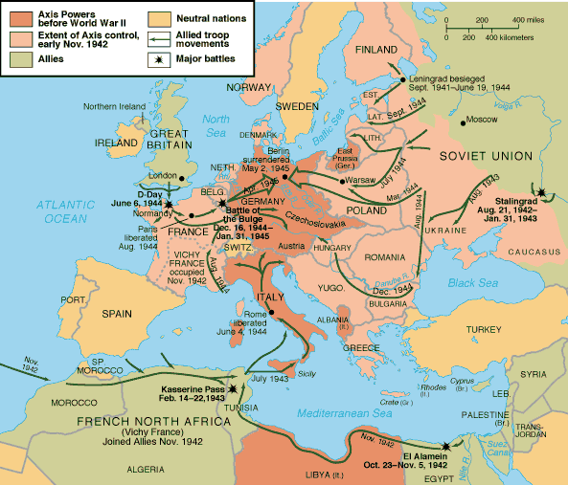
Allied Efforts in Europe
Allies had a “Europe First” strategy
To liberate Europe, the Allies had to begin in North Africa

Slide 9
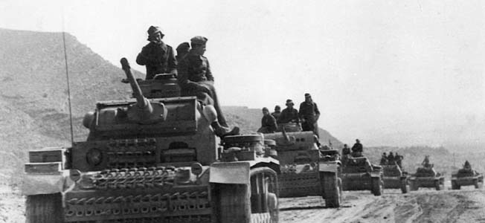
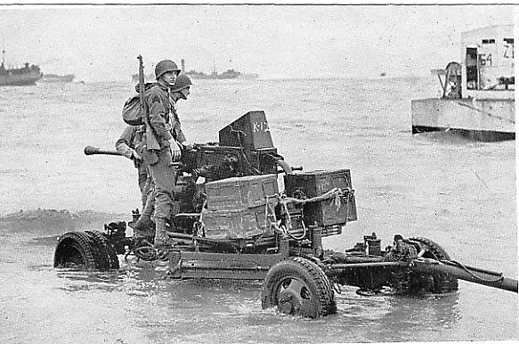
Allied Invasion of North Africa: Operation Torch
First American involvement in Europe
Key Leaders:
General Dwight Eisenhower (American)
General George Patton (American)
General Bernard Montgomery (British)
Allies stop the German advance in Tunisia
May 1943, Axis surrenders

Slide 10
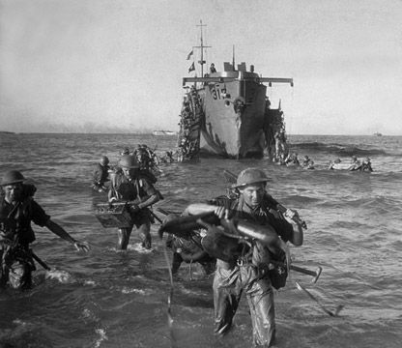
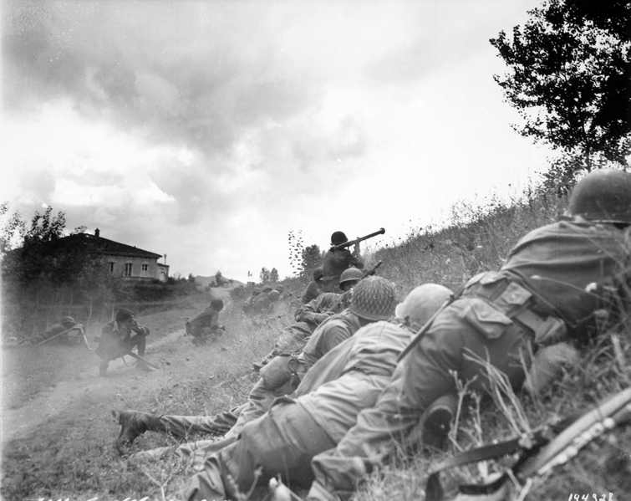
Allied Invasion of Sicily Italy: Operation Husky
July 1943: British and American armies invade Sicily
Largest amphibious operation ever undertaken at that time (soon to be replaced by D-Day)
Allies easily secure Sicily
Allies invade Sicily, Italians begin to turn on Mussolini and he is overthrown and imprisoned
September 1943: Italy surrenders

Slide 11
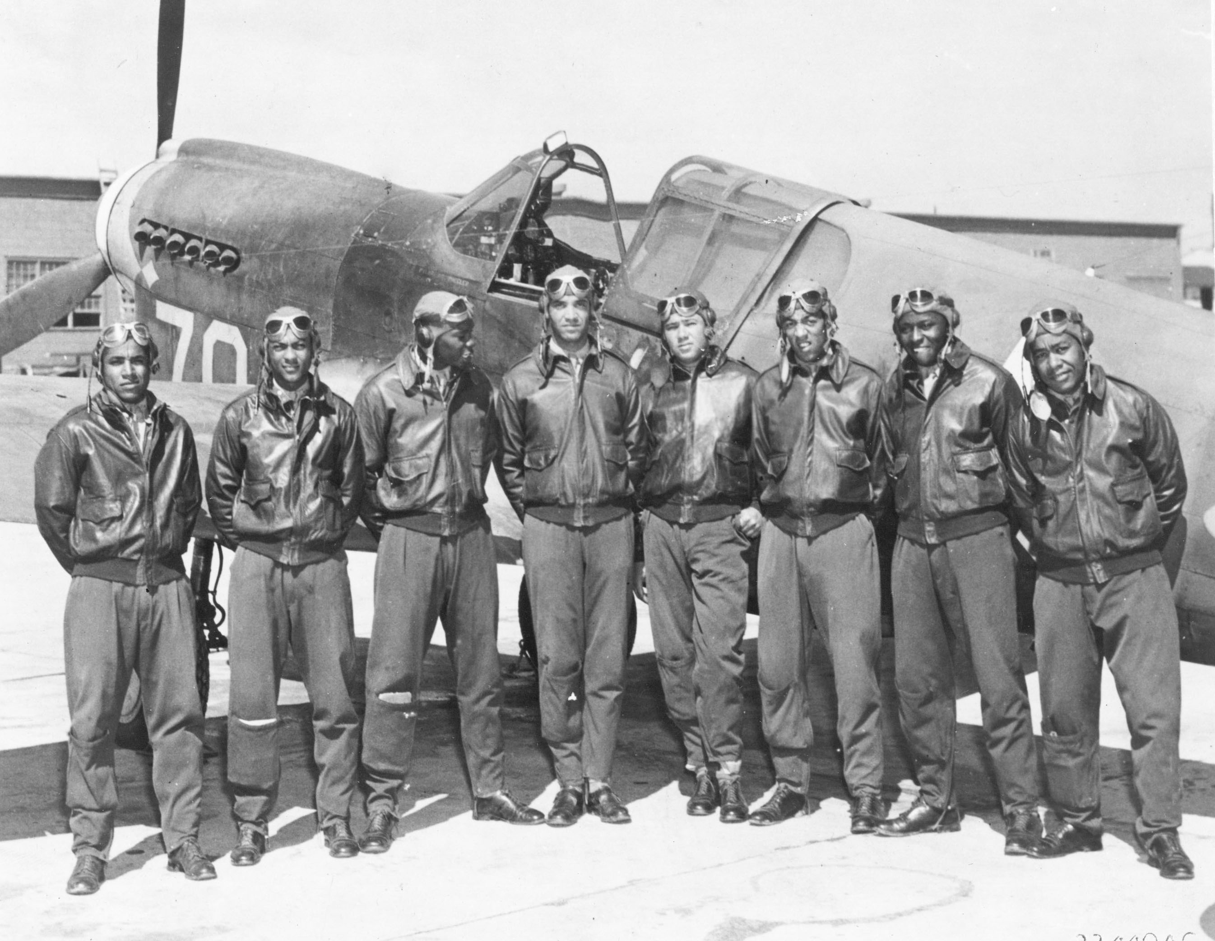
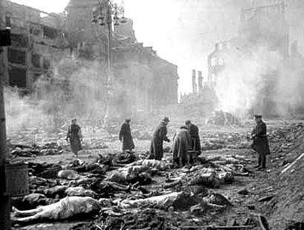
Area Bombing Campaigns in Germany
To relieve pressure on Stalin and the Soviet Union, Allied bombers attack German cities
Target political and industrial centers, massive destruction and civilian casualties
To note:
Firebombing of Dresden February 1943
Massive aerial attack on the city of Dresden
City destroyed; approximately 25,000 people killed
Military significance debated
Tuskegee Airmen:
All black squadron, protected bombers from enemy pilots
1500+ missions, zero casualties

Slide 12
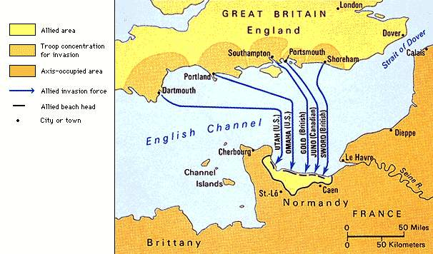
The Liberation of France: The Normandy Invasion June 1944
Full scale assault by the Americans, British, and Canadians on German forces by cutting across the English channel into France along the Normandy coast.
Two goals:
Open a Western Front in
the war which will force
Hitler to fight both the
Soviet Union to the East and
Great Britain and the United
States to the West.
Liberate France from Nazi
occupation and then move
into Germany to further fight
the Nazis.
Supreme Allied Commander: United States General Dwight Eisenhower.

Slide 13
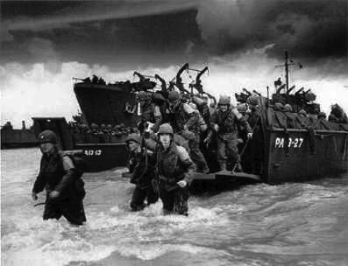
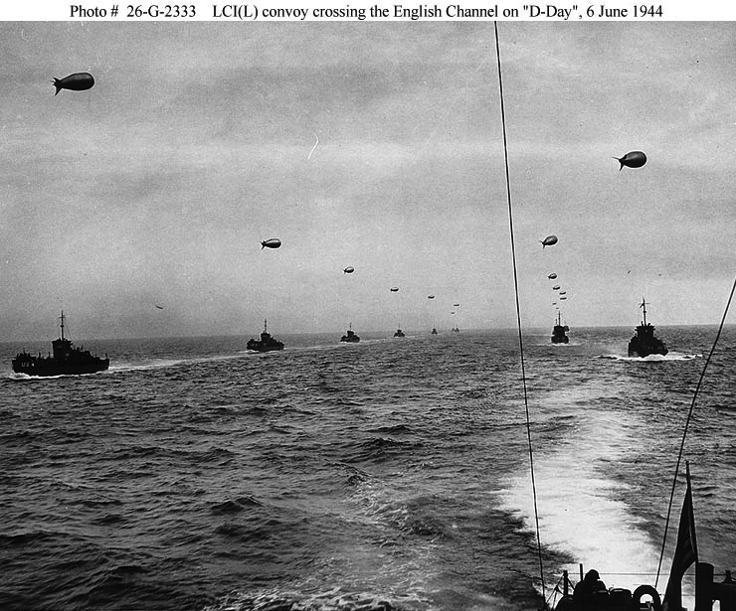
Plan of Attack
Phase One: Air Assault
More than 13,000 fighter, bomber, and transport aircraft would fly over France bombing and parachuting in troops.
Phase Two: Amphibious Landing of Infantry
Land over 130,000 troops on the French shore
Largest single-day amphibious invasion of all time.
Invasion Scheduled for June 6, 1944 (D-Day)

Slide 14
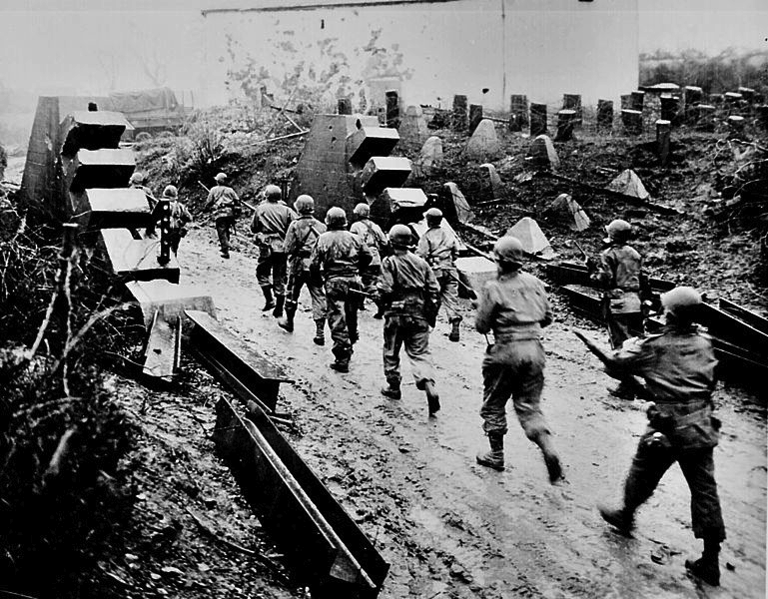
The End of the War In Europe
The Normandy invasion marks the beginning of the end of World War Two.
After the invasion, the allied troops start marching inland to Germany. Within 3 months the Allies had landed 2 million men and half a million vehicles.

Slide 15
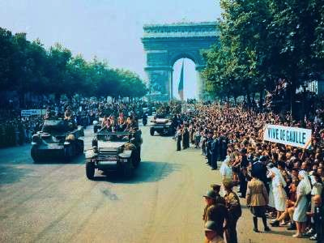
Liberation of Paris
By 1944 the allies liberated Paris and the rest of France.

Slide 16
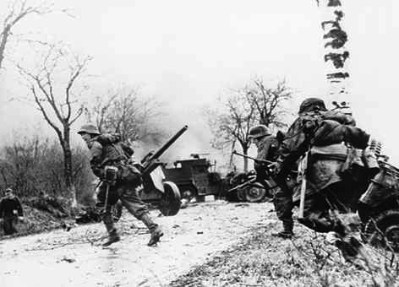
Battle of the Bulge
Dec 1944-Jan 1945
After liberating France the Allied forces push the Germans back into Germany by defeating them in the Ardennes region of Belgium.

Slide 17
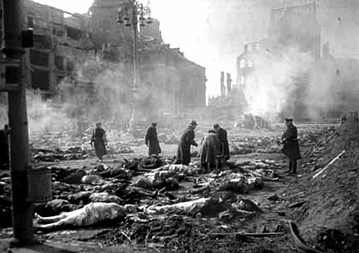
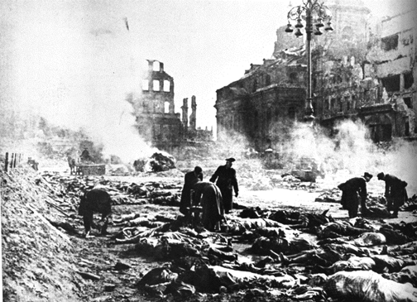
The Allies Push Into Germany
After fighting the Germans through Belgium, the Allies advance into Germany from the West.
Russia advances through the East.

Slide 18
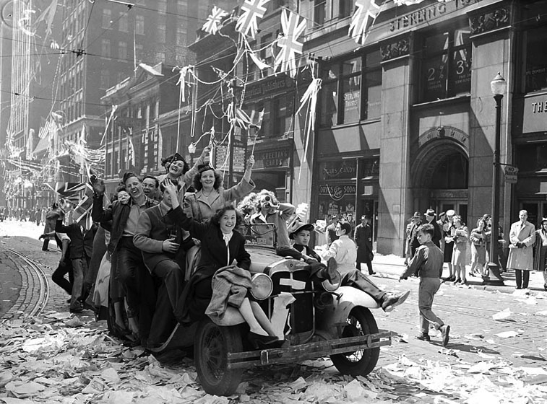
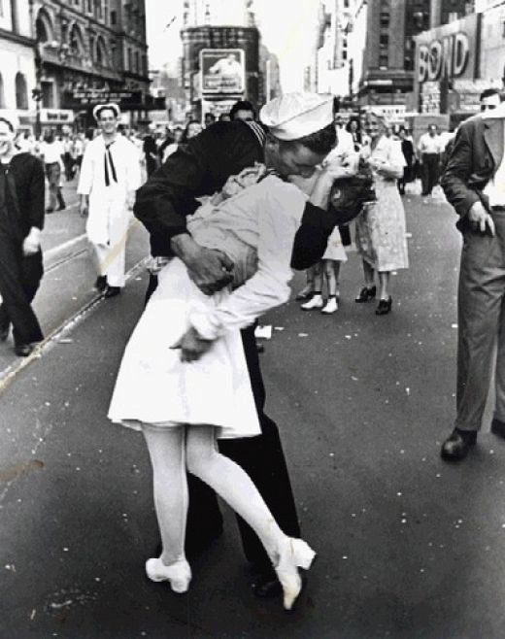
VE Day
On May 8, 1945 German commanders surrender to the Allied Powers.
The war in Europe ends.
VE Day or Victory over Europe Day.
Despite victory over Italy and German, the war still raged on against Japan.

Slide 19
Video!
Apocalypse: World War Two
Notes:
Disc 2, Episode 4
Opening – 8:41 (9 minutes) – U.S. Declares war on Japan
3:42 -15:14
27:03-35:44 (9 mins) – Pearl Harbor / Pacific
22:35-35:44
Disc 3, Episode 5
11:35 – 14:14 (2 mins) Americans arrive in Europe
23:29-25:40 Churchill/FDR/Stalin Meeting
35:15-38:44 (3 mins) Start of Italy
47:27-49:45 (2 mins) Italy
Disc 3, Episode 6
Opening – 17:29 (16 mins) Normandy through end of war
29:58-32:49
34:54- 42:45
43:41-46:20 (3 min)
49:08 – End (5 min)

