Slide 1
L13: World War Two: Decision to Drop the Atomic Bomb
American Foreign Policy
Agenda
Objective:
To evaluate and debate the decision to the drop the atomic bomb.
Schedule:
Whole Class Discussion
Homework:
Test!!
Yellow = Thurs 12/13
Tan = Thurs 12/13
Purple = Wed 12/12

Slide 2
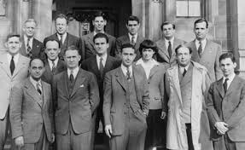
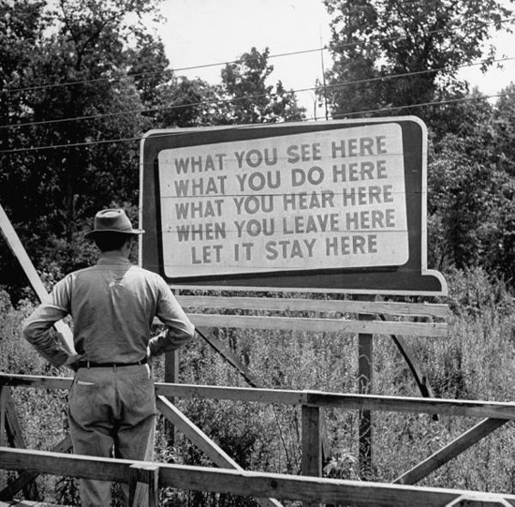
The Atomic Bomb
In the early 1940s, America had started an atomic weapons development program code named the “Manhattan Project”
A successful test was conducted at Alamogordo in New Mexico in July 1945

Slide 3
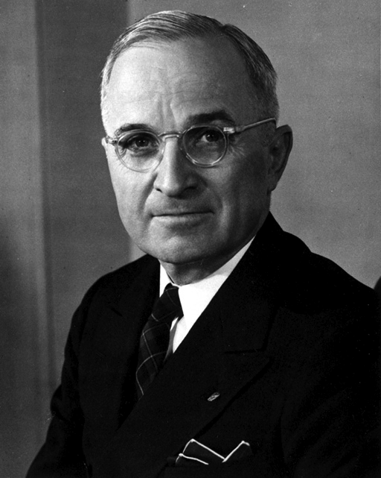
Decision to Drop The Bomb
The Japanese government ignored an ultimatum given at the Potsdam Conference.
Truman made the decision to drop the atomic bomb on Japan.

Slide 4
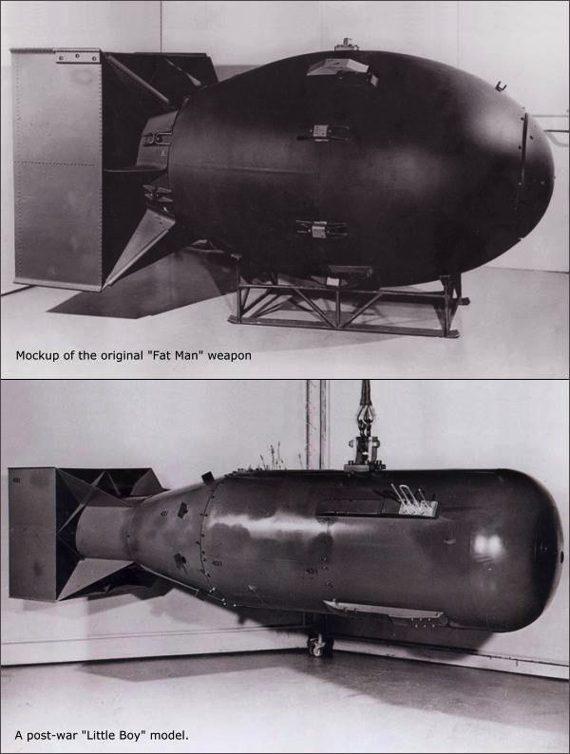
The Dropping of the Bomb
By executive order of President Harry Truman, the United States dropped an atomic bomb, “Little Boy” on the city of Hiroshima on August 6, 1945.
When Japan still failed to surrender, the United States dropped another bomb, “Fat Man,” on the city of Nagasaki on August 9, 1945.
Six days later, Japan surrendered to the allied powers officially ending World War Two.

Slide 5
Surrender
Japan surrenders Sept 2, 1945 aboard the USS Missouri

Slide 6
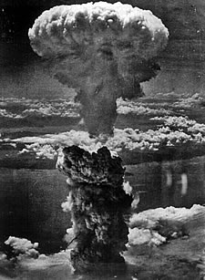
Post-war Impact of Atomic Bomb
Changed the very nature of war
Presented the possibility of annihilation of humankind
US came to place great strategic reliance on atomic bomb
War plans emphasized sudden atomic attack against USSR to allow time for conventional mobilization

Slide 7
Atomic Bomb Discussion
Why did Truman decide to use the atomic bomb against Japan?
Do you think Truman should have dropped the bomb?

