Slide 1
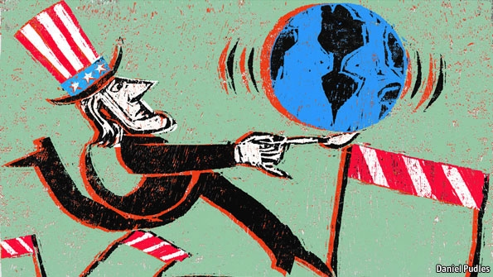
L15: Cold War in the 1950s: The Policy of Containment
American Foreign Policy
Agenda
Objective:
To understand and analyze the origins of the Cold War
To understand and evaluate the policy of containment and key foreign policy events within this period
Schedule:
Lecture and discussion
Homework:
None!

Slide 2
The Cold War
What do we know about the Cold War?

Slide 3
The Cold War
With the end of World War Two in 1945, the world settled into a period of history known as the Cold War
Cold War
1945 to 1989
United States vs. The Soviet
Union
Compete for global dominance now that
Europe is no longer the center of power
For 45 years the US and the
USSR threatened to go to war
with one another, and repeatedly
both nations thought they were on the brink of all out nuclear war
But they never fired a single shot directly at one another
Instead, conflict through:
Competing control over post-war Europe
Competing control over newly independent peoples in Asia, Latin America, and Africa
Sports and Cultural competitions
Technological and military innovations

Slide 4
Phases of the Cold War
Expansionism/Containment (1950s-1960s)
Mutually Assured Destruction (1960s)
Détente (1970s)
Re-escalation (early 1980s)
The End of the Cold War (late 1980s)

Slide 5
Presidents and the Cold War
Truman-(1945-1953)
Containment Policy
Truman Doctrine
Marshall Plan
Berlin Airlift
NATO
Korean War
Firing of MacArthur
H-Bomb
Eisenhower- (1953-1961)
Korean War peace
Guatemala
Cuban Revolution
Vietnam support
Arms Race/Space Race
Kennedy (1961-1963)
Vietnam escalation (Military advisors and equipment sent)
Cuban Missile Crisis (the closest the US will come to Nuclear War)
Johnson (1963-1969)
Escalates Vietnam involvement (500K troops 1968)
Nixon (1969-1974)
Massive Bombing of North Vietnam and Cambodia
Negotiated Settlement of Vietnam
Visits China and begins Détente with Mao Tse Tong
Ford (1974-1977)
Carter (1977-1981)
Russians invade Afghanistan
Aides Mujhadeen fighting Russians
Communists take over in Nicaragua
Reagan (1981-1989)
Focuses American in building “Star Wars” anti-missile program and defense spending to counter Soviets
Causes Soviet economy to suffer-
Gorbachev begins Perestroika- opens frustrations created by Communist economy and peaceful revolution is begun
George H. W. Bush (1989-1993)
1991 the Soviet Union is ended and chain reaction reverberates across Europe (Essentially communism and extreme socialism as an economic system is proven ineffective)
Nationalism takes over in formerly communist controlled regions of Europe

Slide 6
Expansion / Containment: The Cold War in the 1950s
Phase One

Slide 7
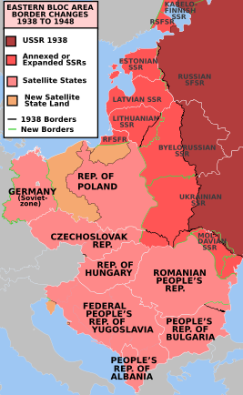
Soviet Approach to the Cold War in the 1950s: Expansionism
Expansion through Soviet Satellites
Stalin viewed the USSR as a “socialist island” and stated that the Soviet Union must see that “the present capitalist encirclement is replaced by a socialist encirclement.”
Called for the acquisition and corporation of “buffer” or “satellite” states into the Soviet Union to protect the USSR.
These nations came to be called the Eastern Bloc
Associated Leader: Stalin

Slide 8
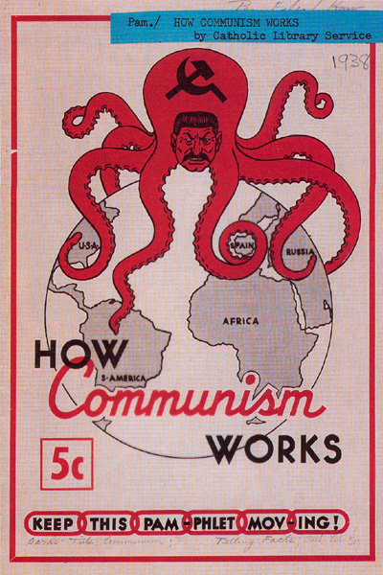
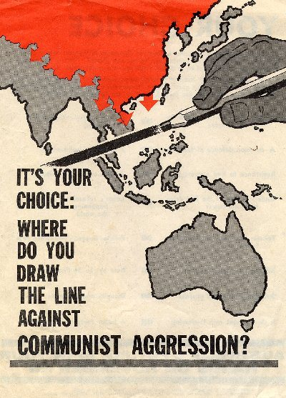
American Approach to the Cold War in the 1950s: Containment
Containment
America’s philosophy on how to deal with Communism
Belief is that:
Communism is here to stay, can’t be eradicated
But…we must stop communism from spreading
If left unchecked, Stalin would spread communism across the world…we must hold it back like a dam
Ex: Turkey and Greece
Created by George Kennan (X) The Long Telegram

Slide 9
Containment Actions/Policies 1945-1950s
Truman Doctrine 1947
Berlin Airlift 1948-1949
Marshall Plan 1948-1951
NATO & Warsaw Pact 1949
Korean War 1950-1953

Slide 10
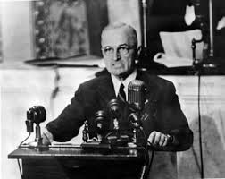
The Truman Doctrine 1947
America’s policy for how to stop the spread of communism
Offer economic and military aid to nations to prevent them from falling to communism
Born out of the experiences in Turkey and Greece
Created by President Harry Truman
Containment (Philosophy)
The Truman Doctrine
(Policy)

Slide 11
The Marshall Plan 1948
Specific American program to give economic aid to rebuild European economies
Hope was that by alleviating poverty and providing material assistance, countries would support democracy over communism
Provided food, machinery, construction, etc.
$12.5 billion allocated to the program
Proposed by U.S. Secretary of State George Marshall
Received Nobel Peace Prize for this work
Containment (Philosophy)
The Truman Doctrine
(Policy)
The Marshall Plan
(Program)

Slide 12
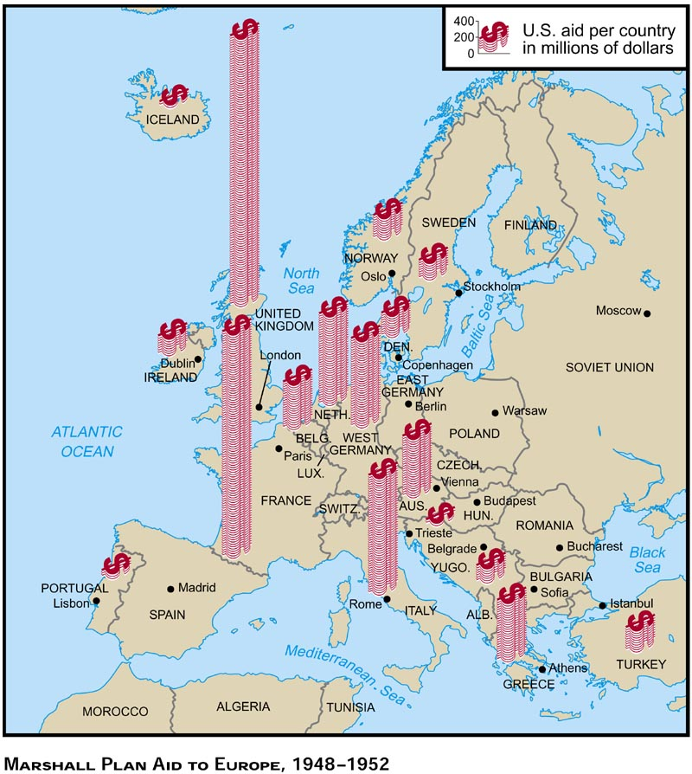
Marshall
Plan
$12.5
billion

Slide 13
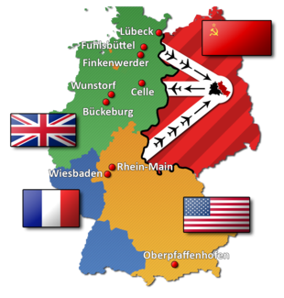
The Berlin Blockade & Airlift
June 1948-May 1949
First major international crisis of the Cold War.
What was the Berlin Blockade & Airlift:
Stalin blocked Western access to sectors of Berlin under Western control through East Germany
Western allies organized the Berlin airlift to carry supplies to the people of West Berlin
At the height of the airlift, one plane reached West Berlin every thirty seconds
After nearly a year, the blockade was lifted
How do the events in Berlin epitomize the theory of containment?

Slide 14
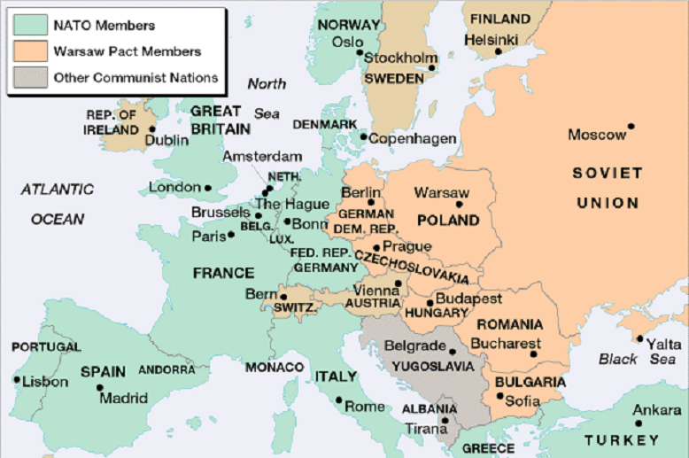
NATO & Warsaw Pact 1949
NATO
North Atlantic Treaty Organization
Alliance in which members promised to defend each other against Soviet Aggression
Committed to
stopping the
spread of
communism
Warsaw Pact
Collective
defense
treaty among
eight communist
states

Slide 15
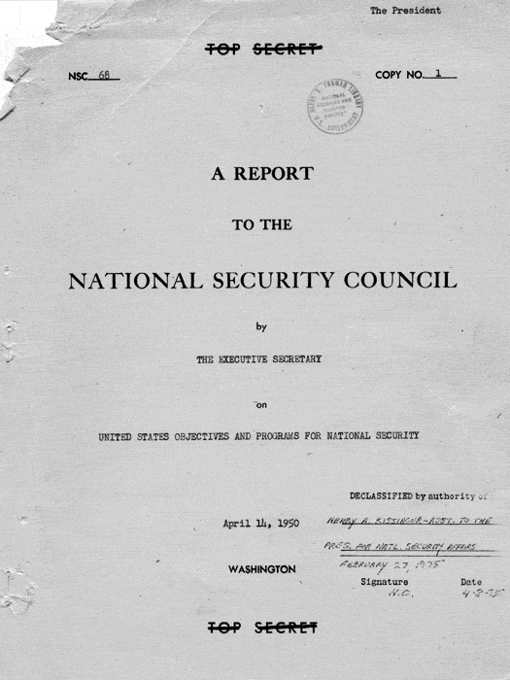
NSC-68
National Security Council Report 68
Presented to President Truman in April 1950
Top secret paper by the US National Security Council
Produced after the Soviets successfully tested their own atom bomb
Called for the militarization of the Cold War
Expansion of the US military budget
Development of a hydrogen bomb
Increased military aid to the allies of the of the United States
Shifts containment policy:
While Kennan had endorsed a multifaceted approach, NSC-68 called for military over diplomatic action!
With NSC-68 containment now becomes militarized!

Slide 16
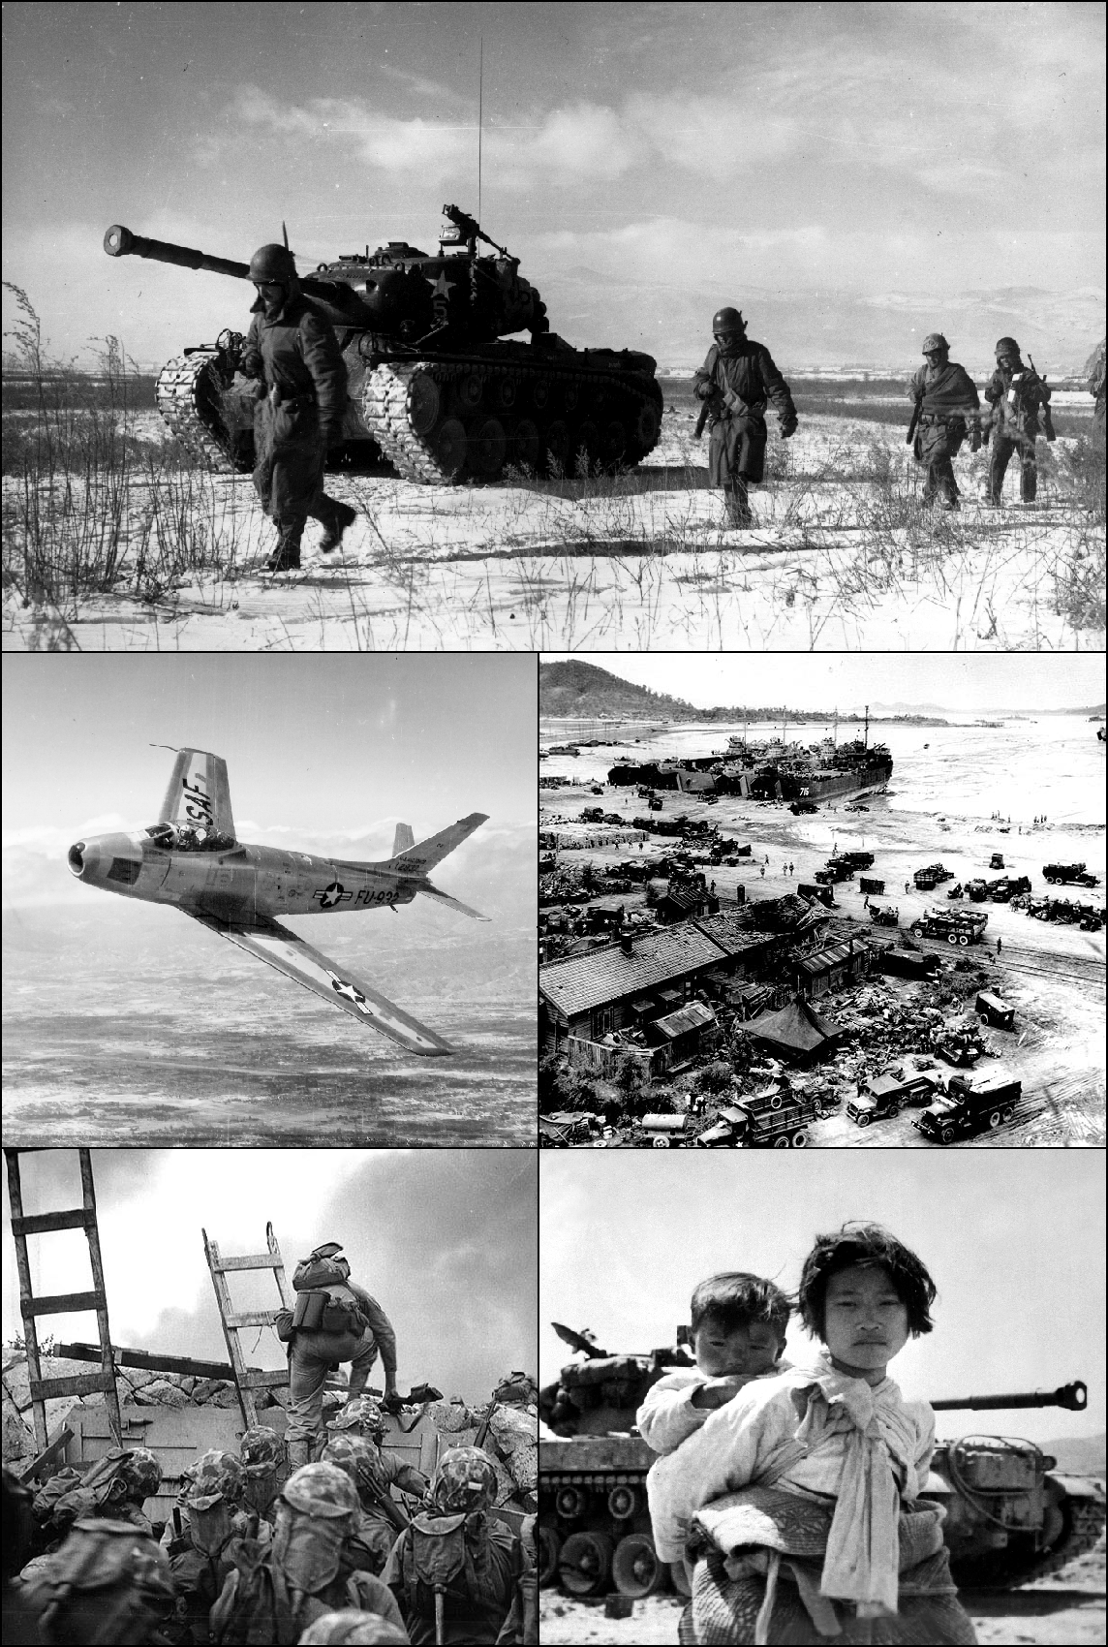
Korean War
June 1950- July 1953
Causes/Issues:
Korea had been a colony of Japan
After WWII, Japan lost Korea as a colony
Korea broke out into a Civil War
North = communist
Supported by the USSR & China
South = democrats
Supported by the USA and UN
Outcome
Stalemate
Korea divided into two countries at the 38th parallel (same line held at the start of the war)
North Korea = communist
South Korea = democratic
Significance
First use of war to contain communist
First proxy war in the Cold War

Slide 17
Closing
How would you describe the containment policy of the 1950s? How does it change?
What does this change portend about the next phase of the Cold War?

