Slide 1
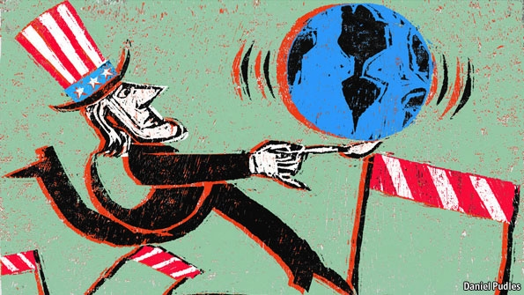
L21: A Brief History of America in the Middle East 1948-1990
American Foreign Policy
Agenda
Objectives:
To understand the nature of American intervention in the Middle East through a look at four case studies.
Schedule:
Lecture and Discussion
Homework
Test!
Yellow = Fri 1/18
Tan = Thurs 1/17
Purple = Thurs 1/17

Slide 2
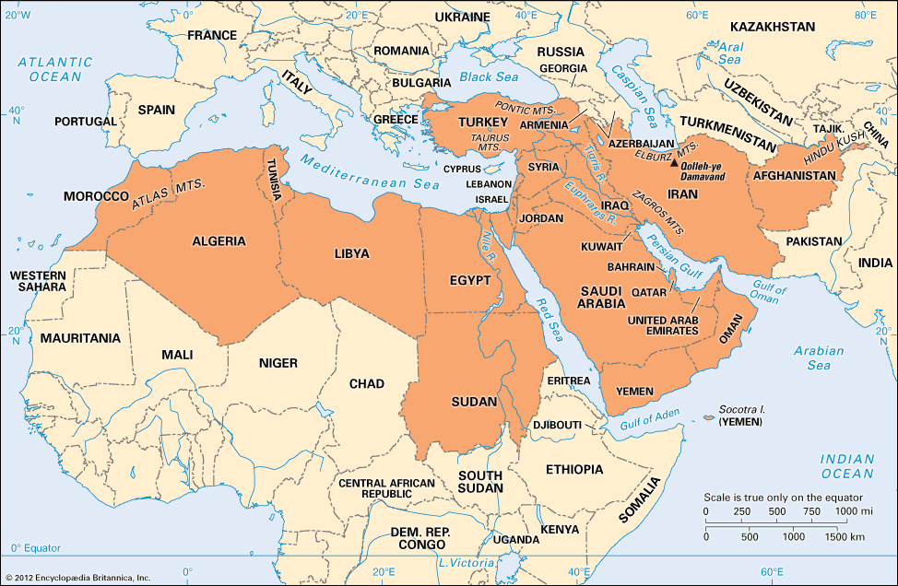
Intro to American Involvement in the Middle East
Prior to the Second World War, America had had minimal involvement in the Middle East
In the post-war era, that began to change.
Since 1948,
America has
demonstrated an
intensive involvement
in the political and
economic affairs of
the Middle East.

Slide 3
So What Changed? Why Get Involved in the Middle East Post 1948?
Three Main (Inter-related Reasons)
Cold War…
The Middle East became yet another terrain of conflict in which they US and the USSR battled for influence/control over newly independent nations
Israel
The creation of Israel was strongly opposed by many Arab countries, while the United States backed the creation of Israel—this brought the United States into conflict with the region, which only deepened as many of these Arab countries became backed by the Soviet Union
Oil
While the withdrawal of Great Britain from the area after WWII, the US became the main ‘guardian’ of Western access to oil from the Middle East

Slide 4
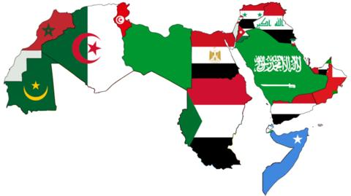
State of the Middle-East: 1945-1948
The Middle East underwent rapid political and economic changes following the end of WWII
Britain and France, who had colonized most of the region, were losing their colonial empires
As a result, many nations were getting their independence for the first time
Most of these independence movements were happening under the banner of Arab nationalism
Idea that the people of
the Arab world constitute
one people bound
together.
In order to flourish as a
independent people they
needed to end Western
influence in the Arab world

Slide 5
State of the Middle East: 1945-1948
The rise of independence movements under the banner of Arab Nationalism, troubled the United States
Regimes that wanted to end Western influence in the region directly threated America and the West’s access to oil.
America then began to feel like it needed to be involved in the region to influence the newly independent nations into adopting pro-American regimes

Slide 6
Case-Studies
We will examine America’s role in the Middle East from 1948-2001 through a look at four case-studies:
Israel
Iran
Afghanistan
Iraq

Slide 7
Israel

Slide 8
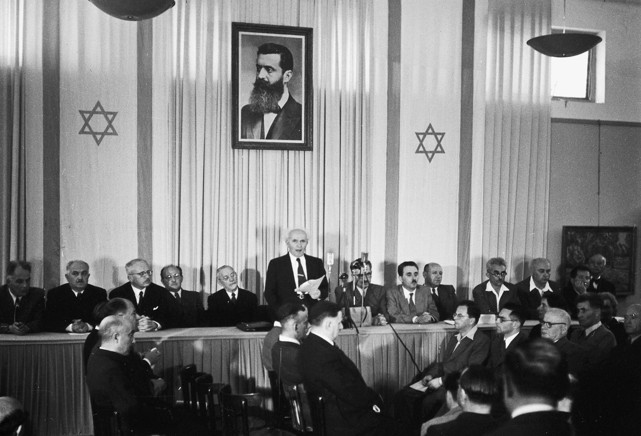
Creation of Israel
1948 The United Nations created Israel out of Arab land in Palestine
Grew out of pressure for a Jewish homeland dating back to the Zionist movement of the 1920, cause advanced by the Holocaust
Both the US and the USSR recognized the sovereignty of Israel
No Arab nation
recognized the state

Slide 9
Conflict between Israel and the Arab World Characterizes the next Three Decades
First Arab-Israeli War 1948
Six Day War 1967
Yom Kippur War 1973
What this means for the US?
In all of the conflicts the United States backed Israel in some way.
This soon made the United States the most hated in the Middle East
US actions, only helped push many nations in the Middle East further towards the Soviet Union as they looked for allies in the efforts to expel the United States (and Israel) from the region

Slide 10
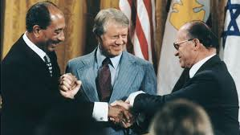
Efforts to Build Peace in the Middle East: The Carter Administration
Democratic President Jimmy Carter sought to achieve peace between Israel and the Arab world in the Middle East
Camp David Accords 1978
Carter, Israeli Prime Minister Begin, and Egyptian President Sadat met at Camp David in Maryland.
Carter brokered an agreement that outlined a framework to bring peace between Egypt and Israel.
As a result, Egypt first Arab nation to recognize Israel

Slide 11
Since 1980, the US has Re-Affirmed its Relationship with Israel
Reagan saw in Israel an important anti-communist ally
He helped to grant Israel “major non-NATO ally” status which gave it access to expanded weapons systems.
Since the Reagan administration, all subsequent President have pledged their commitment to Israel

Slide 12
Iran

Slide 13
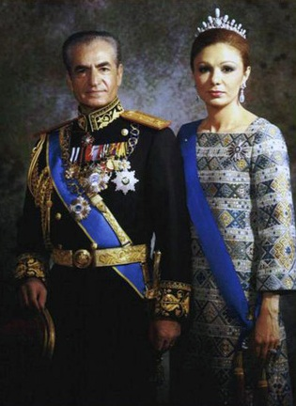
Iran is a Pro-Western Nation from 1941 to 1979
Iran was ruled by the Shah (Mohammad Reza Pahlavi) from 1941 to 1979
The Shah was a pro-Western leader who endorsed Westernization and modernization
He was pro-America and seen as an American ally
When the Shah’s regime was threatened in 1953 by Mossadeq, the United States imprisoned Mossadeq and reinstated the Shah

Slide 14
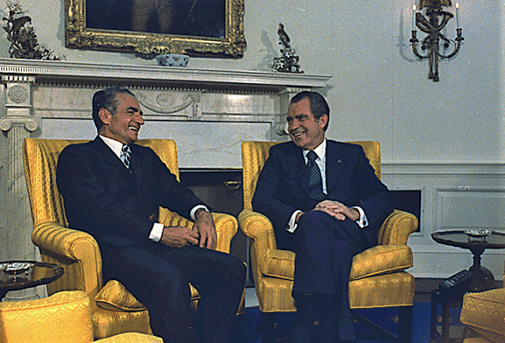
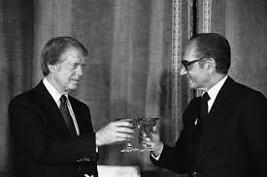
Iran and America’s Strategic Interest in the Middle East
Iran was seen as a key US ally in the Middle East
It was oil rich and opposed the Soviet Union
The fact that it shared a border with the Soviet bloc meant that it was an important barrier state for Soviet influence in the region

Slide 15
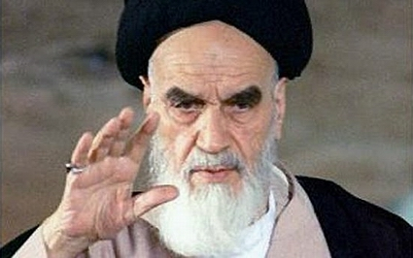
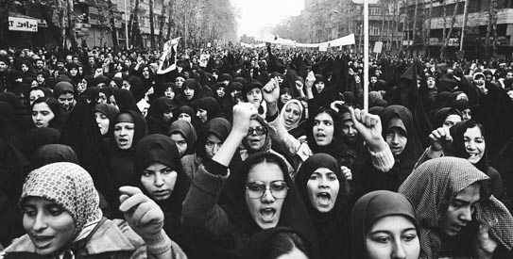
Anti-American Sentiment Builds in Iran
Following the US support for the Shah in 1953, a group of Iranians began to build a distrust for the United States and the Shah
Iranian Revolutionaries
Anti-American, Anti-Shah Iranians
Generally young, college-age students
Embraced traditional Islam and Arab nationalism as a means of generating a unique cultural and economic identity for Iran (Conservative movement)
Led by the religions leader Ayatollah Khomeini

Slide 16
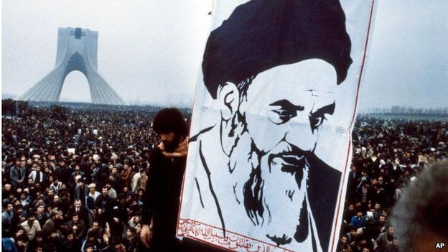
Iranian Revolution 1979
In 1979 the Iranian Revolutionaries overthrew the Shah and replaced him with Ayatollah Khomeini
Iran became an anti-West authoritarian theocracy
The United States suspended diplomatic relations with Iran and began to impose sanctions on the nation

Slide 17
Afghanistan

Slide 18
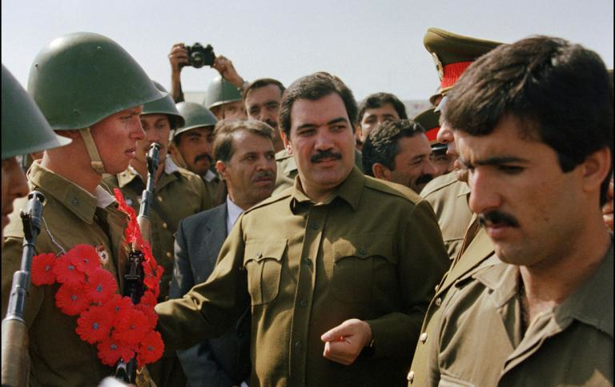
Background
The Democratic Republic of Afghanistan was formed in 1978
The government had
a socialist agenda and
maintained close
relations with the
Soviet Union
The government also began a process of modernization that involved ridding the culture of certain traditional Muslim practices

Slide 19
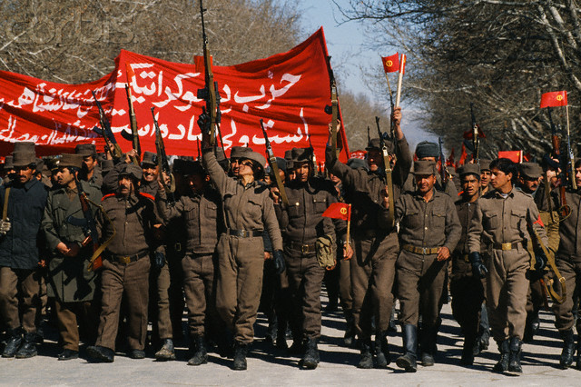
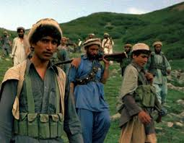
The Soviet-Afghan War
In opposition to the new, modern regime insurgent groups, known as the Mujahideen, began to rise up against the government
The government soon called on support from the Soviet Union
Soon the rebellion became the Soviet-Afghan War
The United States provided money and weapons for the Mujahideen forces

Slide 20
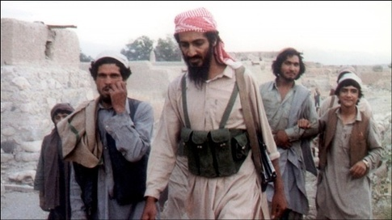
The Rise of Osama Bin Laden
One of these Mujahideen fighters was Osama Bin Laden who went on to form Al-Qaeda

Slide 21
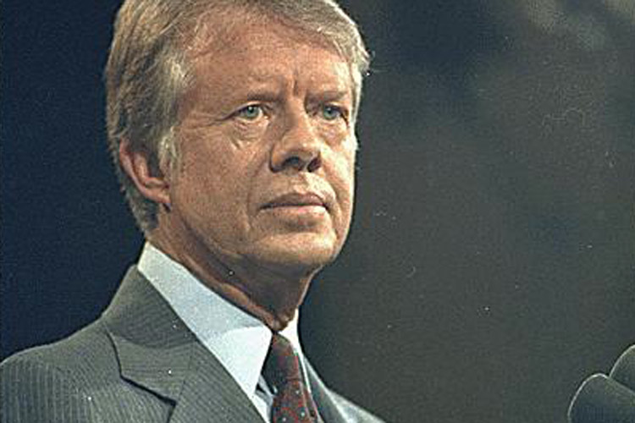
The Carter Doctrine
Policy proclaimed by President Carter in his State of the Union Address in 1980
Response to the Soviet intervention in Afghanistan and was designed to deter the USSR from seeking dominance in the Persian Gulf Region
It stated: “Let our
position be absolutely
clear: An attempt by any
outside force to gain
control of the Persian Gulf
region will be regarded as
an assault on the vital
interests of the United
States of America, and such an
assault will be repelled by any
means necessary, including military force.”

Slide 22
Iraq

Slide 23
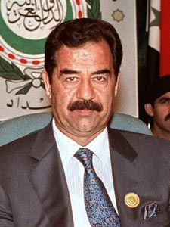
Iraq Since the Second World War
Iraq had struggled with its leadership since getting its independence from Britain in 1932
In 1979 Saddam Hussein took control of Iraq as a dictator and endorsing a mix of Arab nationalism and socialism

Slide 24
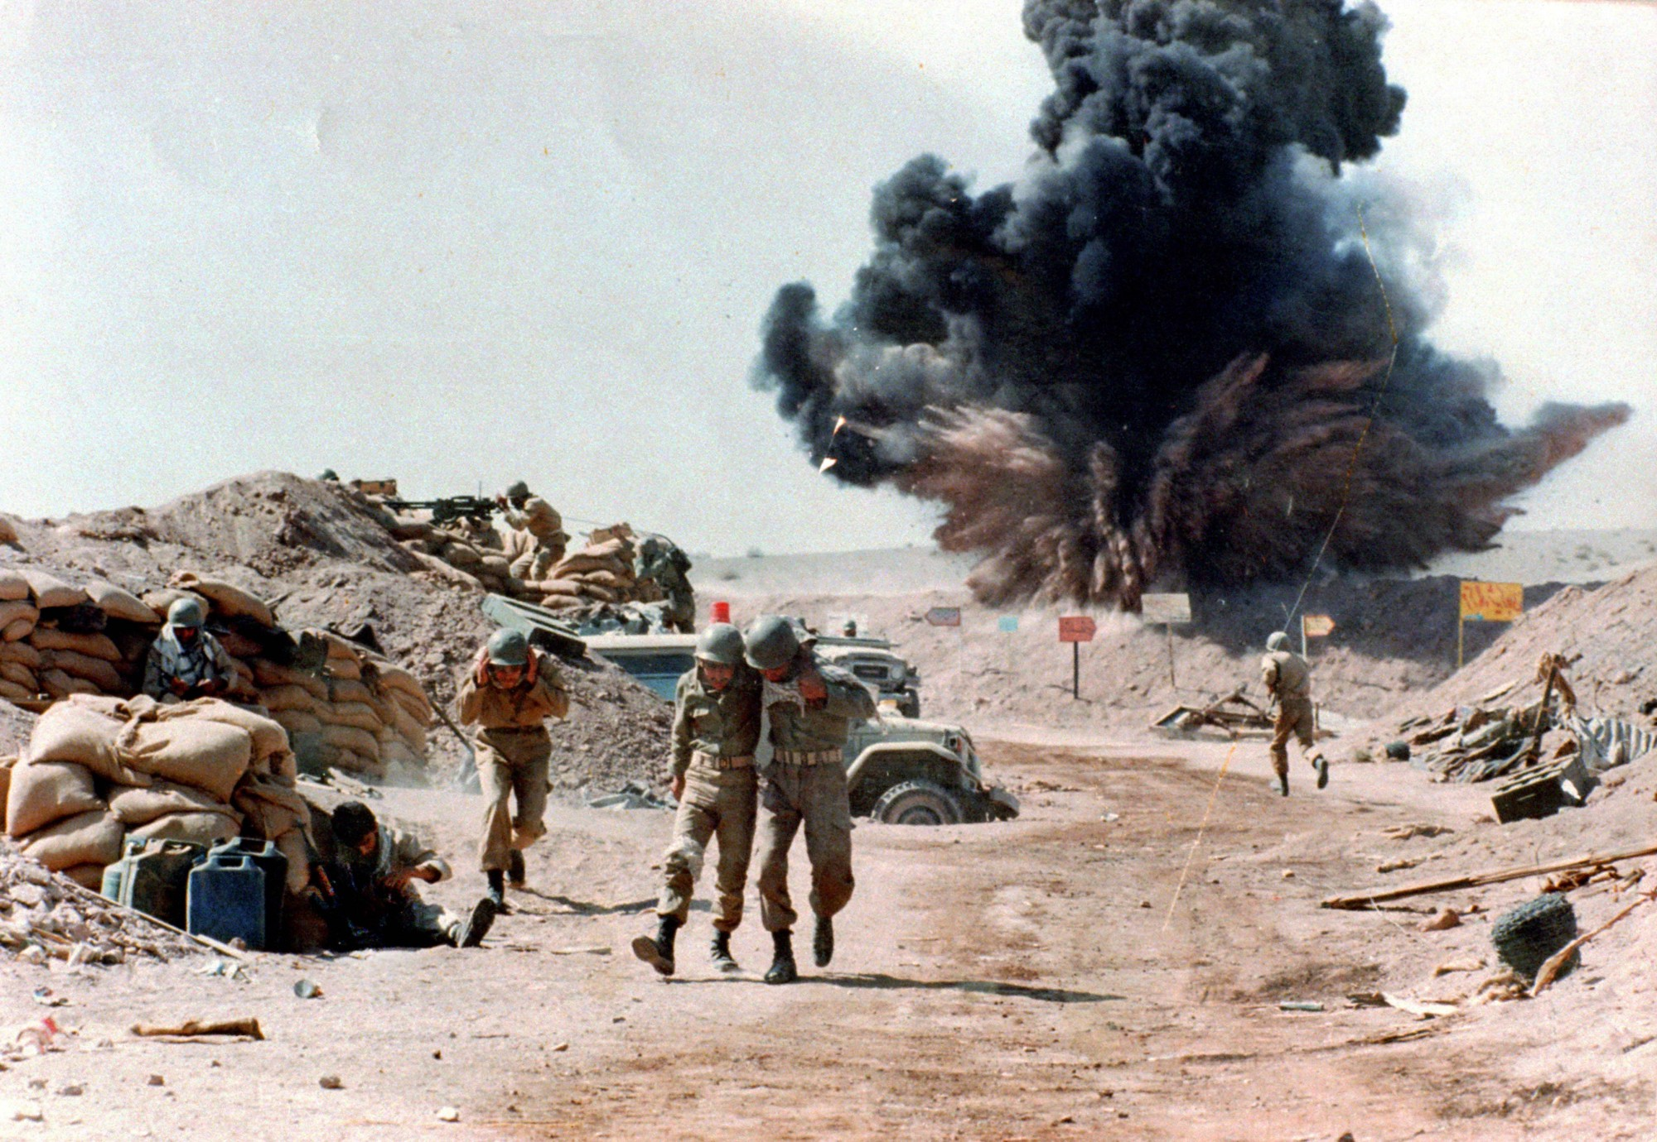
Iran-Iraq War 1979
In 1979, hoping to capitalize on the instability brought about by the Iranian Revolution, Hussein invaded Iran
In this effort he was supported by the United States who hoped he would take out Khomeini
US supplied Hussein with both conventional weapons as well as chemical weapons and biological weapons (anthrax and the bubonic plague)

Slide 25
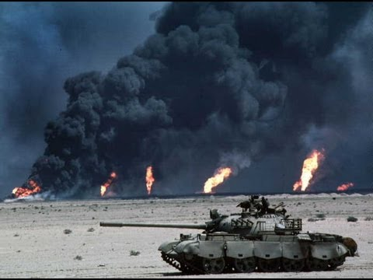
Persian Gulf War 1990
In 1990, Hussein invaded neighboring Kuwait
The United States feared that an invasion of Kuwait would threaten America’s access to oil in the nation
Launched “Operation Desert Storm” to recapture Kuwait
First action taken in the name of the Carter Doctrine
The United States drove Hussein back into Iraq in 6 weeks

