Slide 1
L22: The War on Terror
American Foreign Policy
Agenda
Objective:
To understand and evaluate the actions taken by the Bush administration in the wake of 9/11.
Schedule:
Video: The 2000s
Homework:
Test!
Yellow = Fri 1/18
Tan = Thurs 1/17
Purple = Thurs 1/17

Slide 2
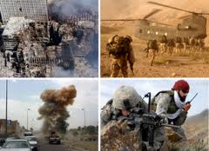
Brainstorm! War on Terror
What do you know about the war on terror?
How did it start? Where is the US engaged? What is its strategy?

Slide 3
The Bush Doctrine
Read Bush’s Speech to West Point 2002

Slide 4
War on Terror
Big Questions:
What is the Bush Doctrine?
How does this foreign policy come to define the war on terror under George W. Bush?
In his September 11 speech, President George Bush said, “We will not distinguish between the terrorists and those countries that harbored them.” What makes this so significant?
What are the foreign policy implications of Bush arguing that the 9/11 attacks were not an act of terror but an act of war?
How is the Bush Doctrine like the Truman Doctrine?
How is the war on terrorism like the Cold War?
How are the strategies used to fight these wars different?
How is America’s willingness to act alone militarily a departure from past U.S. foreign policy?

