Slide 1
L1: Intro to Inequality & The Native American Experience
Founding-Civil War
The Struggle for Equality
Agenda
Objective:
To Understand…
The specific events/experiences that marginalized Native Americans from the Founding to the Civil War
The forces at work as a result of these events/experiences that keep Native Americans on the Margins
The attempts Native Americans made to overcome these forces of marginalization
Evaluate possible reasons why these forces were not successful
Schedule:
Lecture
Discussion
Homework:
Owen’s This Species of Property Due L2
Yellow = Fri 1/25
Tan = Thurs 1/24
Purple = Thurs 1/24
2. Foreign Policy Unit Paper Due Fri 2/1

Slide 3
A Schema for Thinking about Marginalization

Slide 4
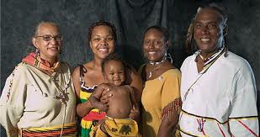
Native American Experience in America Founding-Civil War
Since Europeans came to America, Native Americans have been pushed to the margins of American society
Today we want to understand…
The specific events/experiences that marginalized Native Americans from the Founding to the Civil War
The forces at work as a result of these events/experiences that keep Native Americans on the margins
The attempts Native
Americans made to
overcome these forces
of marginalization
Evaluate possible reasons
why these forces were
not successful

Slide 5
Mini-Lecture on The Native American Experience in America Founding – Civil War
The specific events/experiences that marginalized Native Americans from the Founding to the Civil War

Slide 6
Indian Policy at the Founding
Since colonization, Native Americans and Americans existed in a tenuous relationship.
A series of conflicts resulted in Native Americans and Americans occupying different lands by the founding.
In the late 1700s, lands west of the Appalachian mountains are Native American and east are American.
Tribes accorded independent nation status


Slide 7
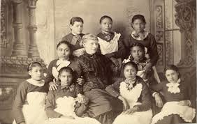
“Civilization” Policy of Thomas Jefferson 1801-1809
By the early 1800s, the American government wanted to grow the country and get more land.
As part of this expansion policy Jefferson issued a “Civilization Policy” for Native Americans
Native Americans could remain east of the Mississippi so long as they became assimilated, or in the language of the time, “civilized”
Encouraged them to learn English, dress like Americans, adopt Christianity, and marry whites
Goal:
In the long run, acquire Native
American lands and to
incorporate Native Americans
into American society in a way that
would assimilate them out of
existence

Slide 8
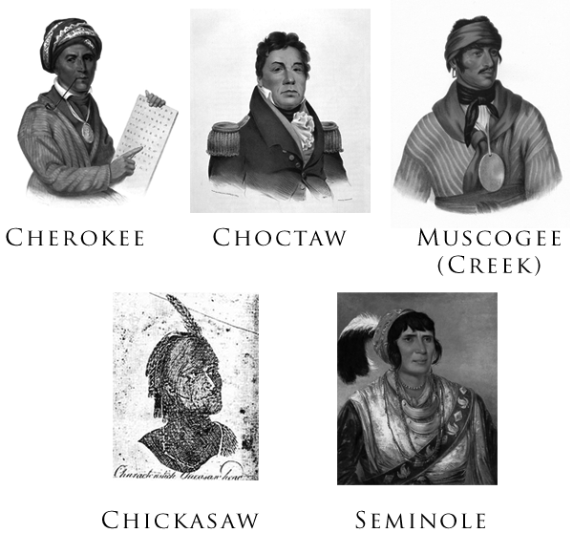
“The Five Civilized Tribes” in 1830
In 1830, there were “Five Civilized Tribes” because many tribesmen had adopted various aspects of European-American culture, including Christianity.
Example: The Cherokees
Own system of writing their own language
Published a newspaper in Cherokee and English.
Formed a Constitution based on that of the US Constitution.

Slide 9
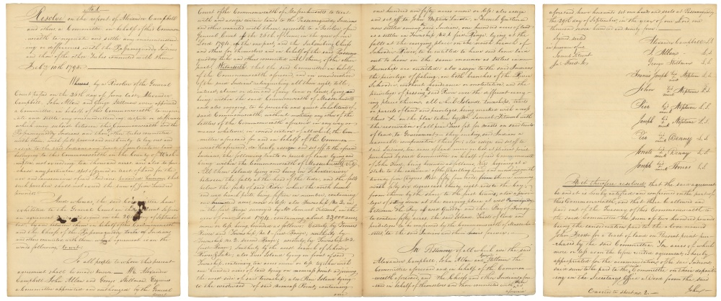
“Land Exchange” Treaties 1817-1830
In the mid 1800s, America continued to pursue an expansionist policy.
Shift in Policy: “Land Exchange”
Native Americans would relinquish land in the east in exchange for “equal” or “comparable” land west of the Mississippi River.

Slide 10
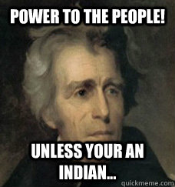
Indian Policy During Andrew Jackson’s Presidency 1829-1837
By the time of Jackson, many white settlers and land speculators in the west and southeast, simply desired the land that was occupied by the tribes and would do anything to get it.

Slide 11
Indian Removal Act 1830
Act passed by Congress which authorized the President to grant unsettled land west of the Mississippi to Native Americans in exchange for the land they resided on within existing state borders.
Signed into law by President Jackson
Ruled unconstitutional
by SCOTUS (John
Marshall) in Worcester v.
Georgia 1832
Jackson ignores SCOTUS
and proceeds to authorize
the removal of Native
Americans

Slide 12
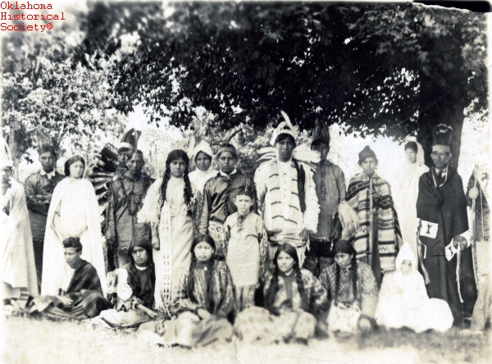
Native American Are Shocked
Thought that their sovereignty as an independent nation was recognized and affirmed by SCOTUS
They thought the American government didn’t have the authority to this…and they didn’t!
“…it never occurred to us for a moment, that without any new treaty, without any assent of our rulers and people, without even a pretended compact, and against our vehement and unanimous protestations, we should be delivered over to the discretion of those, who had declared by a legislative act, that they wanted Cherokee lands would have them.”
~Cherokee Council

Slide 13
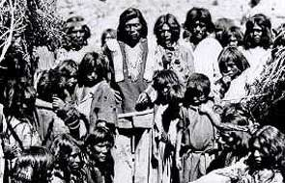
The Trail of Tears 1838-1839
A few tribes peacefully abandoned their lands and homes, but many resisted.
In 1838-1839 Federal Government Began forcibly removing those Native Americans who remained
Trail of Tears
US Army was ordered to remove 15,000 Cherokees from their homes
Men, women, and children were taken from their homes, forced into makeshift forts with
minimal facilities and food.
4,000 Cherokees died as a result
of hunger, disease, and
exhaustion from the forced
march.

Slide 14
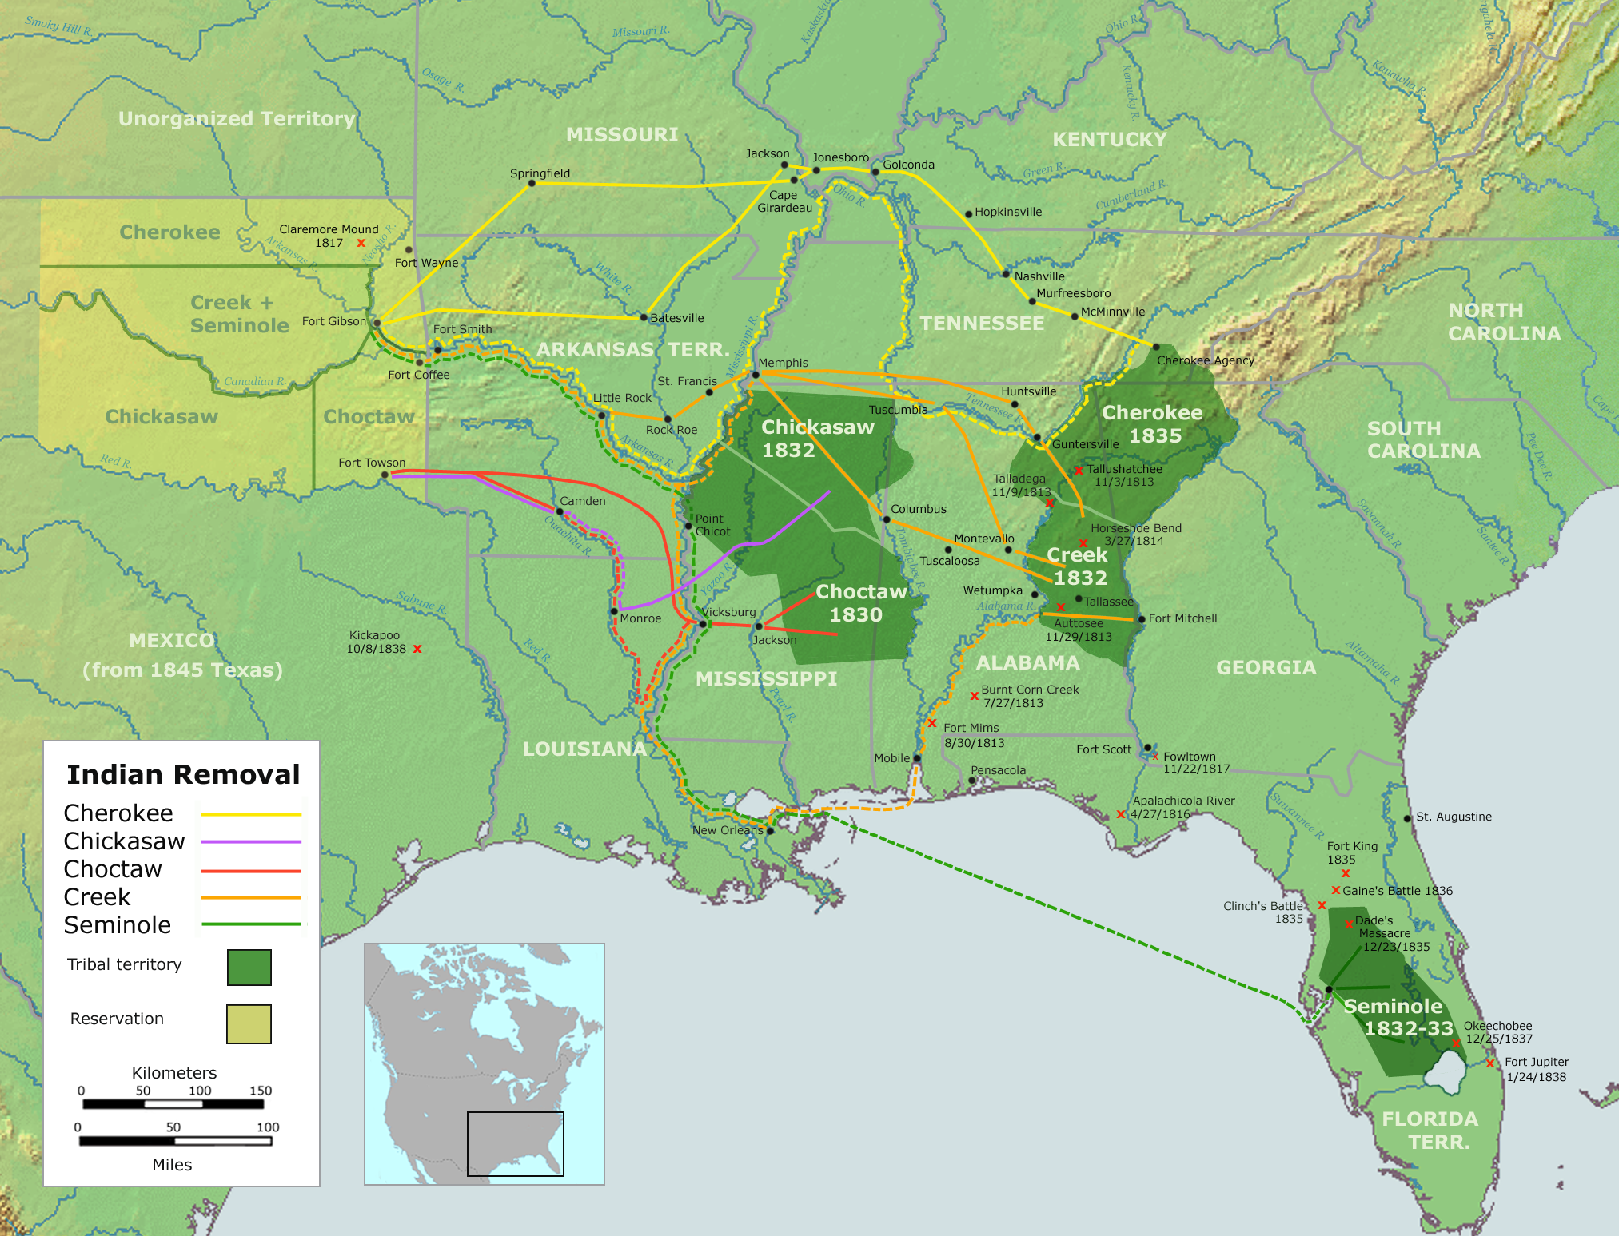

Slide 15
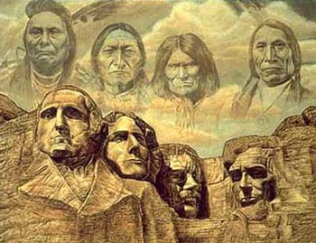
Response of Native Americans
Some complied, but many Natives refused to leave and willingly risked their lives in a attempt to defend their homes.
Tecumseh, Osceola, Sitting Bull, Geronimo, Chief Joseph, Junaluska, and Tsali are just a few of the Native resistance leaders who fought to hold onto their ancestral homes and their cultures.
Unfortunately, outnumbered and outgunned, Native Americans stood little chance against the surging White population.
Eventually, the U.S. government would seize two billion acres of their territories.

Slide 16
Putting It All Together!
What are forces at work as a result of these events/experiences that keep Native Americans on the Margins?
What were the attempts Native Americans made to overcome these forces of marginalization?
Evaluate possible reasons why these forces were not successful.

