Slide 1
L2: Blacks in the Antebellum Period (1800s-1860)
The Struggle for Equality
Agenda
Objective:
To Understand…
The forces at work to marginalize enslaved blacks.
The forces at work within slavery to oppress blacks in that institution
Methods of black resistance
Schedule:
Discussion & Power Circle Work
Homework:
Read excerpts from Woloch’s Women and the American Experience Due: L3
Complete 3 “power circles” by identifying the social forces working to marginalize the following three groups of women & any resistance (grappling hooks).
(1) White Northern Women
(2) White Southern Women
(3) Black Enslaved Women
Yellow = Wed 1/30
Tan = Fri 1/25
Purple = Mon 1/28
2. Foreign Policy Unit Paper Due Wed 2/6 by 11:30 (half day)

Slide 2
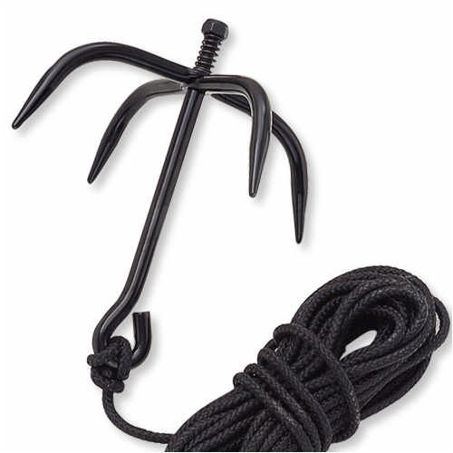
Women in Antebellum America
Northern Women (White & Black, focus on White…) | Southern Slaveholding White Women | Enslaved Black Women
Forces of Marginalization: Openings for Equality: | Forces of Marginalization: | Forces of Marginalization:

Slide 3
Blacks in the Antebellum Period (1800s to 1860)
What are the forces in American society marginalizing enslaved blacks?
Within the social institution of slavery what are the forces at work to oppress blacks?
What did black resistance to these forces look like?

Slide 4
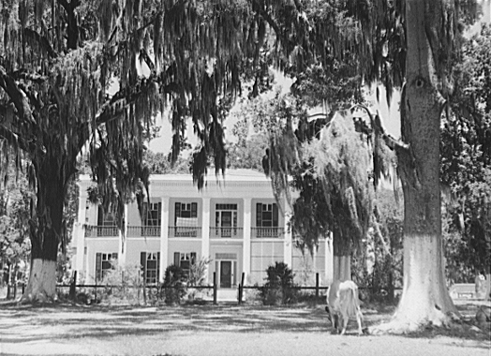

Slide 5
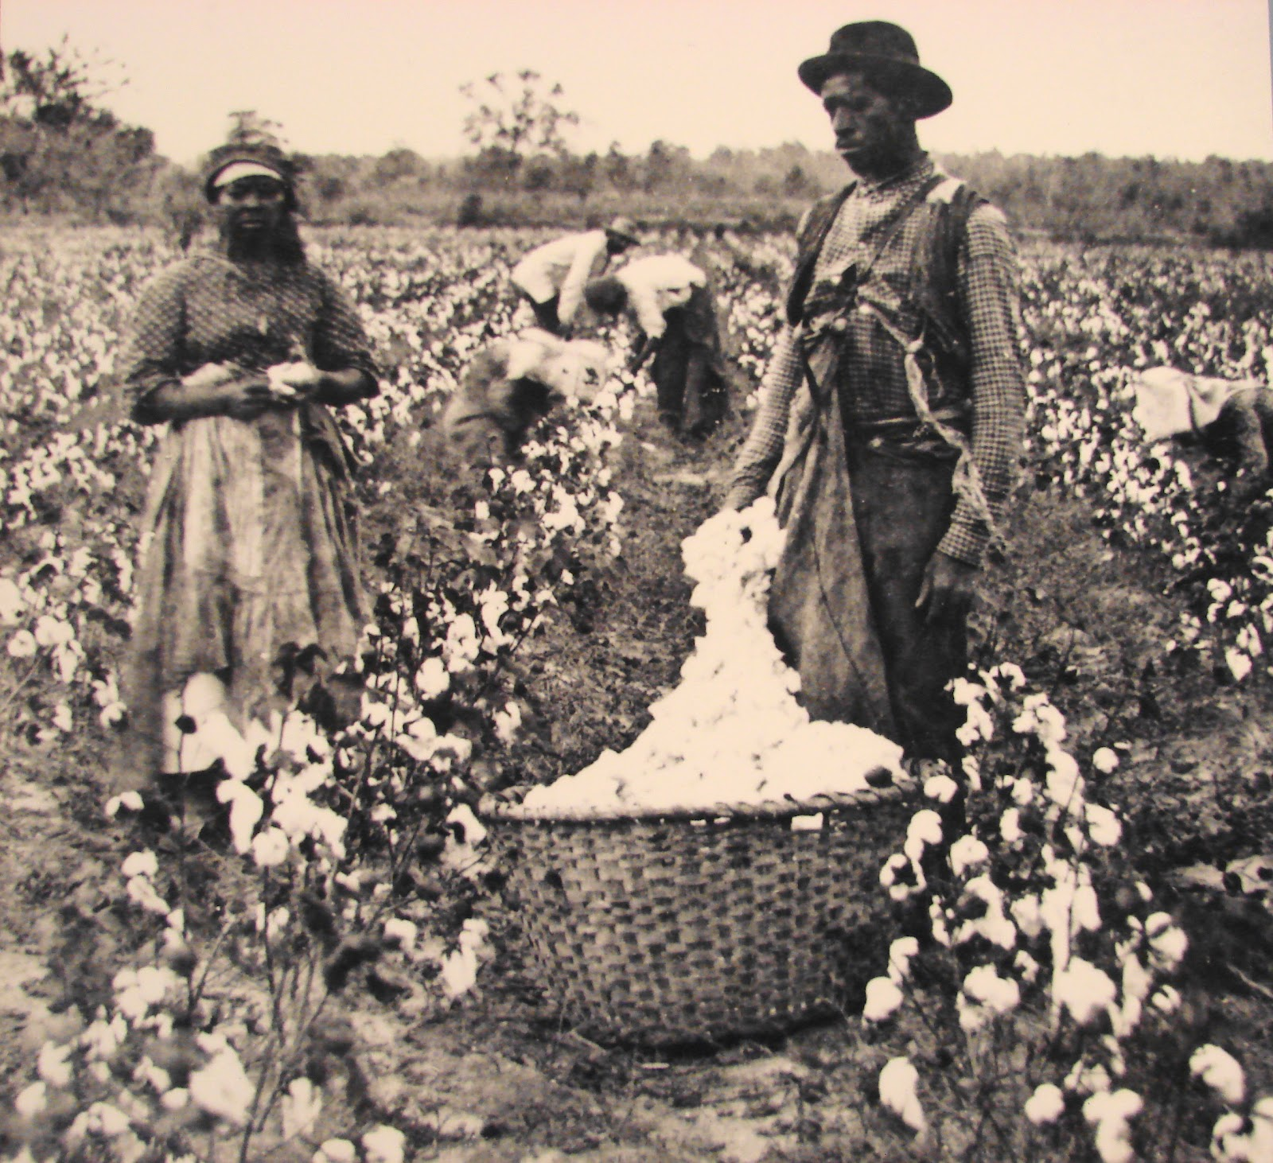

Slide 6
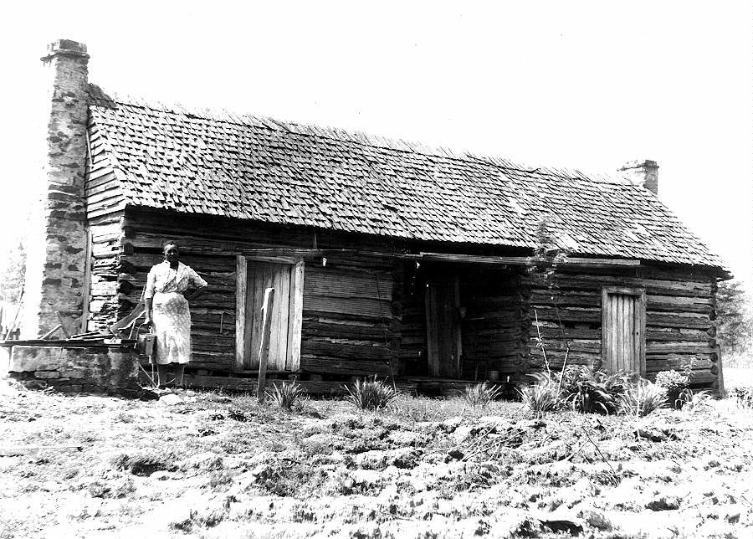

Slide 7
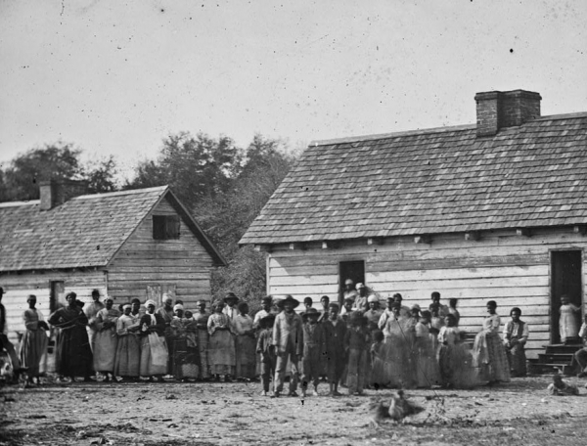

Slide 8
