Slide 1
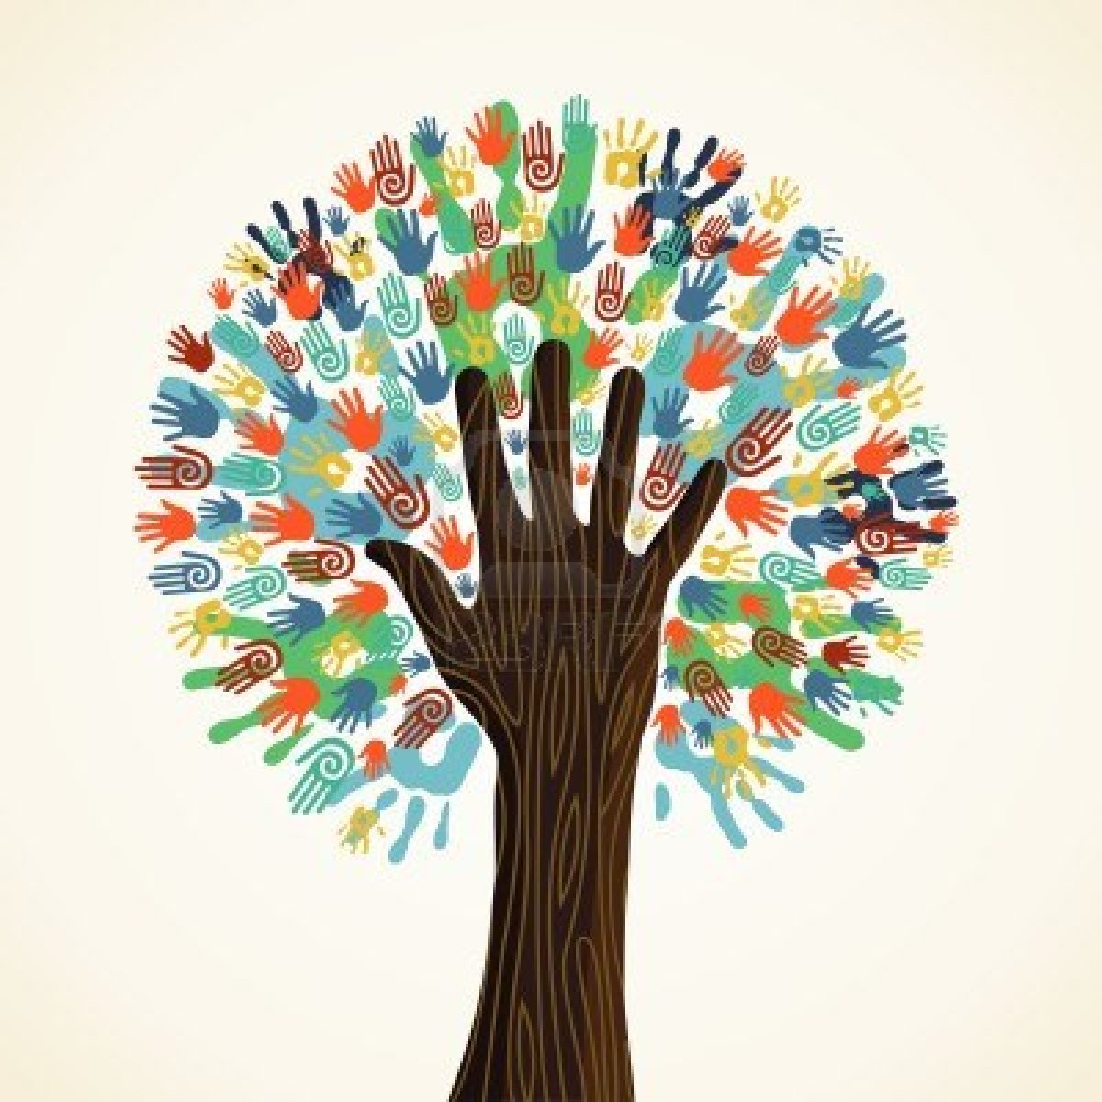
L3: Gender in the Antebellum Period (1800s-1860)
The Struggle for Equality
Agenda
Objective:
To describe the lives of Northern, Southern, and enslaved women before the Civil War.
To describe points of similarities and difference in their oppression, their acts of oppression, and their opportunities for equality.
To discuss the implications of these fractured experiences on women’s rights activism
Schedule:
Discussion & Visual Activity
Homework:
Read “Anti-Slavery” chapter for L4
Yellow = Thurs 1/31
Tan = Tues 1/29
Purple = Tues 1/29
2. Foreign Policy Unit Paper Due Wed 2/6 by 11:30 (half day)

Slide 2
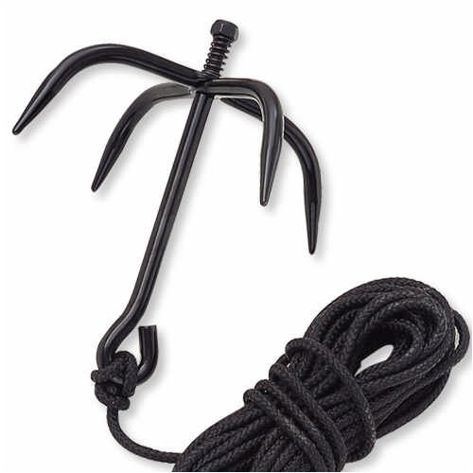
Women in Antebellum America
Northern Women (White & Black, focus on White…) | Southern Slaveholding White Women | Enslaved Black Women
Forces of Marginalization: Openings for Equality: | Forces of Marginalization: | Forces of Marginalization:

