Slide 1
L4: The Reform Impulse: Abolitionism (1820s-1840s)
The Struggle for Equality
Agenda
Objective:
To understand and evaluate the abolitionist movements and their activist strategies.
Schedule:
Discussion
Homework:
1. Read excerpts from Woloch “Benevolence, Reform, an Slavery”
Due: L5
Yellow = Fri 2/1
Tan = Wed 1/30
Purple = Wed 1/30
2. Foreign Policy Unit Paper Due Wed 2/6 by 11:30 (half day)

Slide 2
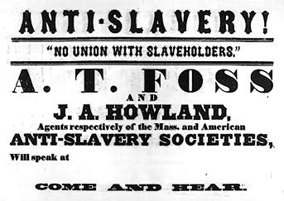
Plan for Today
Goal: Today we want to become knowledgeable about the activist strategies of abolitionists in the 1820s-1840s
Whole class discussion!

