Slide 1
L12: Schism in Black Activism: Booker T. Washington v. W.E.B. Du Bois (1890s to early 1900s)
The Struggle for Equality
Agenda
Objective:
To understand the nature of the Jim Crow South
To evaluate the competing perspectives of Washington and Dubois for how to improve the lives of African Americans in the early 1900s.
Schedule:
Discussion of Jim Crow Laws
Evaluation of Washington & Dubois
Homework:
None!

Slide 2
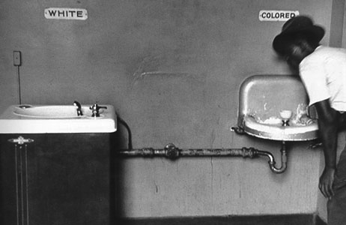
The Jim Crow South
The Jim Crow South was a period in which whites tried to reinstate their definition of social order (racial inequality) following Reconstruction
Effectively recreated systematic oppression of blacks through the use of legal segregation.
Ruled constitutional in the case of Plessy v. Ferguson 1896
Lasted for nearly 100 years from 1877 to 1965.

Slide 3
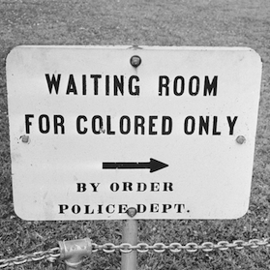
Jim Crow Laws Discussion
What threats/obstacles/fears did Whites hold following Reconstruction?
What was the social order that was created in the Jim Crow South?
What do race relations look like?

Slide 4
The Rise of Civil Rights and Black Agency: Setting the Stage
It is in this context that we have the rise of the first “modern” black activists who sought to “improve” the black condition.
Booker T. Washington
W.E.B. DuBois

Slide 5
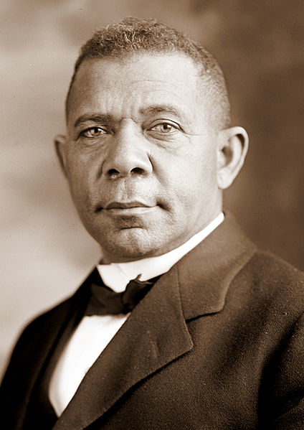
Booker T. Washington
1856-1915
Born into slavery in Virginia
Mother was a slave, father was a nearby planter.
Dominant leader of the African American community from 1890 to 1915
Representative of the last generation of black leaders born in slavery
Founder of Tuskegee University

Slide 6
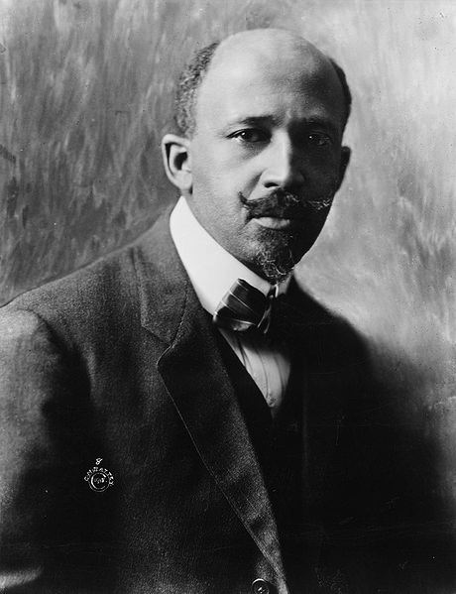
W. E. B. DuBois
1868-1963
Born and raised in Great Barrington, Massachusetts
Experienced very little racism as a child
First African American to earn a doctorate from Harvard
Professor of history, sociology, and economics at Atlanta University
Co-Founder of NAACP

Slide 7
Understanding the Work of Washington and DuBois
Washington and DuBois were two pioneering civil rights advocates who sought to uplift or improve the conditions of African Americans but had very different ways of achieving that.
We will discuss the plans of each thinker and their significance.

