Slide 1
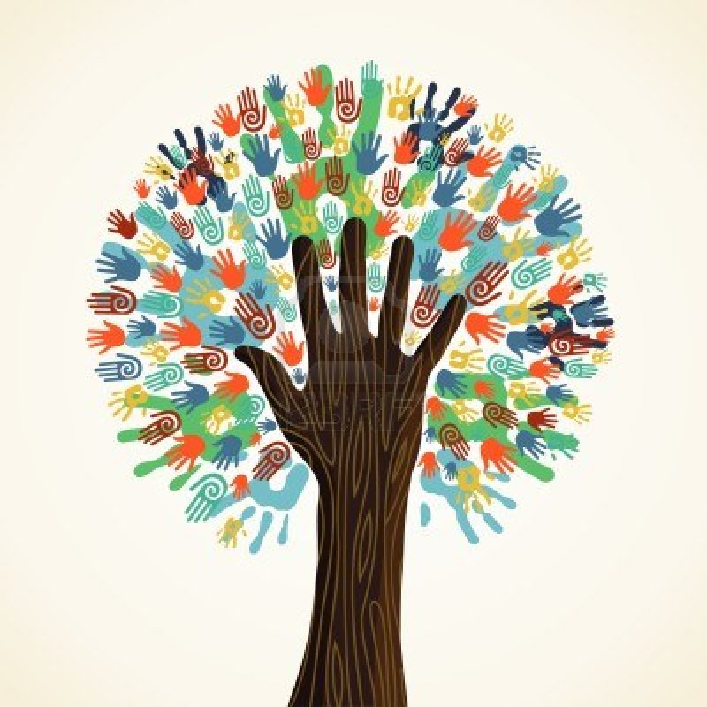
L13: The Great Migration and the Harlem Renaissance 1910s-1920s
The Struggle for Equality
Agenda
Objective:
To understand what the Great Migration was.
To understand what the Harlem Renaissance was.
To understand the significance of the Harlem Renaissance for the black experience.
Schedule:
Lecture
Video: The African Americans: Many Rivers to Cross
Discussion
Homework:
None!

Slide 2
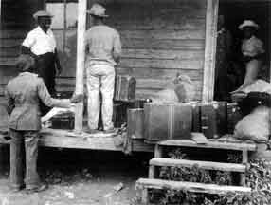
Possibility Opens Up
Life in the Jim Crow south, is the life that the overwhelming majority of African Americans lived.
In 1900, 90% of blacks lived in Southern States!
But…In 1910, a new spark of possibility emerged for African
Americans as an
industrial boom in the
North sparked demand
for new workers.

Slide 3
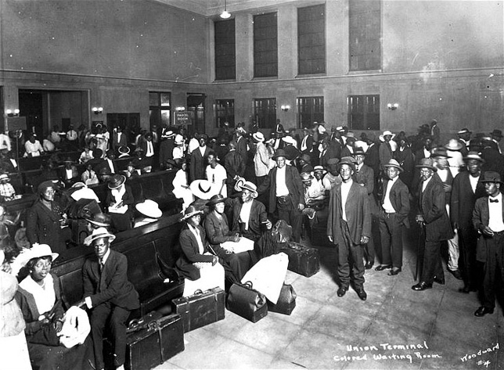
The Great Migration
1910-1930 (second wave,
1930 to 1970)
Movement of 6 million
African Americans out
of the rural south into the
Northeast, Midwest, and
West.
New York, Chicago,
Philadelphia, St. Louis,
Detroit, Pittsburgh,
Cleveland, and Indianapolis
Largest internal movement of an American population.
By the end of the Great Migration…
African Americans became an urbanized—rather than rural—population.
Northern American cities became significantly more black

Slide 4
Causes of the Great Migration
Jim Crow Laws in the South (Push)
Racial Violence in the South (Push)
Limited Economic Opportunities in the South (Push)
Increased Demand for Industrial Workers in the North (Pull)
Better Educational Opportunities in the North (Pull)
Increased Political Opportunities in the North (Pull)

Slide 5
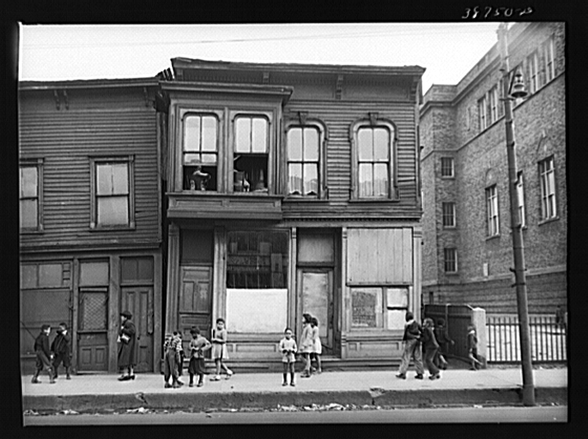
Effects of the Great Migration
Shift Blacks from a Rural Population to an Urban Population
Increase the number of African Americans living in North cities; Make these cities truly multi-racial
But what else??...

Slide 6
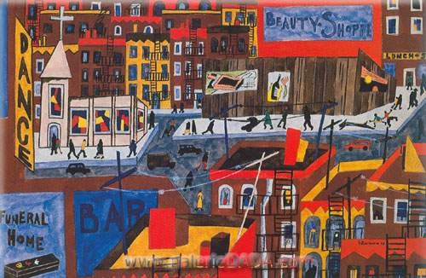
The Harlem Renaissance
1920s and 1930s
The Harlem Renaissance was a flowering of African American social and cultural thought which was expressed through:
Paintings
Music
Dance
Theater
Literature

Slide 7
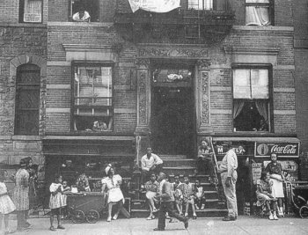
Why the Harlem Renaissance
During the Great Migration the majority of African Americans who moved north ended up in New York City.
Of the almost 750,000 African Americans who moved North, nearly 175,000 moved to Harlem.
The neighborhood of Harlem became a ethnic enclave of African Americans.
Harlem is a section of Manhattan, which covers three square miles
Harlem became the
largest concentration of
black people in the world.

Slide 8
Why Did the Harlem Renaissance Emerge When and Where it Did?
Emergence of a black middle class coming out of the Great Migration
Increased contact between African Americans and white Americans in the workplace and on city streets forced a new awareness of the disparity between the promise of the American dream and reality.
Blacks WWI experience and disillusionment with race relations in the United States
African American soldiers who served in World War I were angered by the prejudice they often encountered back at home, compared to the acceptance they had found in Europe.
Rise of NAACP, Black Nationalism, and Garveyism

Slide 9
Video and Discussion!
The African Americans: Many Rivers to Cross (Episode 4: Making a Way out of No Way)

