Slide 1
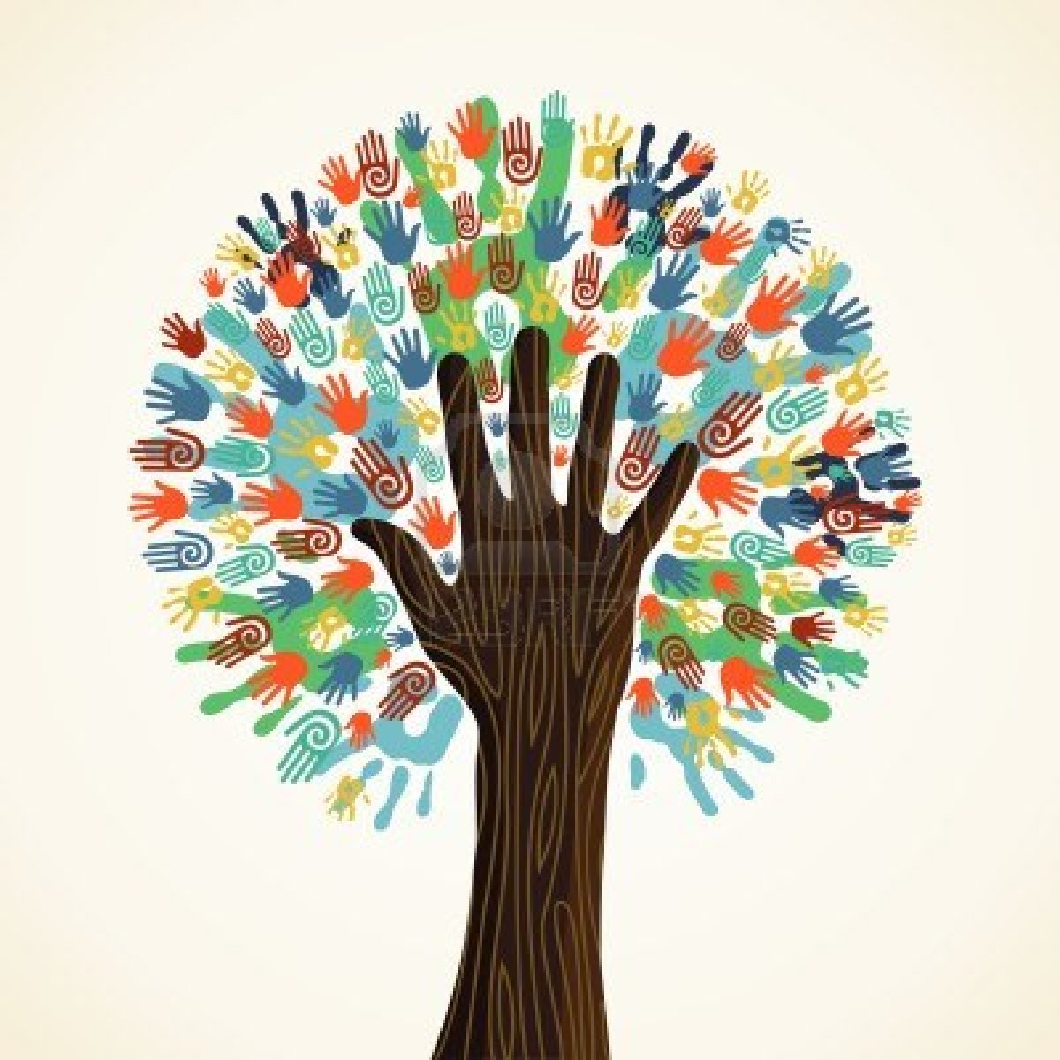
L16: The New Woman of the 1920s
The Struggle for Equality
Agenda
Objective:
To understand…
How the 1920s experienced a transformation in women’s identity under the notion of the “New Woman.”
Who the “New Woman” was and what she believed?
Schedule:
Whole class discussion
Homework:
1. Reading by Fox, Three Worlds of Relief on race and the New Deal
Yellow = Tues 3/5
Tan = Mon 3/4
Purple = Mon 3/4
Unit Test
Yellow = Thurs 3/7
Tan = Fri 3/8
Purple = Thurs 3/7

