Slide 1
L25 & L26: The Women’s Right Movement & Feminist Activism
1960s & 1970s
The Struggle for Equality
Agenda
Objective:
To understand…
The formation of the women’s rights movement and its goals, objectives, and accomplishments.
Schedule:
Video: Makers: Women who Make America
Discussion
Homework
None!

Slide 2
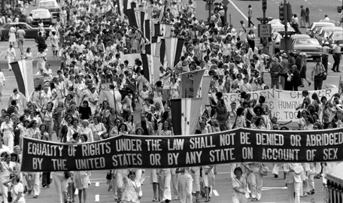
Women’s Rights Movement
1960-early 1980s
Also called:
Second Wave Feminism
Women’s Liberation
Movement
Focus:
Not focused on one issue
Not a single issue movement, instead it is designed to identify and expose a central institution of oppression in women’s lives, and then make widespread change across a range of issues in an effort to undo that source of oppression.
“The personal is political”
What do you think this means?

Slide 3
Denied Suffrage
Laws prohibiting women from divorce
Ideology of Feminine Fulfillment
Gender Gap in Pay
Gendered Division of Household labor
Patriarchy

Slide 4
Four Goals/Agendas of Second-Wave Feminism
Develop a Feminist Theory/
Social Analysis
Raise Awareness of Female Oppression Among Women
Organize
Act
Protest & Activism
Legislative Changes

Slide 5
Plan for Our Study
We are going to organize our exploration of this movement around the documentary Makers: The Women Who Made America
We will watch the documentary and pause at key junctures to explain and add context.
Slides to correspond

Slide 6
Makers Timing
Episode 1:
Start at intro text (3:50)-14:40 “dealing with race issues they were familiar with”
18:30 (creation of Now) end
Episode 2:
2:40 Battle of the Sexes to to 46:15 (rise of Reagan)

Slide 7
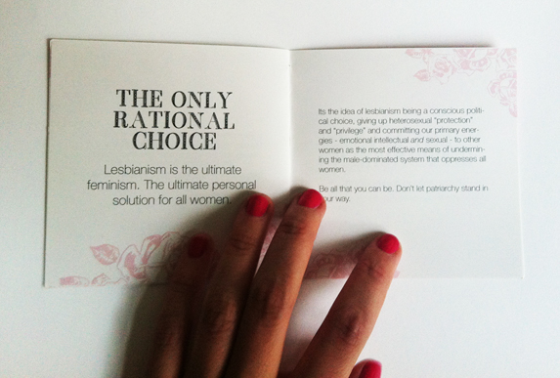
Variants of Feminist Theory
Radical Feminism
Men and women are both equal, but they are fundamentally different.
Though some, like Mary Daly, say women are superior.
Social institutions have been designed to relegate women to inferior roles and positions.
Overthrow this system by any possible means.
Key Figures
Mary Daly
Liberal Feminism (MAIN!)
Argues that all people are created equal by nature and deserve equal rights.
Equality is obscured because social institutions are designed in accordance with patriarchy.
Need to reform social institutions to make them more
equitable
Support legislation that remove barriers to equality for women.
Key Figures:
Betty Friedan
Gloria Steinem
Feminist Separatism
Heterosexuality/Heterosexual sex is a political institution through which gender oppression is maintained.
Two solutions…
Radical-Libertarian Separatism: Women should control every aspect of their sexuality—redefine sex. Advocate artificial means of reproduction so that less time is devoted to pregnancy
Lesbian-Separatism: The only way to completely escape patriarchy is for men and women to separate and practice homosexuality, allowing women to be in complete control of their sexuality.
Mary Daly taught at BC for 33 years. She retired in 1999 after violating the university’s policy by refusing to allow male students in her advanced women’s studies classes. She allowed male students in her introductory class and privately tutored those who wanted to take advance classes.

Slide 8
Act: Legislative Change
Equal Pay Act 1963
Civil Rights Act 1964
No Fault Divorce Laws 1970-2010
Marital Rape Laws 1975-1993
Title IX 1972
Pregnancy Discrimination Act 1978

Slide 9
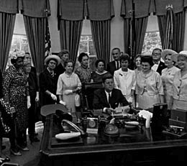
Equal Pay Act of 1963
States that no employer may pay lower wages to employees of one gender than it pays to employees of the other gender employees within the same establishment for equal work at jobs that require equal skill, effort and responsibility, and that are performed under similar working conditions.
Huge step forward for gender equity in employment
But…Does not address inter-occupational inequality for jobs that require the same skill.
Maid vs. Janitor
“Comparable Worth” Argument
Signed into law by President Kennedy

Slide 11
No-Fault Divorce
No-fault divorce is a divorce in which the dissolution of the marriage does not require proof of wrongdoing by either party.
In 1970, California became the first state to pass no-fault divorce.
In 2010, New York became the last state.

Slide 13
Illegalization of Marital Rape
Many United States rape statutes precluded the prosecution of spouses, including estranged, or even legally separated couples.
In 1975 South Dakota became the first U.S. state to remove this exception.
In 1993, North Carolina became the last state to remove the exemption.

Slide 14
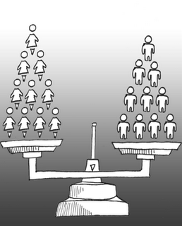
Title IX (1972)
Portion of the Education Amendments of 1972
States that:
No person in the United States shall, on the basis of sex, be excluded from participation in, be denied the benefits of, or be subjected to discrimination under any education program or activity receiving federal financial assistance...
In short, Prohibits sex discrimination in schools whether academic or athletic.
Major effects on the equal creation and funding of women’s athletics
Signed into law by President Nixon

Slide 15
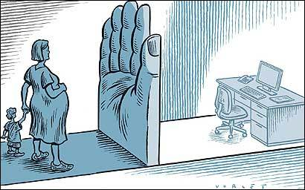
Pregnancy Discrimination Act (1978)
Prohibits sex discrimination on the basis of pregnancy.
Specifically…
Hiring
An employer cannot refuse to
hire a pregnant woman because
of her pregnancy,
Pregnancy and Maternity Leave
An employer may not single out
pregnancy-related conditions for
special procedures to determine
an employee's ability to work.
If an employee is temporarily unable
to perform her job because of her pregnancy, the employer must treat her the same as any other temporarily disabled employee.
Pregnant employees must be permitted to work as long as they are able to perform their jobs.
Employers must hold open a job for a pregnancy-related absence the same length of time jobs are held open for employees on sick or disability leave.

Slide 18
The Comstock Laws
Set of federal acts past in the 1870s that made it a crime to:
Use the U.S. Postal Service to send any of the following items, or information regarding these items, in the U.S. mail:
Obscenity
Contraceptives
Abortifacients
Sex Toys
Personal letters with sexual content or information
Sell, lend or give away any obscene publication or contraception or abortion devices
Import contraceptive information or devices

Slide 19
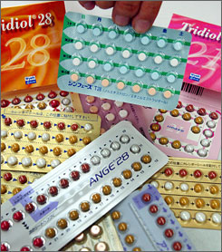
The Birth Control Pill
What is the birth control pill? How does it work?
Developed here in Massachusetts through a combination of work by reproductive physiologist Gregory Pincus and Professor of Gynecology John Rock.
Work was started through the encouragement and persuasion of Margaret Sanger
Sanger helped secured funding through philanthropist Katharine Dexter McCormick
Approved by FDA in 1957 for treatment of menstrual disorders
Contraceptives were not available to married women in all states until 1965 (Griswold vs. Connecticut)
Contraceptives were not available to unmarried women in all states until 1972 (Eisenstadt vs. Baird)

Slide 20
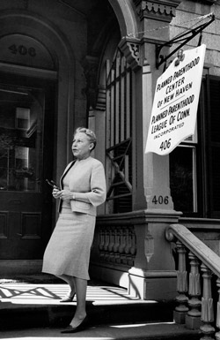
Griswold v. Connecticut (1965)
Facts:
Connecticut had a law that prohibited the use of “any drug, medicinal article or instrument for the purpose of preventing conception.”
The law was passed in 1879 and almost never enforced
Women’s rights advocates wanted to challenge the law in the Supreme Court with the hope that it would be overturned
Estelle Griswold and C. Lee Buxton opened a birth control clinic in New Haven. They were arrested, tried, found guilty, and fined $100 each.
Argument:
Griswold argued that the law violated her 14th Amendment right to liberty
Ruling:
The Court invalidated the Connecticut law 7-2, stating that it violated a woman’s constitutional right to privacy
Made contraception available to all married couples

Slide 21
The Right to Privacy
Bill of Rights does not explicitly mention “privacy”
So where does the court find a right to privacy?
The Court argued that the right was to be found in the “penumbras” and “emanations” of other constitutional protections.
Huh?
Think about car headlights at night. The beam of light that shoots out from the car is light emanating from the original source, the light bulb.
The Court argued that the Bill of Rights is similar, it lists a specific set of rights, but emanating from these rights are other, related, rights not specifically enumerated.

Slide 22
The Right to Privacy
The Court argued that the First Amendment had a penumbra that included a right to privacy.
Take a look at the first amendment. Do you see the argument for such a right?
Congress shall make no law respecting an establishment of religion, or prohibiting the free exercise thereof; or abridging the freedom of speech, or of the press; or the right of the people peaceably to assemble, and to petition the Government for a redress of grievances.

Slide 23
The Right to Privacy
Justice Douglas, writing for the majority, contended that the Bill of Right’s specific guarantees have “penumbras,” created by “emanations from these guarantees that help given them life and opinion.” In other words, the “spirit” of the First Amendment (free speech and association), Third Amendment (prohibition of the forced quartering of troops), Fourth Amendment (freedom from searches and seizures), Fifth Amendment (freedom from self-incrimination), and Ninth Amendment (non-enumerated rights), as applied against the states by the Fourteenth Amendment, creates a general “right to privacy” that cannot be unduly infringed.

Slide 24
The Right to Privacy
The Right to Privacy articulated in Griswold, goes on to form the basis of major supreme court rulings on sex and reproduction.
Roe vs. Wade (1973)
Lawrence vs. Texas (2003)

Slide 25
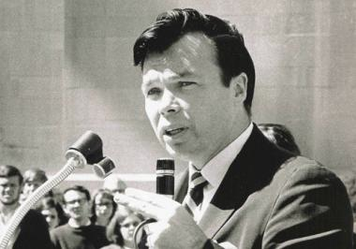
Eisenstadt Vs. Baird (1972)
Facts:
Massachusetts law prohibited the
distribution of contraceptives to
unmarried people.
William Baird was charged with a felony
for distributing contraceptive foams after
lectures on birth control and population
control at Boston University.
Test case; the violation was prearranged
Argument:
Baird argued the law was a violation of the equal protection clause of the 14th Amendment to deny unmarried couples the right to use contraception when married couples did have that right.
Ruling:
In a 6-1 decision, Court ruled that since Griswold allowed the distribution of contraception to married couples, it was discriminatory (and hence a violation of the equal protection clause) to deny contraception to unmarried couples.
Made contraception legal to all persons in the United States

Slide 26
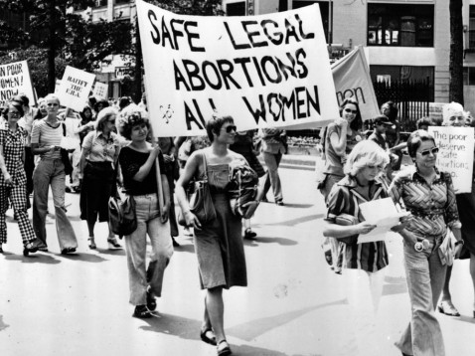
Roe vs. Wade 1973
Facts:
In 1969 Norma L. McCovery
(Jane Roe) became pregnant
for the third time. Though
she desired to end her
pregnancy, she could not attain
an abortion because it was
illegal under Texas state law.
She was referred to attorneys who
decided to use her case to argue for the unconstitutionality of laws banning abortion.
Argument:
Doe argued that the right to privacy articulated in Griswold extended to the right to have an abortion.
Ruling:
Court ruled 7-2 that the right to privacy extended to a woman’s decision to have an abortion

Slide 27
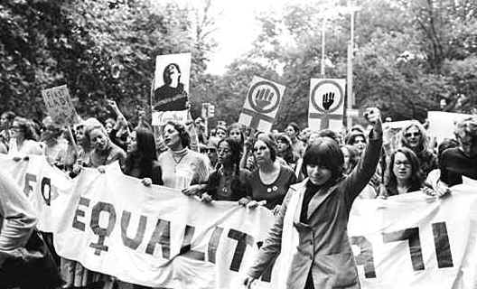
The Equal Rights Amendment (ERA)
Proposed amendment to the United States Constitution designed to guarantee equal rights for women.
TEXT:
Section 1. Equality of rights under the law shall not be denied or abridged by the United States or by any State on account of sex.
Section 2. The Congress shall have the power to enforce, by appropriate legislation, the provisions of this article.
Section 3. This amendment shall take effect two years after the date of ratification.
What does this amendment seek to do?

Slide 28
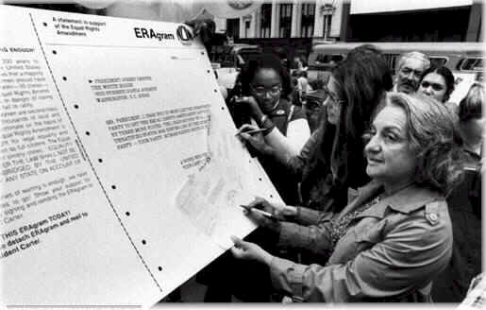
The ERA goes to the States
In 1971, the ERA
passed the House
and the Senate.
It was then
presented to state
legislatures for ratification with a seven- year deadline for ratification.
President Richard Nixon endorsed the ERA’s approval.

Slide 29
The ERA Goes to the States
Initial pace of ratification was rapid, but then slowed.
30 states ratified the ERA by 1973
3 states by 1974
1 state in 1975
0 states in 1976
1 state in 1977
In 1978, President Jimmy Carter signed a resolution extended the ratification until 1982.

Slide 30
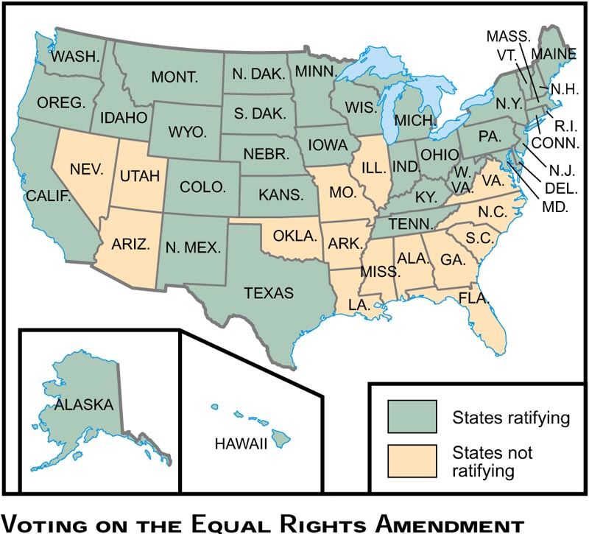

Slide 31
The ERA Fails
By the early 1980s, women had repealed oppressive laws that were based on sex, integrated the "boys' clubs" such as military academies, the United States armed forces, NASA, single-sex colleges, men’s clubs, and the Supreme Court had ruled repeatedly in favor of equal rights for women.
By 1982 (the deadline under Carter’s extension) the ERA was three state’s shy of the needed 38 states for ratification.

