Slide 1
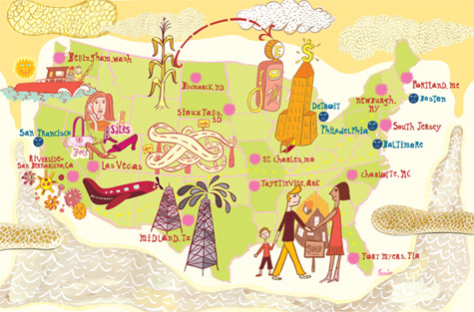
L: Economic Conflict in the Early Years of the Republic:
Small Government Agrarianism vs. Big Government Industrialism
1789-1837
An Economic History of the United States
Agenda
Objective:
To understand the nature of economic conflict in the early years of the republic.
To understand agrarianism as an economic practice and philosophy.
To understand federalism/industrialism as an economic practice and philosophy.
To understand how and why these two ideas came into conflict in the early years of America and the significance of these clashes.
Schedule:
Lecture
Homework:
Read excerpts from Foner Free Soil, Free Labor, Free Men for L2
Yellow = Mon 5/6
Tan = Fri 5/3
Purple = Mon 5/6
3. Work on Equality Unit Paper Due Fri 5/4

Slide 2
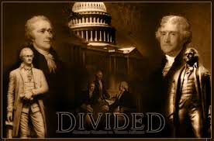
Economic Conflict in the Early Years of the Republic 1789-1837
The early years of America were characterized by considerable debate between two competing visions of America
This debate dominated these early years, and was only strengthened as the North and South continued to
develop unique economic
characteristics through the
1800s.

Slide 3
Competing Economic Ideas of the Period
 | Democrats (Agrarians/Anti-Feds) | Federalists (Industrialism)
Vision for the US Economy | Small nation of independent farmers | Major industrial and commercial global power
View of Government’s Role in the Economy | Government should only interfere to eliminate barriers to economic liberty among ordinary Americans | Government should use its power to promote industry; Government should not interfere however with business contracts and transactions
Region who Endorses | South and West | Northeast
Associated Political Parties | Democratic-Republicans Democrats | Federalists Whigs (Republicans)
Key Figures | Thomas Jefferson James Madison Andrew Jackson | Alexander Hamilton John Adams John Marshall

Slide 4
The Debate Begins 1789-1801
Federalists Take Power
Hamiltonian Economic Policy Established
Republican Opposition Builds

Slide 5
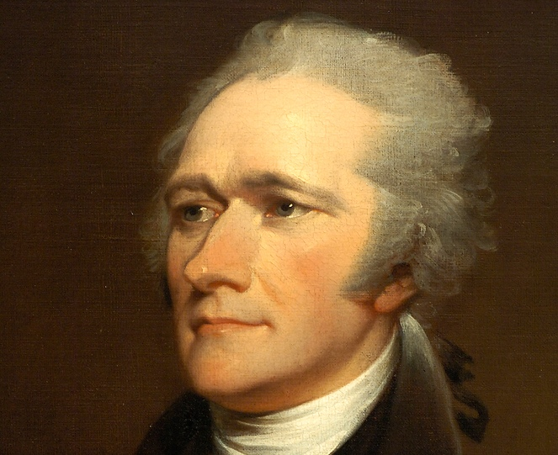
Federalists Take Power 1789-1801
Under the Presidency of George Washington and then John Adams, the U.S. was ruled by Federalists for the first 12 years of its founding.
This “luck” went far to establish a precedence for how the American economy should be structured and what the role of the federal government in the economy should be
Architect of the U.S. economy during this period: Alexander Hamilton (Secretary of the Treasury under Washington)

Slide 6
Hamilton’s Economic Vision
Offered a vision of the sort of nation America should become—a nation with a wealthy, enlightened ruling class, a vigorous, independent commercial economy, and a thriving industrial sector; a nation able to play a prominent role in world economic affairs

Slide 7
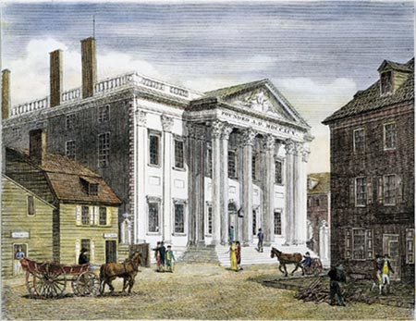
Hamiltonian Economic Policy: The National Bank
Hamilton wanted to create a national bank.
Bank would be a chartered corporation (the weird public/private entity of the pre-capitalist world)
What Would the Bank Do?
Would have a monopoly on the government’s banking business
Would give the government a safe place to deposit federal funds
Help collect taxes and disburse the governments expenditures

Slide 8
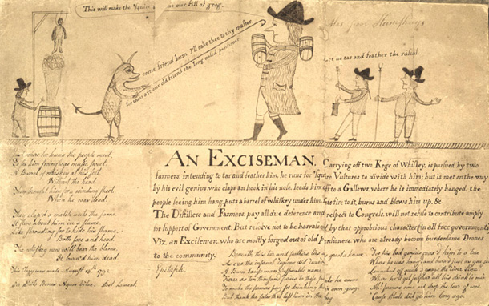
Hamiltonian Economic Policy Debt & New Taxes
Wanted the federal government to
take ownership of existing
Revolutionary War debt which was
now held in the hands of private
(and wealthy) speculators.
US would fund this debt and raise
money through the selling of bonds.
Proposed the creation of two new taxes to fund this debt:
Excise tax to be paid by the distillers of alcoholic liquors
Would fall most heavily on the whiskey distillers of the backcountry, especially in Pennsylvania, Virginia, and North Carolina—small farmers who converted part of their corn and rye crop into whiskey
Import Tariff
Would raise revenue but also protect American manufacturing from foreign competition
In his “Report on Manufactures” of 1791, Hamilton envisioned a grand scheme for stimulating the growth of industry in the United States.

Slide 9
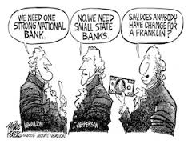
Anti-Federalist Response to Hamiltonian Economics
Big issues with the bank
Argued that because the Constitution did not explicitly call for the creation of a national bank it was not Constitutional
Argued that Congress should exercise no powers that the Constitution had not clearly assigned it.
Hamilton, argued that the creation of the national bank was compatible with the intent of the Constitution
“Implied Power Clause” (AKA elastic clause OR necessary and proper clause; Article 1 Section 8)
Remember: Washington,
Hamilton, Jefferson, and
Madison were all involved in
writing the Constitution—Vague
language at its best!

Slide 10
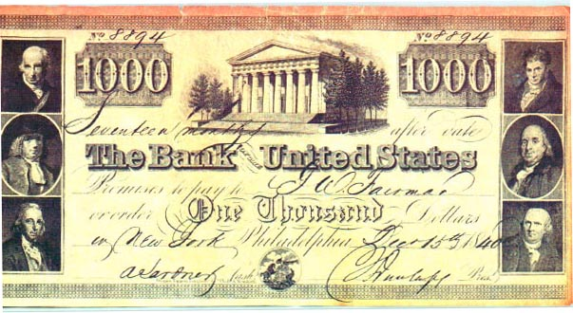
The Bank of the United States Begins Operations
Bank of the United States begins operations in 1791, with a charter that allowed it to run for 20 years
Despite Republican objections, both the House and Senate finally agreed to Hamilton’s proposal
Once established, the Bank had an immediate economic effect on the U.S.:
Restored public credit
Bonds were selling at home and abroad at prices above their face value
Manufacturers profited
from the tariffs

Slide 11
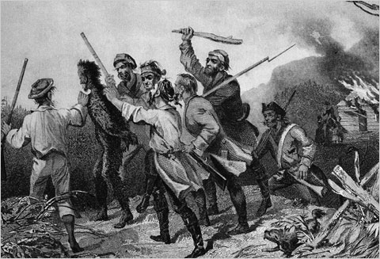
Opposition to Federal Economic Policy Continues to Grow
Small farmers, who formed the vast majority of the population, complained that they had to bear a disproportionate tax burden.
Not only did they have to pay property tax to their state governments, but they bore the brunt of the excise tax.
Many Americans came to believe that the Federalist program served the interests of the small, wealthy elites
Whiskey Rebellion 1791
Tax insurrection among Western Pennsylvania farmers in opposition to the excise tax

Slide 12
Agrarian Supporters Take Power: Jefferson (Democratic-Republican) - Jackson (Democrat) 1801-1837
Jefferson Reverses Hamiltonian Economics
Northern Industry Continues to Grow and Develop
The Cotton Gin Strengthens Agriculture in the South
Chief Justice Marshall Keeps the Federalist Flame Alive
Jackson Vetoes the Bank and Gives Federalism Its First Defeat

Slide 13
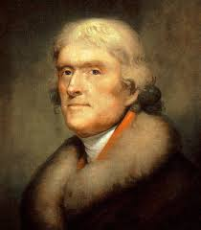
Republicans Take Power 1801 Jefferson Reverses Hamiltonian Economics
Jefferson comes to office in 1801
Wants to develop the agrarian character of America
Jefferson administration moves deliberately to reverse Hamilton’s economic programs.
Abolished all internal taxes, leaving only custom duties and sale of Western lands as sources of revenue
Reduced government spending by cutting the staff of executive departments
Halved the national debt

Slide 14
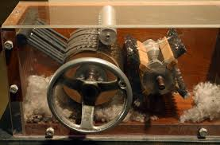
But Industrial Development Continues in the Private Sector
Various technological innovations occur, however, that push the nation forward to industrialization
Spinning Mill
Slater memorized plans from a British mill and built the first “factory” in Pawtucket, RI in 1790
Mechanized Flour Mill 1795
Cotton Gin 1793
Eli Whitney
Machine that would separate the sticky cotton seed from the fiber
With the device, a single operator
could clean as much cotton in a few
hours as a group of workers had
once needed a whole day to do.
Revolutionized the southern cotton
industry

Slide 15
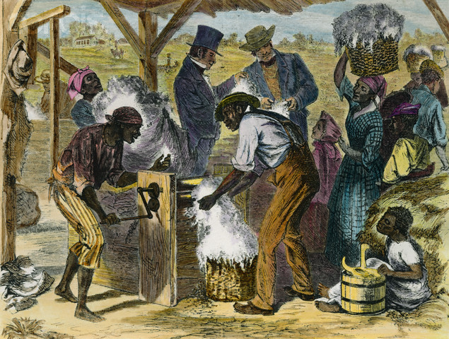
Cotton Gin Entrenches Slavery in the South
The invention of the cotton gin caused massive growth in the production of cotton in the United States
1830: 750,000 bales
1850: 2.85 million bales
The south became even more dependent on slavery, with agriculture becoming the largest sector of the Southern economy.
The number of slaves increased in proportion to increases in cotton production
1790: 700,000
1850: 3.2 million
The large supply of domestically produced fiber incentivized the development of American textile industries in the north.
By 1860, Southern states were providing 2/3rd of the world’s supply of cotton.

Slide 16
The Cotton Gin Increases the Agrarian/Industrial Divide
The invention of the cotton gin, and its effect on cotton growing, injected a declining agrarian south with new vibrancy
Gives new, legitimate claims to developing an agrarian future for the United States, when it looked like it had started to decline by the early 1800s.
America seemed to be divided into two regions--one becoming increasingly industrial, the other more firmly wedded to agriculture--each supporting its own unique political-economic philosophy.

Slide 17
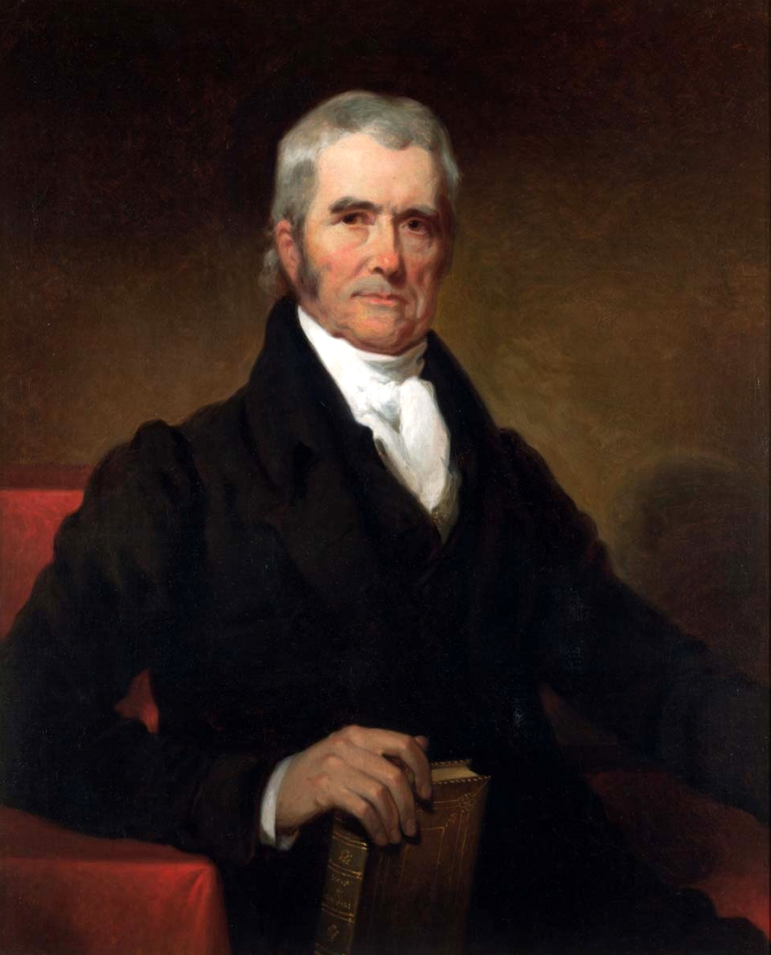
The Marshall Court Keeps the Flame of Federalism Going
John Marshall served as chief justice from 1801 to 1835
Last minute appointee of Federalist John Adams during Adams last few months in office
Stalwart advocate of Federalism and nemesis of Jeffersonian school of government throughout his tenure
Pushes the Federalist vision through the government at a time with the Presidents are trying push through an agrarian vision
Marshall’s tenure is significant for three reasons:
Strengthened the judicial branch at the expense of the executive and legislative branch (Marbury v. Madison 1803) ✔
Increased the power of the federal government at the expense of the sates (McCulloch v. Maryland 1819) ✔
Advanced the interests of the propertied and commercial class

Slide 18
Key Marshall Rulings the Promote Business & Commerce Unfettered by Government Intervention (Federalist Idea)
Fletcher v. Peck (1810)
Government land grants were valid contracts that could not be repealed
Dartmouth College v. Woodward (1819)
Charters were contracts which could not be invalidated by states
Further expanded the meaning of the contract clause of the Constitution
Article I, section 10, clause 1. It states: No State shall enter into any Treaty, Alliance, or Confederation; grant Letters of Marque and Reprisal; coin Money; emit Bills of Credit; make any Thing but gold and silver Coin a Tender in Payment of Debts; pass any Bill of Attainder, ex post facto Law, or Law impairing the Obligation of Contracts, or grant any Title of Nobility.
McCulloch v. Maryland (1819)
Confirmed Hamilton’s “implied powers” interpretation of Congressional powers by upholding the Constitutionality of the Bank of the United States
Gibbons v. Ogden (1824)
Court strengthened Congress’ power to regulate interstate commerce

Slide 19
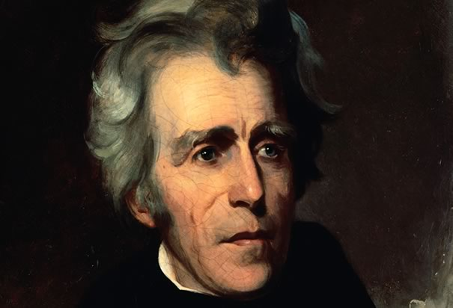
Andrew Jackson Plans a Final Blow to Hamiltonian Economics
Jackson opposed concentrating power either in the federal government or in powerful business and, in his view, aristocratic institutions associated with it.
Jackson’s opposition to federal power and aristocratic privilege lay behind his war against the Bank of the United States

Slide 20
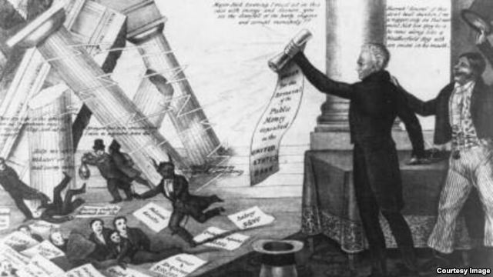
Jackson Destroys the Bank 1832
By 1830 the Bank of the United States was a mighty institution.
Stately headquarters in Philadelphia
29 branches in different cities
Was the only pace that the federal government could deposit its own funds
When the Bank’s charter came up for reauthorization in 1832, Jackson vetoed it.
A Congressional debate ensued over whether
or not to override Jackson’s veto
In the meantime, before the bank could be
eliminated Jackson worked hard to weaken it
Removed the government's deposits from the
Bank and put them in various state banks
In response, Nicholas Biddle (The President of the Bank) retaliated by calling in loans and raising interest rates, hoping to ignite a short recession that would persuade Congress to recharter the bank
Ultimately Biddle’s actions, turned the people against the Bank and Congress did not act to override Jackson’s veto
The National Bank was extinguished in 1836.

Slide 21
A House Divided

Slide 22
By 1840 We Are a Divided Nation: Economic Practice
South
Firmly entrenched, deeply profitable cotton-growing agricultural economy that relies centrally on slavery as an institution
North
Industrial, factory-based economy that relies on free labor

Slide 23
By 1840 we are a Divided Nation: Political View of Economy
Democrats
Steadily expand economic and political opportunities for white males
Endorsed an agrarian view of America
The role of government in the economy should be limited
Though, the government should work against aristocratic privilege would stifles the opportunity of the common man
Members tended to be from the South and West
Whigs/Republicans
Favored expanding the power of the federal government in the economy
Encouraged industrial and commercial development
Wanted to unite the country under the growing industrial economy
Their vision was a nation embracing the industrial future and rising to world greatness as a commercial and manufacturing power.
Members tended to be from the Northeast

