Slide 1
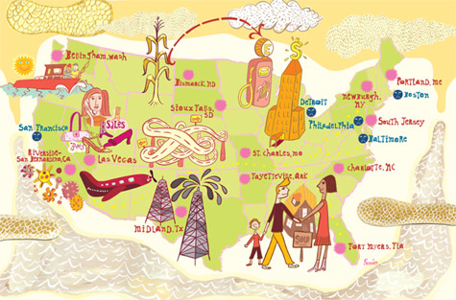
L2: Economic Causes of the Civil War
1800-1861
An Economic History of the United States
Agenda
Objective:
To be able to describe the economy of the pre-Civil War South.
To be able to describe economic stratification in the pre-Civil War South.
To be able to understand the centrality of free labor labor in North.
To explore how some of the economic divergences between the south and north laid a foundation for Civil War.
Schedule:
Whole Class Discussion
Homework:
1. Work on Paper Due by Wed 5/22

