Slide 1
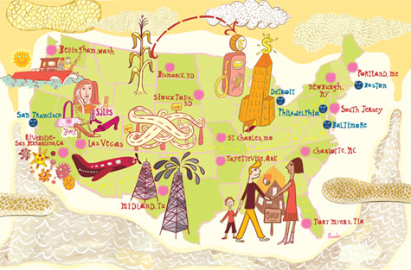
L7: The Great Depression 1929-1930s
An Economic History of the United States
Agenda
Objective:
To understand economic life in the 1920s and how it contributed to the Great Depression.
To understand the experience of the Great Depression and its effects.
To understand Hoover’s response to the Great Depression
Schedule:
Lecture and Discussion
Homework:
Work on Equality Unit Paper Due Wed 5/22!

Slide 2
Defining the Great Depression

Slide 3
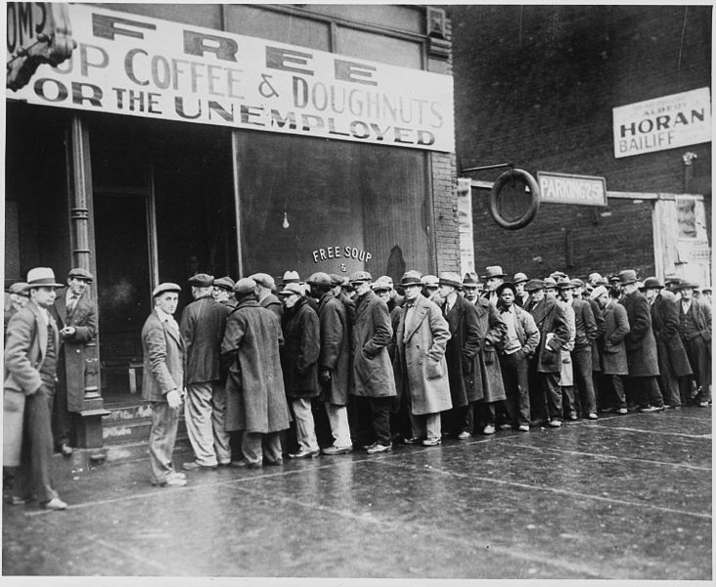
The Great Depression
1929-late 1930s
Worldwide economic collapse in which unemployment and homelessness skyrocketed, government revenue and international trade
plummeted, the stock
market lost significant
value, and banks
closed.

Slide 4
Causes of the Great Depression

Slide 5
Consumer Debt
Overproduction
Federal Reserve Policies
Causes of the Great Depression
Stock Market
Bank Failures
Pres. Herbert Hoover’s
Political Decisions

Slide 6
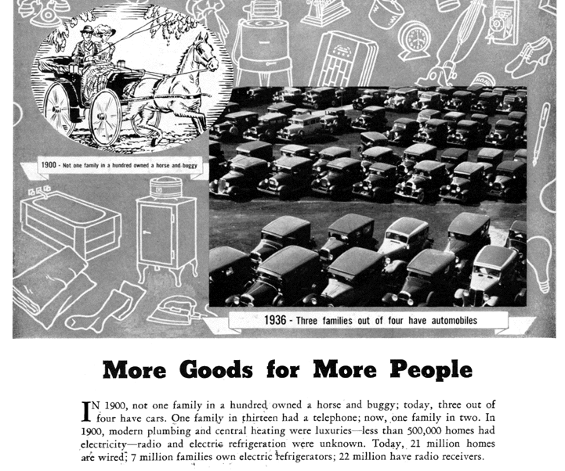
1. Overproduction
The 1920s saw the development of many consumer goods, such as electric appliances, radios and automobiles.
In order to sell these mass produced goods, the 1920s also saw the rise of mass advertising and the notion of mass consumption.
This led to a high demand for such goods, so companies began to produce more and more, in order to meet that demand.
Eventually business produced more than consumers could purchase. You can only own so many radios, cars, and appliances.

Slide 7
Implications of Overproduction for the Great Depression
Supply was greater than demand
Declining prices means declining profits
Declining profits means stock values (for corporations) begin to fall.
A surplus of goods in the market begins to drive prices down

Slide 8
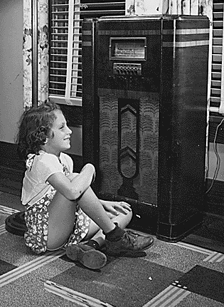
2. Consumer Debt
Advertising encouraged the poor and middle class, not just the wealthy, to possess luxury items, such as cars and radios.
But, wages were not keeping up with the prices.
One solution was to let products be purchased on credit -- “buy now and pay later.”
By the end of the 1920s, 60% of the cars and 80% of the radios were bought on installment credit.
What potential problems is this creating that could lead to an economic depression?

Slide 9
3. Federal Reserve Policies

Slide 10
The Federal Reserve Policies
To stimulate economic growth the Fed lowered interest rates
Lowering the interest rates encouraged buying on credit, why?
Eventually so many people were buying on credit that inflation increased.
By 1929 the Fed decided to slow
inflation by increasing interest rates.
Raising interest rates means that it
cost more to borrow and raises the
price of existing debt set at an
adjustable rate.
People borrowed less and purchased
fewer goods.
They also started using available cash
to pay off debt and therefore
purchased fewer goods.
Less demand + surplus goods →
declining profits → declining stock prices →
rising unemployment

Slide 11
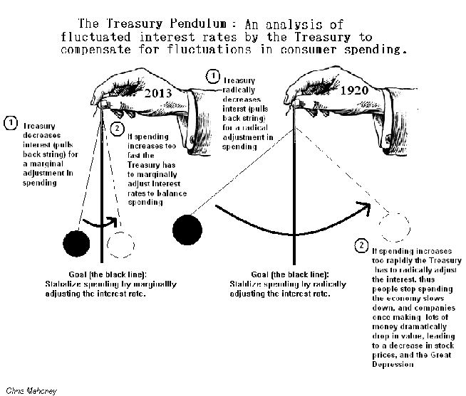

Slide 12
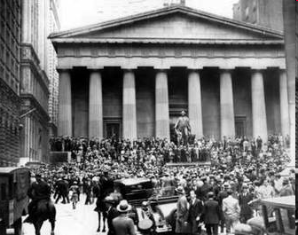
4. Stock Market Actions

Slide 13
The Stock Market
The value of stocks soared in the 1920s as corporate profits rose, fueled by mass consumption (which were in turn fueled by credit which meant that this profit was illusory)
Once a rich man’s game, everyone was in the market in the 1920s because stocks could be purchased “on margin”
Buying on margin
Purchasing stocks with a “down payment” rather than paying the entire purchase price up front.
Idea would be that you would pay back the full value once the stock appreciated.
Speculators expect the value of the stock to go up in price enough (at least 90% to break even) covering the balance.
The Margin Requirement in 1926 was 10%. So a $100 share of stock could be yours with only a $10 down payment
Buying on margin encouraged thousands of small time, new (inexperienced) investors to purchase stocks
As long as corporations were selling goods and turning a profit stock prices rose and buying on the margin was safe.

Slide 14
Stock Market: Banks & Margins
In 1927 banks did two things to further weaken the precariousness of buying on margin
1) Banks began letting customers borrow money to buy stocks and used the customers stock holdings as collateral for the loan. They gave money to people with no money to gamble
2) Banks started to use depositors money to speculate in the stock market. Normally banks pay you interest for savings. Then they loan it to businesses or families that were good risks to buy homes or start companies etc.
Not speculate in the market!
By 1929, banks had made billions of dollars in risky loans with little collateral to back them up if borrowers defaulted

Slide 15
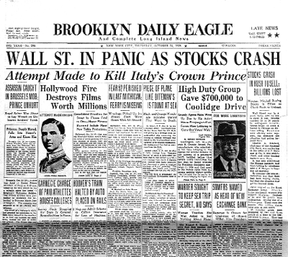
Stock Market Crash
Black Tuesday, October 29th 1929.
The market bubble bursts with a panic sell off of 16 million shares of stock.
Investors lose $26 billion ($312 billion in 2010)
It is impossible to know exactly what caused the initial panic but the market crash exposed the other problems in the economy setting into motion a deep lack of confidence in the economy.

Slide 16
Stock Market Boom and Bust
S&P Composite Index

Slide 17
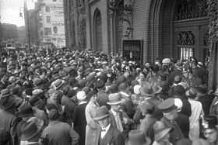
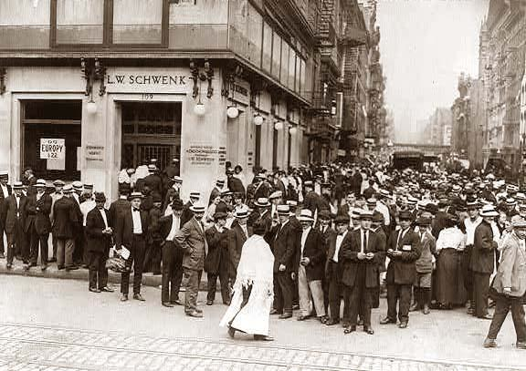
5. Bank Failures
Run on the Banks
With the loss of confidence in stocks, people began to lose confidence in the security of their money being held in banks.
Customers raced to their banks to withdraw their savings.
Customers closed accounts and banks were left without cash reserves putting them on the brink of failure.
But the banks don’t have enough money to cash everyone out…
In 1927, the Fed lowered the reserve requirement for banks, so the banks did not have the cash to cover customer withdrawals.
Some people lost all of their savings
Banks started to close, increasing the panic.
1930, 60 banks fail every month, by 1933 over 9,000 banks fail (40% of the 1929 total)
Federal reserve failed to act as a lender of last resort

Slide 18
Bank Failures (Cont.)
Less money → less consumption → less production
Businesses go bankrupt
People get laid off
Thus the economy begins an irreversible downward spiral.
Banks close and large amounts of money disappear from the economy
By 1931, GNP falls by 18%, unemployment reaches 16% (8 million)

Slide 19
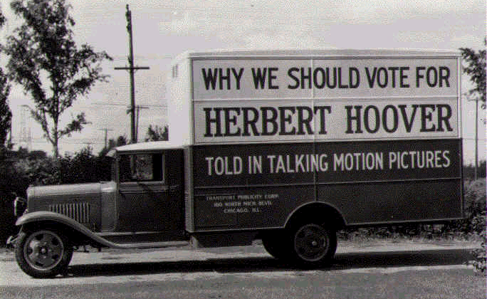
6. President Herbert Hoover’s Political Decisions

Slide 20
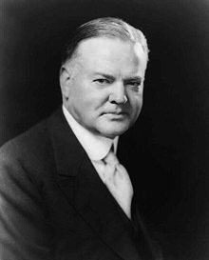
Herbert Hoover’s Political Decisions
Hoover and his administration strictly adhered to a laissez-faire economic policy
“The sole function of the government is to bring about a condition of affairs favorable to the beneficial development of private enterprise.” ~ President Herbert Hoover (1930)
“The Fed will stand by as the market works itself out: Liquidate labor, liquidate stocks, liquidate real estate… values will be adjusted, and enterprising people will pick up the wreck from less-competent people."
~ Andrew Mellon, Secretary of the Treasury (1930)
Believed that private charities, churches, state and local governments, not the Federal Government, should provide relief to the poor.

Slide 21
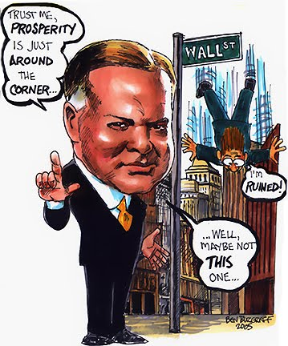
To Stabilize the Economy Hoover Promotes “Voluntary Cooperation”
Hoover promoted “voluntary cooperation” between government and business instead of coercive policies.
Encouraged, but didn’t compel businesses to take measures to ease the Depression.
For example…
Asked business leaders to hold wages steady even though profits were falling
Asked banks to make low interest loans.

Slide 22
Hoover’s Attempts to Make the Depression Better, Actually Make it Worse…
Other actions taken by Hoover to help the Great Depression actually make it worse:
Smoot-Hawley Tariff 1930
Raised tariffs by 50% believing would make imports too expensive and Americans would buy American goods, increasing demand
European countries retaliated with their own tariffs and U.S. exports fell by almost 70%
The trade war cost American farmers 1/3 of their market causing agricultural prices to fall and putting more farmers into bankruptcy.
Tariffs damaged an already shaky economy in Germany which began to default on reparations payments to England and France required by the Versailles Treaty, leading France and England fall behind in their payments on loans from U.S. banks
The Revenue Act of 1932
Increase taxes on corporations and all individuals bring more money into the treasury
Problem?
Balancing the Budget 1932
Since nothing seemed to help the economy, Hoover and Congress decided to balance the Federal budget, by cutting spending
Problem?

Slide 23
Effects

Slide 24
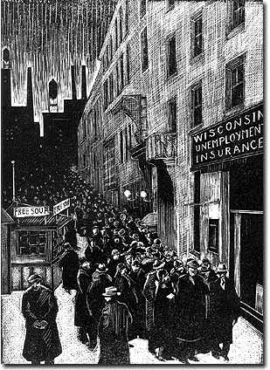
How Great was the Great Depression?
Real output (GDP) fell 29% from 1929 to 1933.
Unemployment increased to 25% of labor force.
Consumer prices fell 25%; wholesale prices 32%.
Some 9000 banks failed.

Slide 25
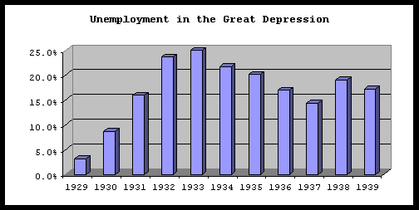

Slide 26
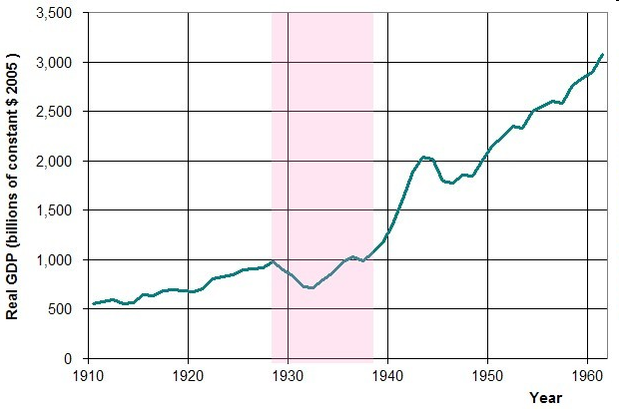

Slide 27
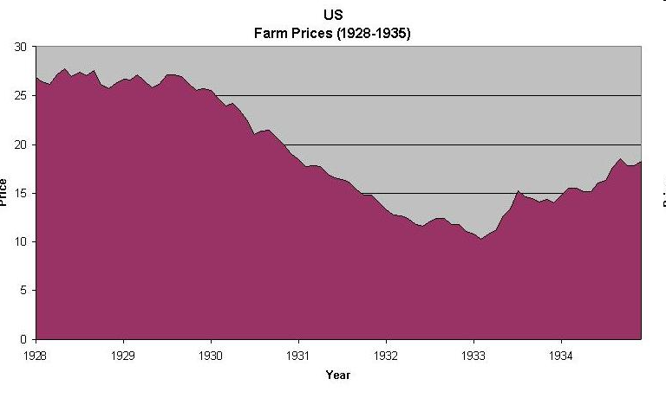

Slide 29
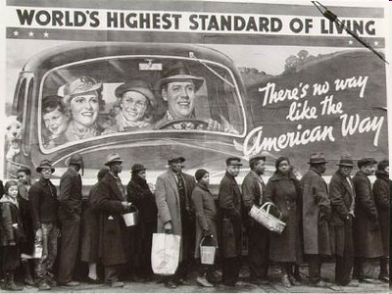

Slide 30
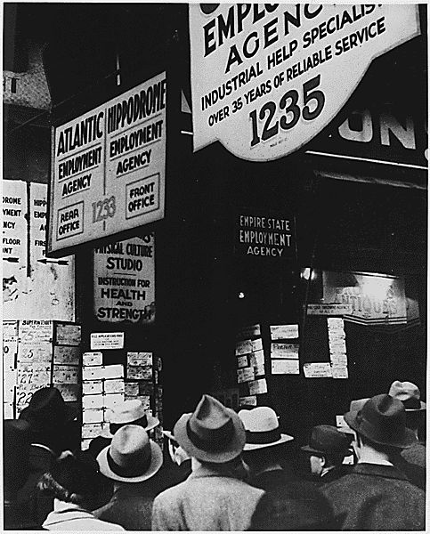

Slide 31
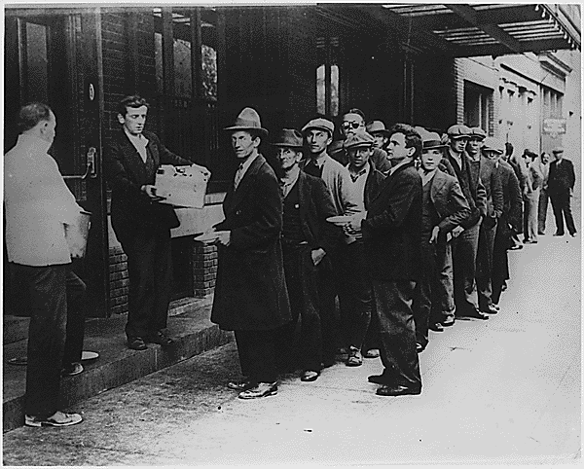

Slide 32
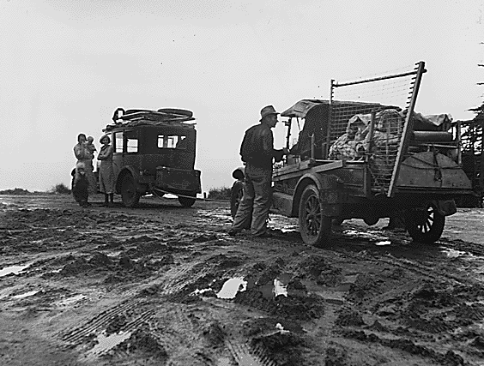

Slide 33
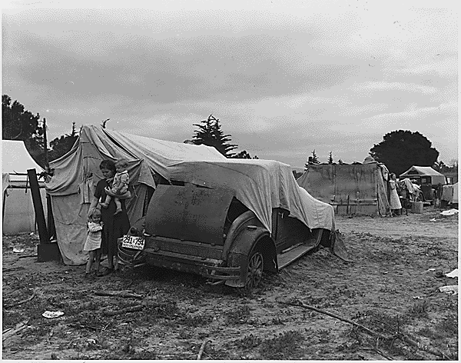
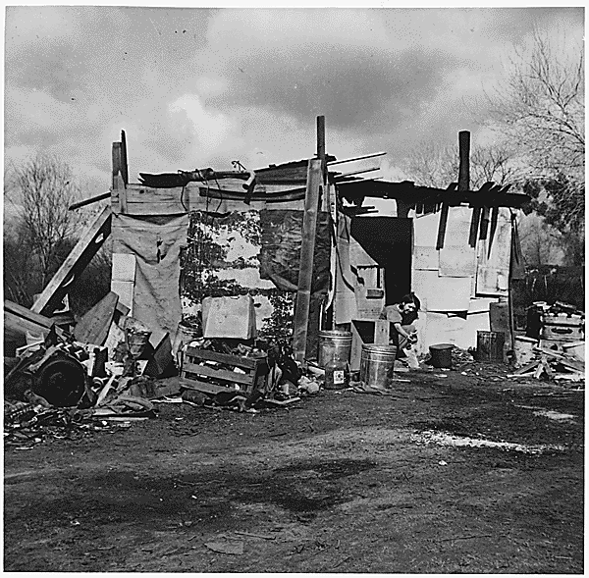
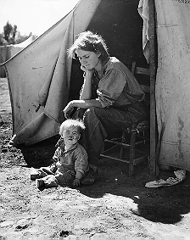
“Hoovervilles”
Some families were forced to live in shanty towns
A grouping of shacks and tents in vacant lots
They were referred to as “Hooverville” because of President Hoover’s lack of help during the depression.

