Slide 1
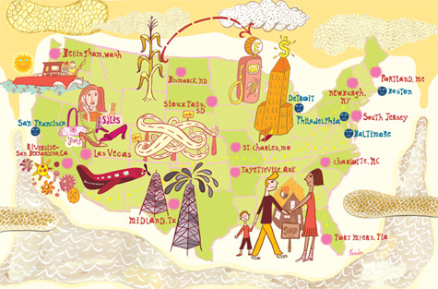
L9: Lyndon Johnson and the War on Poverty 1964-1968
An Economic History of the United States
Agenda
Objective:
To understand the main tenants of the War on Poverty
To engage in a discussion of the significance of the War on Poverty for the economic history of the United States.
Schedule:
Summary
Discussion
Homework:
Equality Unit Paper Due Wed 5/22
Begin working on Final Experience, First Check in due after Memorial Day!
Yellow =Wed 5/29
Tan =Tues 5/28
Purple = Tues 5/28

Slide 2
Economy of the 1950s
Tremendous Economic Prosperity
Why?
GI Bill (Servicemen’s Readjustment Act 1944)
Provided WWII vets with:
College or vocational education
One year of unemployment compensation
Loans to buy a home
In Levittown, Houses could be bought for $7,990 ($78,800) or $60/month ($592) with no down payment.
Loans to start a business
MAJOR economic opportunity for whites!
Massive 2nd wave of consumerism
TVs, Cars, Appliances
Knowledge Economy Emerges
Cold-War scientific developments
Opportunities closed to women and
non-whites

Slide 3
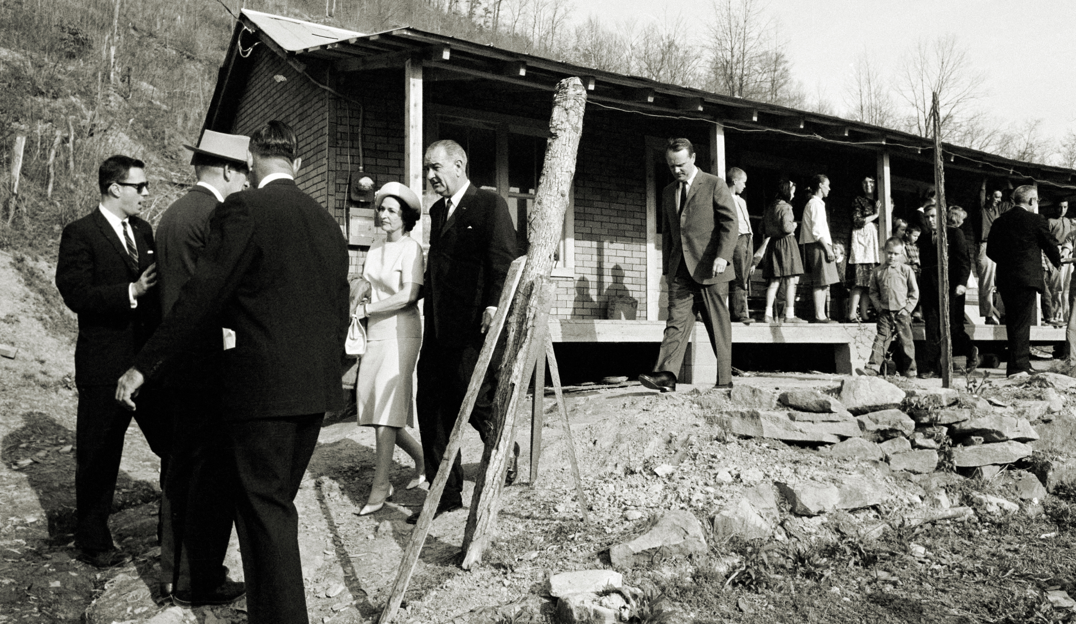
Poverty In America 1950-1964
While most Americans had been celebrating their rising affluence during the post war era, more than 40 million out of 186 million Americans were mired in poverty.
Going into the 1960s, the national poverty rate was around 20%
In 1962, Michael Harrington wrote The Other America and issues of poverty
in America began
getting attention.

Slide 4
Lyndon Johnson and the Great Society
Into this context Johnson becomes President in 1963 and makes the center point of his presidency the promotion of the “Great Society”
“The Great Society rests on abundance and liberty for all. It demands an end to poverty and racial injustice, to which we are totally committed in our time.”
An aspect of the Great Society, is his plan to end poverty in American: The War on Poverty

Slide 5
Johnson’s State of the Union Address 1964
“Unfortunately, many Americans live on the outskirts of hope—some because of their poverty and some because of their color, and all too many because of both. Our task is to help replace their despair with opportunity. This administration today, here and now, declares unconditional war on poverty in America. I urge this Congress and all Americans to join with me in that effort…Let me make one principle of this administration abundantly clear: All of these increased opportunities—in employment, in education, in housing, and in every field—must be open to Americans of every color.”

Slide 7
Effects
In the decades following the war on poverty, poverty rates in the U.S. dropped to their lowest level since 1958 (when they began recording such information).
From 17.3% in 1964 to 11.1% in 1973
Since 1973, the poverty rate has remained between 11% and 15.2%
12.3% in 2017

Slide 8
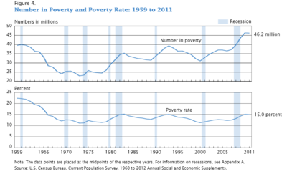

Slide 9
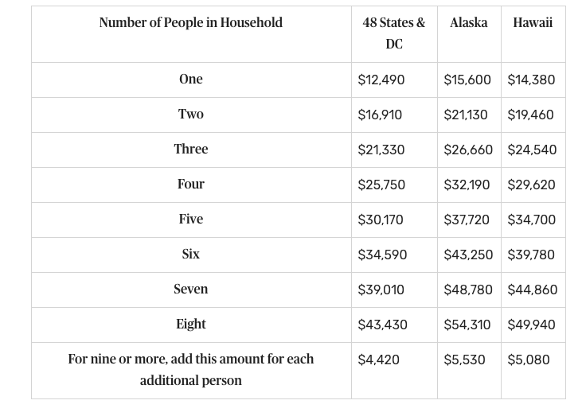
Poverty Levels 2019

Slide 10
Programs that Use the Poverty Level to Determine Eligibility
The Supplemental Nutrition Assistance Program is available to those who earn 130 percent of the federal poverty level. Households must also have less than $3,500 in assets with an elderly or disabled person, or $2,250 or less in households without an elderly or disabled member.
Medicaid is available to families whose income is 138 percent of the poverty level. The Affordable Care Act provides insurance subsidies for households between 138 percent and 400 percent of the poverty level.
Other programs include Head Start, the National School Lunch Program, the Low-Income Home Energy Assistance Program, and the Children’s Health Insurance Program.
Federal programs that hand out cash don't use the poverty guidelines. These programs include Temporary Assistance for Needy Families, the Earned Income Tax Credit, and Supplemental Social Security Income

Slide 11
War on Poverty Discussion
What does LBJ believe is the cause of poverty? How is this different from how people thought of poverty in the past?
How was the War on Poverty (and the Great Society more broadly) an extension of the New Deal?
What new variable did it add to liberal Americans’ understanding of what was required to provide economic security?
Does Johnson reject individualism?

