Slide 1
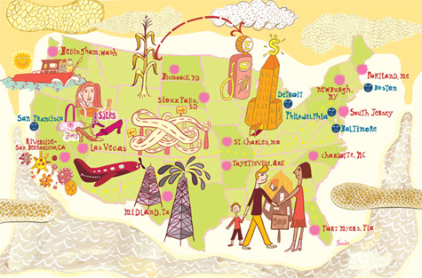
L10: Nixon, Reagan, and the Conservative Resurgence 1968-1988
An Economic History of the United States
Agenda
Objective:
To understand the conservative economic policies of the 1970s and 1980s.
To evaluate this policies as a backlash to the War on Poverty.
To evaluate the legacy of these policies.
Schedule:
Lecture & Discussion
Homework:
Begin working on Final Experience, First Check in due after Memorial Day!
Yellow =Wed 5/29
Tan =Tues 5/28
Purple = Tues 5/28

Slide 2
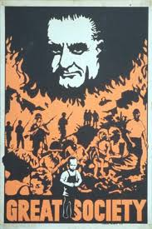
Conservative Critiques of The Great Society
The liberal shifts (political, economic, and social) of the 1960s led some Americans to believe that America was in the throes of revolutionary change.
They criticized the Johnson administration and democrats for…
Creating a pattern of “government dependency”
Giving too many rights to “deviant groups”
Blacks, women, gays, hippies
Success of segregationist George Wallace demonstrates this sentiment…
Giving government money to deviant groups
Creating huge national debt to fund these unnecessary programs

Slide 3
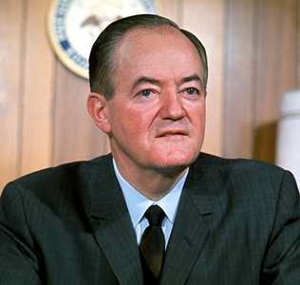
Election of 1968
Democrats: Hubert Humphrey
Johnson decides not to run for re-election
Humphrey was Johnson’s VP
Challenged for the nomination by Robert F. Kennedy (who was seen as more liberal, more youthful)
Kennedy shot by Sirhan Sirhan during the primary campaign
Republicans: Richard Nixon
Had been Vice President under Eisenhower
Ran for President in 1960, but was defeated by JFK

Slide 4
Nixon and the Silent Majority
Nixon ran for president by appealing to what he called the “Silent Majority” of Americans.
Americans who were white, middle class, did not oppose the Vietnam War, were not in favor of expanded Civil Rights, and did not support government spending
To these Americans he promised stability, law and order, a reduction in government spending and programs, and “peace with honor” in Vietnam.

Slide 5
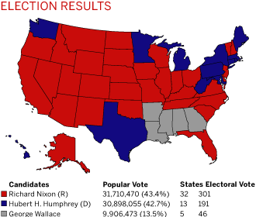

Slide 6
Nixon Begins Cutting and Hollowing the Government
Many of Nixon’s policies were designed in response to what he believed were the demands middle class conservative Americans to end the era of government funded “special privileges” for “deviant” groups.
Early actions…
Blocked the Department of Health, Education, and Welfare from cutting off federal funds from school districts that failed to integrate
Abolished the Office of Economic Opportunity, the centerpiece of the war on poverty
Many of the agencies that remained were “hollowed out”
But, not all of Nixon’s actions were conservative.
Proposed replacing welfare with a program that would have created a guaranteed annual income for all Americans

Slide 7
Economic Crises of the 1970s
Soon after Nixon won re-election in 1972, three problems started to plague the US economy
Inflation
Inflation: Sustained increase in the prices of goods
The greatest cause was the increasing cost of energy!
Unemployment
Loss of Manufacturing Jobs
Caused by competition from abroad (ex. Japan) and outsourcing
Inequality
People in the top income brackets saw their incomes increase while people in the bottom income brackets saw their incomes decline

Slide 8
Stagflation
The US began to settle into a period of stagflation (a combination of high inflation, high unemployment, stagnant demand).
Nixon’s response:
Interest rate manipulation
Hollowing out of the
Department of Energy
to manage the oil crisis
in the private sector
Wage and price freezes
Largely not effective

Slide 9
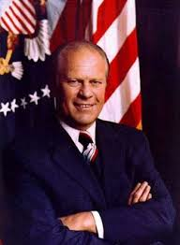
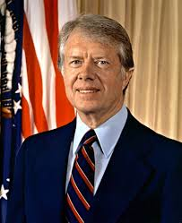
Nixon resigns
In 1974, Nixon resigned over the Watergate scandal
Vice President Gerald Ford assumes the office of the Presidency 1974-1976
Democrat Jimmy Carter defeats Ford in 1976-1980

Slide 10
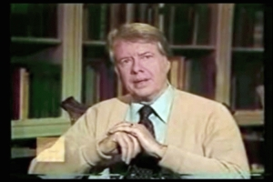
The Carter Presidency
“Malaise Speech”
Bleak assessment of the national condition
If you are cold, put on a sweater…

Slide 11
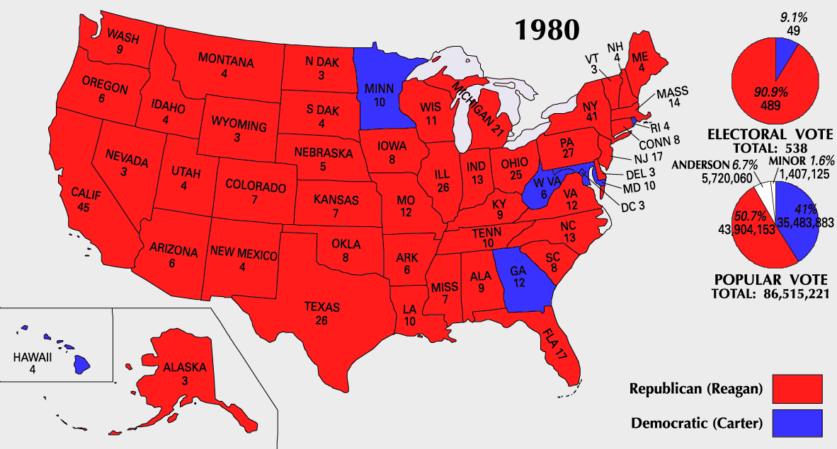
Election of 1980

Slide 12
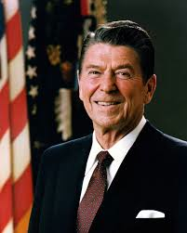
Ronald Reagan
1911-2004
Actor
Governor of California
President from 1980-1988
Launched “The Reagan Revolution”

Slide 13
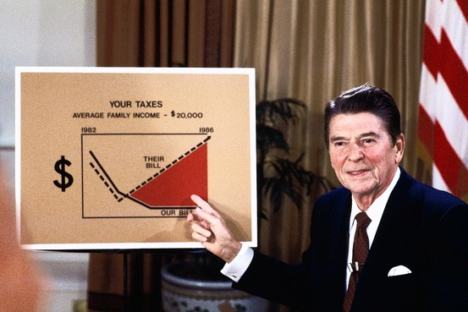
Reaganomics
AKA: Supply-Side Economics or Trickle-Down Economics
Operated from the
assumption that
America’s economic
problem’s were the
result of excessive
taxes which took money
that could be used by
businesses and investors
to stimulate the economy
out of the economy.
Solution…Reduce taxes, slash government spending, and control inflation in order to free up money for wealthy Americans and corporations to spend

Slide 14
Reaganomics
Reduce Government Spending
Reduced Marginal Tax Rates
Reduce Government Regulations
Control the Money Supply to Reduce Inflation
5. (Increase defense spending)
Reduce government Spending
Reduce Marginal Tax Rates
Control $ supply to reduce inflation
Reduce govt. Regulation of Economy
Increase Defense Spending

Slide 15
Reaganomics
Reduce Government Spending
Cuts programs that benefit poor, urban population
Food stamps, subsidies for low-interest housing, reduction in student loans, federal subsidies for school lunches
Reduce Marginal Tax Rates
Income tax rates drop from 70% to 28% for highest earners (over a 7 year period)
Trickle-Down Economics
Reduce Government Regulations
Deregulates corporations
Less industry regulation
Increases competition, results in lower prices
Deregulates the environment
Cuts budget of Environmental Protection Agency
Tells Interior Department to permit more oil drilling, lumbering, coal mining, and to sell millions of acres of public lands
Increase Defense Spending
Defense budget almost doubles (paid for by cutting social programs)

Slide 16
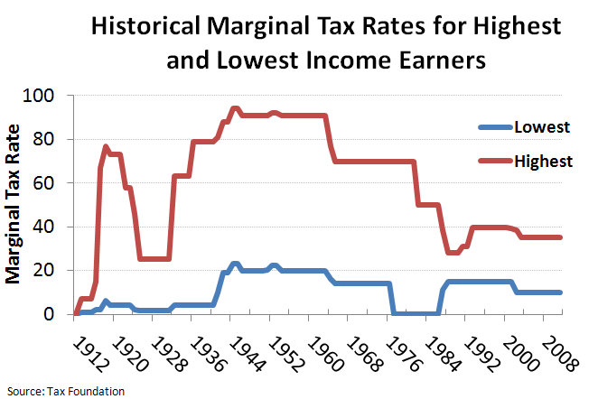

Slide 17
Did Reaganomics Work?
It Depends, how you measure “success” and what you value in an economy

Slide 28
Reaganomics in Action…
Recession of 1982
July 1981-Nov 1982 saw worst recession since Great Depression
Unemployment reached 11%
Economy recovers in 1983
Unemployment drops
GNP grows
Inflation falls
Consumer spending Increases
Business Investment increases
National Debt Climbs in 1982
Spending outstrips revenues
Massive tax cuts, plus increase in defense spending put the nation in deep debt
Further cuts to social programs
In an effort to reduce national debt, Reagan further cuts gov’t spending

