Slide 1
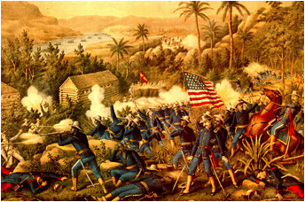
Spanish-American War: Overview
1898
“A Splendid Little War”
Only lasts 10 weeks
Spanish-United States
Two Theaters of Conflict:
Cuba
Philippines
American victory results in
US acquisition of Spanish colonies in the Pacific:
Philippines
Solidified through the Philippine-American War
Guam
Puerto Rico
US influence/authority in Cuba

Slide 2
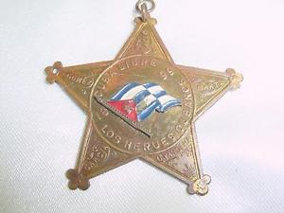
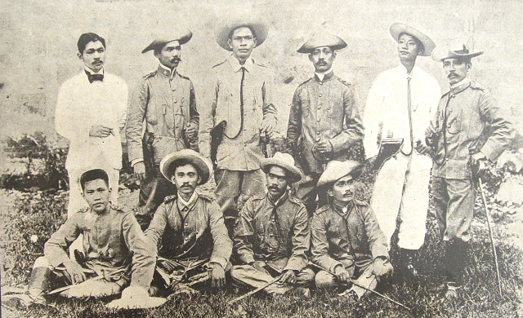
Background: Spain’s empire is collapsing, and the Filipinos and Cubans want out…
Spain was a major colonial power in the world, but by the 1800s was beginning to lose control over its dominion
Most of its former colonies in
Latin America were now
independent, along with Mexico
By the mid-1800s this fervor for
independence had reached other
Spanish possessions.
Cuba: Open Revolt (Cuba Libre)
First in 1868 and then again in early 1895
Philippines: Philippine Revolution
Started in 1896
Was in a state of truce in 1898

Slide 3
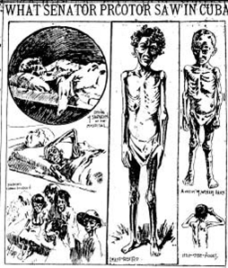
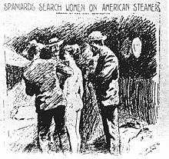
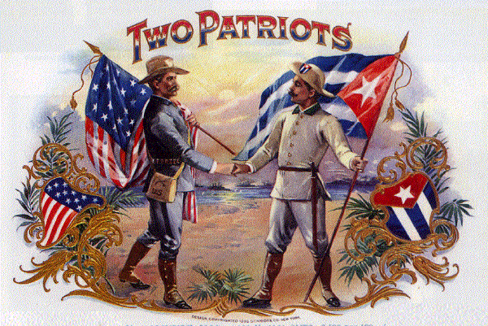
The Build Up to War: Yellow Journalism and Cuba Libre
By the late 1890s, news of Cuba’s revolts were becoming major headlines in the United States
Journalists such as Joseph Pulitzer and William Randolph Hearst, were publishing an ever-increasing number of stories profiling the struggle of the Cuban people against Spain (Cuba Libre).
These stories tended to be strongly anti-Spanish and heavily pro-Cuban.
Portrayed the Cubans as valiantly struggling for freedom and democracy against an oppressive monarchy, a la the American Revolution
Condemned the Spanish as barbarians
Called “yellow journalism” these stories sensationalized events in Cuba to help drive sales of newspapers

Slide 4
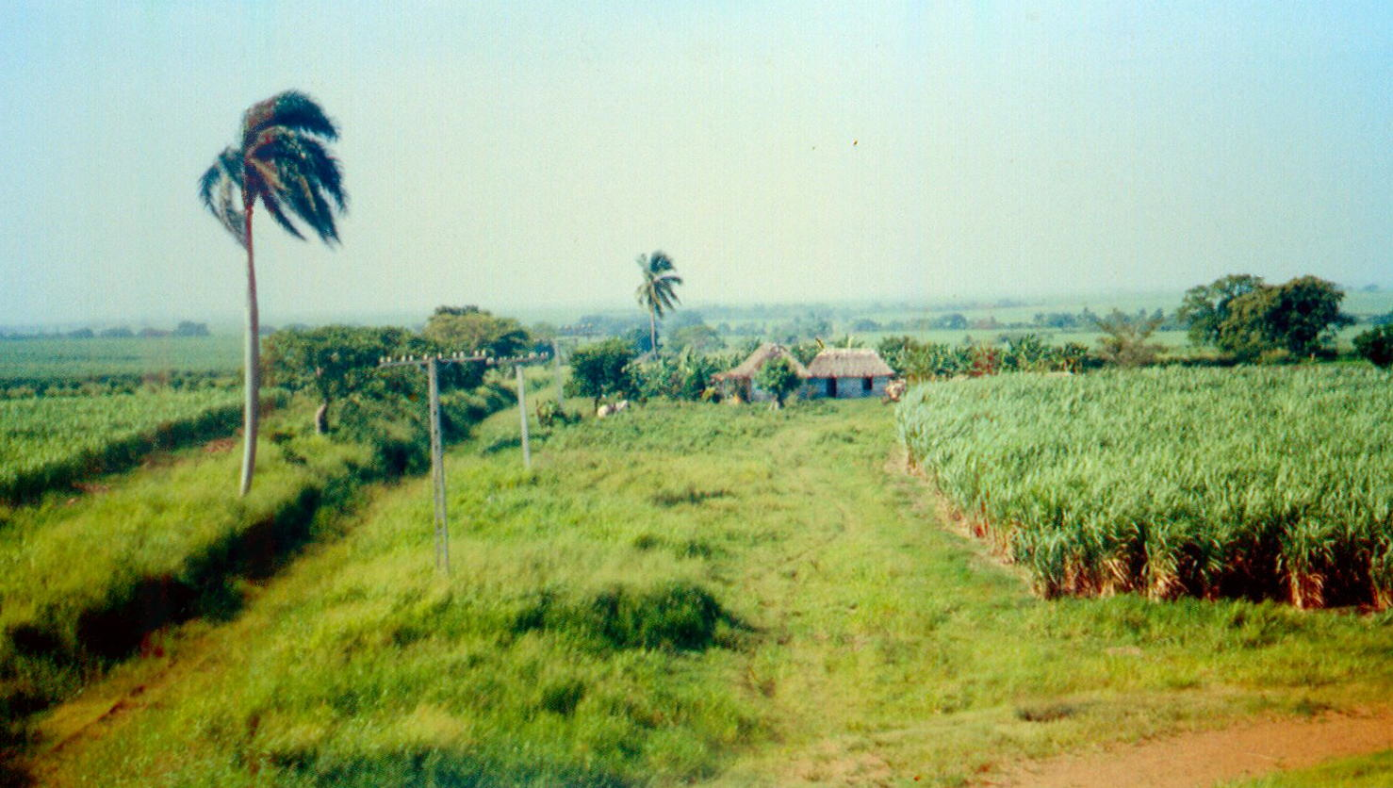
Meanwhile, American sees opportunity in Cuba
By 1894, 90% of Cuba’s total exports went to the US
Cuba’s total exports to the US were almost 12 times larger than the export to Spain
While Spain was wrestling with keeping political authority over Cuba, economic authority, was shifting to the US.

Slide 5
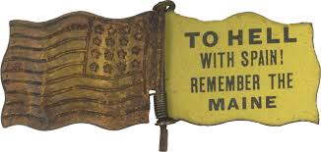
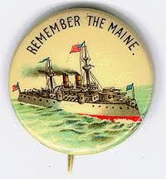
The Spark of War: The Sinking of the USS Maine
America had stationed a warship in Havana Harbor to secure the safety of American citizens in Cuba and to try to press Spain to pursue negotiation and reform with the Cubans
On the evening of February 15, 1898, there was a massive explosion on the Maine and it sank
American citizens began to argue that the ship had been sunk by the Spanish and some initial evidence seemed to point to that as the cause.
Newspapers began to promote this version of events and ran headlines such as “Spanish Murders” and “Remember the Maine”

Slide 6
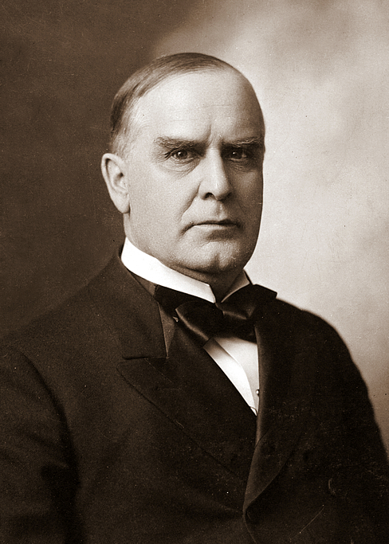
The Call to War
The American people and several American politicians began to call for war.
President McKinley was very reluctant to go to war, but as public and political support built, he asked for war.

Slide 7
McKinley’s Objectives for War Speech to Congress April 11, 1898
First. In the cause of humanity and to put an end to the barbarities, bloodshed, starvation, and horrible miseries now existing there, and which the parties to the conflict are either unable or unwilling to stop or mitigate. It is no answer to say this is all in another country, belonging to another nation, and is therefore none of our business. It is specially our duty, for it is right at our door.
Second. We owe it to our citizens in Cuba to afford them that protection and indemnity for life and property which no government there can or will afford, and to that end to terminate the conditions that deprive them of legal protection.
Third. The right to intervene may be justified by the very serious injury to the commerce, trade, and business of our people and by the wanton destruction of property and devastation of the island.
Fourth, and which is of the utmost importance. The present condition of affairs in Cuba is a constant menace to our peace and entails upon this Government an enormous expense. With such a conflict waged for years in an island so near us and with which our people have such trade and business relations; when the lives and liberty of our citizens are in constant danger and their property destroyed and themselves ruined; where our trading vessels are liable to seizure and are seized at our very door by war ships of a foreign nation; the expeditions of filibustering that we are powerless to prevent altogether, and the irritating questions and entanglements thus arising—all these and others that I need not mention, with the resulting strained relations, are a constant menace to our peace and compel us to keep on a semi war footing with a nation with which we are at peace. . . .

Slide 8
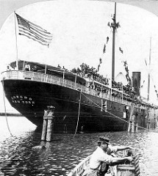
The Teller Amendment
Amidst concern that the United States would try to use a war with Spain to make a play for the American control of Cuba, Republican Senator Henry Teller proposed the Teller Amendment which was passed by Congress.
It stated that the United States would assist the Cubans in the struggle for independence and would leave “control of the island to its people” after the war.

Slide 9
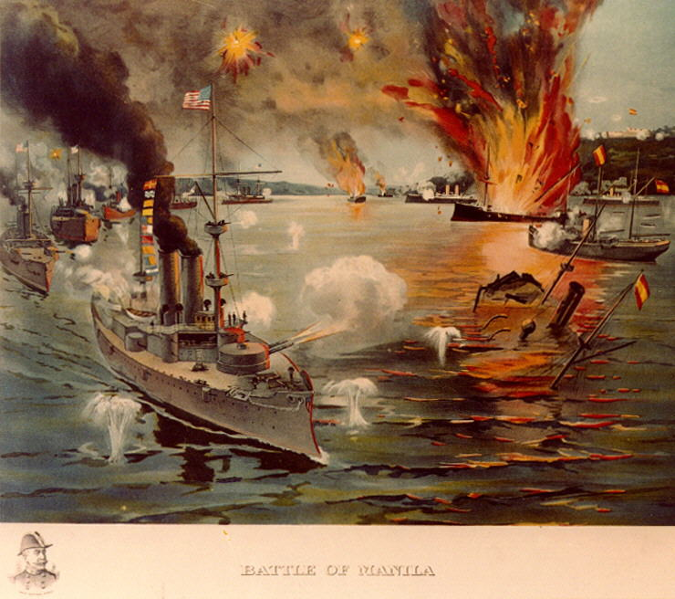
The War Begins…In the Philippines
Despite, the war allegedly being about the liberation of the Cuban people, the war starts in Manila Bay in the Philippines on May 1, 1898
The US navy, the strongest branch of the US military at the time, defeated the Spanish at sea in a matter of hours
The navy then transported the leader of the Filipino rebels, Emilio Aguinaldo, from exile in Hong Kong back to the Philippines to rally more support against the Spanish government
By June, U.S. force and Filipino rebels had taken control of the island.
On June 12, Aguinaldo proclaimed the independence of the Philippines

Slide 10
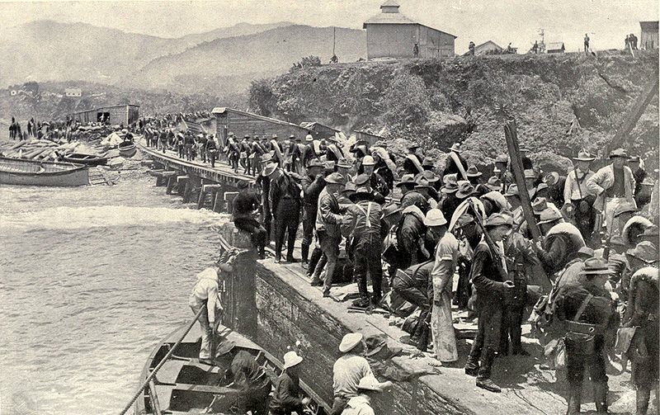
Action turns to Cuba
A land invasion was then planned for Cuba to subdue the Spanish on that island
The only problem was the American army was tiny: 28,000 men
Theodore Roosevelt, then Assistant Secretary of the Navy under McKinley, stepped down from his position and began to establish an all-volunteer regiment, to supplement the standing army.

Slide 11
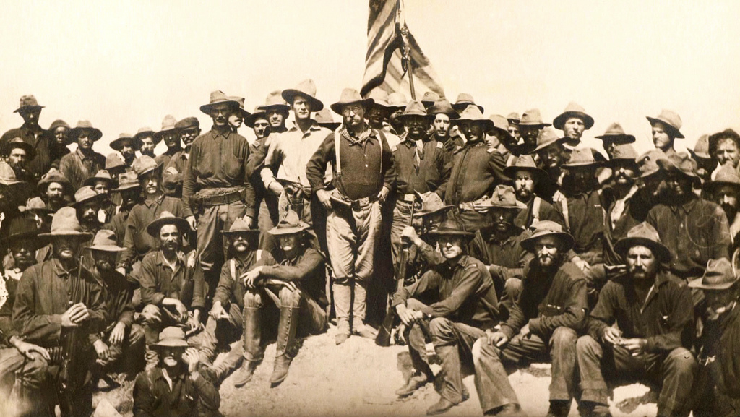
The Rough Riders
The 1st U.S. Volunteer Cavalry, known as the “Rough Riders,” arrived and began to invade Cuba
They worked with Cuban rebels led by General Calixto Garcia
Cuban public saw the Americans as allies in their fight for independence

Slide 12
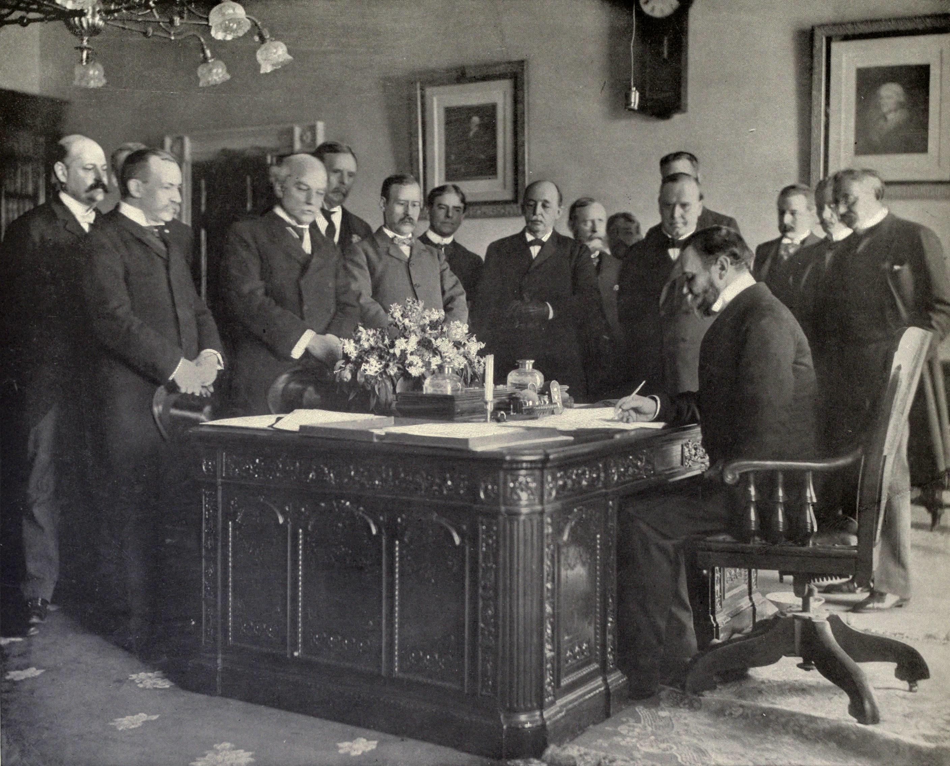
Spanish Defeat & The Treaty of Paris
After a series of difficult battles in Cuba, the Spanish were defeated on that island as well.
The Spanish and Americans began to negotiate an end to the war
Cubans and Filipinos were not included in the negotiations
The Treaty of Paris
US would gain all of Spain’s colonies outside of Africa
Philippines
Guam
Puerto Rico
The exception would be Cuba which would become a US protectorate
Note: The decision over whether or not the Americans should take possession of Cuban colonies was hotly debated, and many Americans believed that the nation should not be involved in imperialism including:
William Jennings Bryan, Mark Twain, former President Grover Cleveland, Andrew Carnegie, Samuel Gompers

Slide 13
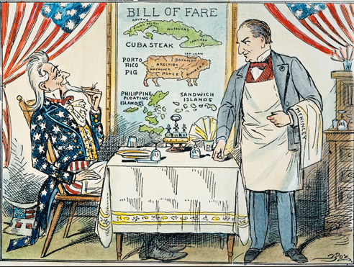
Cuba After the War
Cuba was occupied by America after the war from 1899 to 1902 when it formally gained independence
As part of the end of American occupation the Cubans were
forced to sign the
Platt Amendment
which gave America
substantial authority
over the island

Slide 14
The Platt Amendment 1901
III. That the government of Cuba consents that the United States may exercise the right to intervene for the preservation of Cuban independence, the maintenance of a government adequate for the protection of life, property, and individual liberty, and for discharging the obligations with respect to Cuba imposed by the treaty of Paris on the United States, now to be assumed and undertaken by the government of Cuba.
VII. That to enable the United States to maintain the independence of Cuba, and to protect the people thereof, as well as for its own defense, the government of Cuba will sell or lease to the United States lands necessary for coaling or naval stations at certain specified points to be agreed upon with the President of the United States.

Slide 15
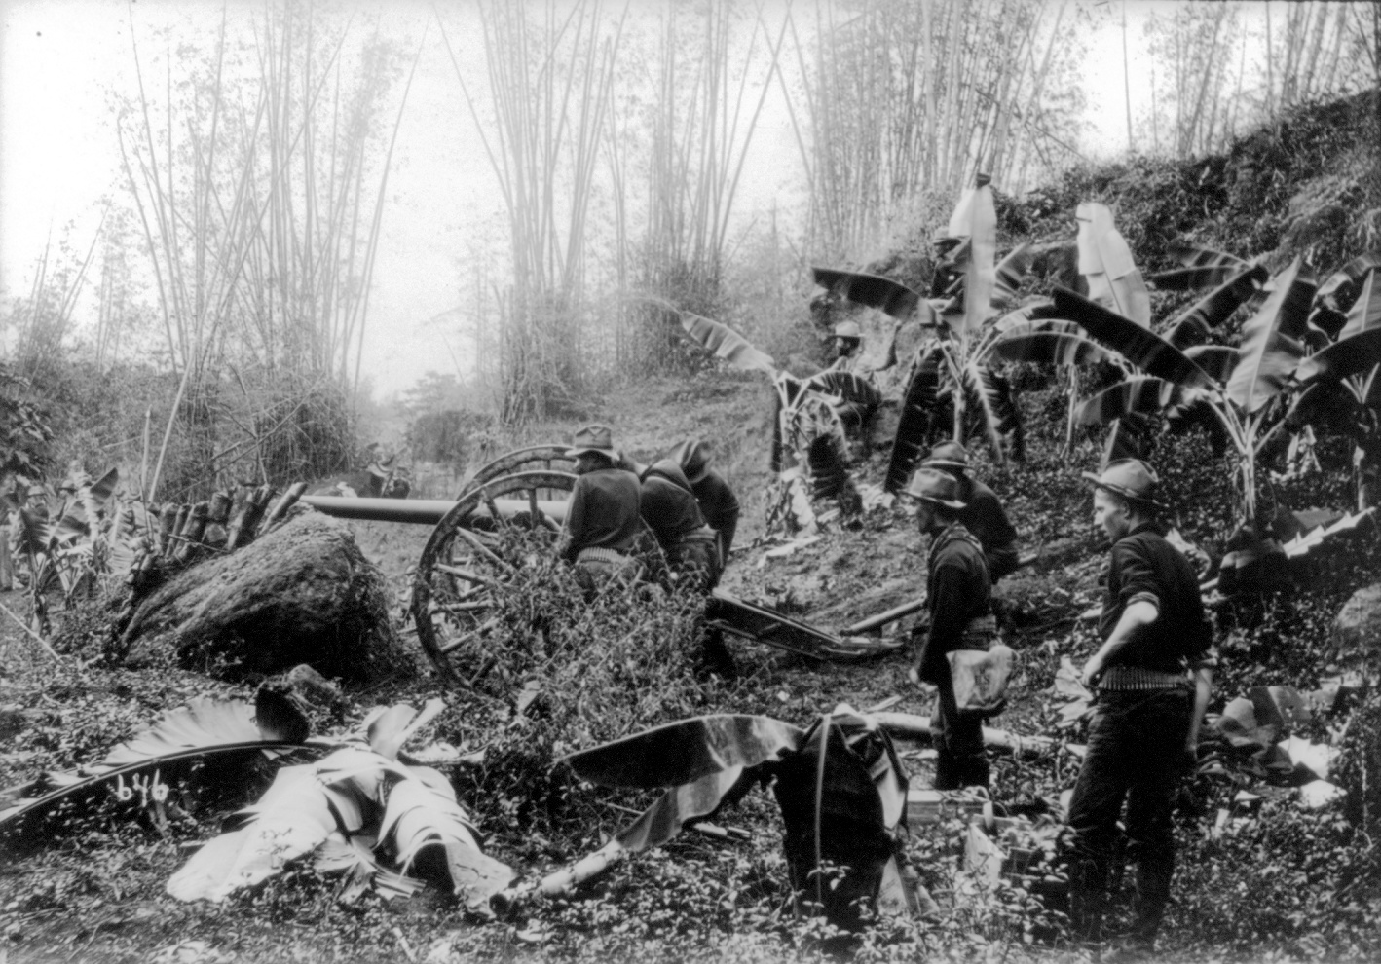
Philippines After the War
The First Philippine Republic objected to the terms of the Treaty of Paris which called for the Philippines to be a colony of the United States
Fighting broke out between the Filipino rebels and the US military
Philippine-American War
In 1902 the Philippines
were defeated by the
Americans and became
an American colonial
possession until 1946

Slide 16
Key Points of Significance of the Spanish-American War
First major action taken in the name of the Monroe Doctrine
Establishes America as an imperial power
Though it is late to the game and has to fight Spain for fairly insignificant colonies
America establishes itself as equal to European powers and engages in imperialism alongside them
Gives America a naval presence and naval bases in the Caribbean and the Pacific
Extends US racism abroad
Establishes a new American national identity:
America is a world power
America is a defender of freedom and democracy throughout the world
As historian Louis Pérez argued in his book Cuba in the American Imagination: Metaphor and the Imperial Ethos, the Spanish–American War of 1898 "fixed permanently how Americans came to think of themselves: a righteous people given to the service of righteous purpose".

