Slide 1
Striving for Balance Between Democracy and Authority
Focus: Andrew Jackson: Democrat or Authoritarian? (1829-1837)
Agenda: To assess whether Andrew Jackson was the “common man president” or an authoritarian executive
changes in voting
Intro to Jackson & Jacksonian Democracy
Evaluating Jackson as Democrat or Authoritarian
Whole Class Closing Discussion

Slide 2
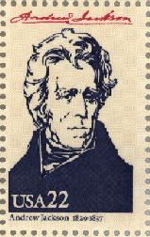
Essential Question:
Champion of the “Common Man”?
“King” Andrew?
OR

Slide 3
Federal Power Gets its First Big Check
The Federalists held the office of the Presidency from 1789-1801
Between 1801 and 1829, power rested with the Democratic-Republicans (formerly the Republicans)
Thomas Jefferson
James Madison
James Monroe
John Quincy Adams
These presidencies were largely consumed with foreign policy questions (Louisiana Purchase, the War of 1812) and economic concerns (the start of the Industrial Revolution) and did little to shrink the federal authority established by the Federalists

Slide 4
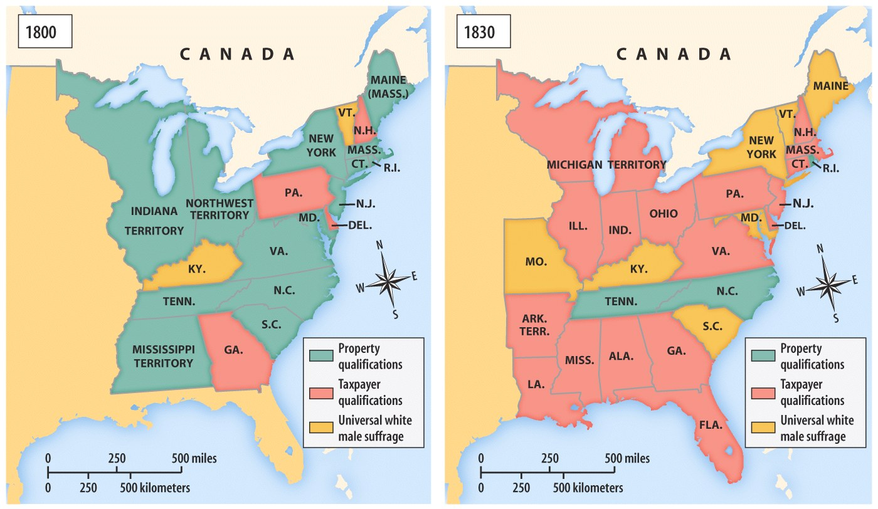
Voting Requirements in the Early 19c
What do you think may be some consequences of these changes? Ask Mr. Adams (p. 14)
Notes:
Reference p. 9-13

Slide 5
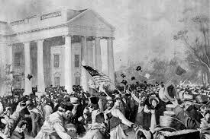
Andrew Jackson Comes to Office
All of that changes with the election of Andrew Jackson in 1829
The story of Jackson’s inauguration best illustrates this change
While inaugurations had been small, dignified events. Jackson’s inauguration was before a crowd of about 20,000 people, who poured into the White House after, ruining furniture, and destroying china and glassware?
So…what changed with the election of Jackson?

Slide 6
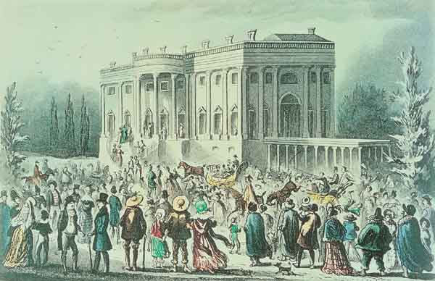
The Reign of “King Mob”
Notes:
Here are some accounts of the day

Slide 7
I. The Daily National Intelligencer, Washington, D.C., March 4, 1829. The inauguration of the new President is to take place to-day at the Capitol. There will be no military array upon the occasion but such as is voluntary. A vast assembly of the People, however, from every part of the country, will attend the ceremony. There is to be a Ball in honor of the occasion, in the evening, at Carusi's Assembly Rooms. The great concourse of strangers in the city, at this season, has attracted hither a proportionate number of those who live by depredations upon society. As a caution to others, it may be useful information, that a gentleman from one of the Southern States had his pocket picked, in the Theatre last night, of a pocket-book containing eight hundred dollars; and we should not be surprized to learn that others than he were equally unfortunate. II. The Daily National Intelligencer, Washington, D.C., March 5, 1829. In the midst of the throng yesterday, in and about the President's Square, where persons of every rank in life (and of almost every nation and complexion) flocked promiscuously, the nimble-fingered gentry were not idle. Several pockets were picked: and notwithstanding the caution published yesterday morning, one gentleman suffered his pocket to be picked of eight or nine hundred dollars, and others of smaller sums. One or more of the cut-purses were detected in the fact, and committed for trial. They are all strangers here. III. The Daily National Intelligencer, Washington, D.C., March 6, 1829. The great concourse of strangers in this City has already subsided; and the steady rain of yesterday kept within doors most of those who remain. This busy throng has passed away without any occurrence seriously to mar the pleasure of its assembly. What particularly gratifies us, and does credit to the character of our People, is, that, amidst all the excitement and bustle of the occasion, the whole day and night of the Inauguration passed off without the slightest interruption of the public peace and order, that we have heard of. At the mansion of the President, the Sovereign People were a little uproarious, indeed, but it was in any thing but a salacious spirit.

Slide 8
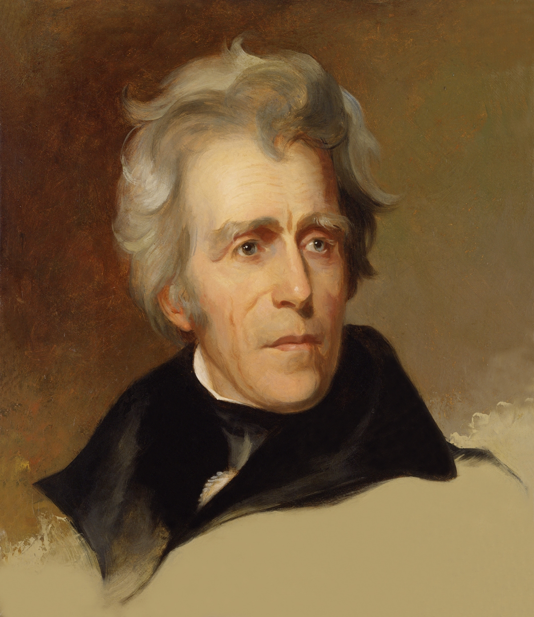
Andrew Jackson
1767-1845
Born to a poor farming family on the North Carolina/South Carolina border
Became a lawyer and a plantation owner in Tennessee
Oversaw decisive victories in the War of 1812
Didn’t go to college, chewed tobacco, and dueled with pistols
Was the first president
From the “West”
Born in a log cabin
Not from a prominent/wealthy family
Two term president from 1829-1837

Slide 9
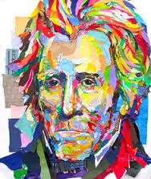
What Did Jackson Believe?
Self-proclaimed champion of the common man, but believed that Native Americans should be excluded from the democratic process and pushed further and further west
Believed states should be the focal point of government activity. Opposed federal efforts to shape the economy or interfere in individual’s private lives.
Weak national authority was essential to both private freedom and states’ rights
Intense distrust of Eastern establishment, monopolies and special privilege
Belief that the common man was capable of uncommon achievements and his heart and soul was with the “plain folk”

Slide 10
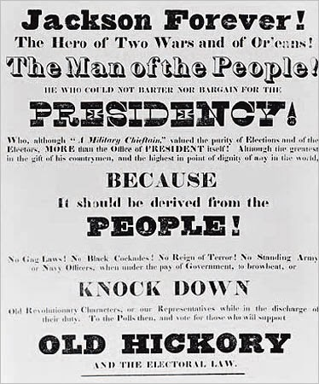
What accounts for Jackson’s Election?
Jackson came to power after many states reduced their property qualification for voting.
By 1840, more than 90% of adult white men were eligible to vote
As a result, with more “common men” voting, it isn’t surprising that they would gravitate to a candidate who also considered himself to be a “common man.”
Spoils system
Popular campaigning (parades, rallies, floats, etc.)

Slide 11
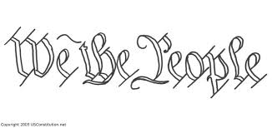
Jacksonian Democracy
The democratization of the vote represented a profound political transformation.
It ushered in the idea that sovereignty belongs to the mass of ordinary citizens.
How is this a new idea?
How does it contrast with the ideals of the founders—both
Federalists and
Anti-Federalists?

Slide 12
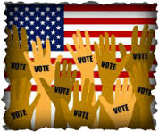
Jacksonian Democracy
So it is not just “Yay! More people get to vote now!”
The expansion of the electorate ushers in a new definition of democracy
Voting because defined as an essential component of citizenship
Elected officials are no longer seen as “philosopher-kings” but as us, people chosen to act directly on our behalf
Elected officials are truly accountable to the people
The people deserve a direct say in the democratic process
The people rule directly, not through elites
(Jeffersonian democracy)

Slide 13
Focus: Was Jackson “The Common Man President?”
Our goal for today is to discuss the following question:
To what extent was Andrew Jackson truly a common man who reflected new democracy emerging in the country? OR Did Jackson extend the powers of the President beyond his constitutional powers, growing the power of the president in ways that increased authority rather than democracy?

Slide 14
Was Jackson “The Common Man President”?
Task:
Small Group Activity:
You will learn about four of Jackson’s actions while president:
The Creation of the Spoils System 1828
The Indian Removal Act 1830
The Vetoing of the Second Bank of the United States 1832
The Nullification Crisis 1832
For each action:
Develop a 1-2 sentence summary statement of what happened
Argue whether Jackson’s actions are evidence of the fact that he:
Promoted common man democracy?
Produced an authoritarian presidency which over-stepped constitutional boundaries?
Whole Class Discussion: Socratic Seminar next class
To what extent was Andrew Jackson truly a common man who reflected new democracy emerging in the country? OR Did Jackson extend the powers of the President beyond his constitutional powers, growing the power of the president in ways that increased authority rather than democracy?
Where does this leave the United States with respect to democracy/authority by 1837?

Slide 15
Homework Day 5
Based upon today’s discussion please complete the following:
Type a central claim (thesis statement) that addresses the discussion question from today:
To what extent was Andrew Jackson truly a common man who reflected new democracy emerging in the country? OR Did Jackson extend the powers of the President beyond his constitutional powers, growing the power of the president in ways that increased authority rather than democracy?
Then, write one body paragraph that proves a part of your claim. Use only documents from reader and class. Cite page numbers of direct quotes. Be sure to have a clear and argumentative topic sentence as well as 2-3 pieces of evidence to support your topic sentence. Due next class
TEST

Slide 16
The
Nullification
Issue

Slide 17
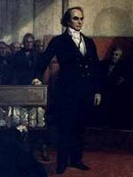
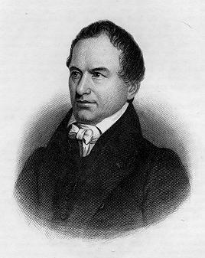
The Webster-Hayne Debate
Sen. Daniel Webster [MA]
Sen. Robert Hayne [SC]

Slide 18
1830
Webster: Liberty and Union, now and forever, one and inseparable.
Jackson: Our Federal Union—it must be preserved.
Calhoun: The Union, next to our liberty, most dear.

Slide 19
Jackson's
Native-American
Policy

Slide 20
Indian Removal
Jackson’s Goal?
1830 → Indian Removal Act
Cherokee Nation v. GA (1831) * “domestic dependent nation”
Worcester v. GA (1832)
Jackson: John Marshall has made his decision, now let him enforce it!

Slide 21
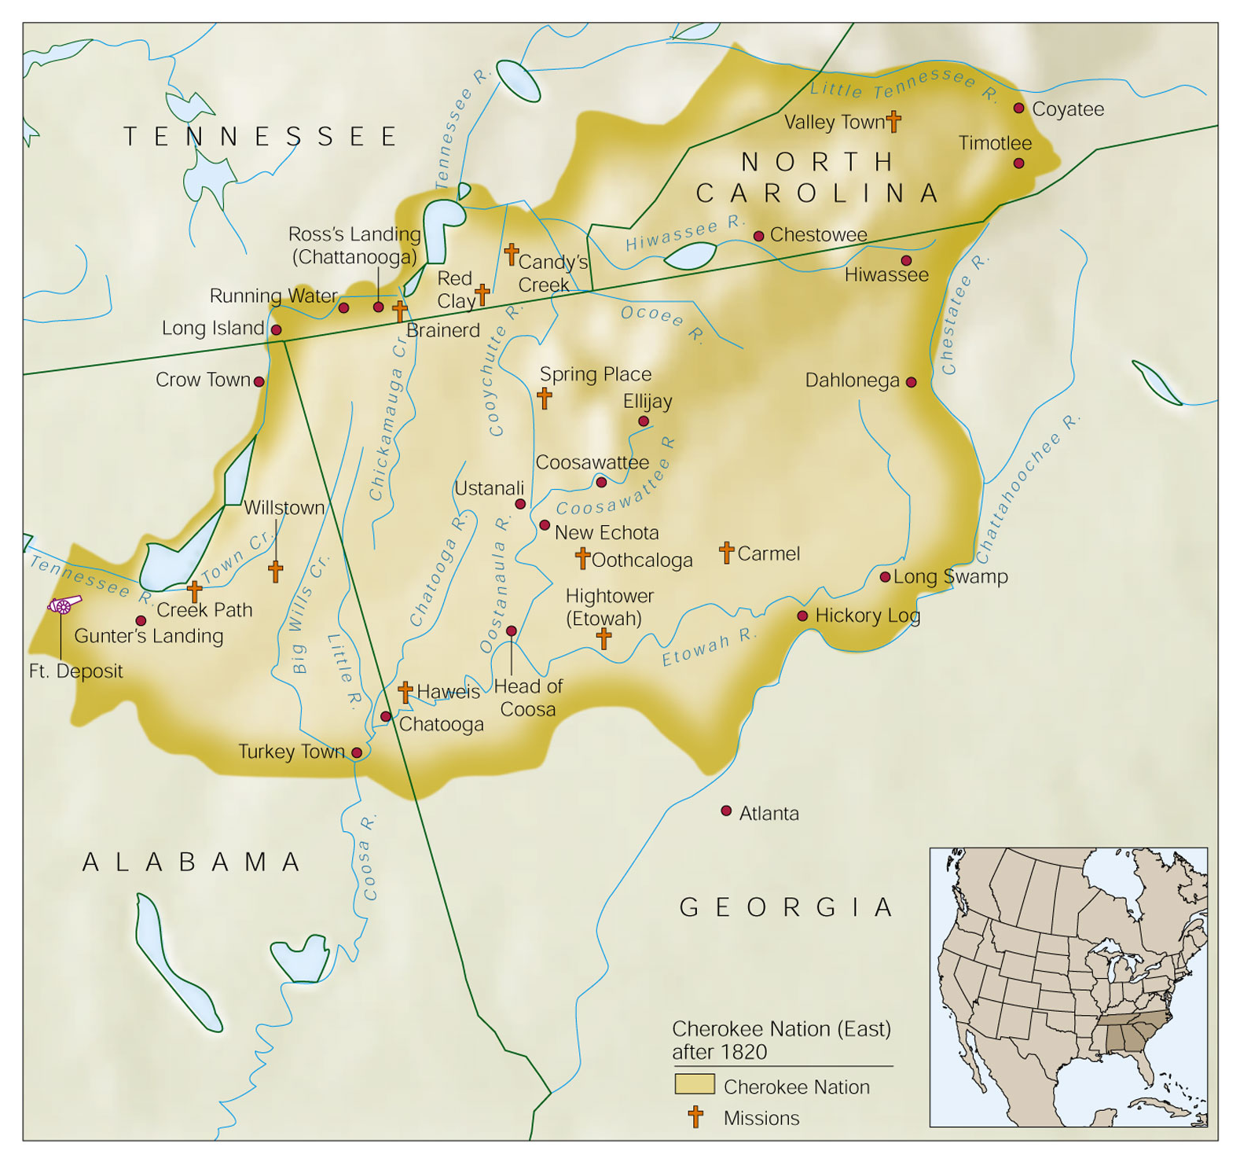
The Cherokee Nation After 1820

Slide 22
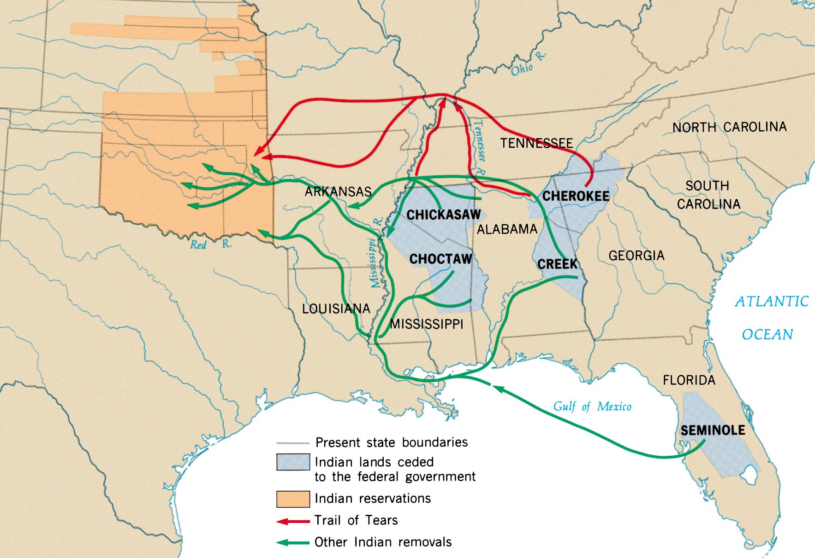
Indian Removal

Slide 23
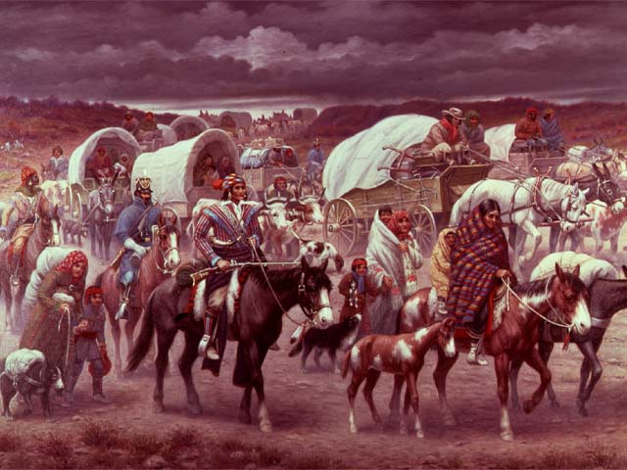
Trail of Tears (1838-1839)

Slide 24
Jackson’s Professed “Love” for Native Americans

Slide 25
Renewing
the Charter
of the
1st National Bank

Slide 26
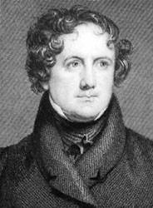
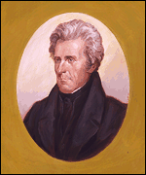
The National Bank Debate
Nicholas Biddle
President Jackson

Slide 27
Opposition to the 2nd B.U.S.
“Soft” (paper) $
“Hard” (specie) $
state bankers felt it restrained their banks from issuing bank notes freely.
supported rapid economic growth & speculation.
felt that coin was the only safe currency.
didn’t like any bank that issued bank notes.
suspicious of expansion & speculation.

Slide 28
The “Monster” Is Destroyed!
“pet banks”?
1832 → Jackson vetoed the extension of the 2nd National Bank of the United States.
1836 → the charter expired.
1841 → the bank went bankrupt!

Slide 29
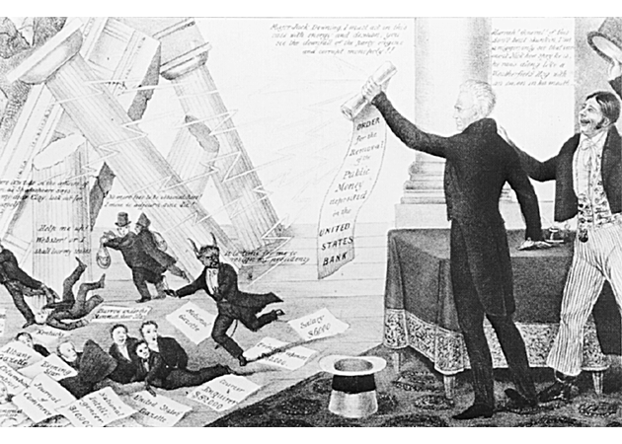
The Downfall of “Mother Bank”

Slide 30
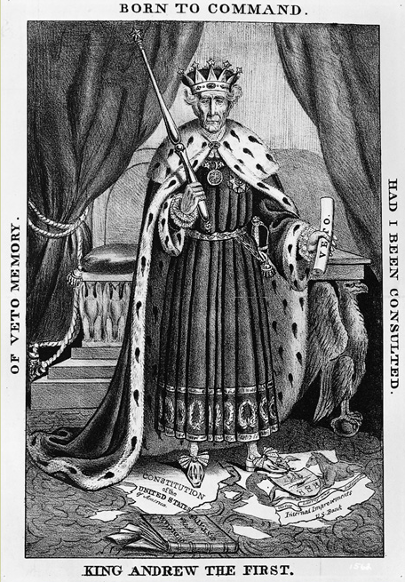
An 1832 Cartoon:
“King Andrew”?
Day 6:
Do Now: Pick up reading and take out homework

Slide 31
King Andrew?
Wrap Up: Where does this leave the United States with respect to democracy/authority by 1837?
Focus: How did the causes of the Civil War demonstrate the tension between how the North & South viewed the increasing power of the federal government and the rights of the people in the United States?

Slide 32
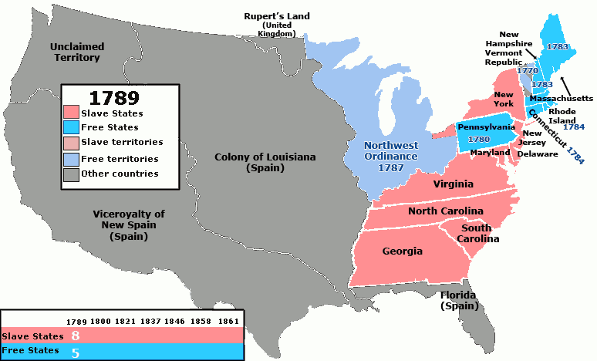
The Slavery Question (1776-1829)
Between the
Founding and
Jackson’s tenure
(1776-1829) the
United States
government did
their best to
ignore the slavery question.
The nation reached the uneasy (and unstable) solution that the north would be free and that the south would be slave and that the two regions would do their best to live side by side.

Slide 33
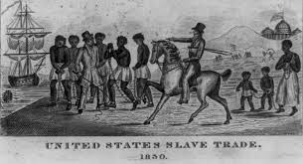
The Slavery Question (1776-1829)
But this “live and let live”
perspective, was far more
ideal than real.
Over-time the two regions
began to look very different
(see next slide)
More intervention was needed to keep them together
The fact that both regions were bound together by a national government, meant that the national government did have to weigh in on the slavery issue from time to time—even if they didn’t want to.
And, in order to maintain the tenuous union, made decisions that in the end enabled slavery
Enabler? Promoter? Prohibitor?
Debate over the North’s intent with slavery…

Slide 34
North and South: Sectionalism
The North:
Primarily industrial
Mostly urban and small farms
Supported tariffs and internal improvements
For strong central government
Relied on free labor
Wanted to limit spread of slavery in West
The South:
Primarily agricultural
Mostly small farms and plantations
Generally opposed tariffs and internal improvements
For “states’ rights”
Relied on slavery due to smaller population
Supported extending slavery in West

