Slide 1
Discussion
How did the legacies of the Cold War produce anti-American sentiment culminating in terrorist activities of the 1990s and 2000s?
How did the 2000s see a return to unilateralism in US foreign policy?
How has military action been increasingly managed out of the executive branch since the Cold War?

Slide 2
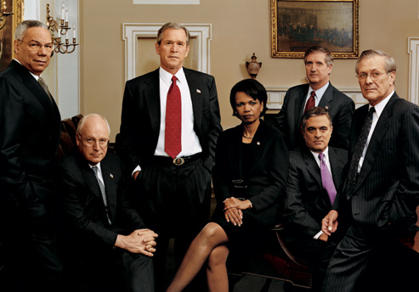
Our Angle for the Study of the 2000s
Up until this point, our focus on the
shifting size and scope of the
American government has focused on
how the size of government agencies/
divisions has expanded or contracted,
and how the scope of the government
has changed as the government has
become more or less concerned with issues of economic regulation, intervention in social life, and the promotion of equality.
Today, we want to pursue our question from a new angle: the shifting size and scope of the executive branch.
We do this because under the Bush Administration we see an incredible expansion in the power of the executive branch, making this the decade some scholars have said has grown the government (or consolidated the government) in new and more powerful ways.

Slide 3
Essential Questions
How did the Bush administration increase the size and scope of the executive branch in the 2000s? (Lecture)
Do you believe that these are Constitutionally-grounded legitimate expansions of presidential power, or did Bush create an era of an “imperial presidency?” (Discussion)

Slide 4
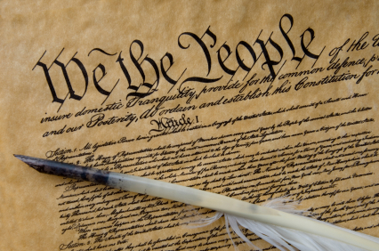
Article II of the United States Constitution
The Vesting Clause of Article II: “The executive Power [of the United States] shall be vested in a President of the United States of America.
The Take Care Clause: “The President shall take care that the laws be faithfully executed…”
What is the Article laying
out as the powers of the
President?
Is this a clear or vague
definition of power?

Slide 5
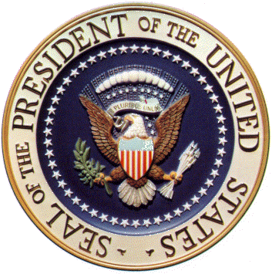
Ambiguity about the Role of the Executive
How strong is the office of the President?
What powers does he have?

Slide 6
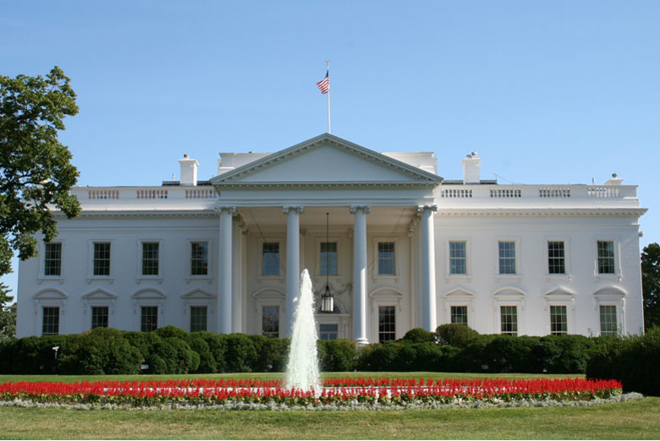
Unitary Executive Theory
Theory of American
constitutional law
holding that the President
controls the entire
executive branch.
Championed by founding
members of the Federalist
Society, “ a group of conservative lawyers who nearly all worked in the Nixon, Ford, and Reagan White Houses and who understood the type of political climate the president operated in” and wanted to protect presidential prerogatives.
Kelly, Rethinking Presidential Power

Slide 7
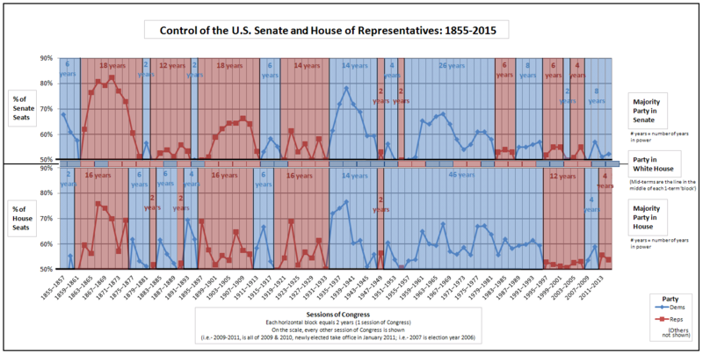

Slide 8
Meese’s 3 Part Strategy for Strengthening the Unitary Executive
Reagan’s Attorney General, Edwin Meese proposed a 3 part strategy that advised Reagan to use in order to build up the power of the executive branch.
Became a blue print for future conservative presidents.
Three Steps:
Appoint judges who support expanded executive powers
Challenge intrusions of presidential authority in the court system
More actively engage in the creation of legislation through executive orders and signing statements

Slide 9
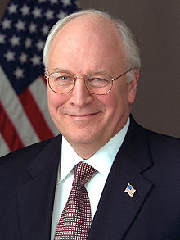
Unitary Executive Theory and Dick Cheney
Cheney was Bush’s Vice President
Also worked for Nixon and Ford
Nixon Administration
Worked in the Office of Economic Opportunity
Ford Administration
Assistant to the President
White House Chief of Staff
“I have repeatedly seen an erosion of the powers and the ability of the president of the United States to do his job.”
Cheney to the Washington Post

Slide 10
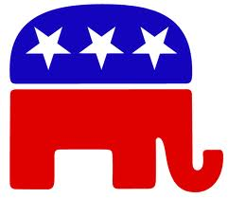
The Unitary Executive Theory and Conservatives view of the Role/Purpose of Government
Princeton Professor Julian Zelizer argues that “since [the] 1980s, we’ve seen a real acceleration in the expansion of executive authority as a means to circumvent the legislative branch, particularly with regards to national security.”
Zelizer believes that conservatives, though initially skeptical of government
and its reach, have found in
executive power a convenient tool
to achieve their goals.

Slide 11
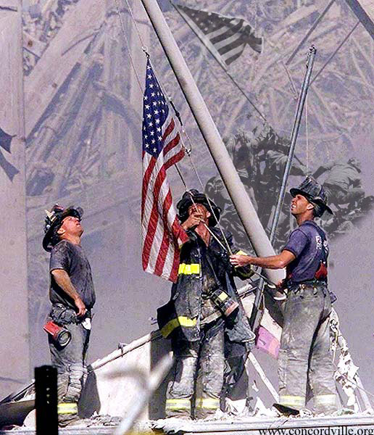
September 11 as an Opportunity to Grow Executive Power
Terrorist attacks of 9/11 provide an opportunity to expand the power of the executive branch
The “War on Terror” was a war with no battlefield, no end, no clear enemies, and most importantly no clear boundaries for how to fight the war.
As a result, anything and everything could be argued to be permissible as part of the war.
Note: War has frequently been used to expand executive power.
Lincoln: Exercised his authority to suspend habeas corpus, arresting and temporarily detaining thousands of suspected secessionists without trial. FDR: Passed an executive order to intern Japanese Americans during World War Two
LBJ: Gulf of Tonkin Resolution

Slide 12
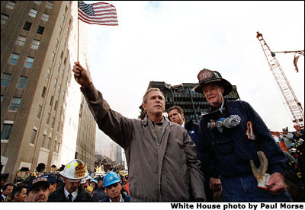
September 11 as an Opportunity to Grow Executive Power
A poll conducted by the Washington Post and ABC News shows that President Bush’s approval rating on September 11, 2001, was steady at 55 percent. However, on October 7, 2001 (the day Operation Enduring Freedom began), his approval ratings skyrocketed to 90 percent.
This extraordinarily high level of support by the American people for the executive, the insecurity and destabilizing effects 9/11 had on Americans and the pressure the Bush administration received from the American people demanding a response to the terrorist attacks set the stage for the administration’s subsequent power grab.

Slide 13
Warrantless Wiretapping
As part of the War on Terror, the Bush administration issued an executive order to monitor, without search warrants, the phone calls, Internet activity, email, text messaging, or any other communication involving any party in the United States who was communicating with a party outside of the United States believed to be involved in terrorist activity.
The Bush administration claimed that “the NSA activities are supported by the
President’s well-recognized
inherent constitutional authority
as Commander-in-Chief and sole
organ for the Nation in foreign
affairs to conduct warrantless
surveillance of enemy forces for
intelligence purposes to detect and
disrupt armed attacks on the United
States.”

Slide 14
Detention, Treatment, and Trial of Certain Non-Citizens in the War Against Terrorism
Following 9/11 the Bush Administration decided to use portions of the naval base at Guantanamo Bay to detain individuals it had determined to be connected to be involved in terrorist activities.
The Bush Administration declared that the camp could be considered outside U.S. legal jurisdiction and therefore the detainees were not entitled to any of the protections of the Constitution or of the Geneva Conventions.
As a result, prisoners could be held without formal charges, held indefinitely, tried in military tribunals rather than courts of law

Slide 15
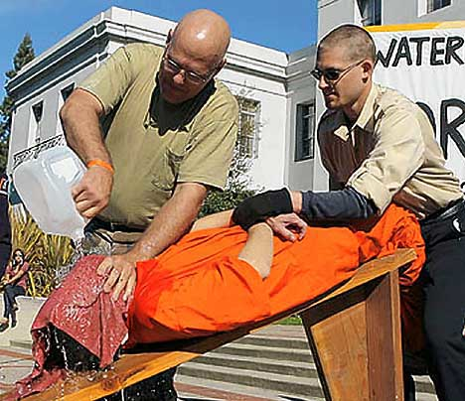
Enhanced Interrogation Techniques
Following 9/11 the Bush administration approved the use of certain severe methods of interrogation including hypothermia, stress positions, and waterboarding on prisoners of war and other detainees in Iraq, Afghanistan, and Guantanamo Bay.
The administration defended their unilateral authorization of terror on the grounds that “Congress may no regulate the president’s ability to detain and interrogate enemy combatants than it may regulate his ability to direct troop movements on the battlefield.”
Dept. Assist. Attorney General John Yoo in a memo to White House Counsel Alberto Gonzales

Slide 16
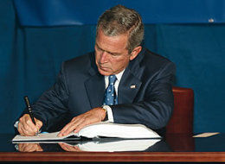
Signing Statements
A statement issued by the President upon signing legislation into law.
Purpose:
To provide the president’s interpretation of the language of the law
To indicate directions to executive branch officials as to how to administer laws
But…can also be a covert line-item veto used to nullify a portion of a passed law
Line-item veteos held unconstitutional in Immigration and Naturalization Service v. Chadha 1983 as a violation of the constitutional separation of powers

Slide 17
Signing Statements
The Bush Administration made the Unitary Executive Theory a common feature of signing statements.
For example, Bush once wrote in a signing statement that he would, "construe Title X in Division A of the Act, relating to detainees, in a manner consistent with the constitutional authority of the President to supervise the unitary executive branch and as Commander in Chief and consistent with the constitutional limitations on the judicial power."

Slide 18
Discussion
Do you believe that these are Constitutionally-grounded legitimate expansions of presidential power, or did Bush create an era of an “imperial presidency?”

