Slide 1
How did the early thinking (Winthrop, Constitution, Washington) create a set of frameworks for American foreign policy?

Slide 2
Overview of Key Topics in US Foreign Policy During the Era of Western Expansion (1776-1847)
Founding Period 1776-1801
Washington’s Farewell Address 1796
Jeffersonian Era
1801-1825
Manifest Destiny/ Western Expansion
1830s-1840s
Indian Removal Act 1830 & Trail of Tears 1838-1839 (Jackson)
Louisiana Purchase 1803 (Jefferson)
War of 1812 (Madison)
Monroe Doctrine 1823 (Monroe)
Texas Revolution
1835-1836
Mexican-American War
1846-1847
Western Settlement
Annexation of Texas 1845 (Polk)
Treaty of Guadalupe Hidalgo 1847 (Polk)
Mexican Cession 1847 (Polk)

Slide 3
Founding Period
1776-1801

Slide 4
America in the “World” at the Founding
At the founding, North America was comprised of a varieties of peoples:
American Indians & Other Indigenous Peoples
English Settlers in Canada
French Settlers in Canada and the Louisiana Territories
Spanish Settlers in the Spanish Colonies
Russian Interest in modern day Alaska

Slide 5
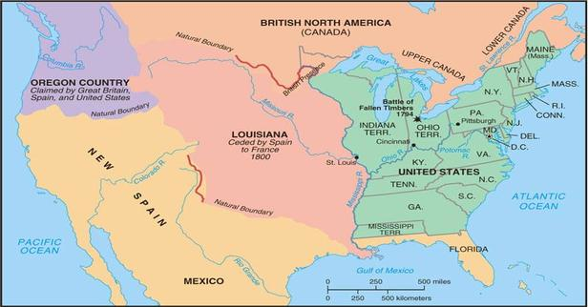

Slide 6
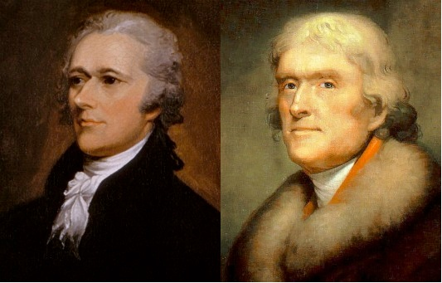
Debate over Foreign Policy at the Founding
Hamiltonians (Federalists) vs. Jeffersonian (Anti-Federalists)
https://www.youtube.com/watch?v=rRI37yamL4Q
Questions:
What are the
competing foreign
policies being
articulated here?
How are they consistent
with the “world views” of
Hamilton and Jefferson as we know them?
Notes:
https://www.youtube.com/watch?v=rRI37yamL4Q (with lyrics)

Slide 7
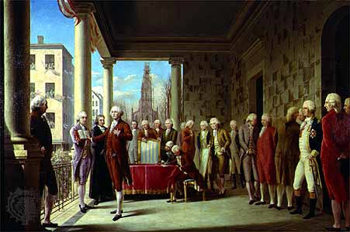
Foreign Policy at the Founding
The Hamiltonian vision wins out, and the foreign policy at the founding largely embraces American neutrality in the world.
US is neutral in the French Revolution
(We see this vision enshrined in Washington’s Farewell Address)
Warns against foreign influence in domestic affairs
Warns against American meddling in European affairs.
Called for an America largely free of foreign attachments, as the United States must concentrate only on American interests.
Encouraged friendship and
commerce with all nations, but
warned against involvement in
European wars and entering into
long-term alliances.

Slide 8
Jeffersonian Era
1801-1825

Slide 9
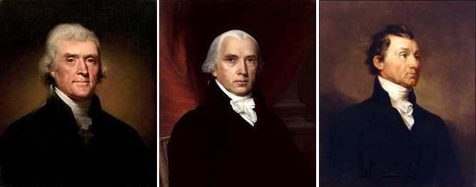
Jeffersonian Era
Includes the presidencies of Jefferson, Madison, and Monroe
Era of Republican rule (Anti-Federalists)
Given what we know about Jefferson’s foreign policy vision, what should we expect to see during this period?

Slide 10
Jeffersonian Era
During this period the country:
Grows in physical size
Sees a more active US foreign policy
Think back to Jefferson’s vision in the rap battle!
Most foreign policy efforts are contained to North America
Key Foreign Policy Moments:
Louisiana Purchase 1803
War of 1812 (Rev War, part deux)
Monroe Doctrine 1823

Slide 11
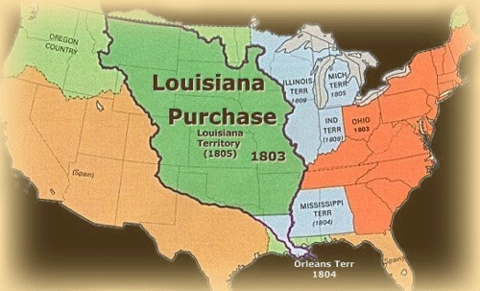
Louisiana Purchase 1803
In 1803 Jefferson bought the Louisiana territory from France
France was losing control of its empire following the Haitian Revolution of 1791-1803
Seen as economically necessary for control of the Mississippi River and the port of New Orleans
Ports vital for American agriculture
Action was opposed by Federalists who said that that it was unconstitutional
to acquire territories
Jefferson argued that it was
Constitutional as part of the
President’s powers to negotiate
treaties.
Doubled the size of the United
States
The largest territorial acquisition
in American history

Slide 12
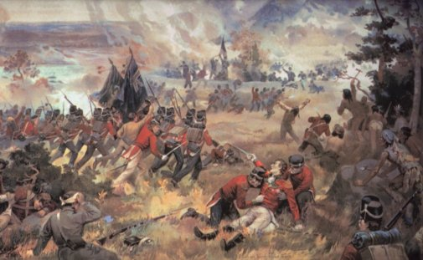
War of 1812
The United States viewed a series of British actions as a threat to American sovereignty:
British raid on the USS Chesapeake
British restrictions on trade with France
British impressment of US sailors
British support for American Indian raids on American settlers
Bottom line: Britain needed to recognize that the United States was a free and independent nation who they could not push around
President Madison declared war on Great Britain (First US declaration of war)
The Course of the War
U.S. army unprepared; British sack and burn
Washington, D.C. in 1814
Control of the war teetered between the British
and the Americans
Peace was negotiated with the Treaty of Ghent
in 1814
Significance:
The war confirmed the sovereignty of the United States
(often called the second war of independence)
Solved the American-Canadian (British colony) border dispute by setting the border at the 49th parallel
Notes:
Start with Red on Wed

Slide 13
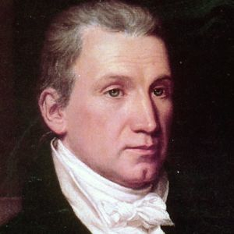
Monroe Doctrine 1823
President James Monroe’s statement on U.S. Foreign Policy
Said…
European powers were no longer to colonize or interfere with the affairs of the independent states of the Americas
U.S. would not interfere with existing colonies or their dependencies in the Western Hemisphere.
Any attempt by a European nation to oppress or control any nation in the Western hemisphere would be seen as an act of aggression and the U.S. would intervene
FIND THESE 3 VIEWS WITHIN THE EXCERPT OF MONROE’S SPEECH TO CONGRESS in 1823

Slide 14
Summarizing this Era
How do these three foreign policy actions of this era fit together? What do they have in common
How do these actions reflect Jefferson’s vision of what US foreign policy should be?
What foreign policy frameworks seem to be present at this moment in American history?
Notes:
Stopped with Purple Wed 11/16

Slide 15
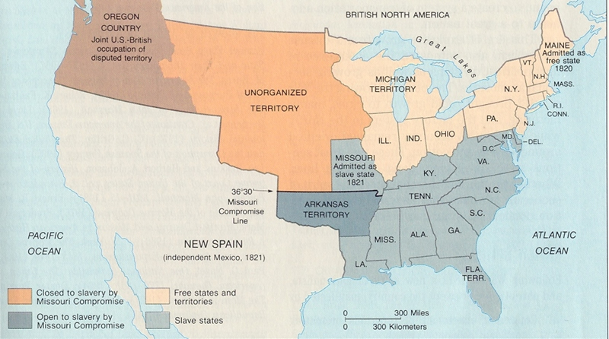

Slide 16
Manifest Destiny / Western Expansion
1830s-1840s

Slide 17
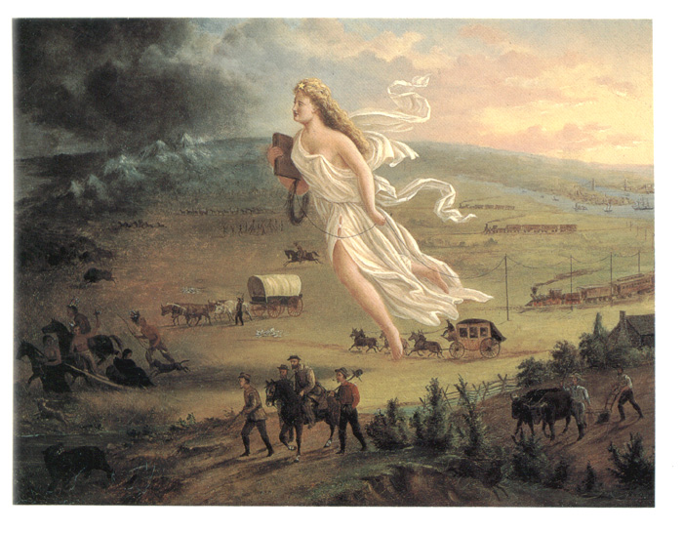
Manifest Destiny
What is the idea of Manifest Destiny?
Coined in 1839, John O’Sullivan…let’s read how it came to become a concept…

Slide 18
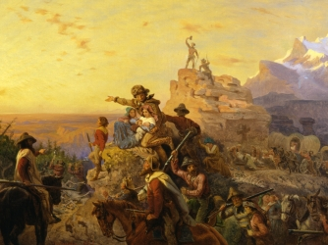
Manifest Destiny
The belief that God had destined America to spread from coast to coast
In the 19th century it was a widely helped belief in the United States that American settlers were destined to spread across North America

Slide 19
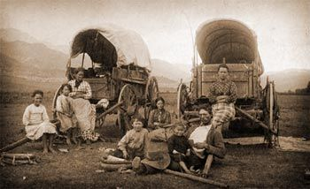
Western Settlement: Who Moved West?
Forty-Niners
After gold was discovered in California many moved West in search of fortune
By 1854, as many as 300,000 people had come to California
Brought settlers from the West (80%) as well as immigrants (20%, mainly Chinese)
Farmers
Sought free land with the
Homestead Act of 1862
Moved as far west as the Pacific
Coast with the Oregon Trail
Mormons
Fled persecution in the east
and Midwest in 1846-1847
Led by Brigham Young
Settle near the Great Salt Lake in Utah

Slide 20
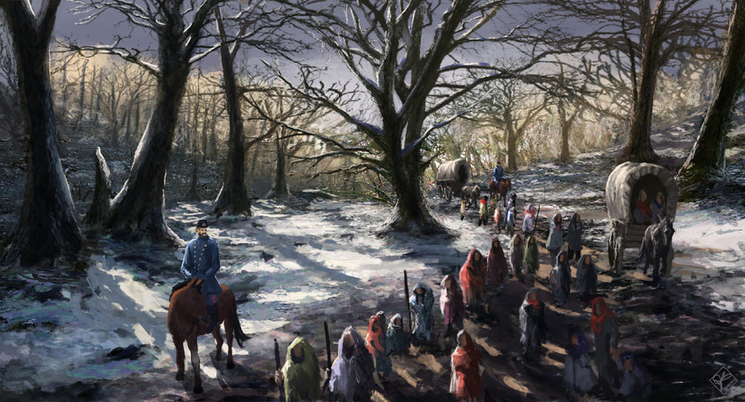
Indian Removal Act and Trail of Tears
Two related actions by Andrew Jackson help to facilitate Western migration…
The Indian Removal Act 1830
Indian Removal Act forces Native Americans off their lands
Supreme Court overturns the act in Worcester v. Georgia 1832,
Jackson disobeys court
ruling
The Trail of Tears 1832-1834
U.S. soldiers forcibly march
15,000 Cherokee living in
the South East off of their
land.
4,000 die in the process
Notes:
Need to start with Red

Slide 21
Summarizing the Era
How is manifest destiny a foreign policy vision?
How is western migration an act of foreign policy?
Could we consider the movement of Americans west as a first act of American imperialism?

Slide 22
Texas Revolution
1835-1836

Slide 23
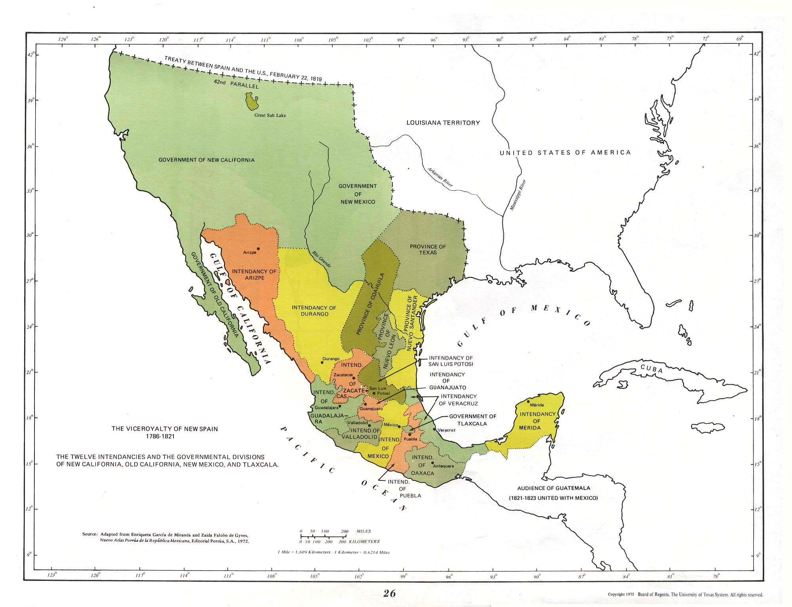
Background on Tejas/Texas
Tejas was settled by the Spanish in the late 1600s
Spanish had tried to use the mission system to settle the region, but it largely failed
By 1800 there were only three Spanish settlements in Tejas
Bottom Line: In 1800 Tejas is a region in the Spanish Colony of New Spain

Slide 24
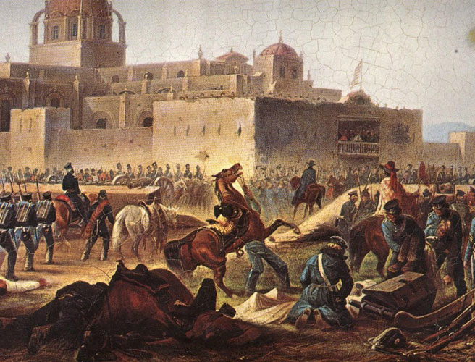
Mexican War of Independence
Beginning in 1810, people living in New Spain begin to fight for independence from Spain.
By 1821, New Spain successfully gained independence.
Mexico was founded as a free and independent nation

Slide 25
And this is where your reading will pick it up…

Slide 26
Summarizing this Period
The annexation of Texas of Texas is both part of the broader movement of Western expansion but also adds a (potentially) new dimension to American foreign policy.
We have seen America acquire new territory through:
Louisiana Purchase (buy land from a sovereign nation)
War of 1812 (settle boundary disputes through Treaties)
Trail of Tears (Take land that we view as rightfully ours because they people are perceived to not be sovereign)
Texas Annexation (incorporate a republic into our land, but this republic is not seen as free by Mexico, thus we acquire territory and piss off a free and sovereign nation)
Is there an evolution here? Are these similar, or is something new in how America grows its territory by the time we get to Texas?

Slide 27
Mexican-American War 1846-1847

Slide 28
The Lead Up to War
Spurred on by the annexation of Texas, President James Polk wanted to acquire the land from Texas to the Pacific Ocean—Land currently owned by Mexico
He sent an envoy to Mexico discuss the sale of these regions
The Mexican government refused to meet with the envoy

Slide 29
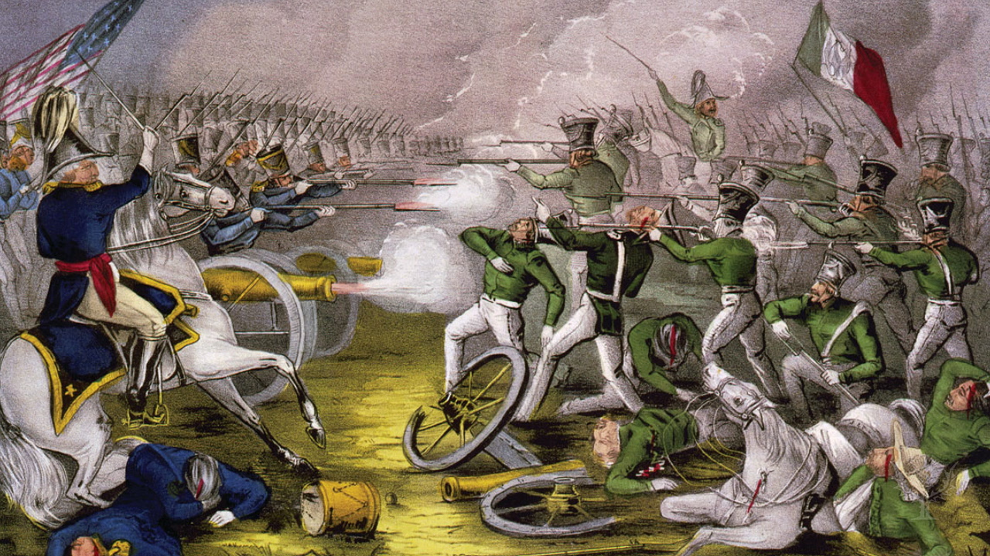
The Course of the War
President Polk ordered troops under the leadership of future President Zachary Taylor to stir up a skirmish in Mexico in order to justify declaring war on Mexico
In a matter of months the Americans had defeated the Mexican troops
Mexicans call the war: “The War of the American Invasion” or “War of Northern Aggression”
The Treaty of
Guadalupe Hidalgo
ends the war:
Required Mexico
turn over its Western
possessions to the
United States

Slide 31
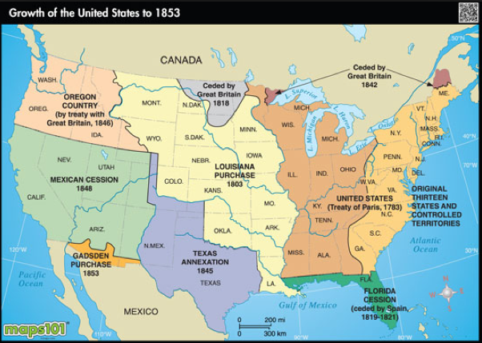

Slide 32
L2 & L3: Foreign Policy and Western Expansion
1776-1847
American Foreign Policy
Agenda
Objective:
To learn the key events in American foreign policy from the founding to 1847
To identify the foreign policy frameworks governing American action in this era.
To offer a analytical summary of the foreign policy of this era.
Schedule:
Lecture & Discussion
Homework:
Paper Check-in by Thurs 11/17
I’ve cancelled the readings due Fri…you’re welcome. WORK ON YOUR ESSAY

Slide 33
Summing Up
How is US action in the Mexican-American war, the next stage in the evolution of American foreign policy? What is new here?
How would you summarize the state of American foreign policy by 1847—characterize the era?

Slide 34
Misc Slides on Texas Revolution/MX-AM War

Slide 35
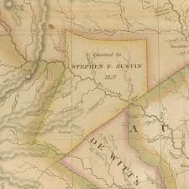
Americans Moves to Texas
Hoping to increase the population of their new nation, Mexican officials looked to recruit new settlers (empresarios)
They began offering free land to individuals who would build settlements in particularly under-populated areas
Stephen Austin was one of the first Americans to take Mexico up on its offer. He established a large settlement of Americans in Texas

Slide 36
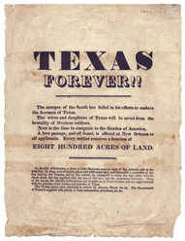
Americans Move to Texas
As a result of the success of Austin’s settlement, more and more Americans began to move to the Texas region of Mexico.
In 1825, Texas had about 3,5000 people with most of Mexican descent. By 1834, the population had grown to about 37,800 people with only 7,800 of Mexican descent.

Slide 37
Americans Make Themselves a Little Too At Home…
Many Americans openly disregarded Mexican laws
In particular…
Americans continued to practice slavery
Americans refused to become Mexican citizens
Fed up, 1830 Mexican officials passed a law banning further American immigration to the nation

Slide 38
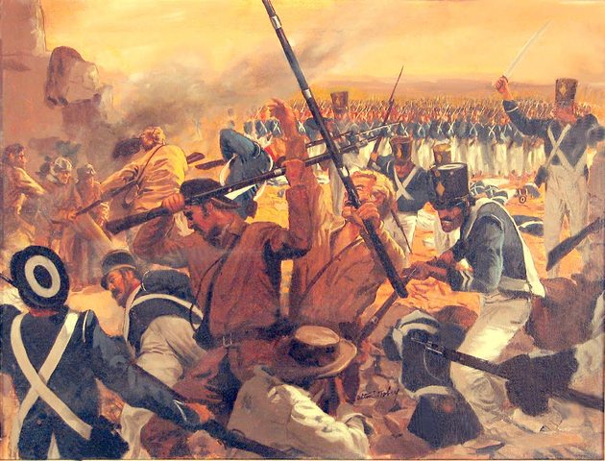
The Texas Revolution
Tensions between American settlers, now calling themselves Texans, and the Mexican government worsened.
These Texans decided they wanted to form their own independent nation and break off from Mexico
In 1835 Texans went to war with Mexico for their independence
By 1836, the Texans had
defeated the Mexicans and
they proclaimed a new nation:
The Republic of Texas

Slide 39
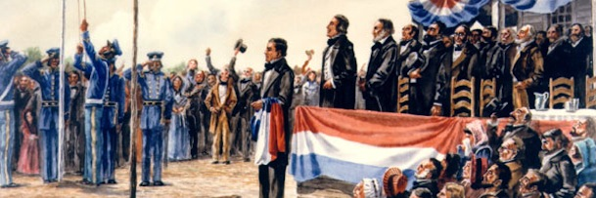
The Annexation of Texas
The Republic of Texas soon saw itself struggling amongst internal political strife and constant fear of Mexican invasion
By the late 1830s Texas requested statehood from the United States
After much political debate, in 1845 congress admitted Texas as a state
In response, Mexico breaks off diplomatic relations with the United States
Perceive annexation as a theft of Mexican lands

