Slide 1
American Immigration History Gilder Lehrman Institute Lecture 1:
Prof. Vincent Cannato
University of Massachusetts Boston

Slide 2
Persons Obtaining Lawful Permanent Resident Status, Fiscal Years 1820-2014
Look for migration patterns within data
Link those patterns to specific events in U.S. history
Four periods in immigration history – Three major waves of immigration
1820-1890
1880-1924
1924-1965
1965-present

Slide 4
Migration is a near-permanent reality in human history
Migration occurred not just to America, but also to Canada, Australia, Argentina, Brazil.
Immigration invariably causes social tensions
In the U.S., restriction of immigration is almost a constant throughout its history
At the same time, the Americans have internalized the idea that immigration is central to our national identity.
“Push” and “pull” factors for immigrants
Immigration has been, and remains, largely an economic issue
Immigrants are usually not the poorest of the poor

Slide 5
Settler, colonist, or immigrant? What’s in a name?
“Nation of Immigrants?
What is an American?
Crevecoeur: “What then is the American, this new man? . . . Here individuals of all races are melted into a new race of men, whose labours and posterity will one day cause great changes in the world.” (1783)

Slide 6
American Creed
Historian David Gerber: The U.S. is a nation of diverse peoples, formed not through a common genealogy . . . [i]nstead, its people have been bound together through allegiances to a constitution, outlining the framework for the making of law and for governance, and a loosely defined, ever contested creed.”

Slide 7
What is an American”
“
“Would America be the America it is today if in the 17th and 18th centuries it had been settled not by British Protestants but by French, Spanish, or Portuguese Catholics? The answer is no. It would not be America; it would be Quebec, Mexico, or Brazil”.
--Samuel Huntington, 2004

Slide 8
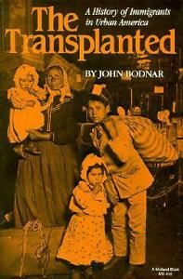
Handlin’s The Uprooted (1951) and Bodnar’s The Transplanted (1987)

Slide 9
European Population, 1600-1950 (in millions)
Year | Population | % increase
1600 | 95 | --
1650 | 100 | 5%
1700 | 120 | 20%
1750 | 140 | 17%
1800 | 190 | 36%
1850 | 270 | 42%
1900 | 400 | 48%
1950 | 580 | 48%

Slide 10
Earlier Settlement
Dutch – New Amsterdam (1620-1664)
Swedish – New Sweden (along Delaware River) (1638-1655)
French
Detroit (1701)
New Orleans (1718)
Spanish
St. Augustine, Florida (1586)
Santa Fe, NM (1608)
San Diego, CA (1769)

Slide 11
Fischer’s Albion Seed (1989)
English Puritans
Southern Cavaliers
Pennsylvania Quakers
Scots-Irish Backcountry

Slide 12
Population of Ireland
Year
1841 | 8.2 million
1851 | 6.6 million
1891 | 4.7 million
2011 | 6.4 million

Slide 13
Irish Immigration, 1820-1924
Decade | Number | Percentage of Total Immigration
1820s | 54,338 | 35.8
1830s | 207,381 | 34.6
1840s | 780,719 | 45.6
1850s | 914,119 | 35.2
1860s | 435,778 | 18.8
1870s | 436,871 | 15.5
1880s | 655,482 | 12.5
1890s | 388,416 | 10.5
1900s | 339,065 | 3.9
1910s | 146,181 | 2.5
1921-1924 | 71,865 | 3.1
TOTAL | 4,578,941 | 12.7

Slide 14
Irish Immigration
Catholic vs. Protestant
An urban people – settle on cities of the Eastern seaboard. Contrast with Irish Canadians
Most remain in the U.S. and don’t return to Ireland
Role of Catholic church
Use of politics for upward mobility/role of saloon
Conflicts with Protestants
Unskilled/Semi-skilled labor

Slide 15
“Gangs of New York”

Slide 16
Irish Catholics
Archbishop John Hughes (1797-1864)
--”Dagger John”
Aggressive defense of the interests of working-class Irish Catholic Americans. “Militant church”
Role of Catholic schools and other institutions
St. Patrick’s Cathedral – “Hughes’s Folly”
--Consecrated 1858, completed 1879

Slide 17
German Immigrants
Decade | Number | Percentage of Total immigration
1820s |  | 5.1
1830s |  | 25.4
1840s |  | 25.3
1850s |  | 36.6
1860s |  | 34.0
1870s |  | 25.5
1880s |  | 27.7
1890s |  | 13.7
1900s |  | 3.9
1910s |  | 2.5
1920s |  | 6.3
TOTAL | 5,643,893 | 16.4

Slide 18
German Immigrants
More affluent than the Irish. More likely to be skilled workers. More likely to become farmers
Settled mostly in Midwest. Chicago, Cincinnati, St. Louis, Milwaukee.
Economic reasons for migration, although the “Forty-Eighters” were liberal who left after 1848
Less likely to enter politics
Split between Protestants (Lutherans), Catholics, and Jews
German “turnverein”
Influence of German language in schools
634 German-language newspapers in 1910

Slide 19
German Immigrants
Influence of German immigrants on food
Hot dogs
Pretzels
Influence of the German Beer Hall
German-American breweries
Pabst Annheiser-Busch
Schlitz Miller
Yuengling Schaefer
Influence of German-Jewish Immigrants
Levi Strauss
Wall Street (Kuhn Loeb, Goldman Sachs, Lehman Bros.)
Department stores (Sears, Filene’s, Rich’s (Atlanta) Goldwater’s (Phoenix), Gimbel’s, Abraham & Strauss, Bloomingdale’s

Slide 20
Scandinavian Immigrants
Settle in upper Midwest and Great Plains
Largely rural farmers, although some urban (Chicago)
Protestant, largely Lutheran

Slide 21
Scandinavian Immigration
Decade | Immigrants
1820-1830 | 283
1831-1840 | 2264
1841-1850 | 14,442
1851-1860 | 24,680
1861-1870 | 126,392
1871-1880 | 243,016
1881-1890 | 656,494
1891-1900 | 371,512
1901-1910 | 505,324
1911-1920 | 203,859
Total of 2,147,859 Scandinavian immigrants: 1,116,239 from Sweden; 695,455 from Norway; 300,036 from Denmark

Slide 22
The Emigrants (1971)

Slide 23
Foreign Born as a Percentage of the Population
Year | Percentage
1850 | 9.7
1890 | 14.8
1910 | 14.7
1920 | 13.2
1940 | 8.8
1970 | 4.7
2000 | 11.1
2015 | 13.7
2025 (est) | 14.9

Slide 24
Rise of “Nativism,” Know Nothings, and Anti-Catholicism
“Believed that Protestantism defined American society.” (Anbinder)
“Catholicism was not compatible” with American values. (Anbinder)
Critical of the influence of Catholics in politics and the general shift away from considerations of the “public good.”
Never publicly advocated for limiting immigration. Called for extending the period of naturalization from 5 years to 21 years.

Slide 25
Governor Henry Gardner, Massachusetts (1855-58)
Know Nothing Party takes control of
Massachusetts state government in 1855.
Controls Governorship and entire state legislature.
Anti-immigrant, anti-Catholic. Passes law banning state aid to parochial schools
Passes other reforms, including banning imprisonment for debt and abolishing racial segregation in schools.

Slide 29
The Irish and “Whiteness”

Slide 30
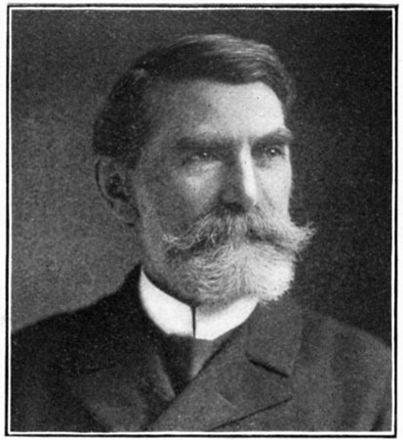
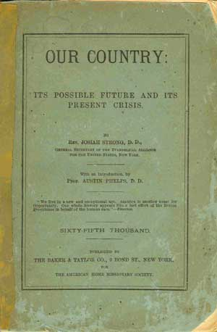
Josiah Strong’s Our Country (1885)

Slide 31
Immigration Regulation
No federal regulation of immigration prior to 1880s, with the exception of laws that regulated steamships that brought over immigrants
State laws governed immigration. Based on state anti-pauper laws that went back to 18th century. Concerned with “assisted” paupers, sent by European governments and landlords
Differences between Massachusetts and New York: NY abolishes pauper removal in 1824. Massachusetts continues it.

Slide 32
Immigration Regulation
Deportation vs. exclusion
Use of “bonding”: $300 bond for “lunatic, idiot, deaf and dumb, blind or infirm persons, not members of emigrating families, and who . . . Are likely to become permanently a public charge.” Charged to ship masters. Also had to pay a one dollar head tax.
In addition, NY officials assisted immigrants in returning back to Europe.
Not until 1880, did NY pass a law allowing for deportation of immigrants already here. In 1881, only 45 paupers were banished from NY.

Slide 33
Castle Garden
Creation of Board of Commissioners of Emigration of the State of New York (1847)
Operated hospitals for immigrants in Staten Island and Ward’s Island
Opening of Castle Garden (1855)
Irish and German Immigrant Aid Societies
State of New York and cities of Brooklyn and NYC
Dual Purpose: Protect immigrants and regulate immigration

Slide 34
