Slide 1
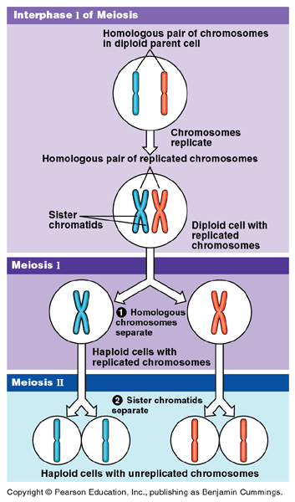
Meiosis
Production of gametes
(hope you remember mitosis!)
Boehm

Slide 2
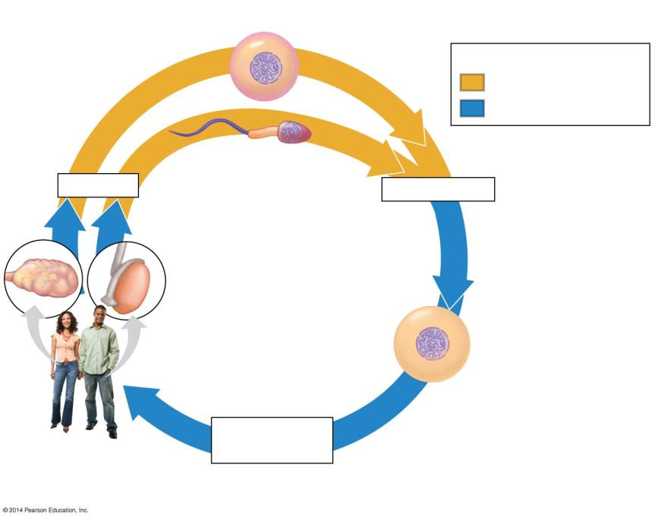
Haploid gametes (n = 23)
n
Key
n
Haploid stage (n)
Egg cell
Diploid stage (2n)
n
n
Sperm cell
Meiosis
Fertilization
Ovary
Testis
2n
Diploid
zygote (2n = 46)
Mitosis and
development
Multicellular diploid adults (2n = 46)
Notes:
Figure 8.12a The human life cycle

Slide 3
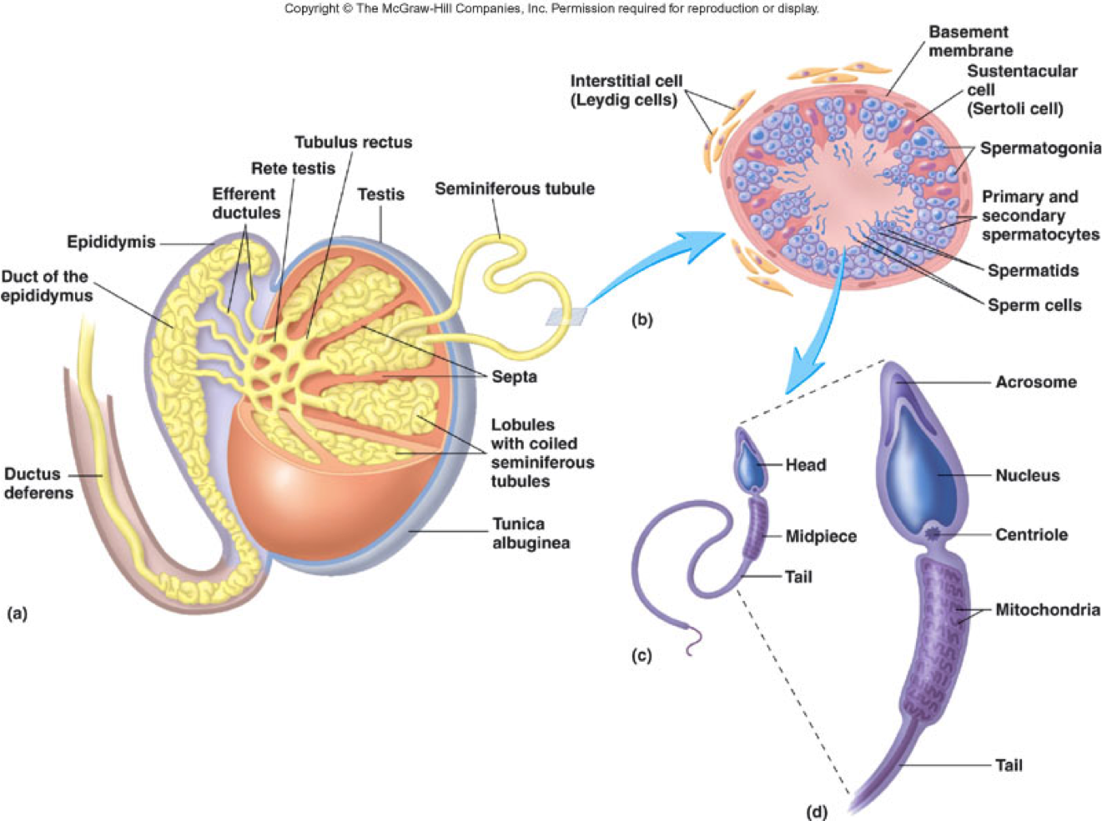

Slide 4
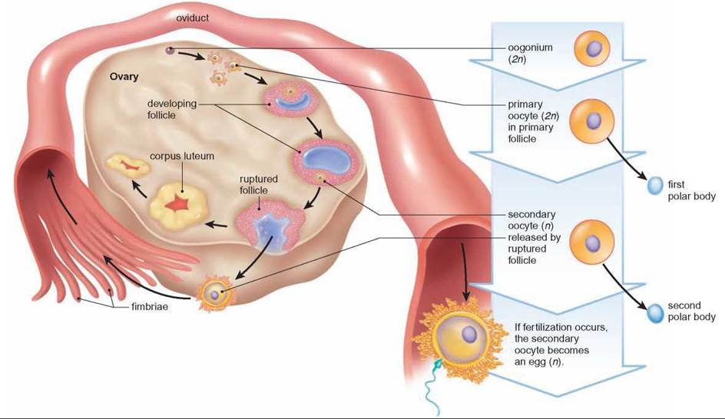

Slide 5
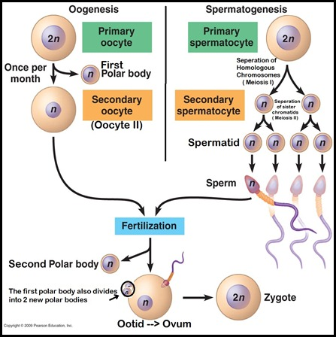

Slide 6
Zygotes form when Sperm and Egg fuse (fertilization)
A Zygote (fertilized egg) is derived from the thousands of genes that inherited from sperm and egg.

Slide 7
Introduction to Meiosis: Review of Homologous Chromosomes
Homologous chromosomes are matched in
length,
centromere position, and
staining pattern.
A locus (plural, loci) is the position of a gene.
Alleles - Different versions of a gene that may be found at the same locus on the two chromosomes of a homologous pair.
These homologous chromosome pairs carry genes that control the same inherited characters.

Slide 8
Homologous Chromosomes

Slide 9
Homologous Chromosomes - Human
In humans
somatic cell (all cells other than sperm or egg) has 46 chromosomes (23 Homologous Pairs, 2n, diploid).
Gametes (23 total chromosomes, n, haploid)
Each chromosome can be distinguished by its size, position of the centromere, and by pattern of staining with certain dyes.

Slide 10
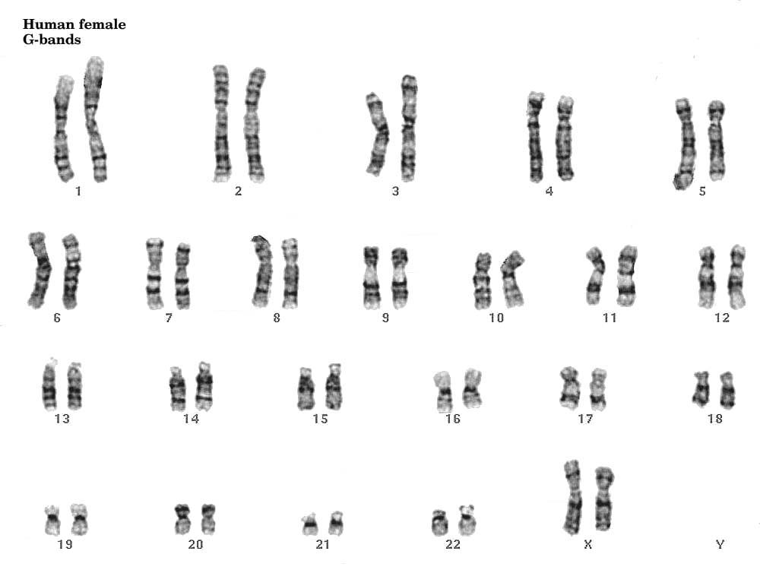

Slide 11
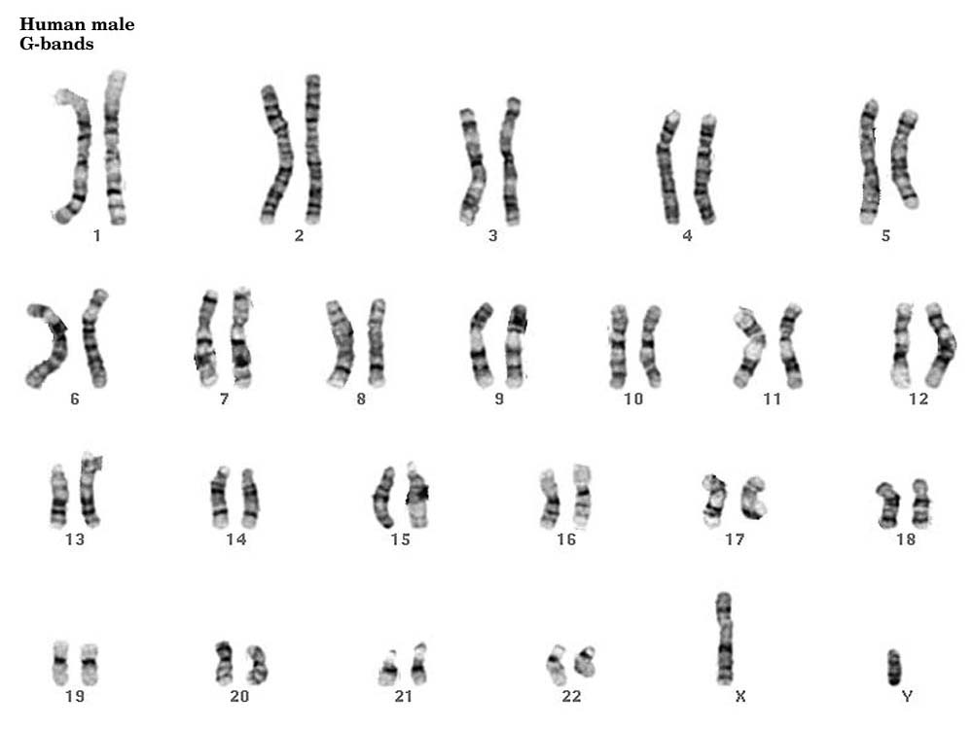

Slide 12
An exception to the rule: Sex chromosomes
The pattern of inheritance of these chromosomes determine an individual’s sex (this is different from gender).
Options for sex chromosomes:
XX (this person has 23 homologous pairs)
XY (this person has 22 homologous and 1 non-homologous)
XO (this person has only one X chromosome)
XXY (this person has 3 sex chromosomes)
XYY (this person has 3 sex chromosomes)
The other 22 pairs, that are not the sex chromosomes, are called autosomes.

Slide 13
The Gender Continuum

Slide 14
Recap and Review
Compare asexual and sexual reproduction. Benefits and drawbacks of each.
How can you identify a pair of homologous chromosomes? Why are they not exactly identical?
Explain the differences between a haploid and diploid cell. Give examples of each. (include the terms somatic cell and gamete)
What is an autosome? How many do humans have?

Slide 15
Making Gametes: Meiosis
Reduces the number of chromosomes by half (goes from diploid to haploid)
Many steps of meiosis resemble steps in mitosis.
Both are preceded by the replication of chromosomes (interphase).
there are two consecutive cell divisions, meiosis I and meiosis II, which results in four daughter cells.
Each final daughter cell has only half as many chromosomes as the parent cell.
Each cell is genetically different

Slide 16
Meiosis reduces chromosome number by copying the chromosomes once, but dividing twice.
The first division, meiosis I, separates homologous chromosomes.
The second, meiosis II, separates sister chromatids.

Slide 17
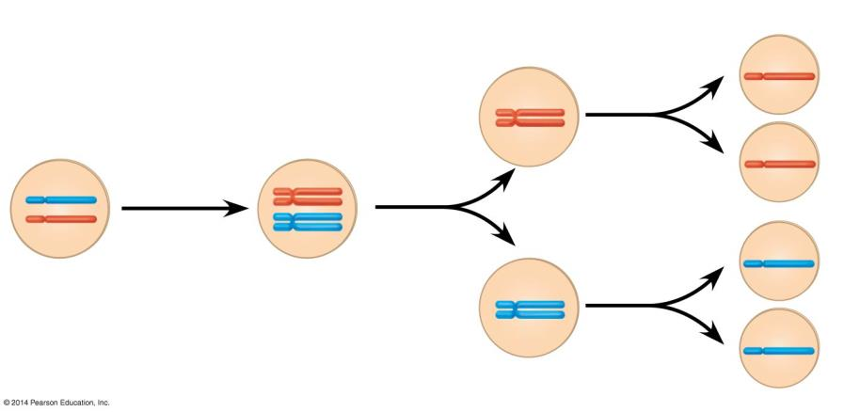
Interphase
Meiosis I
Meiosis II
Sister chromatids
1
2
3
Sister chromatids separate
Haploid cells
Chromosomes duplicate
Homologous chromosomes
separate
A pair of
homologous chromosomes in a diploid
parent cell
A pair of duplicated homologous
chromosomes
Notes:
Figure 8.12b How meiosis halves chromosome number

Slide 18
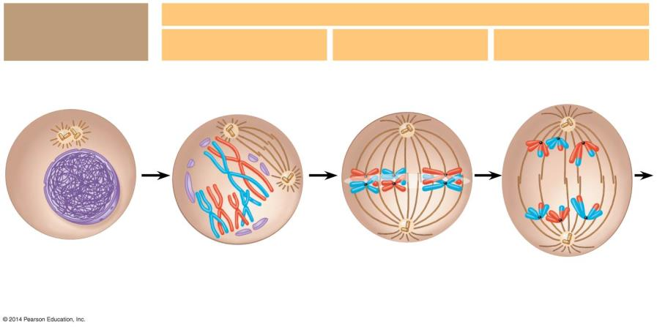
Interphase: Chromosomes duplicate
Meiosis I: Homologous chromosomes separate
Prophase I
Metaphase I
Anaphase I
Sites of crossing over
Spindle microtubules attached to a kinetochore
Sister chromatids remain attached
Centrosomes
Spindle
Tetrad
Metaphase
plate
Nuclear envelope
Chromatin
Sister chromatids
Fragments of the nuclear
envelope
Centromere (with a kinetochore)
Homologous chromosomes separate
Notes:
Figure 8.13-1 The stages of meiosis (part 1)

Slide 19
In prophase I, the chromosomes condense and homologous chromosomes pair up to form tetrads.
In a process called synapsis (or crossing over), homologous chromosomes attach tightly together.
Segments of chromosomes are exchanged.

Slide 21
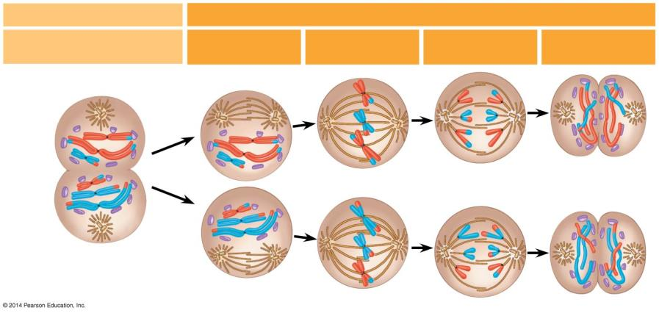
Meiosis II: Sister chromatids separate
Telophase I and Cytokinesis
Prophase II
Metaphase II
Anaphase II
Telophase II and Cytokinesis
Cleavage furrow
Sister chromatids separate
Haploid daughter cells forming
Notes:
Figure 8.13-4 The stages of meiosis (part 4)

Slide 22
Meiosis I occurs in four phases: prophase I, metaphase I, anaphase I, and telophase I.
During the preceding interphase the chromosomes are replicated to form sister chromatids.
These are genetically identical and joined at the centromere.
Fig. 13.7

Slide 23
In prophase I, the chromosomes condense and homologous chromosomes pair up to form tetrads.
In a process called synapsis (or crossing over), homologous chromosomes attach tightly together.
Segments of chromosomes are exchanged.

Slide 24
At metaphase I, the tetrads are all arranged at the metaphase plate.
Microtubules from one pole are attached to the centromere of one chromosome of each tetrad, while those from the other pole are attached to the other.
In anaphase I, the homologous chromosomes separate and are pulled toward opposite poles.

Slide 25
In telophase I, movement of homologous chromosomes continues until there is a haploid set at each pole.
Each chromosome consists of linked sister chromatids.
Cytokinesis by the same mechanisms as mitosis usually occurs simultaneously.
In some species, nuclei may reform, but there is no further replication of chromosomes.
Fig. 13.7

Slide 26
Meiosis II is very similar to mitosis.
DNA does NOT replicate before Meiosis II

Slide 27
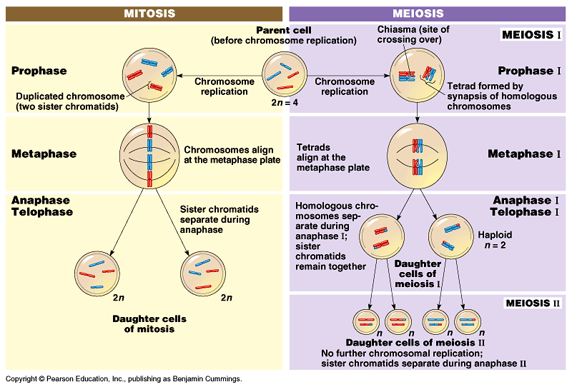
Mitosis produces two identical daughter cells, but meiosis produces 4 very different cells.

Slide 29
Recap and Review
List at least 3 ways that meiosis I differs from mitosis.
Explain crossing over, or synapsis. What is the function of having this event?
Why does meiosis have 2 cell divisions and mitosis only has 1?
Compare meiosis II to mitosis.

