Slide 1
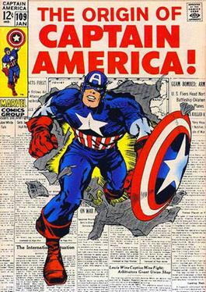
In 1940, writer Joe Simon & Jack Kirby came up with the idea for Captain America.
He was a consciously political creation: Simon & Kirby were morally repulsed by the actions of Nazi Germany in the years leading up to the United States' involvement in World War II.
Physically, Captain America was the symbolic representation of the U.S.
Colors
Strength

Slide 2
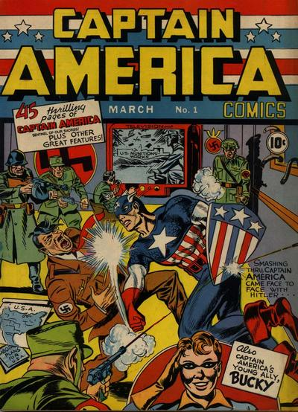
1st issue of Captain America was a FULL YEAR before the United States entered WWII.
This was due in part to the publisher - Marvel Comics, was unsure the German leader would still be alive if printing of the comic went on the regular schedule.
1st comic cover with a hero fighting a villian that was entirely human.
Marvel editor in 2017, Tom Brevoort told The Washington Post’s Comic Riffs, “Apart from Bundists [secular Jewish socialist movement] & supporters of the Axis cause, there was a strong isolationist feeling in America.”
Simon & Kirby were both threatened after the publishing of the comic, though neither came to any harm.

Slide 3
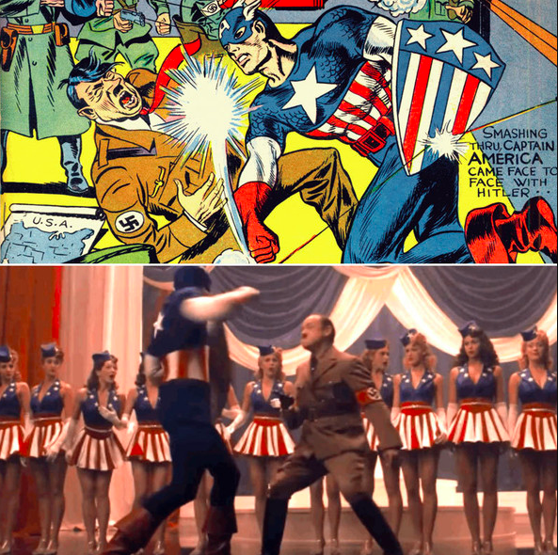
From 1st issue:
“We shall call you Captain America, son! Because, Like you - America shall gain the strength and the will to safeguard our shores.”
Author, Joe Simon said,
“Here was the arch villain of all time...Adolf was live, [and] hated by more than half the world.”
Two years after debuting Captain America in March 1941, Kirby was drafted.
“There is nothing that you would call ‘romantic’ about war,” he observed. “Sure, in the movies and on television they paint a great picture of the fellowship that it creates. I’ve seen war bring people together, but I can tell you that the cost is extremely high: not just in terms of lives, but the human spirit...”
Notes:
More info on Kirby if you’d like to share it: He served in Patton’s army as a scout on dangerous missions taking him into Nazi-held territory in France & Belgium.

Slide 4
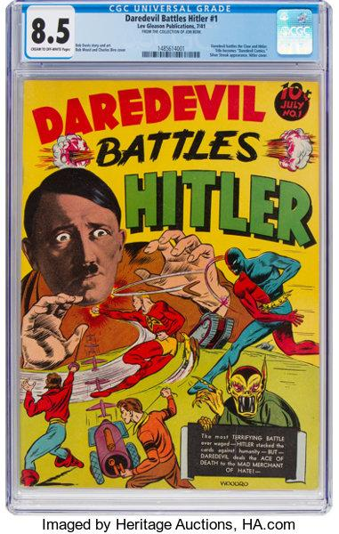
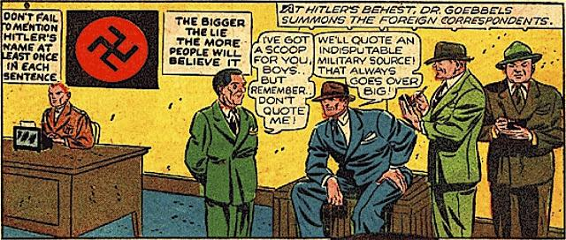
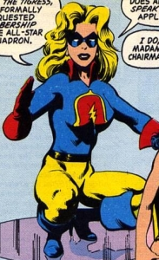
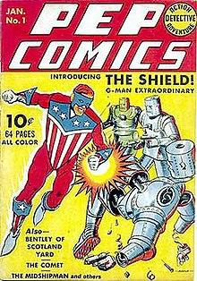
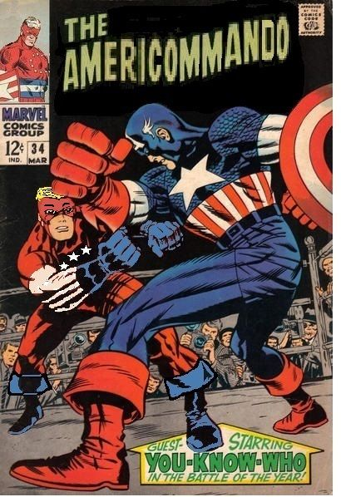
Other superheroes would also battle Hitler, as seen here.
Daredevil
AMERICOMMANDO
The Shield
Liberty Bell
Notes:
Liberty Bell Info: Liberty Belle is the descendent of Miss Liberty, a hero of the Revolutionary War. Liberty Belle is one of the most literal heroes in the very literal world of comics: her powers are triggered by, you guessed it, Philadelphia’s Liberty Bell.
AMERICOMMANDO: Though he was also called Mr. America, Tex Thompson deserves to be remembered for the much awesomer name of Americommando. Like Indiana Jones, he had no superpowers but was good with a whip.
THE SHIELD
By far the most important patriotic superhero other than Cap, the Shield debuted in 1940 (over a year before Captain America) and features the same star-spangled outfit, a very similar super-soldier origin, and the same Nazi-fighting early adventures. In fact, the reason Cap carries a round shield is that his original triangular shield looked too much like the symbol on the Shield’s chest.

Slide 5
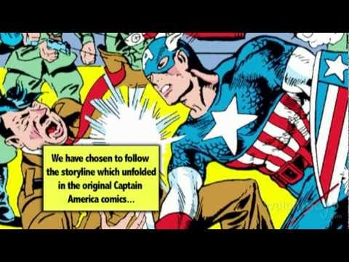

Slide 6
Brainstorm to Create your Comic
You want all details to relate to your response to Zinn’s argument.
Based upon your claim, what would be your character's personality? Consider:
Who is this character?
What is he/she/they like?
What are their positive and negative traits? (which could be a way for you to reference your evidence).
What are the wants and needs that drive most of your character’s actions?
If other countries knew this character - would they be a friend, colleague, neighbor or family member, considering this may allow you more greatly develop the personality.
Using the above responses, you may be able to place your character in a genre.
For example, does your character/response fit more into fantasy, dark, light & happy, etc.
Consider archetypes (which are characters that typically appear repeatedly in fiction)
For example, an archetypal mentor would be wise, patient, and calm.
Play around with the physical traits of the character.
What is your character’s backstory? Where are they from? Where do they live?
Name your character! Consider a name that speaks to your character's personality.

Slide 7
Wrap Up Discussion
Among the characters/comics hung around the room:
Who would be your nemesis?
Who would be your sidekick?
Who has parallel villains to your character?
What do your answers to all of these questions tell us about American Foreign Policy?

