Slide 1
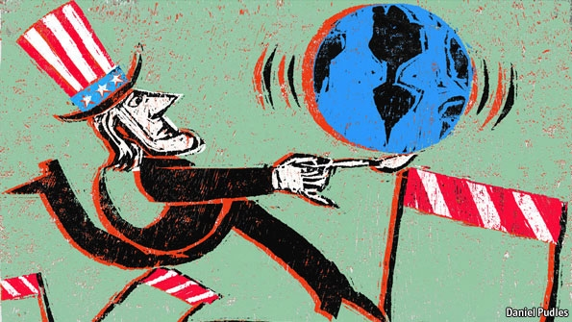
Introduction to the Themes of US Foreign Policy
American Foreign Policy
Agenda
Objective:
To explore the themes/trends in American foreign policy
Schedule:
Intro to Unit
Discussion & Document Exploration
Meet about paper
Homework:
Work on Paper
2. Complete Cartoon Character for our third class

Slide 2
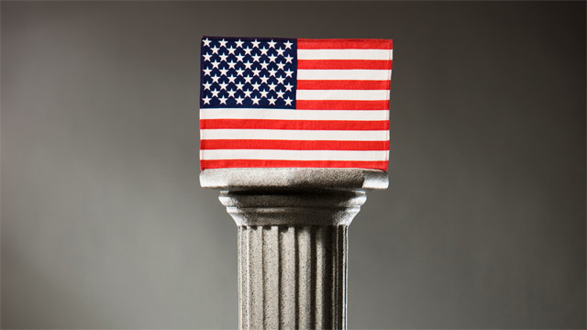
What is American Foreign Policy?
This is the question we will be grappling with this unit.
To begin, we are going to do a “gallery walk”
Move around the room and look at different iconic images associated with American Foreign Policy
Choose one image that best defines for you what foreign policy is and stand in front of that image
Why did we choose the image we did?
What themes/frameworks do we see emerging in American foreign policy?

Slide 3
Howard Zinn on American Foreign Policy
We will read an excerpt from Howard Zinn’s A People’s History of American Expire
While reading, focus on the questions
What is Zinn’s claim?
How does Zinn’s claim (confirm/clarify/reinforce/enlarge/challenge/conflict with/replace) your gallery walk choice?

Slide 4
Stations Activity
We are now going to look at 3 foreign policy frameworks that American leaders have endorsed across US history. In considering these stances, we will see the complexity of US foreign policy and find affirmation of refutation for Zinn’s claim
Foreign Policy frameworks we will consider:
Isolationism
Imperialism
Unilateralism vs. Multilateralism
At each station, read and annotate the documents to answer the following 3 questions:
Define the framework
In what types of historical moments in the framework most likely to be used?
How do leaders justify the use of the framework in their particular historical moment?
You will go through the stations in groups
Whatever we don’t finish today we will finish tomorrow

Slide 5
Discussion
Break up into two groups, for our discussion
Let’s discuss each framework first:
Define the framework
In what types of historical moments in the framework most likely to be used?
How do leaders justify the use of the framework in their particular historical moment
To what extent is Howard Zinn’s claim about the history of US foreign policy valid?
Throughout US history, the military has not been used for moral purposes, but to increase economic, political, and military power

Slide 6
Cartoon Character
To wrap up our introduction, you are going to turn to your response to Zinn’s claim into a cartoon character.
Think, Captain America…
Visually represent your understanding of American foreign policy with a Cartoon Character. Provide a 1 paragraph explanation of your character (10 point assignment)

