Slide 1
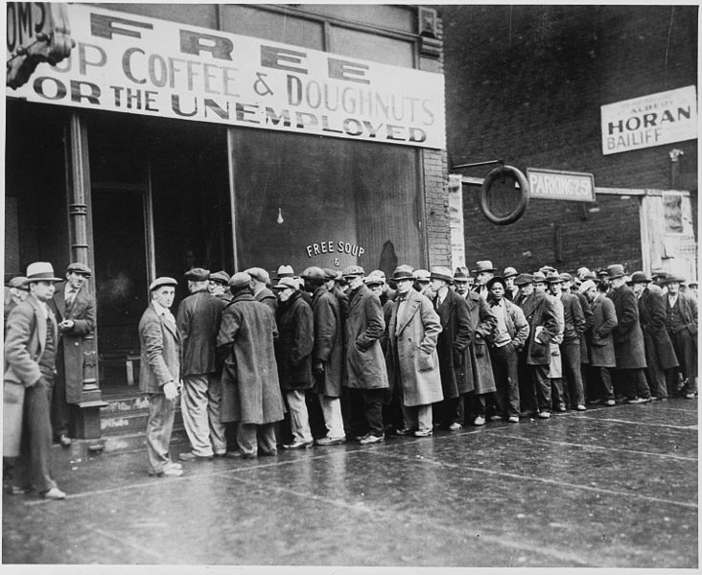
The Great Depression
1929-late 1930s
Worldwide economic collapse in which unemployment and homelessness skyrocketed, government revenue and international trade
plummeted, the stock
market lost significant
value, and banks
closed.

Slide 2
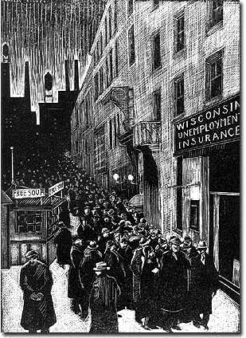
How Great was the Great Depression?
Real output (GDP) fell 29% from 1929 to 1933.
Unemployment increased to 25% of labor force.
Consumer prices fell 25%; wholesale prices 32%.
Some 9000 banks failed.

Slide 3
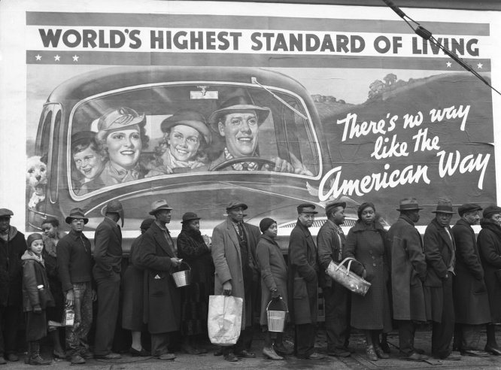
Redefinition of Freedom/Democracy Post Great Depression
Freedom as liberty (free labor) no longer sufficient in the wake of the corporate abuses of the Gilded Age & The Great Depression
Sense that the Progressive definition of industrial freedom doesn’t go far enough…
Need for greater economic
regulations to prevent
extreme economic
downfalls
Many progressive goals
still to be implemented
Ex. No federal minimum
wage

Slide 4
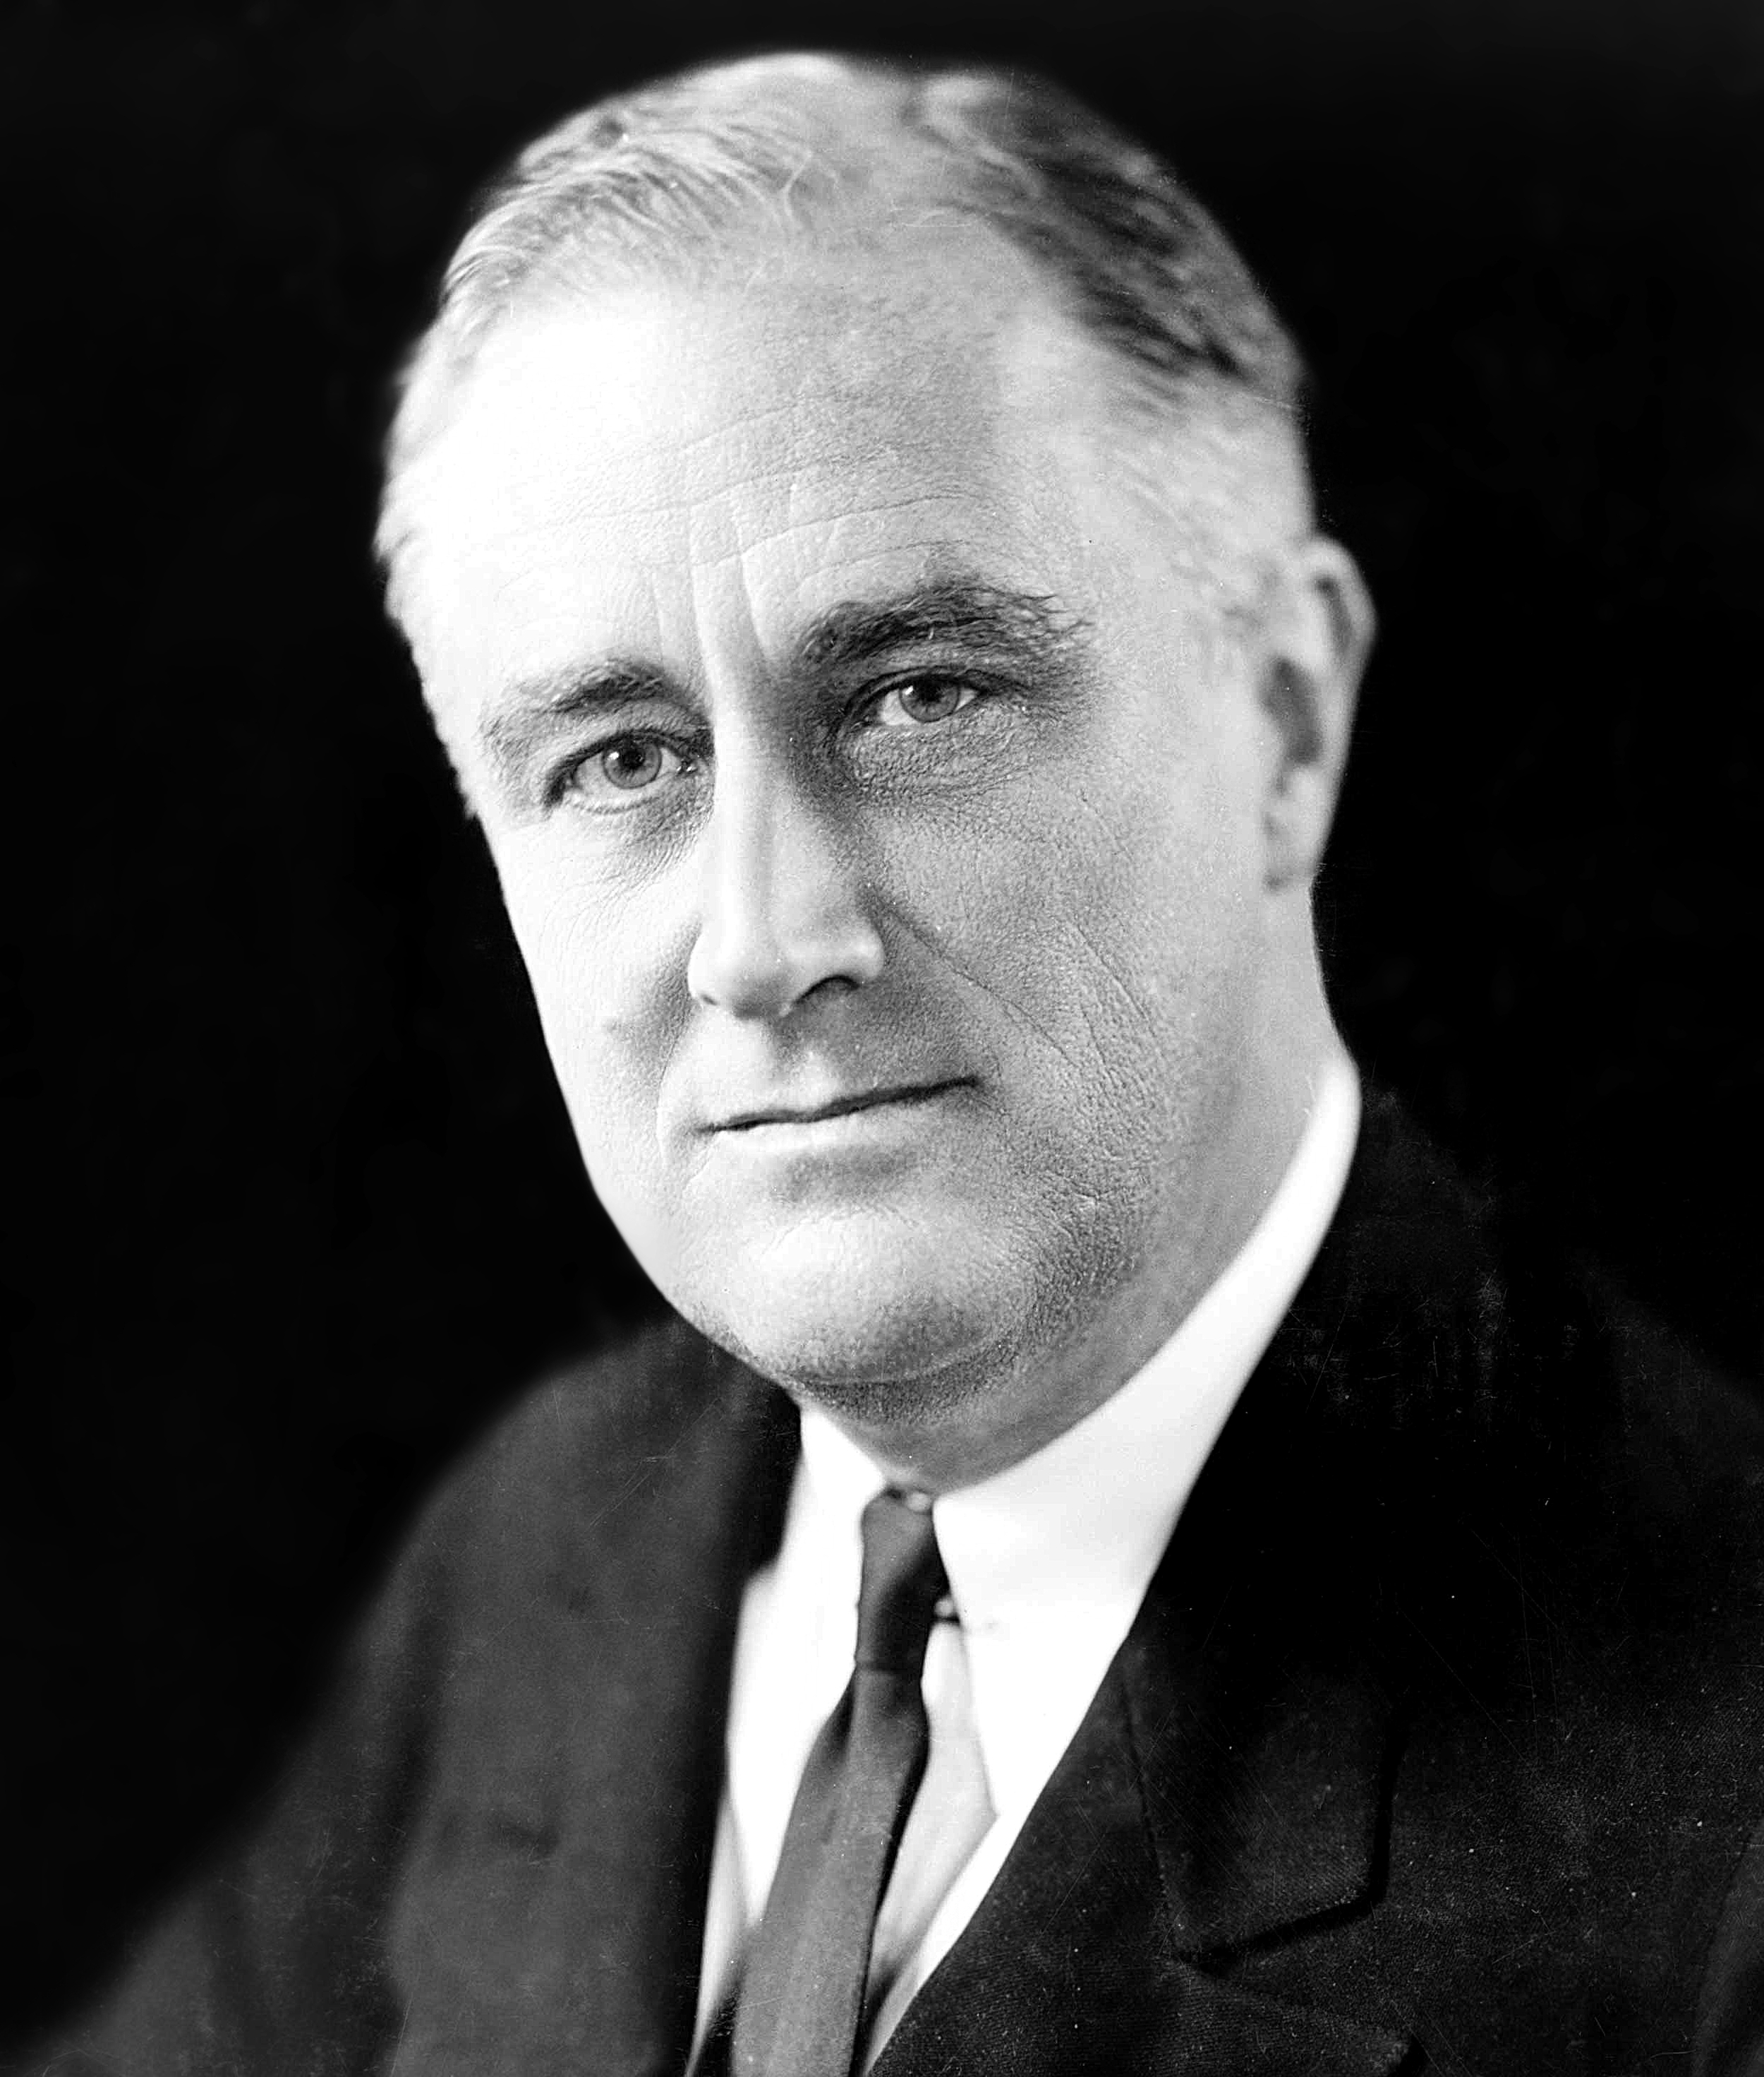
Franklin Roosevelt
1882-1945
Democrat
Married to Eleanor Roosevelt
Was Assistant Secretary of the Navy and Governor of New York
Contracted polio at age 39 and was paralyzed from the waist down
Never used a wheel-chair in public
Always strove to appear ambulatory in public images
President from 1933-1945
Was elected President a record 4 times in a row
Died during his 4th term in office
Oversaw American involvement in the Great Depression & World War Two
Created a massive and instrumental social welfare program in the US known as the New Deal

Slide 5
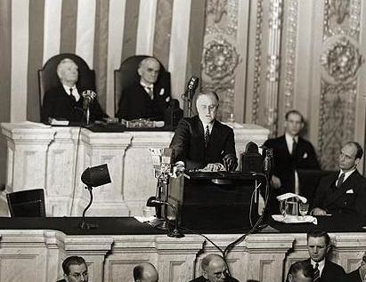
Roosevelt’s Notion of Freedom and Democracy
Together we will listen to excerpts from Roosevelt’s 1941 State of the Union Speech.
Has come to be known as the “Four Freedoms Speech”
https://www.youtube.com/watch?v=tPjYCg8_sKQ (start 26:23)
Discussion:
According to this speech, what is freedom for Roosevelt?
According to this speech, what is the role of the national government in securing that freedom?
In other words, what shape should American democracy take to ensure the freedom of its citizens?

Slide 6
FDR on Freedom and Democracy
Freedom
Freedom can only be accessed if people have economic security
Macro Level (National Level)
The American economy is stable
Jobs, currency is stable, banks are safe
Mico Level (Personal Level)
Your personal family economy is stable
You have a job, money to put food on the table
Democracy
This economic security must be insured by the national government
National government should actively and strictly promote both
National economic stability
Your own personal economic stability
Also helps to usher in a new relationship between the people and the national government
The national government should be close to the people
The national government has an obligation to the quality of your life
In defining democracy this way, Roosevelt transforms the relationship between:
Federal Government & Economy
Federal Government & Citizenry

Slide 7
What Makes Roosevelt’s Ideas about Freedom New?
See Personal Freedom as Inborn/Automatic
Federalists
Personal freedom is natural to men, only obstacle is possible “mob rule”
Jefferson / Jeffersonians
Personal freedom is natural to men, only obstacle is possible tyrannical federal authority
Gilded Age/ 1920s Laissez-Faire Capitalists
Unfettered capitalism grants you freedom naturally (if you use it property)
See Barriers to Accessing Personal Freedom, and Recognize That They need to be Removed…
Jackson
Must have equal political participation (the vote & more) to be free (applies to white males only)
Barrier: Lack of suffrage
Lincoln
Must be free to labor (economic autonomy) to be free
Barrier: Slavery
Radical Republicans
Must have civil rights to be free
Barrier: Legal Inequality
Progressives
Must have economic fairness as a worker and consumer (industrial freedom) to be free
Barrier: Unfettered capitalism
Franklin Roosevelt
Must have economic security to be free
Barrier: Unfettered capitalism, poverty, bad luck

Slide 8
Those Who See Barriers to Freedom, Argue it is the Job of the National Government to Break Them Down
Jackson
Freedom rests on more political participation for the average white farmer → Use broad presidential power outside of war to accomplish this (Trail of Tears, Veto the Bank)
Lincoln
Freedom rests on freedom to labor → Broadly define Presidential War Time Powers to accomplish this by ending slavery (Civil War & Emancipation Proclamation)
Radical Republicans
Freedom rests on the possession of Civil Rights → Expand the authority of the National Government and Empower Congress with the ability to pass Civil Rights Legislation (Reconstruction Amendments)
Progressives
Freedom rests on economic fairness → State and national governments need to promote laws that limit the power of corporations and promote the rights of workers
Franklin Roosevelt
Freedom relies on economic security → Expand the national government and its powers to intervene in both the national economy and our personal economies to achieve macro and micro level economic security
In so doing, recast the idea of freedom by linking it the expanding power of the nation-state!

Slide 9
How Does FDR Go About Using the National Government to Ensure Economic Security?
Consolidate national power
Bring the 3 branches of government in line with FDR’s vision (use extreme-ish means to do this if necessary)
Keep the vision going by running for president 4 times
Produce Programs that Focus Economic Security
Focus on Economic Security at both:
National Level
Personal Level
Use Laws, Programs, and Executive Orders to achieve this
Fire-side chats
Use radio speeches given directly to the American people to develop closeness/relationship/trust between the national government and the people

Slide 10
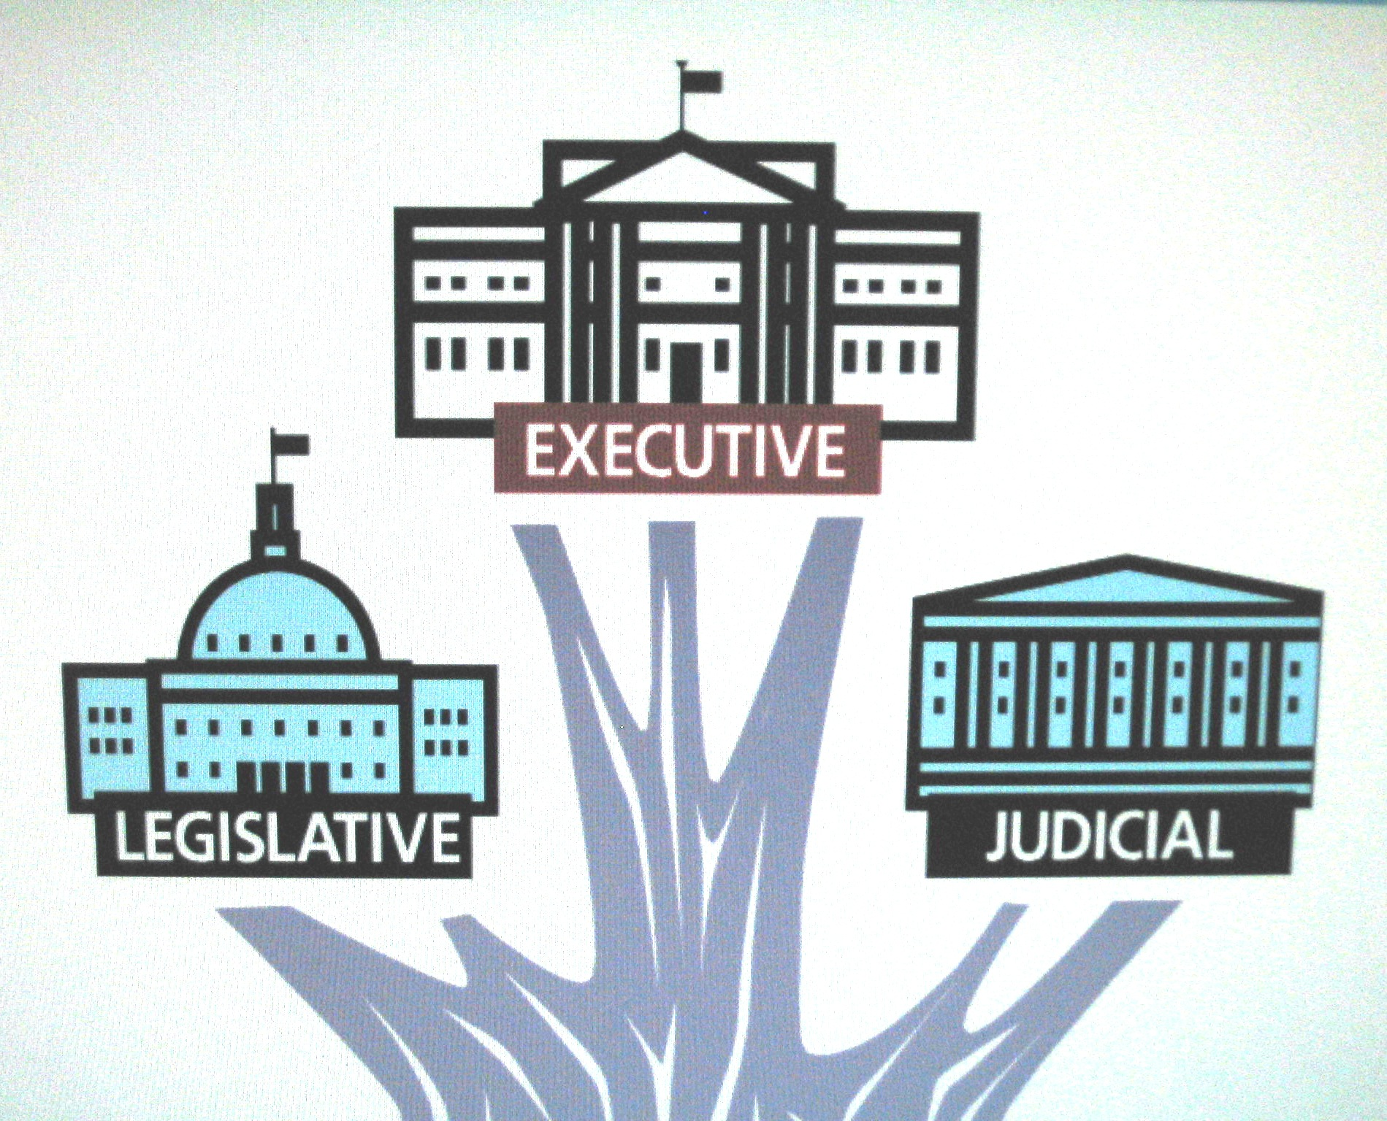
Consolidate National Power by Bring the 3 Branches of Government under his Direction
President
Franklin Roosevelt (Democrat)
Highly visionary and active
Crafted the New Deal and its programs and pushed them through Congress
Congress
Senate: Democratic Majority
House: Democratic Majority
First 100 Days FDR sent Congress 15 major
bills all of which passed easily
Supreme Court
Chief Justice Charles Evans Hughes
Most justices ideologically aligned with the Republican Party
SCOTUS find several pieces of New Deal legislation unconstitutional across approximately 10 different cases
The orientation of SCOTUS is a problem for Roosevelt….

Slide 11
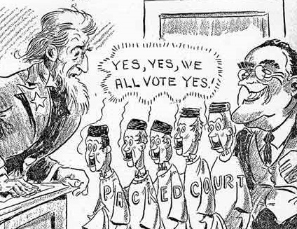
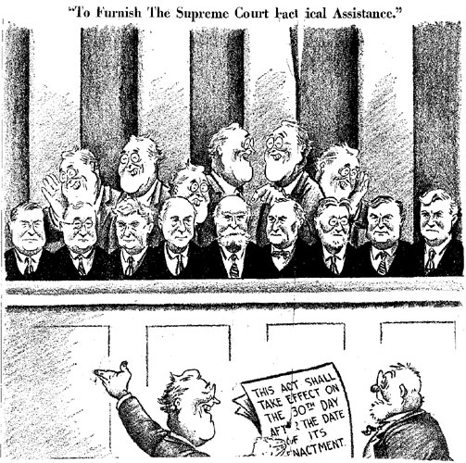
Consolidate National Power by Bring the 3 Branches of Government in line
How to bring the court in line?
Judicial Procedures Reform Bill 1937
“Court Packing Plan”
A legislative initiative (threat) by FDR to add more justices to SCOTUS
Would have granted the president power to appoint an additional Justice to SCOTUS, up to a maximum of 6, for every member of the court over 70.5 years old
Since the Constitution does not define the size of SCOTUS, Roosevelt pointed out that it was within the power of Congress to change it
Bill never makes it out of the Senate Judiciary Committee
But…
Associate Justice Owen Roberts, who had voted against the constitutionality of ND legislation, now began to vote for it
His switch was seen as a direct response to the pressure FDR was putting on the court
Reversal came to be known as “the switch in time that saved nine”
Associate Justice Willis Van Devanter resigns, beginning a process of tipping the court towards Roosevelt
Other deaths/retirements throughout Roosevelt’s 12 years in office leave SCOTUS squarely on his side throughout his 3rd term.

Slide 12
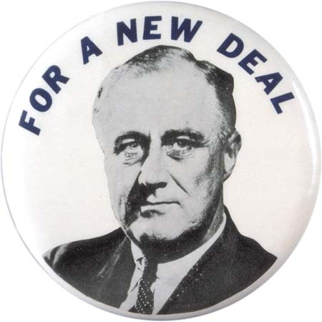
Programs Focused on Economic Security: The New Deal
Series of domestic programs aimed at providing relief, recovery, and reform during the Great Depression
Relief for the unemployed and poor
Recovery of the economy to normal levels
Reform of the financial system to prevent a repeat depression
Achieved through laws passed by Congress as well as presidential executive orders
Mostly enacted between 1933 and 1938
Let’s review some of these programs…
Let’s take a look at a very partial list of ND programs
As we look at the list think about…
How are these programs producing economic security at the national level?
How are these programs producing economic security at the personal level?
How are the powers of the national government being expanded in this process?
http://staff.washington.edu/qtaylor/Courses/101_USH/new_deal.htm
You may wish to also look at the periodic table of the New Deal
http://www.fdrlibrary.marist.edu/education/resources/periodictable.html

Slide 13
How is Economic Security Being Ensured?
Economic Security
National Level
Personal Level

Slide 14
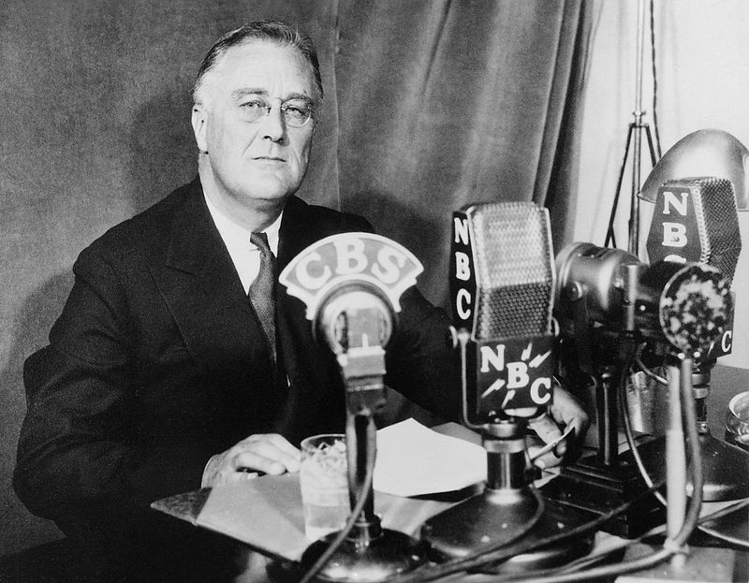
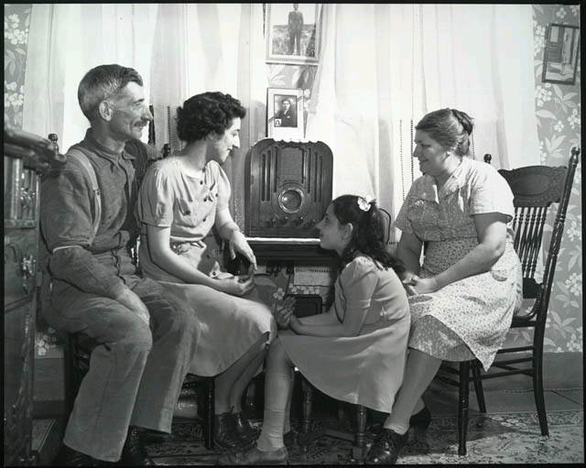
Fire-Side Chats
A series of 30 evening radio addresses given by President Roosevelt between 1933 and 1944
Topics included:
Banking crisis, the recession, New Deal initiatives, and World War Two
Chats had better ratings than the most popular radio shows
Was able to “sell” is programs to the American people
The fireside chats represent the first time in history that a chief executive communicated directly with a large number of citizens
Level intimacy made people feel like they were a part of the administration
Trusted the government
Helped to convince them that the government worked for them

Slide 15
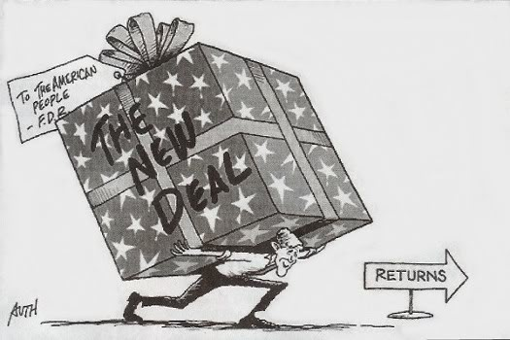
Criticisms of Conservative Opponents
Conservative opponents said the New Deal went too far:
It was socialism (killed individualism)
It added to the national debt It wasted money on relief and encouraged idleness
It violated the constitution & states rights
It increased the power of the Presidency (FDR was reaching toward dictatorship, Congress a rubber stamp, independence of judiciary threatened, separation of powers shattered)

Slide 16
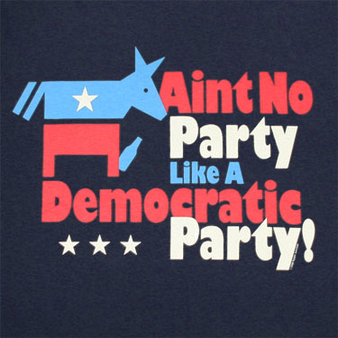
Transformation of the Democratic Party Under FDR
Broad coalition of farmers, industrial workers, reform-minded urban class, liberal intellectuals, and white-supremacist southerners
Commitment to federal intervention in issues of economic stability and justice
Sizeable southern contingency meant that the boundaries of American democracy would continue to be defined by race.
Makes the democrats a party whose
focus is on the economically
marginalized (not yet on other
marginalized groups).

Slide 17
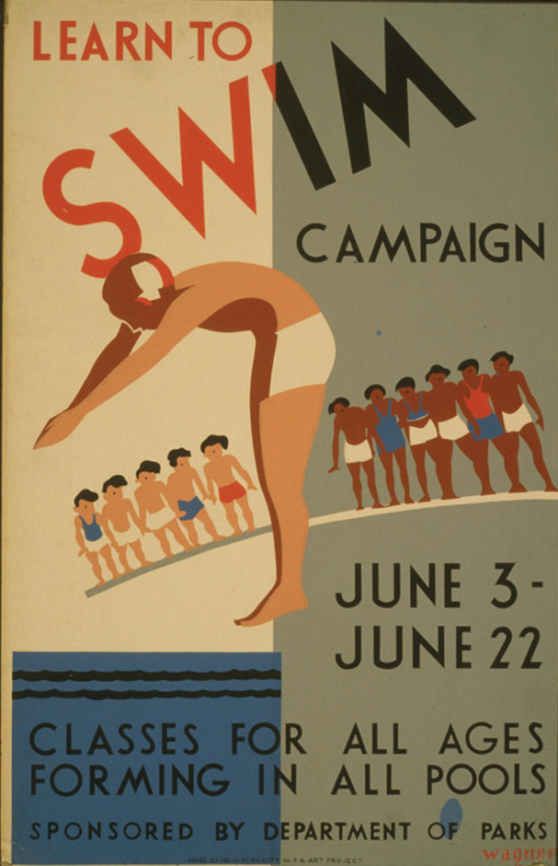
Important Considerations
The power of the Democratic South helped to mold the New Deal welfare state into a set of entitlement programs for white (male) Americans
FDR does not challenge, and in fact works within, dominant understandings of race and gender to enact his programs
Goes beyond this, and codifies and institutionalizes our assumptions about race and gender into New Deal Programs
Examples:
Tennessee Valley Authority’s rural electrification program disproportionately aids whites
Segregation permitted in Civilian Conservation Corp
Social Security Act only provided old age benefits for people who worked for the government or in companies, not people who were employed in informal labor markets. For example, black women, who tended to work in domestic help, were not given any social security benefits.

Slide 18
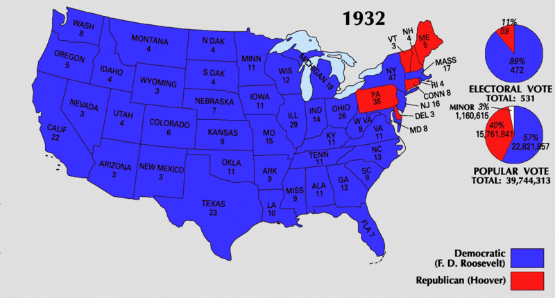

Slide 19
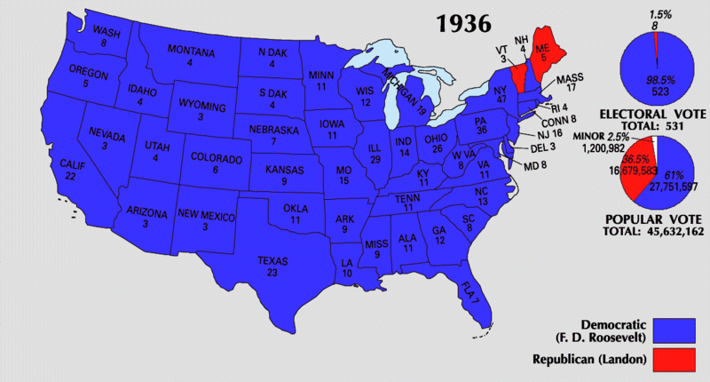

Slide 20
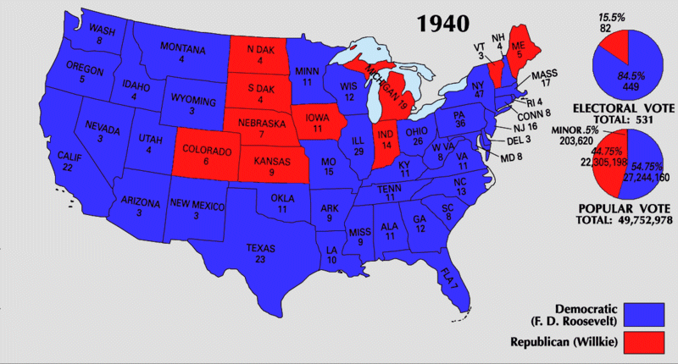

Slide 21
