Slide 1
History Writing Workshop
Agenda
Objective:
To learn how to do historical writing
Work on our first paper in class
Schedule:
Elements of a history paper
How to do footnotes
Time to work on our paper
Homework
Get started on the paper!

Slide 2
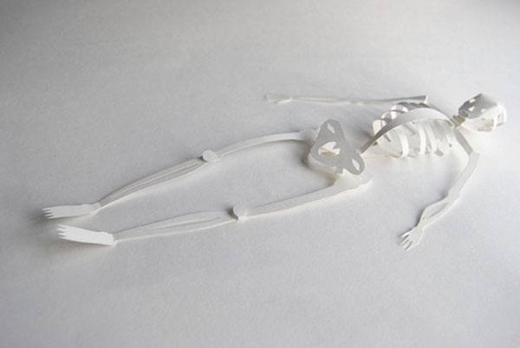
Anatomy of a History Paper
Central Claim
Introduction
Sub-claims (Claim Team)
Evidence
SPARC
Reasoning
Conclusion
Footnotes
Bibliography

Slide 3
Central Claim
What is a central claim?
What you will argue in your paper!
What will your central claim have to do?
Have an argument
Have a single line of reasoning
Where does your central claim go in your paper?
The last sentence of your introduction

Slide 4
Introduction
Provides the information necessary to understand the central claim and its importance
As your central claims become more complex, you think of your introduction as the place you lay out your central claim across multiple sentences
Last sentence(s) should be the central claim (a summary)

Slide 5
Sub-Claims (Body Paragraph Ideas and the Topic Sentences that Capture Them)
What are sub-claims claims?
The components of your argument.
Each sub-claim has its own body paragraph
The idea of each sub-claim is said in each corresponding topic sentence
Sub-claims do two things:
Address an aspect of the central claim
Manage the transition across paragraphs
What do the topic sentences that correspond to each sub-claim do?
Are one sentence
Have an argument that ties to the central reasoning
Have a single line of reasoning
The “claim team”
When put together, all of the sub claims address the whole central claim
Work as a team to prove the argument

Slide 6
Anatomy of a History Paper
Central Claim
(Last sentence of your introduction)
Sub-Claim 1
(Body Paragraph 1; Articulated in Topic Sentence 1)
Sub-Claim 2
(Body Paragraph 2; Articulated in Topic Sentence 2)
Sub-Claim 3
(Body Paragraph 3; Articulated in Topic Sentence 3)

Slide 7
Evidence
What is evidence?
The facts (who, what, where, when) of history
The happenings that support what you argue in your paper
Tangible, specific facts from the time period
SPARC Evidence
Specific
Precise
Accurate
Relevant
Credible
Course readings/handouts should be your main source for evidence

Slide 8
Evidence
Where can you find evidence?
Primary Sources
Secondary Sources (books & documentaries)
Only happenings recorded by the author, not interpretation of happenings
Interpretations of the happenings can be used to support our reasoning…more on that later…
Caution:
We must be careful of what our happenings provide evidence of

Slide 9
Body Paragraph Reasoning
What is it?
Sentences that explain how your evidence is proof of your sub-claim
Reasoning explains the connection between the evidence and the sub-claims
Your reasoning should be detailed and explicit
Use your “back up dancers” to add depth to your reasoning
Use scholars’ reasoning on historical evidence to support your own reasoning
Course material should always be your first stop for supporting analysis

Slide 10
A Note on Sources…
You should be using class resources and readings extensively for both evidence and supporting scholarly reasoning.
Papers that do not make effective use of class resources will not receive an A
You may always use outside sources to COMPLIMENT course readings
Here are some good resources
The Miller Center for Presidential History
Individual Presidential Library Websites
The US Census Bureau
The US Department of Labor
Scholarly books housed on Googlebooks
ABC-Clio
Academic Journals on J-Stor

Slide 11
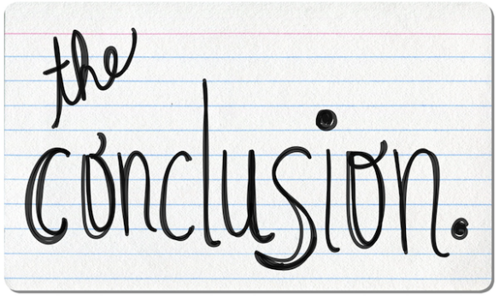
Conclusion
Five sentence formula:
Restate central claim
Restate subclaim 1
Restate subclaim 2
Restate subclaim 3
Closing sentence: If what you have just proven is true, what does this lead us to conclude about this topic/time period?

Slide 12
3 Sample Structures for Organizing Your Paper
The Multipart Argument Paper
You have a central claim that contains multiple components (A→ B→C→D)
You prove each component in a distinct paragraph, building the whole argument across the paper
You have as many paragraphs as components to the argument
The Case-Study Paper
You have a straightforward claim (A→B)
You prove the argument is true in 3 distinct cases (time periods, groups, countries, etc.)
The Ante-Up Paper
Your argument accepts an existing argument and adds to it (A+B or A*B)
Your first paragraph acknowledges the existing paragraph (ante in)
Your remaining paragraphs add on to the argument (raise the stakes)

Slide 13
Organizing your Paper
Remember, your central claim tells you how to organize your paper! It will determine for you the number of paragraphs you need to have
Pro-Tip!
Write your central claim as a math equation, each part of the equation gets its own paragraph
A+B→C
A→B→C

Slide 14
Footnotes
For ALL of your papers you need to reference specific ideas/facts/arguments from class discussion and/or course readings.
These references must be cited (in other words, you need to give credit to your sources).
The method you will use
to cite these references
is footnotes
You will format these footnotes using Chicago Style
There will be a zero tolerance policy on footnotes, I will not grade your paper until your footnotes are correct

Slide 15
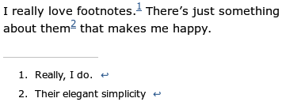
Footnotes: What Are They?
Citations to credit sources.
Footnotes are indexed within the text using a superscripted numeral that refers to an expanded note presented at the bottom of the text which gives the full citation information for a source.
Footnotes should go at the end (after the period) of the sentence(s) to which a reference is made.
Footnotes should be in the same font as the text, but 2 points smaller
Choose “footnotes” from the Insert Menu in Google Docs to insert into paper

Slide 16
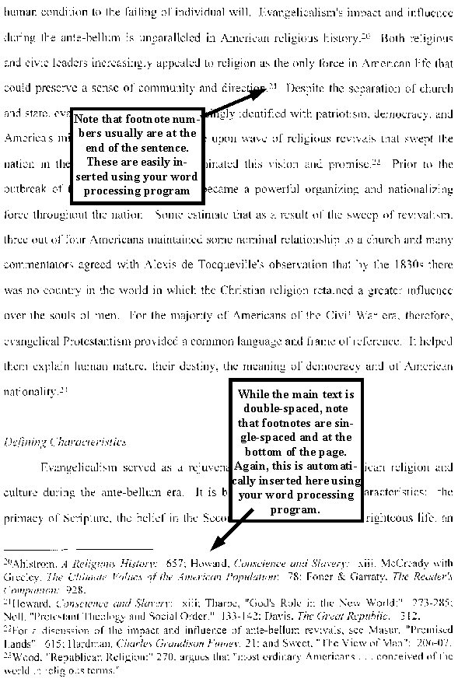

Slide 17
Footnotes: How Do I Properly Cite My Sources in Footnote Form?
http://www.chicagomanualofstyle.org/tools_citationguide.html
NoodleTools
EasyBib
Write down everything I am about to say….

Slide 18
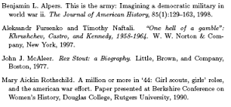
Bibliography
All papers should end with a Chicago style bibliography
See: http://www.chicagomanualofstyle.org/tools_citationguide.html

Slide 19
Writing Tips!
Always write about historical events in the past tense
Always write about scholarship in the present tense
No apostrophes in decades—1960s, not 1960’s
The first time you reference a historical figure use their first name and last time. All subsequent references should be last name only.
All historical figures and scholars referenced in the paper should be given a title the first time you mention them (President George Washington, Historian Eric Foner, Chief Justice Earl Warren…)
Supreme Court cases should be in italics (Roe v. Wade)
All major pieces of legislation, battles, major events should have a year
“Novel” is for a work of fiction only
Never use the word “huge”
Only reference sources by name in the text if the source is a primary source or an important scholarly text. The source has to be worthy of a shout-out.
Only quote from secondary sources if you can’t say it any better yourself or if you need the author’s words, exactly as they are, to back up a point you are making.

