Slide 1
League of Nations
Agenda
Objective:
To understand the debate over the League of Nations.
To analyze the debate over the League of Nations in light of American foreign policy themes.
Schedule:
Review of Wilson’s 14 points: Whole Class
Understand the debate over the League: Group Work
Analyze the debate over the League in light of US foreign policy themes: Whole Class

Slide 2
Brainstorm!
What do you remember about how World War One ended?
The Treaty of Versailles?
The League of Nations?

Slide 3
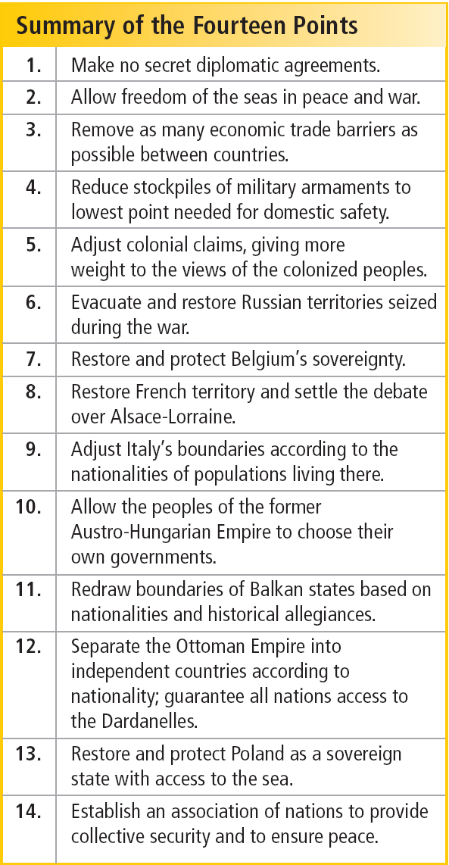
President Wilson’s 14 Points
What were the Fourteen Points?
Let’s take a look at the document.
Questions:
How would you describe the philosophy/vision of the document?
What terms could be argued to benefit the United States?
What terms could be argued to hurt the United States?

Slide 4
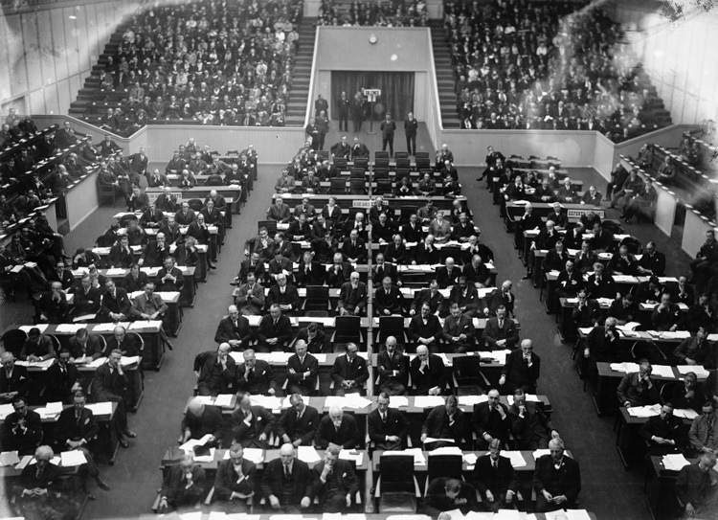
The League of Nations
Intergovernmental organization founded as a result of the Paris Peace Conference.
Its primary goals were to prevent war through collective security and disarmament and to
settle international
disputes through
negotiation and
arbitration.
Proposed by President
Wilson in his Fourteen
Points.

Slide 5
The Debate over the League of Nations
The Paris Peace Conference, Wilson, Lloyd George, and Georges Clemenceau drafted the Treaty of Versailles to end the war. The Treaty contained a provision to create the League of Nations.
Each leader brought the treaty back to their home countries to ratify.
While Britain and France ratified the treaty, there was much debate in the United States over whether to sign on. The debate centered around whether or not the United States should sign on to become a member of the League of Nations.

Slide 6
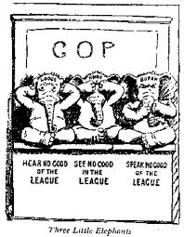
The Debate Over the League of Nations
In order to understand the issues at stake in the debate over the League of Nations, you will read three major viewpoints supporting/opposing the League of Nations
Internationalists
Reservationists
Irreconcilables
Question you will note: What
were the central issues in the
debate over of the League of
Nations?

Slide 7
Whole Class Discussion
Summarize Activity: What were the central debates over the League of Nations?
Closing Discussion:
Why didn’t the United States enter into the League of Nations, despite the fact that it was proposed by President Wilson?
What issues does the League of Nations debate raise about fundamental questions/themes in American foreign policy?
Collective Security vs. National Sovereignty?
Idealism vs. Pragmatism?
The Use of Force to Accomplish Goals?
The Duties of Being a World Power?

