Slide 1
The World of the 14th and 15th century
Who will become globally dominant and why?

Slide 2
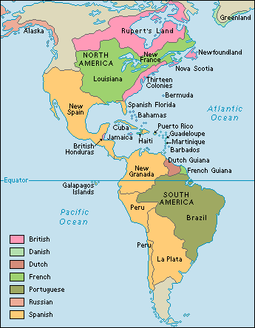
What we already know about North and South America
Aztec and Inca are conquered by the Spanish.
What other countries take land in the “New World”?
Notes:
Russians form the largest territorial empire, making Russia an Asian and European empire
Qing Dynasty

Slide 3
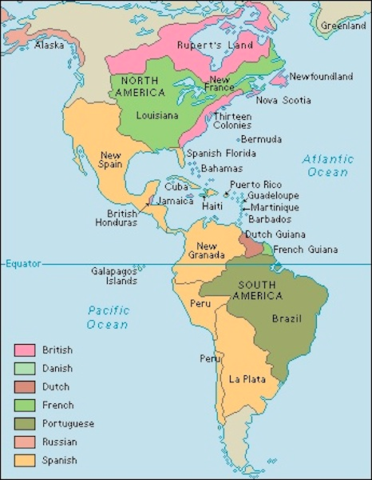
The blue circles represent the areas that WE are examining.
Aztec and Spanish
Inca and Spanish

Slide 4
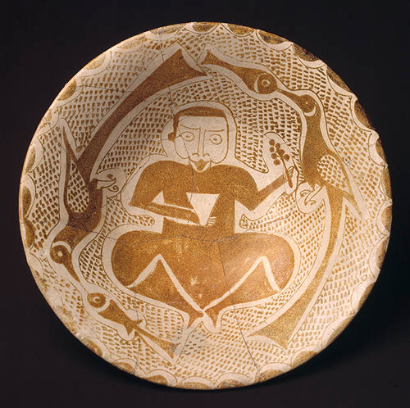
Major Empires in 1400s Earthwatch
Inca (review!)
Road system
Wealth in gold
Much power in the Americas-expanding slowly
Secure and strong military
Ming China
Ottoman Empire (Close study)
Connected to the earlier Abbasid dynasty (review)
Again strong enough to interact with European countries (Islam meets Christianity)
Notes:
The Abbasids came to power under the auspices of a Shi`ite movement which, they claimed, had transferred its loyalty to Muhammad b. `Ali, the great-grandson of Muhammad's uncle `Abbas. Intensive propaganda began around 718 in Iraq and Khurasan. Muhammad was succeeded to his claims by his son Ibrahim, who decided to concentrate his efforts on Khurasan; in 745 he sent his Persian mawla, Abu Muslim, as his personal representative to Khurasan. The decision paid off: Abu Muslim was able to create a solid base of support and in 747 began the rebellion that would quickly lead to the end of the Umayyad caliphate. The death of Ibrahim in 748 after his capture by the Umayyads could not halt the steady westward procession of Abbasid forces: in 749 they reached Iraq and declared Ibrahim's brother, Abu al-Abbas, to be the new caliph with the title al-Saffah. The last Umayyad caliph was killed in 750.
http://www.metmuseum.org/toah/works-of-art/1977.126
Under the ^{c}Abbasid caliphate (750–1258), which succeeded the Umayyads (661–750) in 750, the focal point of Islamic political and cultural life shifted eastward from Syria to Iraq, where, in 762, Baghdad, the circular City of Peace (madinat al-salam), was founded as the new capital. The ^{c}Abbasids later also established another city north of Baghdad, called Samarra’ (an abbreviation of the sentence "He who sees it rejoices"), which replaced the capital for a brief period (836–83). The first three centuries of ^{c}Abbasid rule were a golden age in which Baghdad and Samarra’ functioned as the cultural and commercial capitals of the Islamic world. During this period, a distinctive style emerged and new techniques were developed that spread throughout the Muslim realm and greatly influenced Islamic art and architecture.

Slide 5
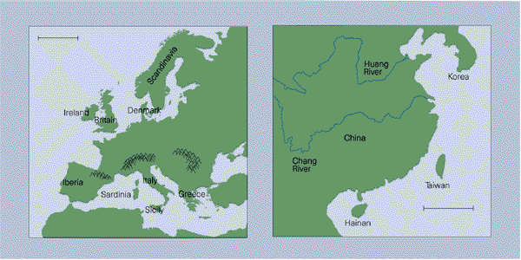
Geography
Why are China and Europe matched in Guns, Germs and Steel?
How does geography help create hegemony in China?
How does geography create competition and disunity in Europe?

Slide 6
Ottoman Empire and Ming Dynasty
Are these areas also poised to dominate the world? What do you think?
What will you look for to make a determination?
THINK: Jared Diamond claim, GEOGRAPHY
THINK: How did Spain conquer the Aztecs and Inca?

Slide 7
What advantages did Europe have?
Advantages for Europe:
Motivation
Rivalry--Competition
“We came here to serve God and the King, and also to get rich.”-Spanish conquistador
Boats
Guns, Germs and Steel (Diamond thesis)
Discontent in the Americas
Notes:
Competition: nobles wanted to have the best stuff and the most money, Christinity had to be the largest religion, minorities wanted a new life without oppression, cut out Eurasian traders who had a monopoly
Boat technology is taken from ottoman and china
Ironworking, diseases

Slide 8
Any disadvantages?
Disadvantages:
Far away from home
New environments (climate and geography
Q:Which other regions had these advantages over the Americas?
China?
Ottoman?
Notes:
Competition: nobles wanted to have the best stuff and the most money, Christinity had to be the largest religion, minorities wanted a new life without oppression, cut out Eurasian traders who had a monopoly
Boat technology is taken from ottoman and china
Ironworking, diseases

Slide 9
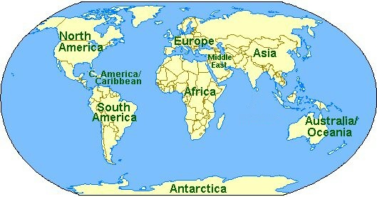
Understanding Paul Kennedy

Slide 10
The European Miracle
Read the quotations from the book by yourself Read the quotations with a partner Answer questions 1-7 in writing, in the Reader Express one of your answers with a diagram/cartoon/symbol

