Slide 1
Tributary States
Aztec

Slide 2
Tributary States in the Aztec Empire
“Tribute or payment from conquered peoples, helped the Aztecs turn their capital into a magnificent city”
The following slides give more details about Aztec tributary states. But this quotation is significant because it explains why the system was important to the Aztec Capitol, Tenochtitlan.
Notes:
This is on page 6.

Slide 3
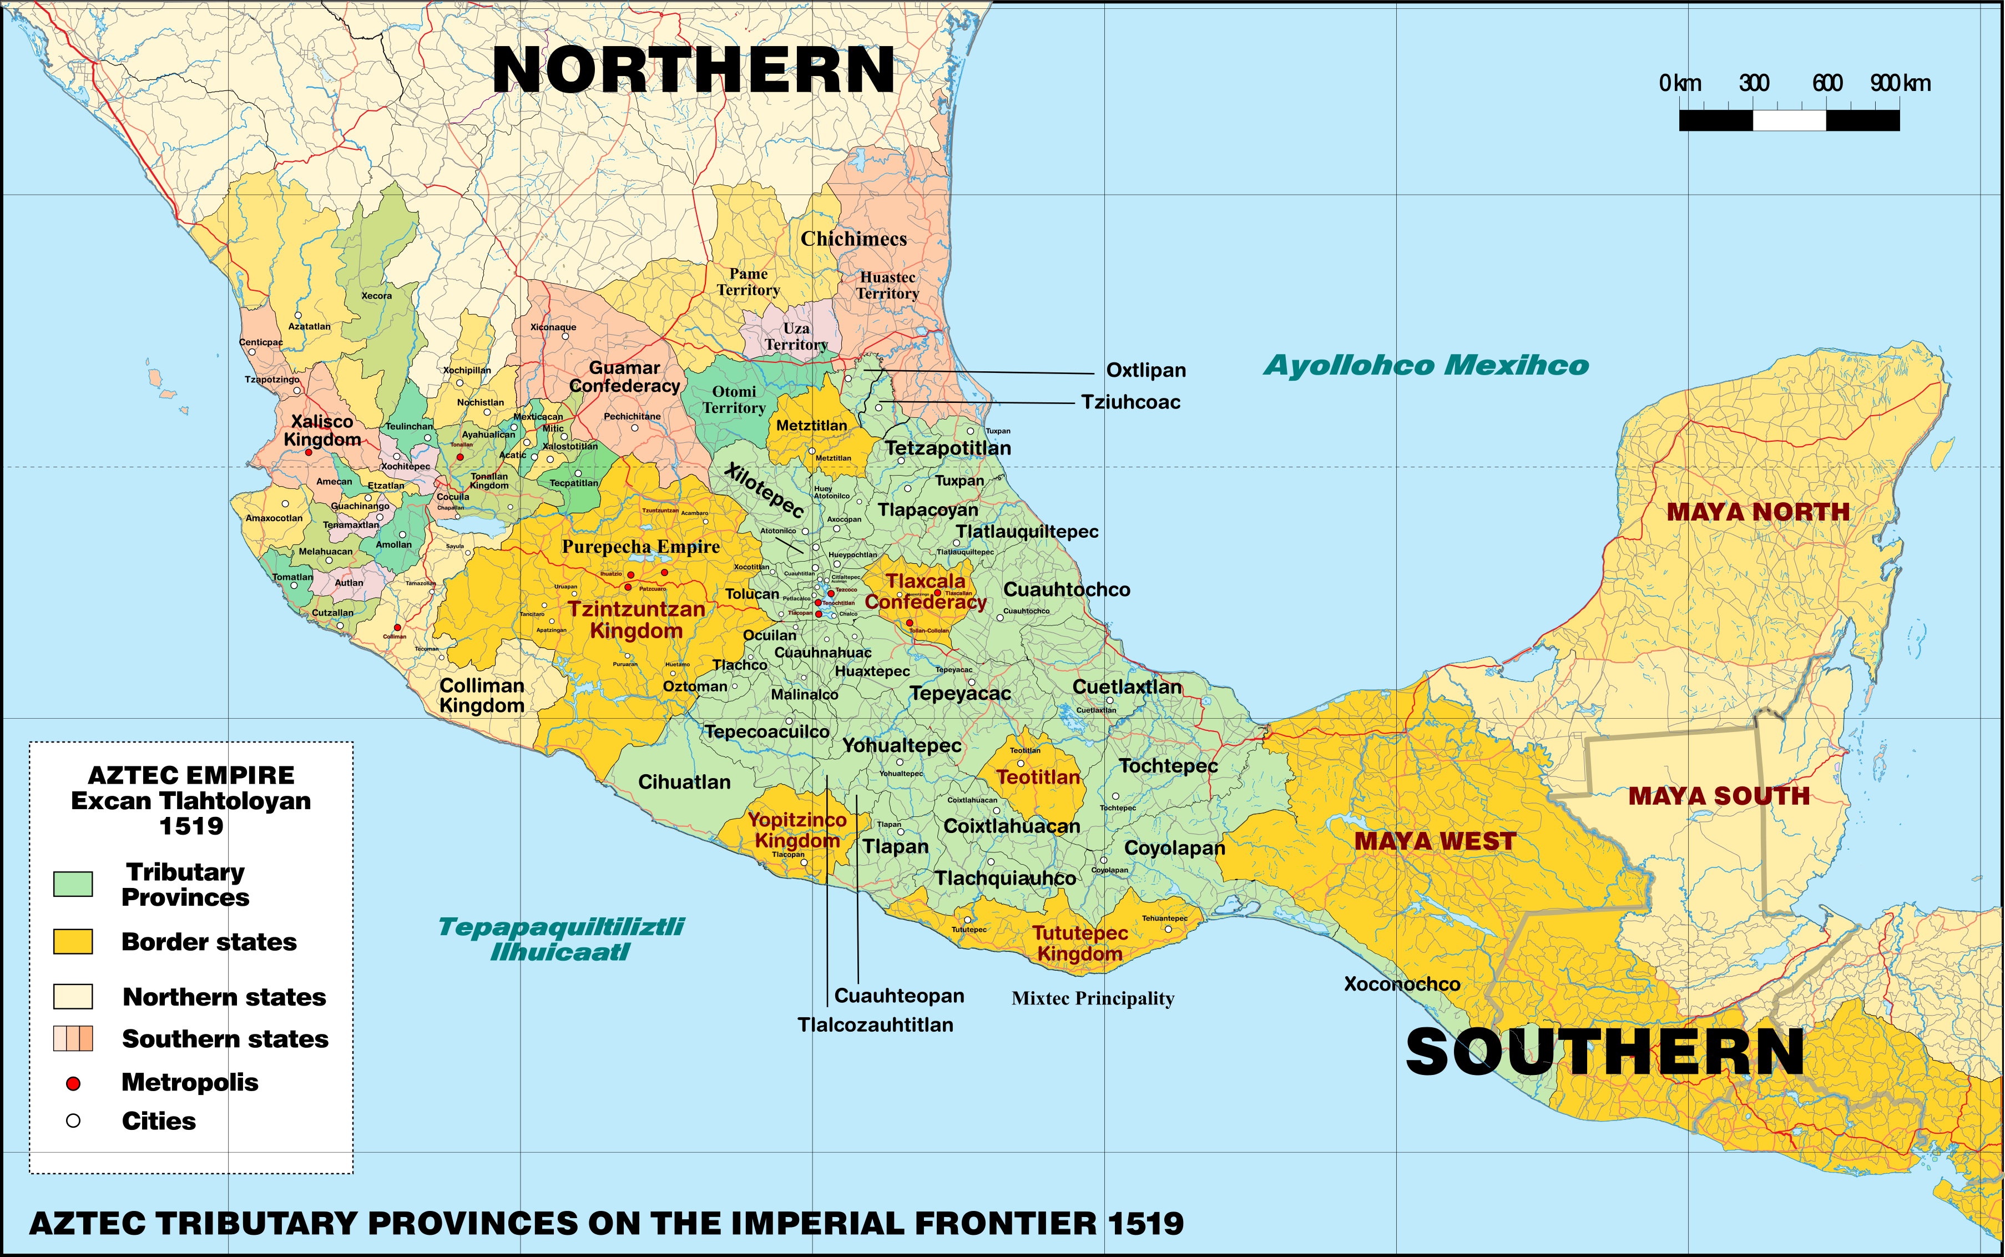
Cuetlaxtlan (a tributary state) gave annually:
1 quaxcolotl warrior costume and shield
1 warrior custome with quetzalpatzactli device, and shield
1 string of greenstones
400 handfuls of rich green feathers
20 lips plugs of crystal, with blue smalt [this could indicate either crystal in a blue shade or crystal with accompanying blue feathers, as is depicted in the text] and set in gold
20 lip plugs of clear amber, decorated in gold
200 loads of cacao [this would probably mean 200 bags of about 8000 beans each]
1 royal badge of quetzal feathers
Notes:
It is because of the Codex Mendoza that we know that the "province" of (where Grijalva put ashore) was to supply annually:

Slide 4
At the imperial level, the Aztecs drew tribute from 38 provinces. The officials who controlled the tribute system were the calpixqueh. Imperial calpixqueh were sent to conquered regions from Tenochtitlan to collect tribute from the rulers. The imperial calipixqueh were from noble families while the local calpixqueh were commoners.
Notes:
Source: Ross Hassig, Trade, Tribute and Transportation.

Slide 5
Determining Tribute
Distance from capitol (closer to the capitol provided more food and clothing.
The specialty of each tributary state
If no specialty, then food and clothing
Resistance to conquest
If your state resisted the Aztecs initially, you paid more tribute (probably 2x the value)
Tribute goes up every year
probably to account for increase in population
What the Aztec capitol and state needed

Slide 6
Commoners paid tribute but not all commoners. Nobles were exempt, as were administrators and government officials, priests and teachers of various temples, commoners who had distinguished themselves in war. Tribute was paid at three levels; imperial, provincial and town. The heaviest tribute was to provincial and town. Warehouses for tribute existed in each town and were called trojes.

Slide 7
The empire, which stretched across central and southern Mexico, rested on the collection of tribute payments, and otherwise the conquered peoples were largely left on their own. The Aztecs made no effort to incorporate them by imposing the capitol’s language or religion. The annual tribute payments typically consisted of corn, cotton blankets, and occasionally, victims for sacrifice. In areas that produced a specialty product, that product served as tribute to the Aztecs. Thus, chocolate-growing areas sent chocolate, regions with the exotic Queztal bird sent the feathers, artisans who produced outstanding feather work sent their products and areas that have silver mines sent silver.”
Source: Beezley, William. Mexico in World History
Notes:
Source Beezley, mexico in world history.

Slide 8
A rich province, we have other textual evidence that the are around Cuetlaxtlan had also had tribute demands of gold, exotic skins, conch shells, and dried fish, in addition to demands recorded at the time of the Coedx Mendoza. The Codex also records that the province was required to send to the Aztecs twice a year almost 3000 cotton mantas (cloaks) in various styles, along with 400 women's tunics and skirts. This follows a general pattern in which more luxurious items would be demands annually and more staple good would be demanded in biannually. The calpixque were there to make sure this tribute occurred, cajoling the local rulers who would themselves benefit from this tribute system though "re-gifting" and to report on any problems which may be arising.
Calpixque had a vested interest in making sure cities were pacified and amenable to sending tribute, as they were often the first victims of an uprising. A fairly common tactic was actually to send emissaries to a region demand tribute and then, when they were killed, to use that as an excuse for retaliation. This is actually how Cuetlaxtlan was made an Aztec province to begin with. The Tlaxcalans convinced them to not pay tribute and to murder the stewards sent asking for it, then completely failed to back up the cities of the region when the Aztec army retaliated.

Slide 9
The threat of violence was always backing up the institutional role of the calpixque. In a famous instance from the reign of Ahuizotl (1486-1502), several towns in the Tepequacuilco province, in the border region of modern day Guerrero with Michoacán, refused to pay tribute. The texts do not record what happened to the calpixque of the area, but precedent suggests they would have been killed. In response, the Aztec army rolled in, offered the rebellious towns a chance to resume paying tribute and, when that was denied, leveled the key rebel towns of Oztoman and Alahuiztlan. All the men were killed, and the women and children were sold into slavery. Couples from the core Aztec cities were then selected to resettled the region. There's much larger socio-political causes behind this, but the message was clear: pay your taxes.

