Slide 2
Overview
Founder: Confucius (500 BCE)
  For Review: Hinduism (1200 BCE), Christianity (33 CE), Islam (629 CE)
Sacred Text= Analects
  His students wrote down what he said and kept those records
It’s a philosophy NOT a religion
  There is no god and Confucius is not worshipped as one

Slide 3
Main Beliefs
Five Relationships
  Emperor to subject (Ruler to ruled)
  Husband to Wife
  Parent to Child (Father to Son)
  Elder Sibling to Younger Sibling (Elder Brother to Younger Brother)
  Friend to Friend
Filial Piety
  Importance of family
  Ancestor worship

Slide 4
Social Structure in China
Emperor (Mandate of Heaven)
Gentry (educated scholars who have passed the Civil Service Exam)
Belief that hard work will be rewarded with success
Relies on the idea that there is opportunity for everyone
For Confucius, this means that the hardest workers will lead the government
  How do you decide who works the hardest?
Farmers
Artisans
Merchants

Slide 5
Social Structure in China
Legitimacy of EMPEROR:
Emperor (Mandate of Heaven)
Legitimacy of GENTRY
Gentry (educated scholars who have passed the Civil Service Exam)
LACK of Legitimacy for FARMERS and ARTISANS but MORE than MERCHANTS
Farmers
Artisans
Merchants
LACK of Legitimacy for MERCHANTS

Slide 6
Gentry
Background:
  Received many academic degrees
  Passed the Civil Service Exam
Bureaucratic Duties
  Local, County or National levels positions
    Those without official jobs were unpaid
  Social leaders in local areas
  Social welfare
  Maintained local law and order
  Conducted Confucius ceremonies
  Taxes
  Represented morality and virtue
  Highest social status provided them with what they needed

Slide 7
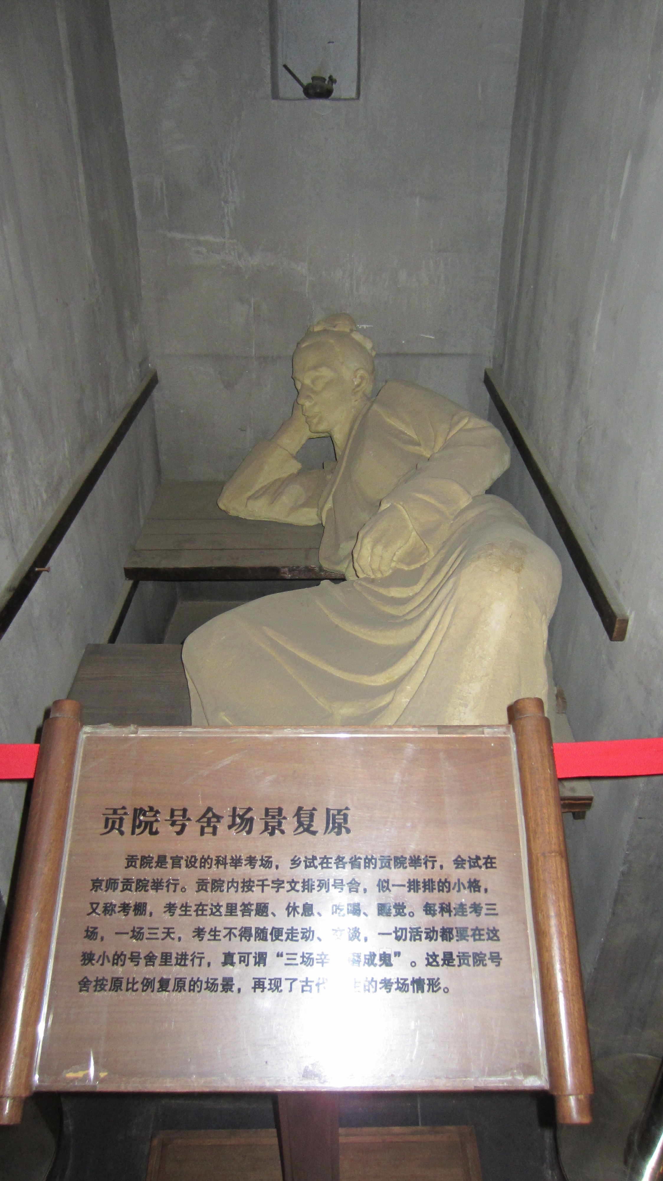
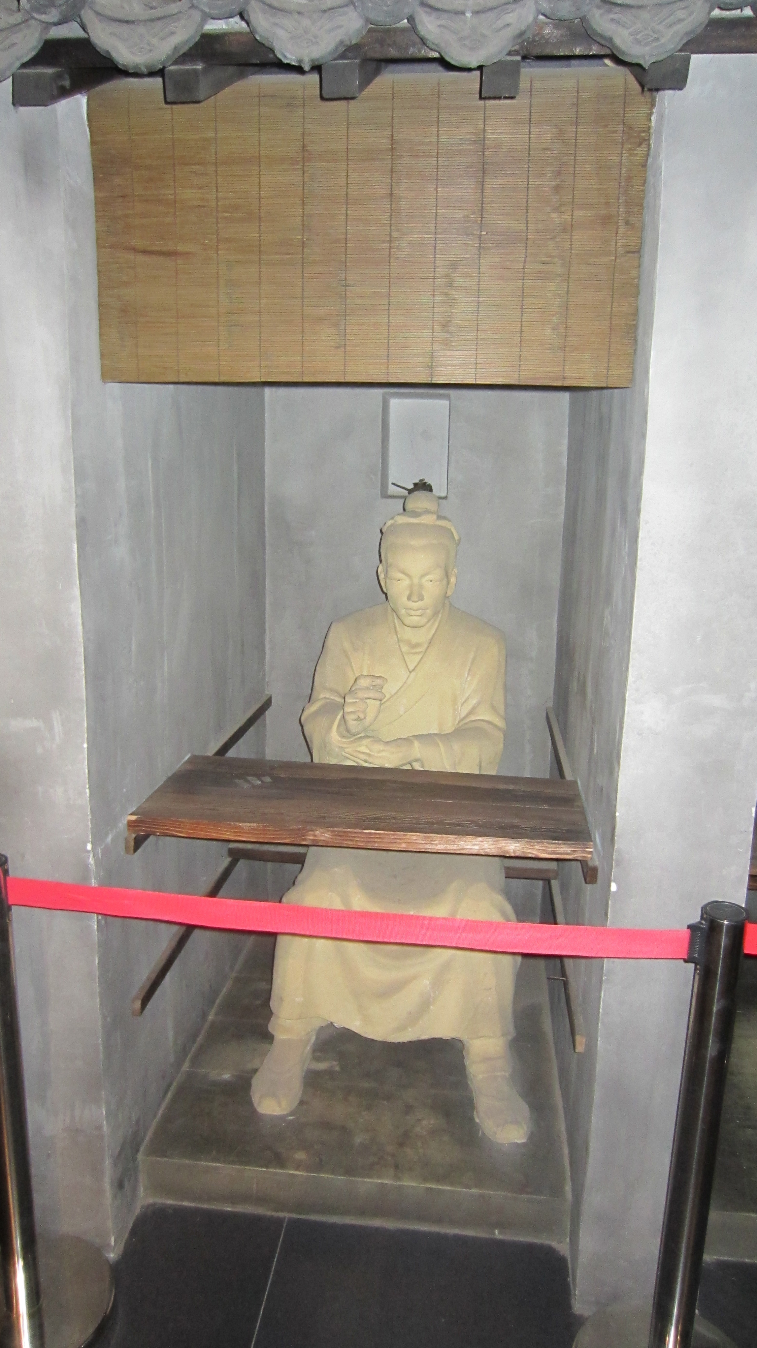
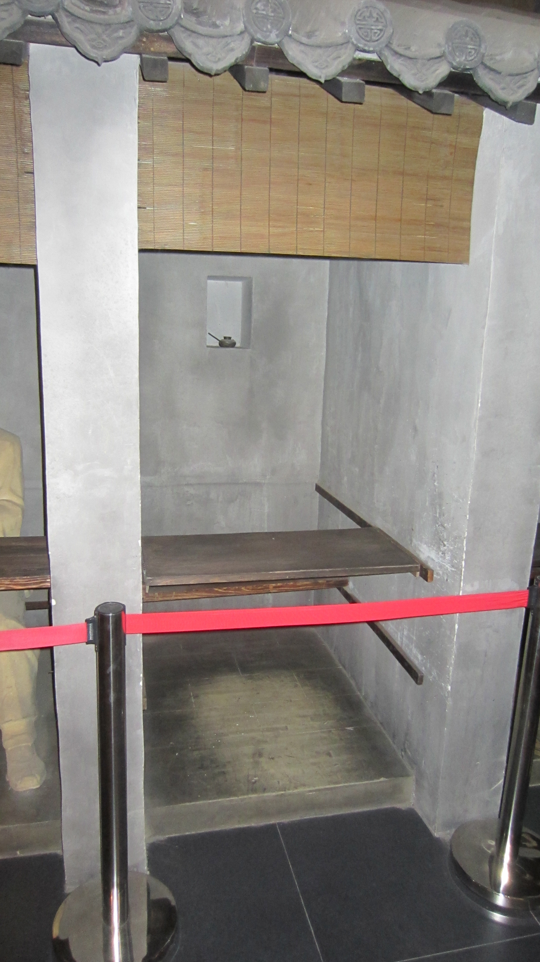

Slide 8
Agency
Agency
  Being able to change your life.
  Being able to exercise your own decisions.
  Being able to choose your own path.
  YOU HAVE POWER TO DETERMINE YOUR LIFE OUTCOMES
Examples of Agency:
Example of a LACK of agency:

Slide 9
Social Structure in China
Emperor (Mandate of Heaven)
Gentry (educated scholars who have passed the Civil Service Exam)
Farmers
Social Mobility is ALLOWED but difficult
Artisans
Merchants
Where is there opportunity?
Who has agency?

Slide 10
Social Structure in China
BUREACRACY
Emperor (Mandate of Heaven)
Gentry (educated scholars who have passed the Civil Service Exam)
BUREACRACY
BUREACRACY:
This means a government with levels. (like national, state and local)
Farmers
Social Mobility is ALLOWED but difficult
Artisans
Merchants
Why are merchants NOT the bureaucracy?

Slide 11
Ming China
Context
Mongols had ruled before
Reclaim China for the Chinese in 1368
  From Yuan dynasty
  Peasant leader Zhu Yuanzhang
What is reclaimed?
  Restored the Civil Service Exam
  Increased agricultural production
  Revival of Chinese culture
Fix and improve on the Great Wall
AGENCY
Notes:
Yuan dynasty--Mongol dynasty declines after there are no heirs to Kublai khan in China. Most Chinese despised the foreign rule--scholars retreated because they did not see the purpose of barbarians or any potential in them. Push the Mongols back to the Great Wall. Ming means brilliant.
Ming leaders sought to reassert Chinese greatness, made confucian learning the road to success, boards of censors rooted out corruption in the bureaucracy.
Agriculture: supported a population of more than 100 million--fertile--well--irrigated plains. Better methods of fertilizing helped to create more foot. Also, reshaping the the landcapre by cutting steps (terraces) into the hills created more food. Also new crops like corn and sweet potatoes reached China from the Americas.
Revival of arts and culture--new landcapre painting and blue and white porcelain. More poetry and literautre, novels, first detective stories.

Slide 12
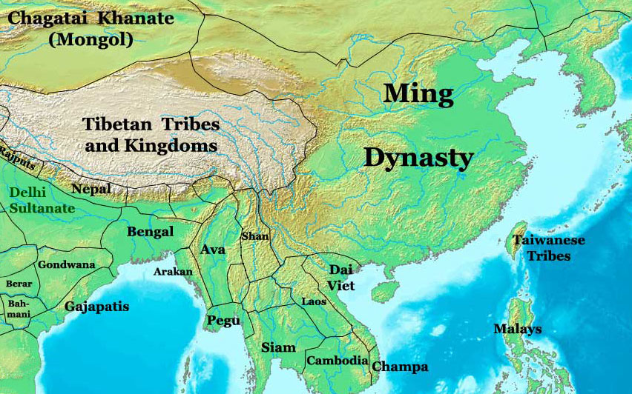
Blue

Slide 13
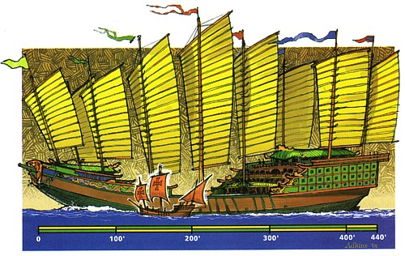
Ming China and Exploration
AGENCY
Zheng He
  1405: 7 expeditions total
  Powerful ships
Collecting tribute along the way
Promoted trade
Showed strength of Chinese empire
TRIBUTARY STATES
Notes:
62 huge ships initially with 200 smaller ships with 28,000 sailors. Goal--make contact and collect tribute for the Ming.

Slide 14
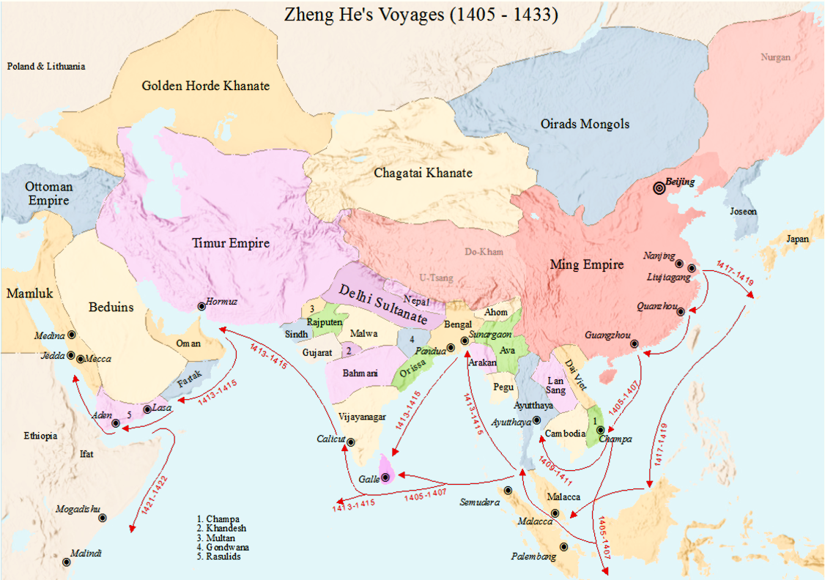

Slide 15
Ming China and Tributary States
TRIBUTARY STATES
Zheng He TRAVELED AROUND THE INDIAN OCEAN
  1405: 7 expeditions total
  Powerful ships
COLLECTED tribute along the way
  COMPLIMENTS
  STATUES
  WOMEN
OFFERED presents (luxury goods and food) to their tributary states
Notes:
62 huge ships initially with 200 smaller ships with 28,000 sailors. Goal--make contact and collect tribute for the Ming.

