Slide 1
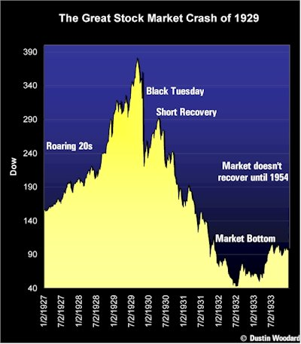
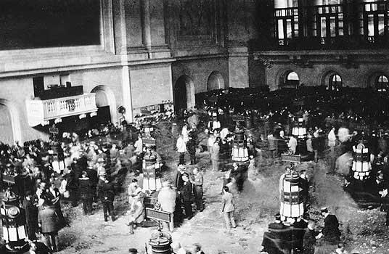
CRASH, DEPRESSION, AND NEW DEAL
1920s = good economic times
Tues. 10/291929 - NYC Stock market crashed, causing a depression that would last until 1942

Slide 2
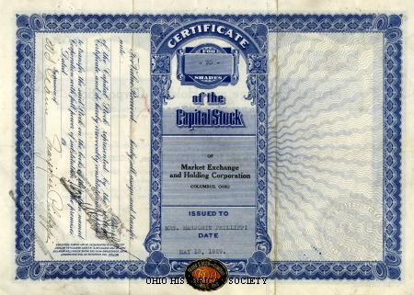
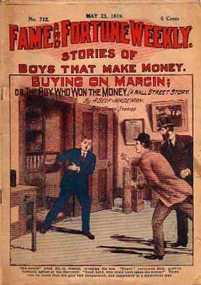
The stock market:
the public invests by purchasing stocks
Expect profit in return
1920s economy: $ plentiful
Banks quick to make loans to investors
Investors pay 10% of the stock's actual value
BUYING ON MARGIN- the balance was paid at a later date
Notes:
‹#›

Slide 3
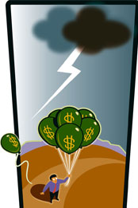
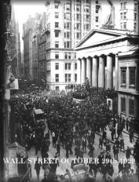
STOCK SPECULATION
Buy/sell stocks quickly to make a quick buck
Caused stock value to increase
Quick turnover didn't aid cos. → long term investments needed to pay bills
Unscrupulous traders buy and sell fast to inflate stock value
Gave a false sense of security/confidence in the American market
Notes:
‹#›

Slide 4
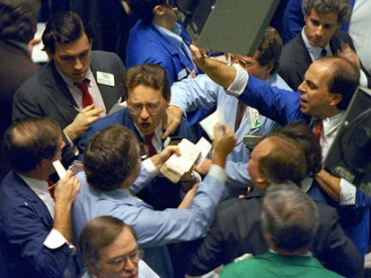
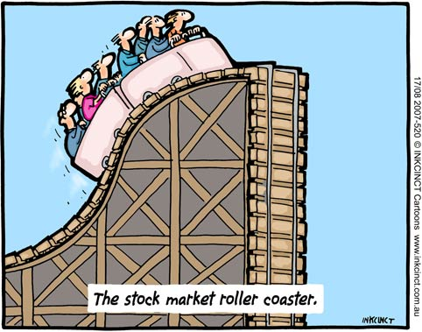
Oct. 1929, investors’ confidence dropped
Leads to a market collapse
All tried to sell at once = panic selling
Many bankruptcies as banks called in loans
Tiny minority traded on the stock exchange, but they possessed vast wealth
Crash = ripple effect on economy
Notes:
‹#›

Slide 5
For poor, mass consumption already low
Unemployment rose → no gov't assistance at first
People couldn’t buy → productivity dropped = further unemp.
Additional unemployment → purchasing power declined again → reduced productivity yet again (ECONOMIC CYCLE)
Economic Cycle
Unemployment
Purchasing Power Productivity
Notes:
‹#›

Slide 6
PRODUCTIVITY AND UNEMPLOYMENT
1920's U.S. Econ. based on the productivity – purchasing power - employment cycle
Production of goods needs demand → high employment + healthy economy
1924-27, U.S. productive capacity x2 due to technological innovation
→ Electricity & mechanical advances for better production… no new jobs were added to economy
More goods available, less people buy (OVERPRODUCTION)
Notes:
‹#›

Slide 7
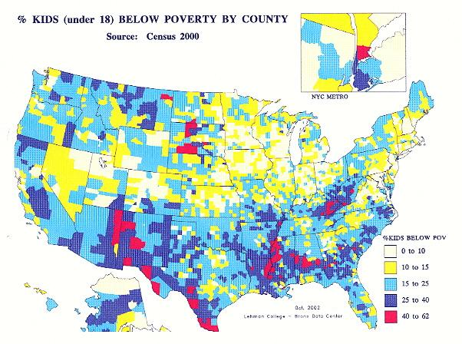
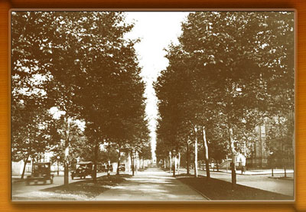
2nd major problem= Uneven distribution of wealth
Top 0.1% owned as much as bottom 42% of American families
42% below poverty line
Of middle 58%, most = middle class
Not wealthy
Had jobs b/c of industrialization & consumerization
Middle class depended on their salaries
When productivity declined, they lost their jobs and cut back purchases
Notes:
‹#›

Slide 8
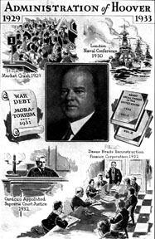
Pres. Hoover “gov't shouldn’t play an active role in the economy”
Persuaded bankers/business to follow policy of VOLUNTARY NON - COERCIVE COOPERATION
Tax breaks in return for private sector economic investment
Private relief agencies for unemployed
System with indebted European powers
HOOVER MORATORIUM - Temporary stop to war debt & reparations payments
Euro. countries to purchase American goods to stimulate American economy
Notes:
‹#›

Slide 9
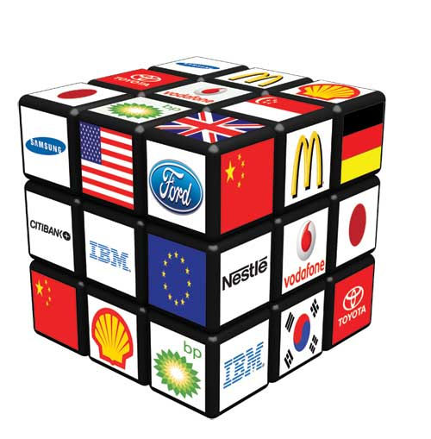
Early 1931: measures successful, but then… TARIFF WARS
Democrats passed a high tariff (SMOOT HAWLEY) to protect U.S. industry
FATAL ERROR
Congress did not understand that the world = GLOBAL ECONOMY
SO other countries = High tariffs
No foreign markets purchased American goods, so U.S. productivity decreased again
Notes:
‹#›

Slide 10
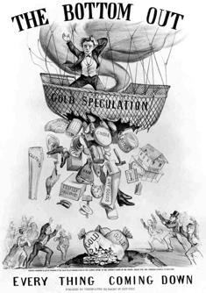
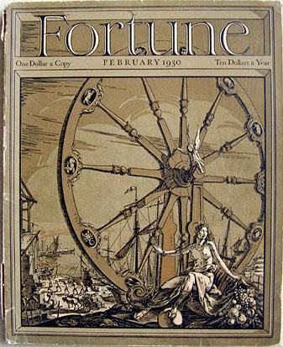
ALSO 1931
Soviets flooded world market w/ cheap wheat (1/2 U.S. price)
(But price was too low and they couldn't)
Resulted in the BANKERS’ PANIC
Austrian banks borrowed from German banks + appealed to the BANK OF INT'L SETTLEMENT
Austrian banks + loaning German banks forced into bankruptcy
B/c German banks had borrowed from Americans, U.S. banks began to go bankrupt
Notes:
‹#›

Slide 11
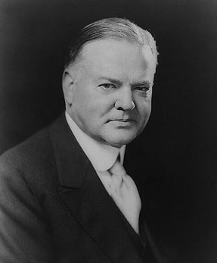
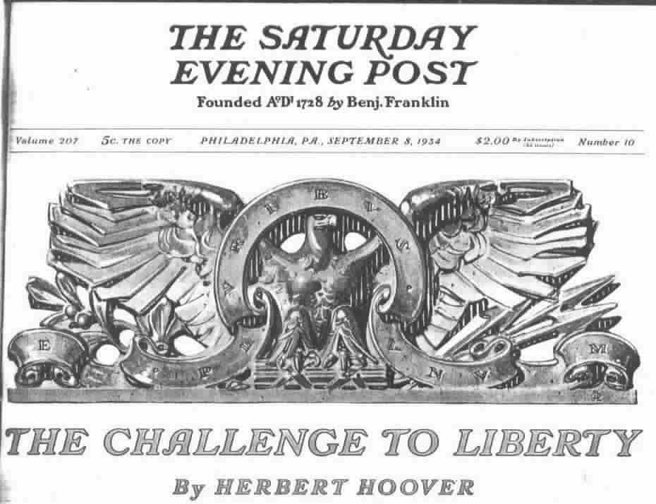
AMERICANS REACT TO HOOVER
Hoover increasingly unpopular, but continued to try
→ persuaded Congress to establish RECONSTRUCTION FINANCE CORPORATION
Had power to make emergency loans to banks
Too little too late
Hoover wouldn't involve himself in direct gov'tal aid to individuals
Didn't want to erode Americans’ sense of "RUGGED INDIVIDUALISM"
Notes:
‹#›

Slide 12
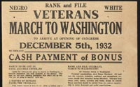
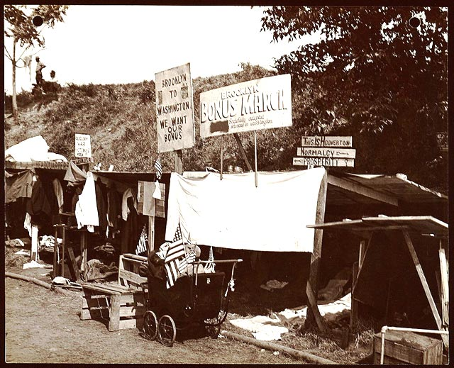
People frustrated - isolated protest movements
EX: Dairy farmers frustrated w/ low price of milk refuse to sell
EX: WW1 veterans (pensions discontinued by congress) march on Washington = BONUS MARCH (by BONUS ARMY)
Reached Washington by 1931→ set up shantytowns = HOOVERVILLES
Food scraps = HOOVER-MEALS
Hitchhiking journeys = HOOVER RIDES
After one year, forcibly dispersed by Army (MacArthur/Eisenhower)
Notes:
‹#›

Slide 13
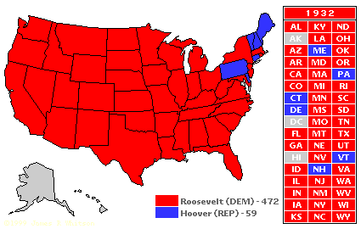
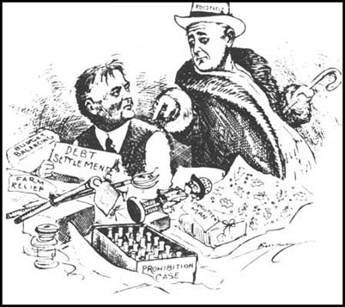
1932 ELECTION:
1 out of 4 unemployed…
National income was 50% of what it had been in 1929
Repubs. nominated Hoover → NO HOPE
Winner by a landslide = FRANKLIN DELANO ROOSEVELT
Dem - N.Y. governor
Notes:
‹#›

Slide 14
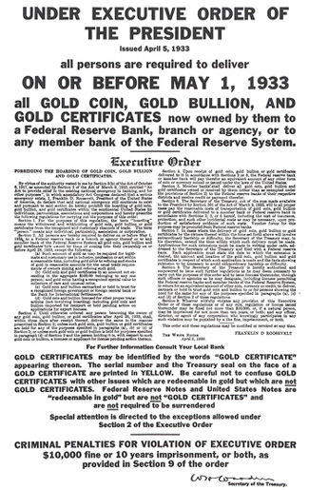
THE NEW DEAL
Revolution in American society
COMPLETELY changed way the gov't functions
First phase of the New Deal dealing w/ eco. reform
Unlike Hoover, FDR believed gov't involvement = crucial for economy
Step 1: dealt w/ the banking crisis
BANKING HOLIDAY: banks shut down + gov't inspection
Allowed to open when "healthy"- people's confidence returned → they redeposited, allowing banks to invest in the economy
Notes:
‹#›

Slide 15
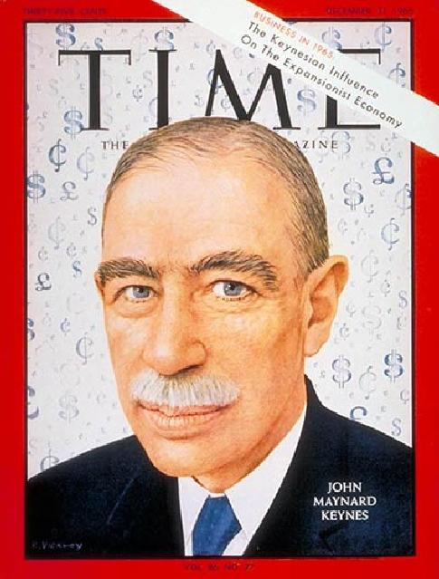
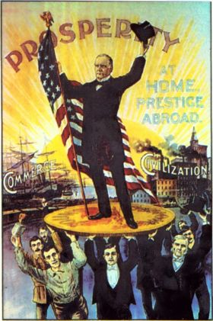
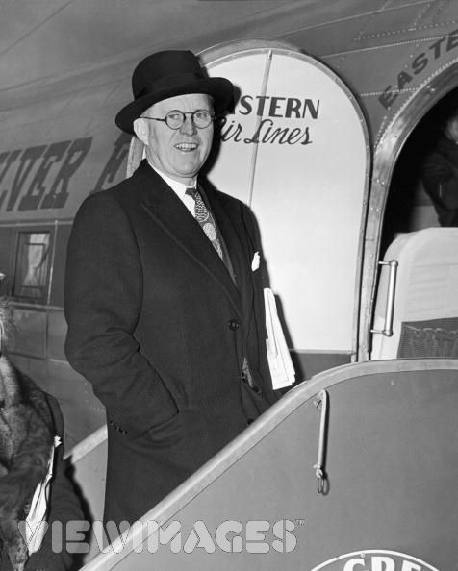
Step 2: stock market reform
SECURITY EXCHANGE COMMISSION est. to police the NYSE (first chmn. Joseph P. Kennedy)
Practice of buying on margin = regulated
Step 3: put more $ in circulation
FDR → GOLD STANDARD (gov't print more $ than Fort Knox gold reserves allow)- more $ in circulation, wages and prices increased
(= inflation), causing dollar value to lower- gave gov't spending power (Keynesian economics)
Notes:
‹#›

Slide 16
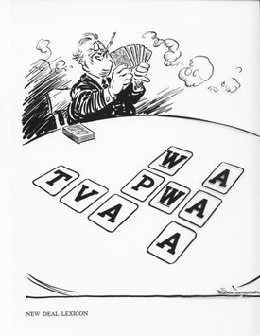
SPECIFIC PIECES OF LEGISLATION (direct gov't intervention in the eco.):
NATIONAL INDUSTRIAL RECOVERY ACT (NIRA) and NATIONAL RECOVERY ADMIN (NRA)
to end animosity b/n labour and business → all was redirected to industrial growth → fair labour codes established - wages, no child labour, shortened work hours
Business people dislike NRA: “it’s communist”
LIBERTY LEAGUE: Supreme Ct. overturned the NIRA & NRA b/c fed. gov't exceeding authority (interfering in state jurisdiction)
Notes:
‹#›

Slide 17
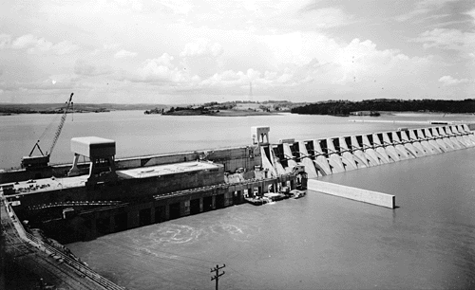
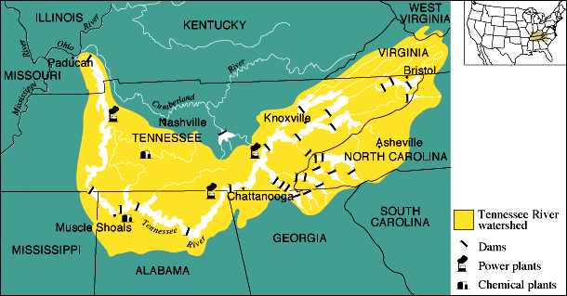
TENNESSEE VALLEY AUTHORITY (TVA) - promote hydroelectric power, control flooding - lower rates → private industry, manuf. fertilizer →fed. gov't. took ownership (nationalization v. privatization)
Notes:
‹#›

Slide 18
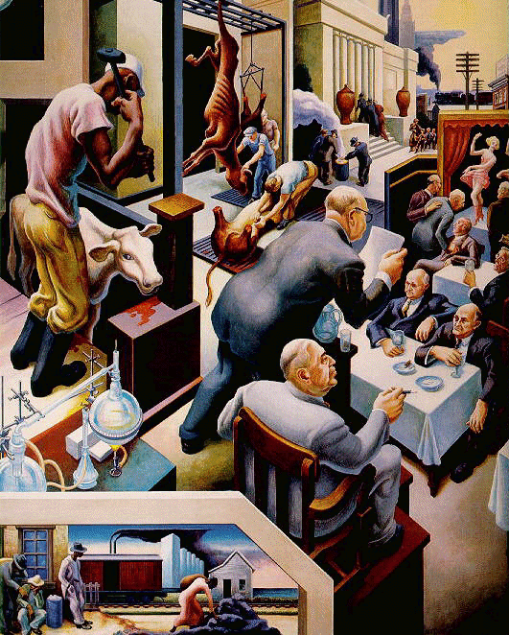
Kansas City from Politics, Farming, & the Law
Thomas Hart Benton, 1936
Notes:
‹#›

Slide 19
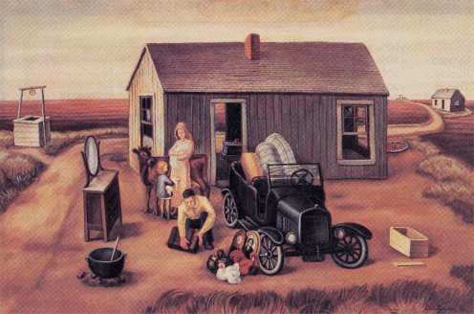
The Annual Move by Otis Dozier, 1936
Notes:
‹#›

Slide 20
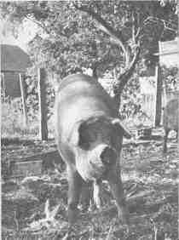
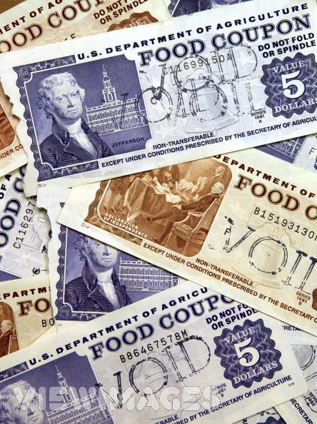
AGRICULTURAL ADJUSTMENT ACT (AAA) (1933)
To aid farmers - to restore farmers' purchasing power + the family farm
Had farmers cut back on production by paying them equivalent SUBSIDIES
Bad side…
1) Food production down when millions starving
2) Black sharecroppers hurt: white landowners paid not to farm so got rid of Black tenant farmers
(1935) AAA declared unconstitutional by courts (too much control over individual states)
Revised + introduced as new legislation
Food Stamp Act of 1939
Gave surplus food to poor
Guaranteed (small) farmers a market
Notes:
‹#›

Slide 21
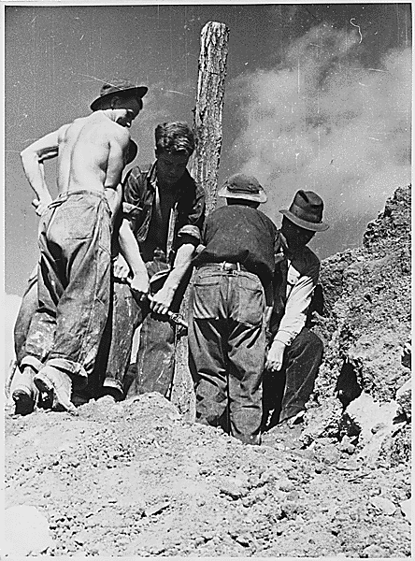
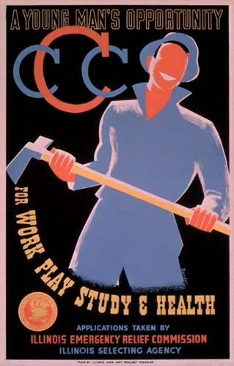
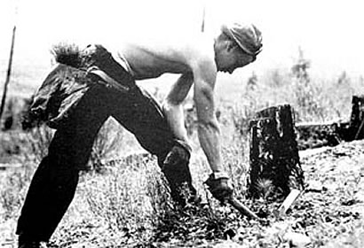
FDR wary of gov't handouts
Wanted people to earn their keep → temp. gov't agencies created to address unemployment
CIVILIAN CONSERVATION CORPS (CCC) (1933)
Establish work for young men (18-25) in reforestation, soil conservation, flood control, road construction
Blacks not permitted to enroll
Notes:
‹#›

Slide 22
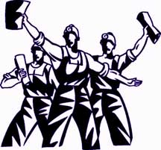
NATIONAL YOUTH ADMIN. (NYA) - created urban jobs for young
FED. EMERGENCY RELIEF ACT (FERA)
For older workers
Worked well, but unemp. still at 6 million in 1941
NEW DEAL - SOCIAL REFORM ASPECT
After immediate economic relief & reform addressed (1935), New Deal → Social Welfare
NATIONAL LABOUR RELATIONS ACT (aka Wagner Act)
Legitimized unions + labour tactics (collective bargaining & collective action (strikes, etc...)
Outlawed BLACKLISTS & other anti-union practices
Notes:
‹#›

Slide 23
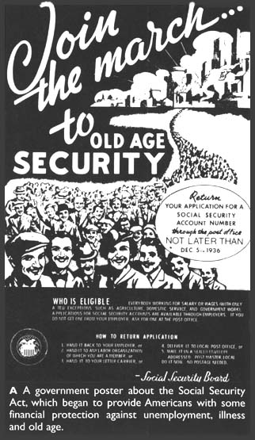
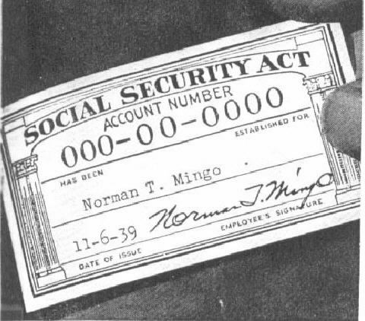
SOCIAL SECURITY ACT (1935)
Feared by opponents b/c "creeping socialism"
Typifies the WELFARE STATE - unemployment insurance, old age pensions
Problem: Took $ out of circulation (payroll deductions) when purchasing power already low- also
Only covered the unemployed
1936 - "Soak The Rich" tax
Notes:
‹#›

Slide 24
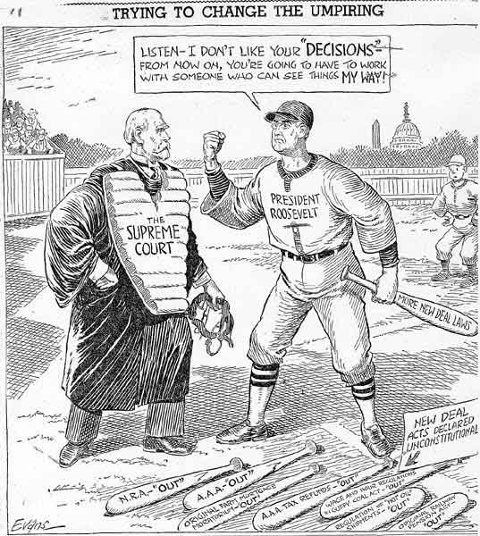
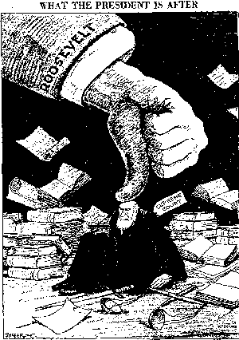
ELECTION OF 1936 - FDR won easily (v Repub. Alf Landon - Kansas governor)
→ FDR to continue New Deal
1st objective: Reorganize Supreme Court - they disallowed some New Deal legislation
FDR wants # of judges changed from 9 →15 (to "pack the court")
Great opposition, so FDR w/drew this proposal
Judges retired & FDR replaced → new ones approved all New Deal legislation
Notes:
‹#›

Slide 25
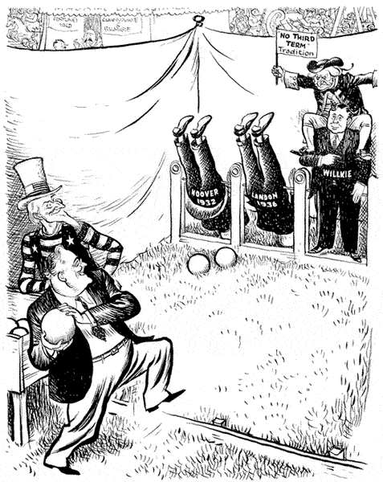
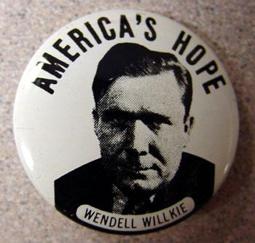
FDR concerned w/ int'l issues
1939 proposed no new major domestic reform measures (1st time in his pres.)
ELECTION OF 1940
Broke with tradition & ran a 3rd time
FDR v. Wendell Wilkie - big issue = American support of the Allies (G.B.), now embroiled in WWII v. Nazi Ger.
Both U.S. parties wanted to support G.B. but remain neutral
A CONSENSUS had developed b/n the Dems. and Repubs.
Both parties approved of (most) New Deal legislation & wanted an isolationist foreign policy
FDR won in 1940 (and again in 1944)
Notes:
‹#›

Slide 26
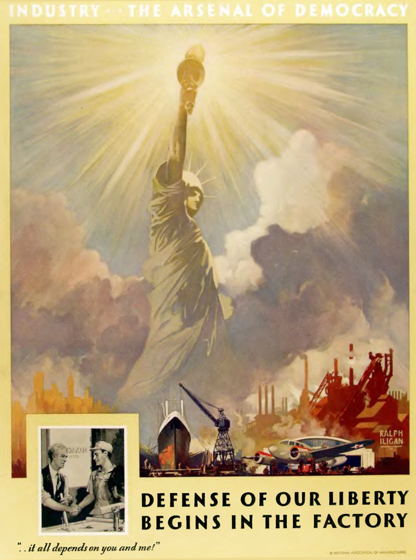
IMPACT OF THE NEW DEAL
3rd revolution in American culture + politics
More gov't involvement but w/in context of traditional U.S. democracy (not socialist…)
New Deal stimulated economy (but WWII would solve) → unemployed got jobs in munitions factories + the military, as U.S. became the ARSENAL OF DEMOCRACY
New Deal saw expansion of U.S. gov't in:
1) Economy - constant gov't intervention/deficit spending
2) Social reform (welfare state)
Precedent for gov't being expected to become involved in economic crises
Notes:
‹#›

