Slide 1
Equality and Hiearchy
1800-1915
Privilege and Agency

Slide 2
Class Conduct
Remember…
Intent vs. impact
Use Qualifiers
Use AND instead of But
We are all learners and have good intentions

Slide 3
Define:
Equality:
Hierarchy:
Privilege:
Agency:

Slide 4
Who is a the top?
What privileges do people at the top get?
Who is not at the top?
What don’t they have?
1800

Slide 5
Who is a the top?
White Men
What privileges do people at the top get?
Voting
Land
Autonomy
Who is not at the top?
Women
Enslaved and free African-Americans
Native-Americans
What don’t they have?
1800

Slide 6
What are Civil Rights?
Civil Rights refers to the positive acts governments take to protect against arbitrary or discriminatory treatment by government or individuals.
Civil Rights promote equality and undermine hierarchy
Agency ties to Civil Rights because…

Slide 7
Conditions During Slavery
Letters from Former Slaves:
Douglass:
T&S:
0%
Full Hierarchy
100%
Full Equality

Slide 8
Agency
Black and White abolitionists
Douglass
Grimke Sisters
Garrison
Harriet Jacobs
Harriet Beecher Stowe
Run-away
Subversive fighting back

Slide 9
Reconstruction (1865-1877)
Our Focus:
1. What will the new labor system of the South be?
2. How are the newly emancipated people to be integrated?
Notes:
Remind student that federal means both the state and national level. Have students use their homework to report on how different people feel the answer should be to these questions.
They can consider the first questions in their essay.
Bold questions equal the focus on the unit.
We will focus on q’s 3 and 4.

Slide 10
Approaches
Was equality on people’s minds?
Lincoln
Johnson
Radical Congress
State Government
Notes:
Glimpses at the Freedman's Bureau: Issuing Rations to the Old and Sick James E. Taylor September 22, 1866 Reproduced from Frank Leslie's Illustrated Newspaper
http://lsm.crt.state.la.us/cabildo/cab11.htm
Note--these Republicans are not under the same ideologies as Republicans today. Republicans during Reconstruction believed in the increased role of the federal gov’t to help with newly freed slaves and establish free labor in the South. Since the gov’t is controlled by Republicans and because most Southern state are not allowed representation and many are not allowed to vote, the Republicans are able to pass through legislation that they want.
Quotation from pg 134 Foner--In the face of so much aid to the freedman, whites, but also poor whites are angered.
Enfrocement acts---1870-1871--Cannot interfere with a person’s right to vote.

Slide 11
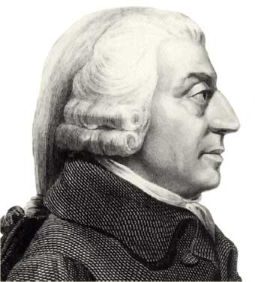
Adam Smith
What economic system do Northerners want the South to use? (picture is a clue)
Does capitalism promote equality?
Notes:
Laissez-faire economics--influenced by Adam Smith--Free labor, just simply ask the slaves to work as free laborers.
Redistribute land to encourage small farms and people (blacks).
South’s share of the wealth has decline from 30% to 12%--half of the regions livestock and farms machinery is destroyed.

Slide 12
Plantation System to Wage Labor (the idea)
Free labor
Most important goal of the national government during Reconstruction (Foner)
How would free labor help the emancipated peoples obtain equality and undermine hierarchy?
Notes:
Set the context--Severe crops failures. Quotation=pg 64 (Foner)--optimistic quotation but the weather and disruption of the South’s farms and equipment set a tense time for race relations to begin.
2.d quotations: Blacks AND poor white who had been working for a share f the crop to use and later sell were left with nothing. Many blacks--with few rights (thousands) were evicted before anything could be harvested.
Northerners and the gov’t saw the transition to free labor as something that would come naturally b/c of the obvious benefits but it was clear that the plantation owners were not going to give up their power so early.

Slide 13
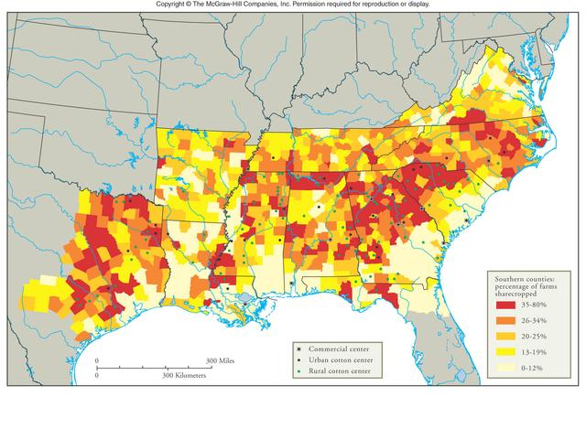
Sharecropping and tenant farming (what happened)
“We didn’t get no half. We didn’t git nothin’…We hadn’t done nothin’ to him. He just wanted the crop for hisself and he run us off. That’s all.”

Slide 14
Why?
“If Providence had smiled on this region in 1866, by giving it a reasonable crop, injustice to the negro and the new-comer, bitterness of heart and hatred of the government would have all but disappeared. In the absence of a good crop…all these were intensified.”
Enough land to share?
National vs. state/local levels
Does the new economic system of the South create equality or hierarchy?
Who gets the privilege? Who loses?
Notes:
This question most closely connected to our unit!
1862 Homestead Act - each family given 160 acres of land as long as they farmed it for five years
1873 Timber Culture Act - a further 160 acres of land was given as long as 40 acres was planted with trees
1877 Desert Land Act - 640 acres of very cheap land was made available in areas with low rainfall

Slide 15
National Government
Q 2. How will freedmen be treated?
13th amendment
14th amendment
15th amendment
Provided homesteads
Forty acres (mule is a myth!)
Radical Henry Wilson: “That is more than we do for white men.”
Charles Sumner Response: “White men have never been in slavery.”
Enforcement Acts (Ku Klux Klan acts) (1870-1871)

Slide 16
Freedman’s Bureau
Responsibilities:
“…introducing a workable system of free labor in the South, establishing schools for the freedman, providing aid to the destitute, aged, ill and insane, adjudicating disputes among black and between races, and attempting to secure for blacks and white Unionists equal justice from the state and and local governments…”
H
E
Notes:
African American line up at the Freedmens' Bureau office.
Quote from Foner pg 64.
Have students read the section from Foner for homework (either Jigsaw or all) and have them fill in the slide
Repsonsibliites contradict each other. For example, they wanted blacks to be put back on the plantations in a system of free labor but outlawed labor discipline and wanted to protect blacks against violence and give them an education. They want o help both the planter and the emancipated ppls. These would also help poor ehites supposedly.
Education as the great equalizer..true or false?--FB helps to form the foundation of black schools in the Souht. Fist black colleges open in the Souht, volunteers as school teachers live in the South to helpthem and train teechers. Belief that education could teach nlacks frugality, temperance, honesty, dignity of labor--problem as blacks advance econmically it leads to class conflict.
Most other meausres were looked at as temporary measures that would be removed or the control of the gov’t removed after awhile like hospitals, courts, orphanages---there is a fear that blacks will become dependent on the gov’t.
They also heard court cases.
“ A man who can work has not right to support by the government. No really respectable person wishes to be supported by others.”

Slide 17
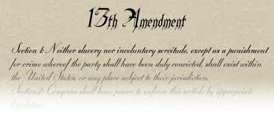
EFFECTIVENESS? 13th amendment
Sharecropping
Who else is losing privilege through sharecropping?
Notes:
Series of landmark decisions that restricted the scope of 14th amendment--a citizen had national rights, the national gov’t cannot control how the states interpret the laws.
US vs Cruink--you are protected only from the stats infringing not people.
http://faculty.polytechnic.org/gfeldmeth/0110201q.html
Which of the following was a feature of the sharecropping system that developed in the South following the Civil War? (A) cotton prices rose quickly to their pre-war levels (B) the landowner was usually African-American and the sharecropper was usually white (C) at the end of the growing season landowners paid workers a share of the harvest's profit (D) landowners were consistently honest in their treatment of sharecroppers (E) ex-slaves quickly gained economic and social status in the new South

Slide 18
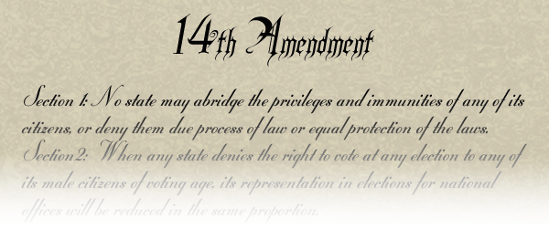
EFFECTIVENESS? 14th amendment
National level
Supreme Court:
US v Cruikshank
Slaughterhouse cases-1873
State level:
Jim Crow Laws
Local Level
KKK = terrorism
Notes:
Series of landmark decisions that restricted the scope of 14th amendment--a citizen had national rights, the national gov’t cannot control how the states interpret the laws.
US vs Cruink--you are protected only from the stats infringing not people.

Slide 19
Jim Crow Laws
Promotion of Equality Any person...who shall be guilty of printing, publishing or circulating printed, typewritten or written matter urging or presenting for public acceptance or general information, arguments or suggestions in favor of social equality or of intermarriage between whites and negroes, shall be guilty of a misdemeanor and subject to fine or not exceeding five hundred (500.00) dollars or imprisonment not exceeding six (6) months or both. Mississippi
Intermarriage The marriage of a white person with a negro or mulatto or person who shall have one-eighth or more of negro blood, shall be unlawful and void. Mississippi
Hospital Entrances There shall be maintained by the governing authorities of every hospital maintained by the state for treatment of white and colored patients separate entrances for white and colored patients and visitors, and such entrances shall be used by the race only for which they are prepared. Mississippi
Amateur Baseball It shall be unlawful for any amateur white baseball team to play baseball on any vacant lot or baseball diamond within two blocks of a playground devoted to the Negro race, and it shall be unlawful for any amateur colored baseball team to play baseball in any vacant lot or baseball diamond within two blocks of any playground devoted to the white race. Georgia
Wine and Beer All persons licensed to conduct the business of selling beer or wine...shall serve either white people exclusively or colored people exclusively and shall not sell to the two races within the same room at any time. Georgia
Housing Any person...who shall rent any part of any such building to a negro person or a negro family when such building is already in whole or in part in occupancy by a white person or white family, or vice versa when the building is in occupancy by a negro person or negro family, shall be guilty of a misdemeanor and on conviction thereof shall be punished by a fine of not less than twenty-five ($25.00) nor more than one hundred ($100.00) dollars or be imprisoned not less than 10, or more than 60 days, or both such fine and imprisonment in the discretion of the court. Louisiana

Slide 20
A way to guarantee universal equality for all races (not women!)
Democrat Response: “Asiatic influx and control of the state by an alliance of the Mongolian and Indian and African.”
Republican Response: “The same God created both Europeans and Asiatic.”
Notes:
These measures were also intended to prevent voting by Chinese immigrants in California--Democrats tried to use these ideas to gain suport gains the amendment. Quotation from Foner pg 135.

Slide 21
EFFECTIVENESS? 15th Amendment
National Level
US v Reese
State
Poll taxes
Literacy tests
Local level (including government)
KKK (fear and intimidation)
Notes:
These measures were also intended to prevent voting by Chinese immigrants in California--Democrats tried to use these ideas to gain suport gains the amendment. Quotation from Foner pg 135.

Slide 22
Sample Questions from a Literacy Test
State of Louisiana
One wrong answer denotes failure of the test. (10 min)
Draw a line around the number or letter of this sentence.
Draw a line under the last word in this line.
Cross out the longest word in this line.
Draw a line around the shortest word in this line.
Circle the first, first letter of the alphabet in this line.
In the space below draw three circles, one inside the other.
Above the letter X make a small cross.
Draw a line through the letter below that comes earliest in the alphabet. ZVSEDGMKYTPHC
Draw a line through the letter below that comes last in the alphabet. ZVSEDGMKYTPHC
In the space below write the word noise backwards and place a dot over what would be its second letter should it have been written forward.
Give your age in days.

Slide 23
Who is a the top?
What privileges do people at the top get?
Who is not at the top?
What don’t they have?
1877

Slide 24
STATE GOVERNMENTS DURING RECONSTRUCTION
New State Constitutions (pass the laws)
Who’s in charge?
Southern White Republicans
Carpetbaggers
Blacks (depending on location)
Results
Free public education
New services
“Completed the Equal Rights Revolution” (TX newspaper)
Notes:
Southern White Republicans are also there who all pposed secession ad have served in the Unoin army or been imprisoned for Union beliefes during the far--form alrgest number of delegates. Some were mercahnts, upcoutnry famers, most had not serves in policitcs.
Carpetbagges gain control in state govermnents during Recon. They were usually the best educated Republican delegrtes, veterans of the Union army, lawyers, physicians, and other professionals. They helped most to create the new Constitutions in the South.
Blacks (in places like LA where free blacks held such prestige had many positiion were able to gain representation and also in South Caorline were they the majoirty. IN Florida they were 40% of the attendess.
New services: orphages, peniteniers, homes for the insance, provision of poor relieft, commpulsory education in SC and TX. Abolish whipping as a punishment for cmie, property qualiifcations for voting, impsisonment for debt, reduced the number of capital crimes, right of married women to separet property, SC first time to grant divorces.

Slide 25
State Governments
Enforce the laws
Provide homesteads for blacks
Credit for purchases
…and not enforced
Fear of blacks dominating the government
Notes:
And not enforced: failure to agree on what kind of schools and shold they be integrated, should their be social euqlaity as well? Different states take different routes. LA and SC forbade separet schools but none requried them

Slide 26
Klan: Local Level and local government
The KKK emerged to prevent blacks and other groups from gaining access to the rights they felt belonged to their racial group.
"We must secure the existence of our people and a future for white children."

Slide 27
KKK
Involved in the (corrupt) government
Often avoided punishment in the early years
Supporters in both the north and the south
Arranged lynching and pull blacks out of jail to provide their own form of justice
Still in existence today

Slide 28
“I saw them kill my husband, he was shot in the head while he was in bed sick, there were between twenty and thirty men, they came into the room, then one, put the pistol to his head and shot him three times, then one of them kick him and another shot him again when he was down, he never spoke after he fell.”
Response by National Government
Enforcement acts (1870-1871)
Limited Success

Slide 29
Alabama: ORION (Our Race Is Our Nation) Knights of the Ku Klux Klan - Once a large and active group, the ORION Knights have mostly disappeared, with a remnant in Alabama. White Knights of the Ku Klux Klan - A small Alabama Klan group. Arkansas Bayou Knights of the Ku Klux Klan - An active regional Klan group, with a presence primarily in Louisiana, Arkansas, Texas, and Oklahoma. International Keystone Knights of the Ku Klux Klan - Once a larger group, the Keystone Knights are much smaller today, with active members in Pennsylvania and Arkansas. Knights of the Ku Klux Klan - An Arkansas-based Klan group with chapters in around seven states. Ku Klux Klan, LLC - A small Arkansas Klan group. Southern Arkansas Knights of the Ku Klux Klan - A small Klan group based in Smackover. California Kalifornia Knightsof the Ku Klux Klan - A small California Klan group. White Legion Knights of the Ku Klux Klan- A small southern California Klan group. Florida Empire Knights of the Ku Klux Klan - A growing Klan group based in Florida, claiming chapters in some 18 states, mostly in the South, the Northeast, and the West Coast. National Aryan Knights of the Ku Klux Klan - A small Klan group with chapters in Florida and Louisiana. United White Knights of the Ku Klux Klan - A small Florida Klan group. Georgia: American White Knights of the Ku Klux Klan - A small Klan group with chapters in Georgia and Texas. Georgia Knight Riders of the Ku Klux Klan - A Georgia-based Klan group. North Georgia White Knights of the Ku Klux Klan - A Georgia-based Klan group. Indiana: American Knights of the Ku Klux Klan - Possibly the most active Klan group in the 1990s, the American Knights are now nearly dead, with only a few members in Indiana. Church of the National Knights of the Ku Klux Klan - Headquartered near South Bend, Indiana. It claims chapters in around 20 different states, in all parts of the country. United Knights of the Ku Klux Klan - A small Indiana Klan group. Iowa: Fraternal White Knights of the Ku Klux Klan- A small Iowa Klan group. Kentucky: Imperial Klans of America - A prominent Klan group based in Kentucky with chapters in eight states. White Mountain Knights of the Ku Klux Klan - A small Kentucky Klan group. Louisiana: Bayou Knights of the Ku Klux Klan - An active regional Klan group, with a presence primarily in Louisiana, Arkansas, Texas, and Oklahoma. Louisiana White Knights of the Ku Klux Klan - A Louisiana Klan group. National Aryan Knights of the Ku Klux Klan - A small Klan group with chapters in Florida and Louisiana. Southern White Knights of the Ku Klux Klan- A small Louisiana Klan group. MichiganUnited Northern and Southern Knights of the Ku Klux Klan - A Klan group with chapters in nine states, mostly in the Midwest. It is based in Michigan. Mississippi Mississippi White Knights of the Ku Klux Klan- A Klan group with a number of chapters in Mississippi. New Jersey: Confederate Knights of the Ku Klux Klan - A small New Jersey Klan group headquartered in Millville. North Carolina Cleveland Knights of the Ku Klux Klan - A small North Carolina Klan group. Ohio Brotherhood of Klans - One of the larger and more active Klan groups in 2006, headquartered in Tennessee until the late 2006 death of its leader. It appears its new headquarters will be in Marion, Ohio. It claims chapters in some 15 states, from all around the country. Mystic Knights of the Ku Klux Klan - An Ohio-based Klan group that claims to be active in eight states, mostly in the Midwest, although it lost much of its membership to the United Northern & Southern Knights.

Slide 30
Oklahoma Bayou Knights of the Ku Klux Klan - An active regional Klan group, with a presence primarily in Louisiana, Arkansas, Texas, and Oklahoma. Pennsylvania International Keystone Knights of the Ku Klux Klan- Once a larger group, the Keystone Knights are much smaller today, with active members in Pennsylvania and Arkansas. South Carolina International Knights of the Ku Klux Klan - A small South Carolina Klan group. Tennessee Great Tennessee Knights of the Ku Klux Klan - A small Tennessee Klan group. Knights of Bedford Forest - A small Tennessee Klan group. Knights of the Golden Circle - A small Tennessee Klan group. Knights of Yahweh - A small Klan group based in Dandridge, Tennessee. Texas American White Knights of the Ku Klux Klan - A small Klan group with chapters in Georgia and Texas. Bayou Knights of the Ku Klux Klan - An active regional Klan group, with a presence primarily in Louisiana, Arkansas, Texas, and Oklahoma. White Camelia Knights of the Ku Klux Klan- A Texas Klan group based in Cleveland, Texas. Virginia Victory Knights of the Ku Klux Klan- A small Virginia Klan group. Virginia Knights of the Ku Klux Klan - A small Virginia Klan group. West Virginia Knight Riders of the Ku Klux Klan - A small West Virginia Klan group.

Slide 31
The End?
Carpetbaggers and scalawags---Redeemers
Grant (scandals and economic troubles)
Compromise of 1877
Notes:
The Election of 1876 virtually ended in a tie. Democrat Samuel Tilden, the governor of New York, narrowly won the popular vote but, with several states still in dispute, remained one vote shy of winning the electoral college vote. Republican Rutherford B. Hayes needed twenty electoral votes, a sweep of the disputed states, to win the election. As the term of President Grant was set to expire, a compromise was reached that handed Hayes the White House. In exchange, Hayes ended Reconstruction and returned the former Confederate states to home rule. As a practical matter, this ended federal supervision of race relations and ushered in the political and social system of white supremacy known as Jim Crow. The electoral map shows the discrepancy between the popular and electoral vote. Robert Smalls was an African American man, born a slave, who, after the Civil War, was elected to the House of Representatives five times from South Carolina. This essay decries the sorts of fraud practiced against Republicans in the state. Southern whites voted overwhelmingly Democratic while Southern African Americans voted heavily Republican. Smalls speaks of measures designed to discourage Republican voters, which disproportionately impact black voters. In the coming years, many of these same techniques were refined beyond party affiliation and concentrated exclusively on race. This, and other more drastic legal measures, disenfranchised nearly all black voters.

Slide 32
Post-Reconstruction (1877)
Post Reconstruction, how are blacks lives different?
Post Reconstruction, what challenges do blacks face?
At the end of Reconstruction, where do blacks fall on our spectrum?
What other groups have been pushed to the bottom?
How has the system pushed people to the bottom?
Notes:
Notes: own their own farms, more choices in occupation, more literacy, reunited families.

Slide 33
Plessy vs. Ferguson: Supreme Court
Through what means are blacks seeking to gain Civil Rights: Agency
Deliberate action!
Supreme Court creates doctrine of “Separate but equal”
“separate does not imply inferiority”
Does it?
Lone dissent (Harlan)
When does Reconstruction end?
Notes:
Majority opinion:
--handpicked for the task by the Comité des Citoyens, an organization of prominent African-American civil libertarians who had already raised the funds necessary for his legal defense
: Constitution is color blind, mixing of races is inevitable

Slide 34
Jim Crow
What system does Jim Crow Laws create?
Who benefits?
Long-term impacts of this system?
H
E

Slide 35
Parchman Farms
What system is created?
Who benefits?
Long-term impacts of this system?
H
E

Slide 36
Agency
How do people (usually in the group pushed to the periphery) attempt to gain civil rights and move toward equality?
Civil Rights: Positive acts governments take to protect against arbitrary or discriminatory treatment by government or individuals.

Slide 37
On Booker T Washington
Washington’s Beliefs:
Dubois’s Beliefs:

Slide 38
Agency
Booker T Washington-Former slave
“Cast down your bucket”
“In all things that are purely social we can be as separate as the fingers, yet one as the hand in all things essential to mutual progress”
Economic success, wait for whites to accept blacks
Don’t deal with discrimination now--it will fade over time

Slide 39
Agency
WEB Dubois
“Exceptional men-the talented tenth.”
“Can the masses of the Negro people be in any possible way more quickly raised than by the effort and example of this aristocracy of talent and character?”
Niagara movement
Take freedom now--do not wait
Use education in college to rise up

Slide 40
Lynching
Humiliation and eventual death of a person at the hands of a mob (2+ persons) often without due process of law
Examine pg 2-3 in Class Reader
Major causes for black lynching:
Characteristics:
Notes:
Socializing with white women
rape or murder
Economic success
Carry out quick justice
Seen as vigilante
Image: Jesse Washington postcard
Executed without due process of law
Normally done by large mob
Mobs killing and torturing
Punishment of the crime by common man
Very public
Victim usually not proven guilty
Mobs enforce own form of justice
Sends message
Children, entire community present
Gov’t involved--even as bystander
Public event--school stops, stores close
Photographs are produced
Often mutilated body
Hung the bodies
Children and women lynched rarely
Most common in the South
Sale of mementos was common
Not all people lynched were black
Lynching is passed on through generations

Slide 41
Anti-lynching
Agency
NAACP
Media
Legislation
Ida B Wells
Notes:
In this letter, Congressman Leonidas C. Dyer (R-Missouri) invites the NAACP to support a new federal anti-lynching bill. Dyer, who served a largely black constituency in St. Louis, had tried to advance a bill in Congress since 1911. He was reinvigorated by the testimonies of the many survivors of the 1917 East St. Louis riot who relocated to his district. Dyer also asks NAACP Secretary John Shillady for recent data on lynchings that he might include in a speech. His request led to the publication of Thirty Years of Lynching, 1889–1918 a year later.
Congressman L.C. Dyer to John R. Shillady concerning an anti-lynching bill, April 6, 1918. Typed letter. NAACP Records, Manuscript Division, Library of Congress (047.00.00) Courtesy of the NAACP http://myloc.gov/Exhibitions/naacp/newnegromovement/ExhibitObjects/1918AntiLynchingBill.aspx

Slide 42
Agency-Ida B Wells
Born into slavery
Educated
3 actions blacks can take
Self help
Use the media -- raise awareness
Self-defense--get a gun!
Boycott--economic--don’t buy from whites
Emigrate (to the North)
Goals: end violence against blacks, educate the masses about the violence against blacks, debunk the myth that blacks are oversexualized, gain freedom and equality

Slide 43
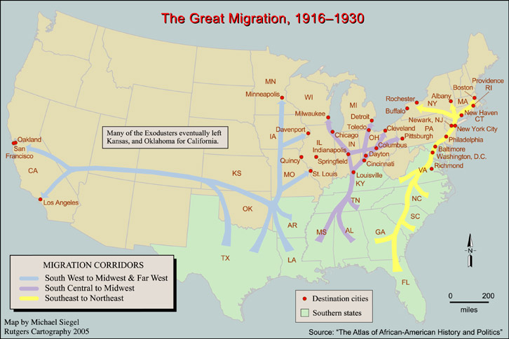
Agency: The Great Migration

Slide 44
Agency: The Great Migration
“We are bitter no more; we are leaving! We are leaving our homes, pulling up the stakes to move on. We look up at the high southern sky and remember all the sunshine and all the rain…We take one last furtive look over our shoulder to the Big House--high upon a hill beyond the railroad tracks--where the Lord of the Land lives, and we feel glad, for we are leaving.” –Richard Wright
Jacob Lawrence (1940-1941)

Slide 45
Agency: NAACP
Formed in 1908 by Niagara movement
1905=first meeting--not yet the NAACP
1908--blacks and white progressives meet to form the NAACP out of concern for violation of blacks civil rights
“physically free from peonage, mentally free from ignorance, politically free from disfranchisement, and socially free from insult.”
Use courts to achieve Civil Rights for blacks, focus on challenging unfair laws
Demand equal access to housing and professional careers
1915--Successful in in striking grandfather clauses in OK and MD
Notes:
Niagara movement--1905-restore the vote
Response to lynching. Both white and black reformers, multi religion
One nation in which all citzens were ensured equality.

Slide 46
Who is a the top?
What privileges do people at the top get?
Who is not at the top?
What don’t they have?
How is this systematic hierarchy?
1915

Slide 47
Women’s Rights
H-----------------------------------------------------E

Slide 48
Hiearchy-1800-1850
Legal Disabilities
Marriage and Property Laws
Representation (voting)
Divorce
Employment
Education
Confidence
Examples
Marriage Protests
Our Costume
Rev John Todd

Slide 49
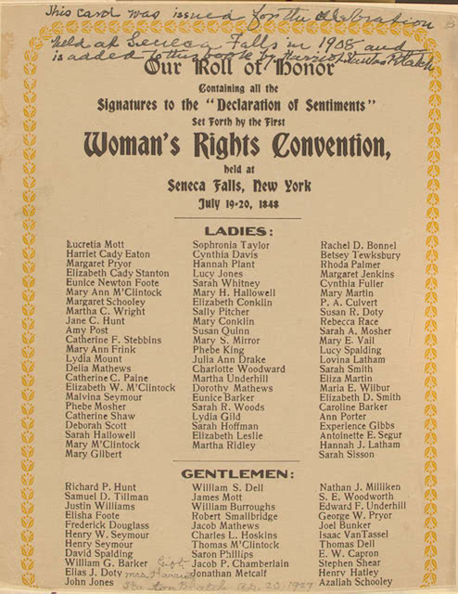
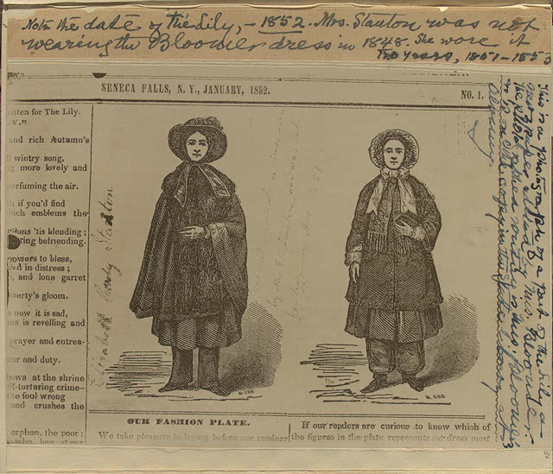
Agency: 1848
Seneca Falls
Declaration of Sentiments
Notes:
http://www.loc.gov/exhibits/treasures/trr040.html
Elizabeth Cady Stanton (1815-1902), Our roll of honor, signatures to the "Declaration of Sentiments" Set Forth by the First Woman's Rights Convention held at Seneca Falls, New York July 19-20, 1848. with emendations by her daughter Harriot Stanton Blatch (1856-1940)

Slide 50
Agency: What to fight for? (1830s-1850s)
Upper/Middle Class:
Property Rights
Marriage Rights
Access to higher education
Anti-Prostitution
Voting Rights
Abolition
Access to Employment
Dress Reform
Also
Working Class:
Temperance
Anti-Gambling
Better working conditions
Better living conditions
Help for the poor
Representation in gov’t
Control of earnings

Slide 51
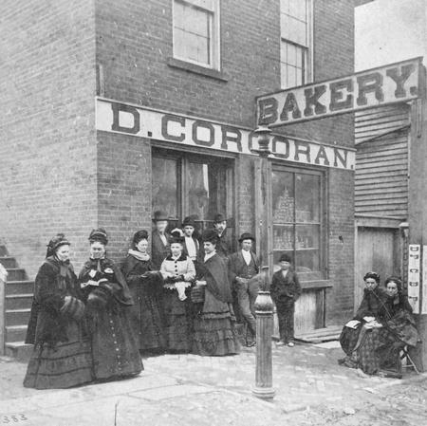
Agency: Methods
Upper/Middle class women:
Lobbying
Abolitionist movement
Publish journals
Protesting colleges
All used these methods:
Picketing
Civil disobedience
Notes:
Refusal to pay taxes, vote anyway

Slide 52
Abolitionism and Women’s Rights

Slide 53
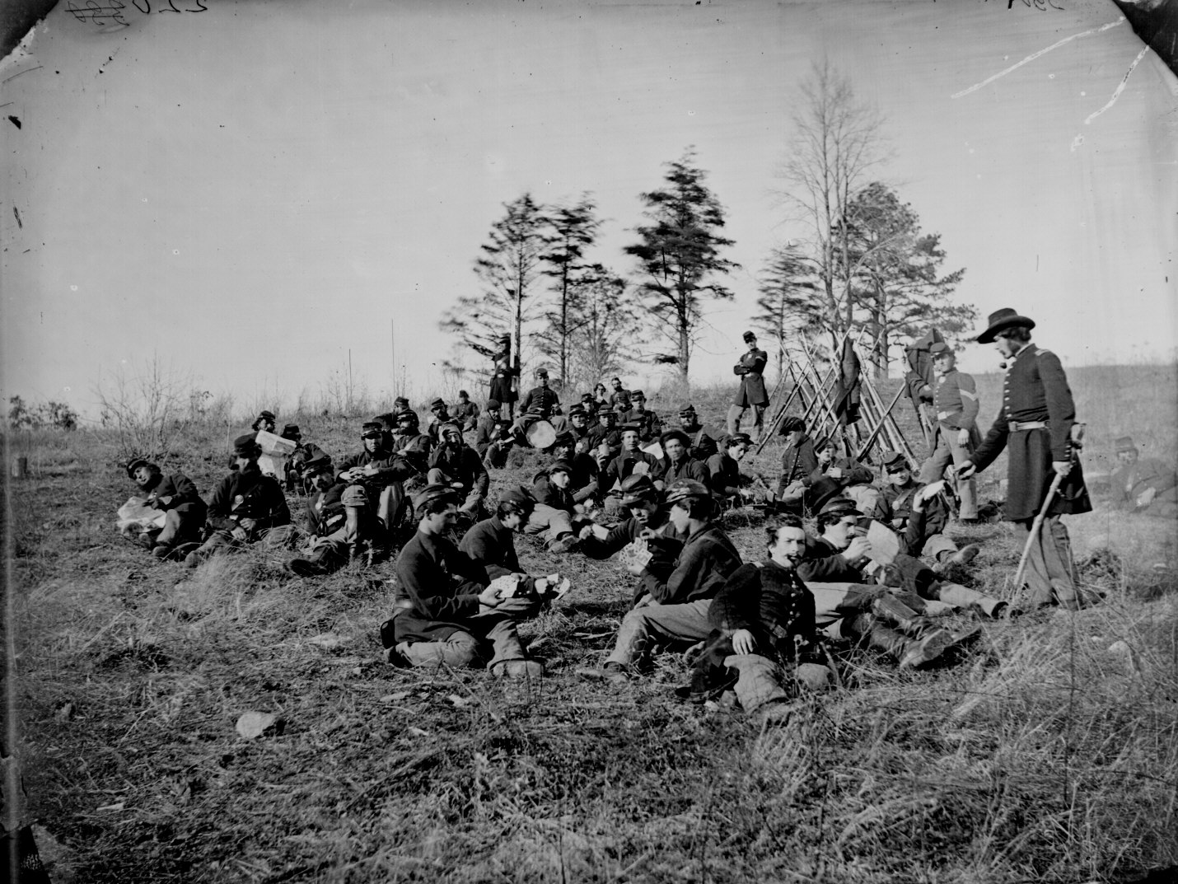
Civil War
Movement Stalls: Why?
Women as soldiers and spies
Civil War Photography--Thesis topic?

Slide 54
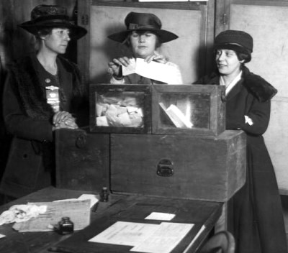
Hope
13th, 14th, 15th amendment
Promotes equality?
Do these amendment give women rights?
Why or why not?
Conflict
Notes:
Why was the Fourteenth Amendment controversial in women's rights circles? Because, for the first time, the proposed Amendment added the word "male" into the US Constitution. Section 2, which dealt explicitly with voting rights, used the term "male." And women's rights advocates, especially those who were promoting woman suffrage or the granting of the vote to women, were outraged.Some women's rights supporters, including Lucy Stone, Julia Ward Howe, and Frederick Douglass, supported the Fourteenth Amendment as essential to guaranteeing black equality and full citizenship, even though it was flawed in only applying voting rights to males. Susan B. Anthony and Elizabeth Cady Stanton led the efforts of some women's suffrage supporters to defeat both the Fourteenth and Fifteenth Amendments, because the Fourteenth Amendment included the offensive focus on male voters. When the Amendment was ratified, they advocated, without success, for a universal suffrage amendment.Each side of this controversy saw the others as betraying basic principles of equality: supporters of the 14th Amendment saw the opponents as betraying efforts for racial equality, and opponents saw the supporters as betraying efforts for the equality of the sexes. Stone and Howe founded the American Woman Suffrage Association and a paper, the Woman's Journal. Anthony and Stanton founded the National Woman Suffrage Association and began publishing the Revolution.
Though the second article of the Fourteenth Amendment introduced the word "male" into the Constitution in respect to voting rights, nevertheless some women's rights advocates decided that they could make a case for women's rights including suffrage on the basis of the first article of the Amendment, which did not distinguish between males and females in granting citizenship rights.

Slide 55
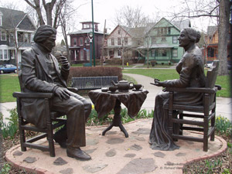
Agency Failure and Redirection
“They always unified the words ‘without regard to sex, race or color.’ Who hears of sex now from these champions on freedom.”
Douglass
Splits movement:
Champion for black equality?
Suffrage for women?
Suffrage is still a goal for women
E-----------------------------------------------------H
Notes:
The "Let's have tea" statue depicting Susan B. Anthony and Frederick Douglass having tea. The statue is about a block from the home of Susan B. Anthony in Rochester.

Slide 56
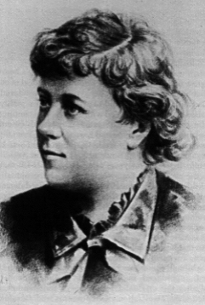
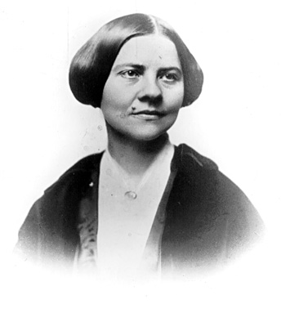
Agency: A Split 1880s
2 groups
1. National Woman Suffrage Association-Constitutional amendment
2. American Woman Suffrage Association--State amendments
Why do these groups seek help from
different governments to
achieve the same goal?
Why seek help from the government?
Notes:
Disagreement over the next steps to take led to a split in the women's rights movement in 1869. Elizabeth Cady Stanton and Susan B. Anthony, a temperance and antislavery advocate, formed the National Woman Suffrage Association (NWSA) in New York. Lucy Stone organized the American Woman Suffrage Association (AWSA) in Boston. The NWSA agitated for a woman-suffrage amendment to the Federal Constitution, while the AWSA worked for suffrage amendments to each state constitution. Eventually, in 1890, the two groups united as the National American Woman Suffrage Association (NAWSA). Lucy Stone became chairman of the executive committee and Elizabeth Cady Stanton served as the first president. Susan B. Anthony, Carrie Chapman Catt, and Dr. Anna Howard Shaw served as later presidents.
Picture = luc stone

Slide 57
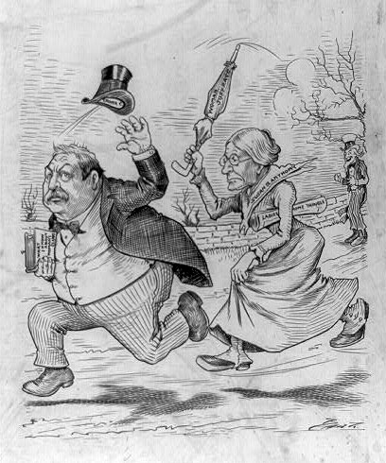
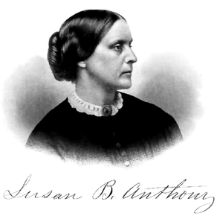
Notes:
1884 Grover Cleveland

Slide 58
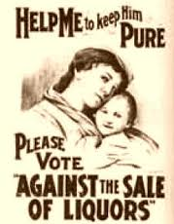
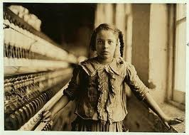
Other methods to gain equality
Expand domestic sphere to include social evils
Can leave the home
Fight for the morality of society
Run for office
Mass voting
Courts
Through 14th amendment
Political Cartoons and Media
Notes:
Eventually, in 1890, the two groups united as the National American Woman Suffrage Association (NAWSA). Lucy Stone became chairman of the executive committee and Elizabeth Cady Stanton served as the first president. Susan B. Anthony, Carrie Chapman Catt, and Dr. Anna Howard Shaw served as later presidents.
The struggle to win the vote was slow and frustrating. Wyoming Territory in 1869, Utah Territory in 1870, and the states of Colorado in 1893 and Idaho in 1896 granted women the vote but the Eastern states resisted. A woman-suffrage amendment to the Federal Constitution, presented to every Congress since 1878, repeatedly failed to pass.

Slide 59
The Bicycle
(1888)
(1895)
“Bicycling has done more to emancipate women than anything else in the world. I stand and rejoice every time I see a woman ride by on a wheel. It gives women a feeling of freedom and self-reliance.”
-- Susan B. Anthony, 1896

Slide 60
Agency: Myra Bradwell (state level)
1869--Illinois Supreme Court denied
application to practice law
“femme covert”
Appeals again with 14th amendment
Right to choose livelihood
"It certainly cannot be affirmed, as a historical fact, that this [the right to choose one's profession] has ever been established as one of the fundamental privileges and immunities of the sex. The paramount destiny and mission of women are to fulfill the noble and benign offices of wife and mother."
Notes:
Myra Bradwell's case was one of the first to advocate for use of the 14th Amendment to defend women's rights. Myra Bradwell had passed the Illinois law exam, and a circuit court judge and a state attorney had each signed a certificate of qualification, recommending that the state grant her a license to practice law.However, the Supreme Court of Illinois denied her application on October 6, 1869. The court took into consideration the legal status of a woman as a "femme covert" -- that is, as a married woman, Myra Bradwell was legally disabled. She was, under the common law of the time, prohibited from owning property or entering into legal agreements. As a married woman, she had no legal existence apart from her husband.Myra Bradwell challenged this decision. She took her case back to the Illinois Supreme Court, using the Fourteenth Amendment's equal protection language in the first article to defend her right to choose a livelihood. In her brief, Bradwell wrote "that it is one of the privileges and immunities of women as citizens to engage in any and every provision, occupation or employment in civil life."The Supreme Court found otherwise. In a much-quoted concurring opinion, While the Bradwell case raised the possibility that the 14th Amendment could justify women's equality, the courts were not ready to agree.
One, women would not be allowed to practice the law. Two, this would open the flood gates and many more women would want to follow in Bradwell’s foot steps. Three, brutal cases would not be appropriate for a woman to handle. Finally, the state was worried about the effect women would have on the administration office. Bradwell felt that she was being treated unfairly. She decided to take her concerns to the United States Supreme Court. But in 1873 the Supreme Court also denied her to the bar because of her gender. In 1872, the Illinois legislature passes a law stating that “No person shall be precluded or debarred from any occupation, profession, or employment (except the military) on account of gender." Bradwell continued to work on the Chicago Legal News where she was the journals publisher, business manager, and editor in chief. In 1890, she was admitted to the Illinois Bar and in 1892 she had received her license to practice before the United States Supreme Court(Meezey).

Slide 61
Agency: Virginia Minor National level
Minor vs Happersett (1875)
Happersett refuses Minor’s attempt to register to vote in Missouri
Case goes to Supreme Court
Suffrage is not a right but a privilege to be granted by individual states
Women are indeed citizens
Notes:
Another woman, Virginia Minor, was turned away from the St. Louis polls when she tried to vote -- and her husband, Frances Minor, sued Reese Happersett, the registrar. (Under "femme covert" presumptions in the law, Virginia Minor could not sue in her own right.) The Missouri state law said that men could vote. The Minors' brief argued that "There can be no half-way citizenship. Woman, as a citizen in the United States, is entitled to all the benefits of that position, and liable to all its obligations, or to none."The unanimous decision of the US Supreme Court found that women born or naturalized in the United States were indeed American citizens, and that they always had been even before the Fourteenth Amendment. But, the Supreme Court also found that voting was not one of the "privileges and immunities of citizenship" and therefore states need not grant voting rights or suffrage to women.Once again, the Fourteenth Amendment was used to try to ground arguments for women's equality and the right as citizens to vote and hold office -- but the courts did not agree.

Slide 62
Women on the Frontier
“Her husband lay prostrate before her and senseless with loss of blood from a bullet-wound in the right shoulder. Staunching the flow of blood with styptics which she gathered among the forest shrubs, she brought water and the wounded man soon revived. After a slow and weary march she brought him back to the cabin, carrying him part of the way upon her shoulders. Under her careful nursing he at length recovered his strength though he always carried the bullet in his shoulder. It appears he had met three Indians who told him they were in search of their two missing companions. One of them afterwards treacherously shot him from behind through the shoulder, and in return Pentry sent a ball through his heart. Then becoming weak from loss of blood he could only point his gun-barrel at the remaining Indians, and this was his situation when his wife came up and saved his life.”
Notes:
WOMAN ON THE AMERICAN FRONTIER.
A Valuable and Authentic History
OF THE HEROISM, ADVENTURES, PRIVATIONS, CAPTIVITIES, TRIALS, AND NOBLE LIVES AND DEATHS OF THE "PIONEER MOTHERS OF THE REPUBLIC."
By WILLIAM W. FOWLER, M.A.
ILLUSTRATED WITH NUMEROUS ENGRAVINGS.
FROM 1923

Slide 63
Who is a the top?
What privileges do people at the top get?
Who is not at the top?
What don’t they have?
How is this systematic hierarchy?
1870

Slide 64
Justifications for Equality
Embrace and expand
Suffrage = main goal

Slide 65
Justifications: Maintain hierarchy
Women (particularly suffragists) were potential hysterics
They cannot be taken them seriously
“A women's emotional instability would make her a dangerous voter. She would let her feelings rather than her intellectual concerns be her primary reason for voting. ”
“"Women did not have the intellectual capacity of men because their brains were smaller and more delicate.
Notes:
2.The other explanation to women's intellectual inferiority was related to the same basis for diagnosing hysteria.
3. They argued that the women's thought process was less equipped to handle logical progressions than were men's. For example, an anti said that "women's mind arrives at conclusions on incomplete evidence; has a very imperfect sense of proportion; accepts the congenial as true and rejects the uncongenial as false; takes the imaginary which is desired for reality, and treats the undesired reality which is out of sight as non-existent-building up for itself in this way... a very unreal picture of the external world."
4. Women in politics would mean corruption and irrationality."
5. They warned that if women got the vote they would compete with men in the male sphere and lose the qualities which made them feminine. "'The question to be decided...is simply this: Is it desirable to have women become masculine, instead of retaining the characteristics of her own sex?"
6.While women would become more masculine, antis argued that men would become more effeminate. Male antis saw women in politics as a threat to their masculinity.
"Giving women the vote was views as a shirking rather than a sharing of responsibility, and therefore a resignation of manhood.".
"Woman suffrage would produce a nation of transvestites." (Mayor, 69)3.Once traditional sex roles were tampered with the family structure would annihilate, argued antis. The antis argued that women had a separate but equal form of power. They could shape their children's growth. The antis argued that giving women political power was not the solution to women's dissatisfaction. 'They advocated that women use the power they had within the home to produce sons and husbands who were effective extensions of themselves." (Mayor, 71)
9..Since all women suffragists bordered on hysteria there was no need to take their arguments seriously.
10." Men had an obligation to protects other women from contamination of the suffragists.
11..A women's emotional instability would make her a dangerous voter. She would let her feelings rather than her intellectual concerns be her primary reason for voting. "Since women obviously could not be trusted to behave rationally, they would be extremely dangerous in a political setting."

Slide 66
Equality State laws
Marriage laws that legally disabled women were slowly uplifted
Women could practice law and medicine in several states
Slows movement
Suffrage
Notes:
Pro-Suffrage Cartoon A pro-suffrage cartoon in a Puck Magazine of 1915 depicts the western states carrying the torch of women's suffrage to the eastern states.
http://www.corbisimages.com/stock-photo/rights-managed/IH165327/pro-suffrage-cartoon/?ext=1
1869-Utah
1870-Wyoming
Based on the map
Which part of the United States (geographically) first allowed women the rights to vote?
Which states were last to give women the right to vote?
Is this surprising? Why or why not?
Read the section above the map:
How did states impact each other in granting women suffrage

Slide 67
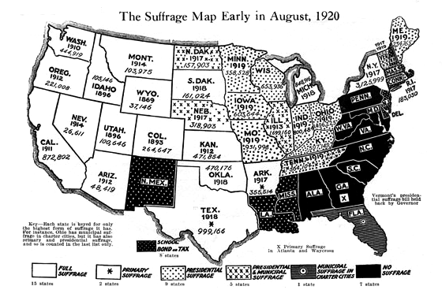

Slide 68
By 1915 (use pgs 64-66)
Achievements | Restrictions

Slide 69
Who is a the top?
What privileges do people at the top get?
Who is not at the top?
What don’t they have?
Why is this systematic?
1915
Women

Slide 70
Native Americans/American Indians
H-----------------------------------------------------E

Slide 71
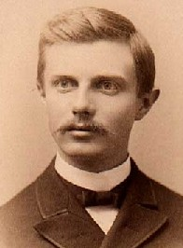
Turner Thesis (1893)
What is Turner’s frontier thesis?
Democratic principles
Open society
Unfettered economy
Rugged individualism
Who do these principles apply to?
Black exodus, mining, ranching, farmers all at the expense and to the disadvantage of Native Americans

Slide 72
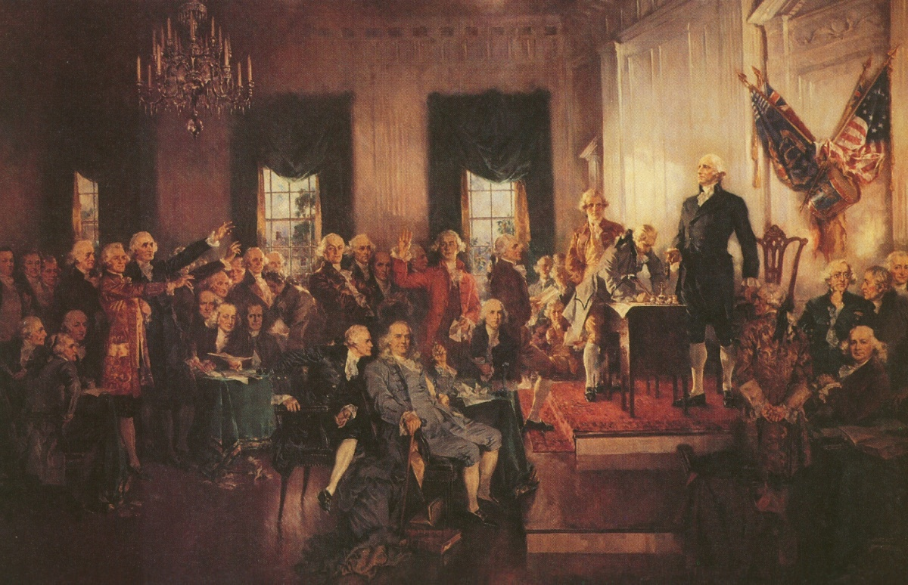
Native Americans and the Constitution
Open your pocket Constitutions and find where Native Americans are addressed.
What are the implications of that section?
Notes:
“tribal authority was not created in the Constitution--tribal sovereignty predated the formation of the US--but the Constitution acknowledged the existence of tribes.”
Still acknowledged as third source of sovereignty
3x in Constitution--Indians not taxed used twice--of historical importance--intended as reference to non citizen Indians
When the representatives of the thirteen colonies/states started drafting the United States Constitution, to form the United States government we now live under, the “Founding Fathers” of this nation had to carefully consider the role of Indian tribes in the political arrangement of the new nation. As James Madison pointed out, much of the trouble that England and the thirteen colonies had suffered with Indian tribes from the 1640’s forward arose when individual colonists or colonial governments tried to greedily take Indian lands. In those instances, the colonies and individual colonists would negotiate with tribes without the permission or the involvement of the English King or the American national leadership. The drafters of the U.S. Constitution tried to solve this problem by taking Indian affairs out of the hands of the colonies/states and individuals and placing the sole power to deal and negotiate with tribes into the hands of the U.S. Congress. Thus, Indian tribes and their people, and the United States relationship with tribes are addressed in the U.S. Constitution.
In Article I, the United States Constitution accomplishes the goal of excluding states and individuals from Indian affairs by stating that only Congress has the power “To regulate Commerce with foreign Nations, and among the several States, and with the Indian Tribes . . . .” The United States Supreme Court has interpreted this language to mean that the Congress was granted the exclusive right and power to regulate trade and affairs with the Indian tribes. The very first United States Congress formed under our new Constitution, in 1789-1791, immediately assumed this power and in the first five weeks of its existence it enacted four statutes concerning Indian affairs. In 1789, the new Congress, for example, established a Department of War with responsibility over Indian affairs, set aside money to negotiate Indian treaties, and appointed federal commissioners to negotiate treaties with tribes. In July 1790, this Congress passed a law which forbids states and individuals from dealing with tribes and from buying Indian lands. This law is still in effect today.
Indian tribes are also referred to, but are not expressly designated, in Article VI of the Constitution where it is made clear that all treaties entered by the United States “shall be the supreme Law of the Land.” In 1789, the United States had only entered a few treaties with European countries while it had already entered nine treaties with different Indian tribes. Consequently, this treaty provision of the U.S. Constitution states that the federal government’s treaties with Indian tribes are the supreme law of the United States.
Individual Indians are also mentioned in the Constitution of 1789, Article I, and again in the Fourteenth Amendment to the Constitution which was ratified in 1868. In counting the population of the states to determine how many representatives a state can have in Congress, Indians were expressly not to be counted unless they paid taxes. In effect, Indians were not considered to be federal or state citizens unless they paid taxes. After the Civil War when citizenship rights were extended through the Fourteenth Amendment to ex-slaves and to “[a]ll persons born or naturalized in the United States,” that Amendment still excluded individual Indians from citizenship rights and excluded them from being counted towards figuring congressional representation unless they paid taxes. This demonstrates that Congress still considered Indians to be citizens of other sovereign governments even in 1868 when the Fourteenth Amendment was adopted. This view was correct because most Indians did not become United States citizens until 1924 when Congress passed a law making all Indians United States citizens. For many years after 1924, states were still uncertain whether Indians were also citizens of the state where they lived and in many states Indians were not allowed to vote in state elections.
http://www.flashpointmag.com/amindus.htm

Slide 73
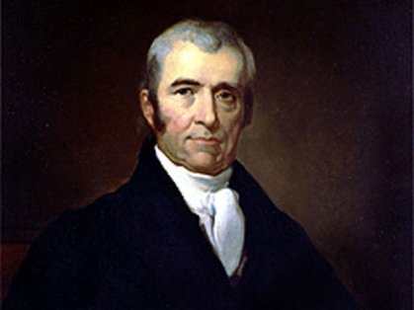
Marshall Trilogy
Johnson v McIntosh (1823)
“doctrine of discovery”
Cherokee Nation v Georgia (1831)
“domestic dependent nation”
Worcester vs. Georgia (1832)
“tribal sovereignty”
What relationship does the Supreme Court establish between Native Americans and citizens of the US and the US government?
Control…at arms length
H--------------------------------------------------------------------E
Notes:
Marshall 1801-1835 as Supreme Court Justice
JOHNSON v. M'INTOSH, 21 U.S (8 Wheat) 543 (1823). This case involved a dispute between two white men who held conflicting titles to land sold within the reservation to them. Johnson held a title sold him by the Tribe within the reservation. Chief Justice Marshall, examined the history of how land was acquired during the European invasion and ultimately held that the tribe did not have an enforceable title to the land it sold. The Indians enjoyed a right of "occupancy" only. The ultimate title to land had passed to the United States government under a principle called "discovery." The "discovery doctrine" was developed by the Spanish philosopher, Vittorio, in an attempt to justify and explain the taking of land from aboriginal people. In its essence, Vittorio opined that it was the manner in which the civilized nations dealt with each other as it pertained to the land, that governed who had title. A European nation that discovered land occupied by aboriginal people, assumed certain rights over that land that were recognized by the other European nations. It was these "recognized" rights that were passed on to the United States when it won the War of Independence. I will not attempt to go on a further dissertation on the doctrine, except to say that, in it, Marshall found the rationale for asserting federal title power over the land versus state power. As a result, with the adoption of the "discovery doctrine," the Court held the title to land passed to the plaintiff by the Illinois and Piankeshaw tribes was invalid because Indians held only a title of occupancy, and not full title.
This case primarily related to land issues and the interpretation of the Doctrine of Discovery in the United States. The case involved a man named Thomas Johnson who bought land from the Piankeshaw Indians and William M’Intosh who later obtained a patent to the same land from the United States federal government. The Court was asked to settle the dispute between the two men and sided with M’Intosh. The Court went on to say that the Indians did not own land outright, but that they had rights to occupy lands and only the discovering nation (U.S.) could settle those land rights. Indians could not sell lands to individuals and states do not have legal standing to settle aboriginal land claims. There was a case similar to this much later in Alaska called United States v. Berrigan (1905). That case involved gold seekers trying to purchase land from Athabascan people who were living in what is now Delta Junction. Judge Wickersham ruled that only the federal government could negotiate with Indians over land rights.
In upholding this power of discovery over Indian tribes for the United States, the Supreme Court had to ignore its own opinion that Indians possessed natural rights to their lands. In fact, the Supreme Court refused to say why American farmers, “merchants and manufacturers have a right, on abstract principles, to expel hunters from the territory they possess” or to limit the tribal rights. Instead, in determining tribal rights to sell their lands, the Court relied on the doctrine of discovery and the fact that the United States had beaten some tribes in war to decide that only the United States could buy Indian lands. “Conquest gives a title [to the land] which the Courts of the conqueror cannot deny . . . .” Id. at 588.
CHEROKEE NATION V. GEORGIA, 30 U.S. (5 Pet.) 1 (1831). State of GA tried to a cherokee for the murder of another cherkokee within the boundaries of the treaty reserved lands of the Cheorkee nation. GA ignores the writ of habeus corpus was based on the Chreokee entitlement to to their own courts. http://www.flashpointmag.com/amindus.htm
The Cherokee Nation sought review with the Supreme Court to impose an injunction on the State of Georgia prohibiting implentation of certain laws of that state on the Cherokee Nation reservation. Pursuant to the Constitution, all regulations concerning commerce with Indian nations were within the sole power of the federal government. In what is known as the Commerce Clause, the Founding Fathers empowered Congress to "regulate commerce with foreign nations, and among the several states, and with the Indian tribes." The Supreme Court was authorized to hear only matters of "original jurisdiction", that is, matters expressly provided for in the Constitution. The Supreme Court held that the Cherokee Nation was not a foreign nation, rather a "domestic dependent nation" subject to the sovereignty of the United States federal government. Since the tribe was not a "state" nor a "foreign nation", the Supreme Court's held that the motion for an injunction was not a matter of original jurisdiction and refused to grant the injunction.
Is the CN a legal state
S.C. rules----they are not like France and England, they are a foreign country yes but a domestic dependent nation.
Federal pre-emption: in an ideal world the federal authority would have pushed the state of GA out of the Cherokee nation---President Adams basically said the indiands are not worth going to war over.
W vs. G= state law tries to require permission from Governor to enter Cherokee territory--this is an explicitly violated the federal trade and intercourse act which allowed Congress to regulate travel. Sam Worcester (a missionary) did not seek gov’t approval before entering, S.C. rules against states--law is unconstitutional
WORCESTER V. GEORGIA, 31 U.S. 515, 8 L.Ed. 483 (1832). The State of Georgia attempted to force whites to register and pledge allegiance to Georgia law before entry onto the reservation was allowed. Worcester was a postmaster for the mail service and refused to register and pledge his allegiance. The State of Georgia charged him with a crime. The Supreme Court held that Indian tribes, as separate nations, had defined territorial boundaries within which state law was inoperative and ordered Worcester charges dismissed.
In summary, the cases set out the following principles of federal Indian law:
Aboriginal land claims: Aboriginal people had land use rights of occupancy and only the United States government can settle those claims.
Tribal Sovereignty: Tribes are similar to sovereign nations with the authority to govern themselves. The source of their authority to govern is ‘inherent,’ meaning that it comes from tribes being self-governing long before explorers and settlers came to the New World.
Federal Trust Responsibility: The Federal Government has a responsibility to protect Indian lands and resources, and to provide essential services to Indian people. This comes from the fact that the federal government took away the vast majority of Indian lands, and in return promised to provide these things.

Slide 74
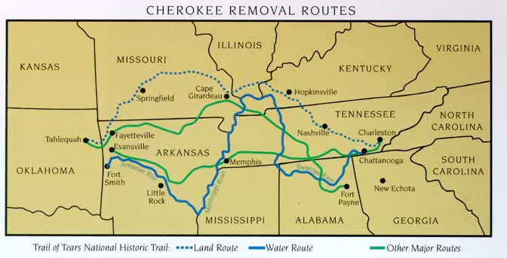
Step 3: Native Americans
“Be it enacted by the Senate and House of Representatives of the United States of America, in Congress assembled, That it shall and may be lawful for the President of the United States to cause so much of any territory belonging to the United States, west of the river Mississippi, not included in any state or organized territory, and to which the Indian title has been extinguished.”
Notes:
What does this map show?2. What were some of the advantages of the various methods of travel?3. Why would the routes go through major cities and forts rather than a direct route?4. What kind of problems would they face on a jouney of this disance

Slide 75
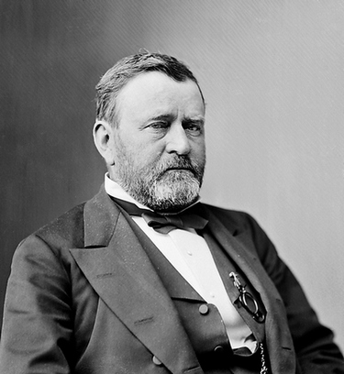
Post Civil War
Peace policy--President Grant
Turned over reservation administration to missionaries
“Would hasten the day when Native Americans would, ‘live in houses and have schools and churches.’”
Notes:
Jackson (1830s) moves them off their land to the Great Plains
Post Civil War: Gold and silver are discovered, the US wants them. Also, Americans want a transcontinental railroad. Move the Native Americans onto reservations, faced poverty due to loss of land to hunt and find ffod one. Buffalo heards are killed by diseases from the Americas. Buffalo are also slaughtered, hunted for sport or hide.
Dawes Act--at the time Americanization included religion and education, sports, homes, ideals, CITIZENSHIP
Most land not given back to n-a’s, profits promised to them from sale of land was not given to them, much of the land given to western settlers.

Slide 76
Reformers and Missionaries
Mohonk Conferences (fall 1887)
Formalized goals for reformers in assimilating the Native Americans
Created the Dawes Act (1887)
Established boarding schools and normal schools
Reallocated land to Native Americans
1881=155 m acres, 1890, 104 m acres, 1900 77 m acres
"The Indian may now become a free man; free from the thralldom of the tribe; freed from the domination of the reservation system; free to enter into the body of our citizens. This bill may therefore be considered as the Magna Carta of the Indians of our country." — Alice Fletcher

Slide 77
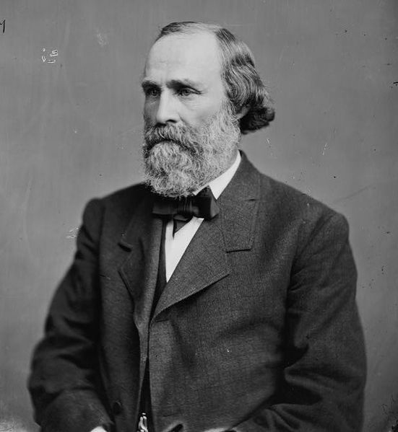
Reformers and Missionaries
3 goals--CCE
Christianity
Citizenship
Education
Who was there?
Religious leaders
Education leaders
"... expressed his faith in the civilizing power of private property with the claim that to be civilized was to 'wear civilized clothes ... cultivate the ground, live in houses, ride in Studebaker wagons, send children to school, drink whiskey [and] own property."

Slide 78
Success?
By 20th century, reform is over
Why?
1. CCE does not assimilate tribes
2. New Native American leaders rise that call for the protection rather than destruction of their culture
3. Citizenship does not guarantee anything
"We do not want our land cut up in little pieces... A groan of assent ran along the dark line of Sphinxes.”
Notes:
A Nez Perce Indian expressed a quite different reaction.
Standing Bear, Tibbles, and other who participated in the lecture to the East to gain support for the Ponca cause specifically, and the Indian cause in general, did not foresee the problems that legislation like the Dawes Act would create. Land allotted to individual Indians was soon controlled by non-Indians. Indian lost much of their land and received very inadequate payment for the land they gave up. Indians, who received compensation for giving up their land, also quickly spent the money. They were unused to managing money. Few contemporary historians would judge the allotment policy of acts like the Dawes Act, successful.

Slide 79
Native American Response
Resistance
Treaties
Battles
View of Treaties
Temporary vs permanent
Sand Creek
"THEY WERE SCALPED, THEIR BRAINS KNOCKED OUT; THE MEN USED THEIR KNIVES, RIPPED OPEN WOMEN, CLUBBED LITTLE CHILDREN, KNOCKED THEM IN THE HEAD WITH THEIR RIFLE BUTTS, BEAT THEIR BRAINS OUT, MUTILATED THEIR BODIES IN EVERY SENSE OF THE WORD."
Notes:
Treaties are not broken by the US—seen as a temporary measure.
http://www.lastoftheindependents.com/sandcreek.htm
Two Editorials from the Rocky Mountain News (1864)
The Battle of Sand Creek Among the brilliant feats of arms in Indian warfare, the recent campaign of our Colorado volunteers will stand in history with few rivals, and none to exceed it in final results. We are not prepared to write its history, which can only be done by some one who accompanied the expedition, but we have gathered from those who participated in it and from others who were in that part of the country, some facts which will doubtless interest many of our readers.
The people of Colorado are well aware of the situation occupied by the third regiment during the great snow-storm which set in the last of October. Their rendezvous was in Bijou Basin, about eighty miles southeast of this city, and close up under the foot of the Divide. That point had been selected as the base for an Indian campaign. Many of the companies reached it after the storm set in; marching for days through the driving, blinding clouds of snow and deep drifts. Once there, they were exposed for weeks to an Arctic climate, surrounded by a treeless plain covered three feet deep with snow. Their animals suffered for food and with cold, and the men fared but little better. They were insufficiently supplied with tents and blankets, and their sufferings were intense. At the end of a month the snow had settled to the depth of two fee, and the command set out upon its long contemplated march. The rear guard left the Basin on the 23rd of November. Their course was southeast, crossing the Divide and thence heading for Fort Lyon. For one hundred miles the snow was quite two feet in depth, and for the next hundred it ranged from six to twelve inches. Beyond that the ground was almost bare and the snow no longer impeded their march.
On the afternoon of the 28th the entire command reached Fort Lyon, a distance of two hundred and sixty miles, in less than six days, and so quietly and expeditiously had the march been made that the command at the fort was taken entirely by surprise. When the vanguard appeared in sight in was reported that a body of Indians were approaching, and precautions were taken for their reception. No one upon the route was permitted to go in advance of the column, and persons who it was suspected would spread the news of the advance were kept under surveillance until all danger from that source was past.
At Fort Lyon the force was strengthened by about two hundred and fifty men of the first regiment, and at nine o'clock in the evening the command set out for the Indian village. The course was due north, and their guide was the Polar star. As daylight dawned they came in sight of the Indian camp, after a forced midnight march of forty-two miles, in eight hours, across the rough, unbroken plain. But little time was required for preparation. The forces had been divided and arranged for battle on the march, and just as the sun rose they dashed upon the enemy with yells that would put a Comanche army to blush. Although utterly surprised, the savages were not unprepared, and for a time their defense told terribly against our ranks. Their main force rallied and formed in line of battle on the bluffs beyond the creek, where they were protected by rudely constructed rifle-pits, from which they maintained a steady fire until the shells from company C's (third regiment) howitzers began dropping among them, when they scattered and fought each for himself in genuine Indian fashion. As the battle progressed the field of carriage widened until it extended over not less than twelve miles of territory. The Indians who could escaped or secreted themselves, and by three o'clock in the afternoon the carnage had ceased. It was estimated that between three and four hundred of the savages got away with their lives. Of the balance there were neither wounded nor prisoners. Their strength at the beginning of the action was estimated at nine hundred.
Their village consisted of one hundred and thirty Cheyenne and with Arapahoe lodges. These, with their contents, were totally destroyed. Among their effects were large supplies of flour, sugar, coffee, tea, &c. Women's and children's clothing were found; also books and many other articles which must have been taken from captured trains or houses. One white man's scalp was found which had evidently been taken but a few days before. The Chiefs fought with unparalleled bravery, falling in front of their men. One of them charged alone against a force of two or three hundred, and fell pierced with balls far in advance of his braves.
Our attack was made by five battalions. The first regiment, Colonel Chivington, part of companies C,D,E,G, H and K, numbering altogether about two hundred and fifty men, was divided into two battalions; the first under command of Major Anthony, and the second under Lieutenant Wilson, until the latter was disabled, when the command devolved upon Lieutenant Dunn. The three battalions of the third, Colonel Shoup, were led, respectively, by Lieutenant Colonel Bowen, Major Sayr, and Captain Cree. The action was begun by the battalion of Lieutenant Wilson, who occupied the right, and by a quick and bold movement cut off the enemy from their herd of stock. From this circumstance we gained our great advantage. A few Indians secured horses, but the great majority of them had to fight or fly on foot. Major Anthony was on the left, and the third in the centre.
Among the killed were all the Cheyenne chiefs, Black Kettle, White Antelope, Little Robe, Left Hand, Knock Knee, One Eye, and another, name unknown. Not a single prominent man of the tribe remains, and the tribe itself is almost annihilated. The Arapahoes probably suffered but little. It has been reported that the chief Left Hand, of that tribe, was killed, but Colonel Chivington is of the opinion that he was not. Among the stock captured were a number of government horses and mules, including the twenty or thirty stolen from the command of Lieutenant Chase at Jimmy's camp last summer.
The Indian camp was well supplied with defensive works. For half a mile along the creek there was an almost continuous chain of rifle-pits, and another similar line of works crowned the adjacent bluff. Pits had been dug at all the salient points for miles. After the battle twenty-tree dead Indians were taken from one of these pits and twenty-seven from another.
Whether viewed as a march or as a battle, the exploit has few, if any, parallels. A march of 260 miles in but a fraction more than five days, with deep snow, scanty forage, and no road, is a remarkable feat, whilst the utter surprise of a large Indian village is unprecendented. In no single battle in North America, we believe, have so many Indians been slain.
It is said that a short time before the command reached the scene of battle of an old squaw partially alarmed the village by reporting that a great herd of buffalo were coming. She heard the rumbling of the artillery and tramp of the moving squadrons, but her people doubted. In a little time the doubt was dispelled, but not by buffaloes.
A thousand incidents of individual daring and the passing events of the day might be told, but space forbids. We leave the task for eye-witnesses to chronicle. All acquitted themselves well, and Colorado soldiers have again covered themselves with glory.
http://www.pbs.org/weta/thewest/resources/archives/four/sandcrk.htm

Slide 80
Major Battles
Little Big Horn (1875)
Sitting Bull and Crazy Horse
Nez Perce (1871-72)
Chief Joseph
Battle of Wounded Knee (1890)
End of the fighting
Notes:
LBH: (1875)--Sitting Bull and Crazy horse drive out prospectors in the Sioux Valley (they were looking for animal hides and for gold). When the Nas attack, the US gov’t sends in troops to stop the NAs.
Colonel Custer led the charge against the Native Americans and meet 200 Indians who charge and kill all of them.
Chief Joesph (Nez Perce (accent on e don’t pronounce z = french pierced nose) in Idaho and his group the Nez Perces are forced to leave their land and are given land in OK. He tried to avoid the order by taking everyone on a trip which stopped just short of Canada. They were Christians and had settled down and become successful horse and cattle breeders. They were being mvoed so whites could settle. ith 2,000 U.S. soldiers in pursuit, over 800 Nez Perce fled east, hoping to take refuge with the Crow nation, but when the Crow refused to grant them asylum, the Nez Perce went north in an attempt to reach Canada. For over three months, the Nez Perce outmaneuvered and battled their pursuers traveling 1,300 miles (2,100 km) across Oregon, Washington, Idaho, Wyoming, and Montana. General Howard, leading the opposing cavalry, was impressed with the skill with which the Nez Perce fought, using advance and rear guards, skirmish lines, and field fortifications. Finally, after a devastating five-day battle during freezing weather conditions with no food or blankets, with the major war leaders dead, Joseph formally surrendered to General Nelson Appleton Miles on October 5, 1877 in the Bear Paw Mountains of the Montana Territory, less than 40 miles (60 km) south of Canada in a place close to the present-day Chinook in Blaine County. The battle is remembered in popular history by the words attributed to Joseph at the formal surrender:
Tell General Howard I know his heart. What he told me before, I have it in my heart. I am tired of fighting. Our chiefs are killed; Looking Glass is dead, Too-hul-hul-sote is dead. The old men are all dead. It is the young men who say yes or no. He who led on the young men is dead. It is cold, and we have no blankets; the little children are freezing to death. My people, some of them, have run away to the hills, and have no blankets, no food. No one knows where they are—perhaps freezing to death. I want to have time to look for my children, and see how many of them I can find. Maybe I shall find them among the dead. Hear me, my chiefs! I am tired; my heart is sick and sad. From where the sun now stands, I will fight no more forever.^{[8]}
The popular legend deflated, however, when the original pencil draft of the report was revealed to show the handwriting of the later poet and lawyer Lieutenant Charles Erskine Scott Wood, who claimed to have taken down the great chief's words on the spot. In the margin it read, "Here insert Joseph's reply to the demand for surrender"^{[9][10]} Although Joseph was not technically a war chief and probably did not command the retreat, many of the chiefs who did had died. His speech brought attention - and therefore credit - his way. He earned the praise of General William Tecumseh Sherman and became known in the press as "The Red Napoleon".
Battle of Wounded Knee (1890): Sitting Bull is arrested due to the popularity of ritual dances and ceremonties and revived the Ghost Dance. They believed the ritual would help aidsh the white and restore the buffalo. Gov’t officials are concered and hostility breaks out at the battle of wounded knee in South Dakota. 100 men and women children die.
End of the Native American fighitng, the fightign becomes poltical rather than war.

Slide 81
“I am tired of fighting. Our chiefs are killed; Looking Glass is dead, Too-hul-hul-sote is dead. The old men are all dead. It is the young men who say yay or not…I am tired; my heart is sick and ad. From where the sun now stands, I will fight no more forever.”
Notes:
English: Description by museum: This photograph is historically significant and has great human interest as well. It may be the only extant copy in existence of F. M. Sargent's cabinet card of Nez Perce Chief Joseph and his family in Leavenworth where they were exiled from 1877 to 1885. Chief and his band of Nez Perce lived peacefully in the Wallowa Valley of Eastern Oregon until 1877 when the U.S. government decided to move the band to a small reservation in Idaho. When General O.O. Howard threatened a cavalry attack, a few dissatisfied warriors raided a settlement and killed several whites. Fearing retaliation, Joseph fled with his band of 700 men, women and children in a retreat towards Canada that covered 1400 miles. They finally gave up 40 miles from the Canadian border where Joseph uttered the famous words "From where the sun now stands, I will fight no more forever." Curator's statement: Look into Chief Josephs's face. What was he thinking and feeling at that moment? I believe this photograph is one of the most revealing portraits in our collection. You can see great dignity, pride, intelligence, and sadness in Joseph's face and body language as well as tension, and perhaps some anger.
- Elaine Miller (1880) Unsure if these are his words: The popular legend deflated, however, when the original pencil draft of the report was revealed to show the handwriting of the later poet and lawyer Lieutenant Charles Erskine Scott Wood, who claimed to have taken down the great chief's words on the spot. In the margin it read, "Here insert Joseph's reply to the demand for surrender"^{[9][10]} Although Joseph was not technically a war chief and probably did not command the retreat, many of the chiefs who did had died. His speech brought attention - and therefore credit - his way. He earned the praise of General William Tecumseh Sherman and became known in the press as "The Red Napoleon".

Slide 82
Further Legislation
Talton vs. Mayes (1896)
Indian tribes are not bound to the 5th amendment
Burke Act
Citizenship extended by 1901 to some
1924-Snyder Act
Notes:
Talton vs Mayes--Indian believed his 5th amendment right was violated, court determines that those laws do not apply to Indian tribes because they are soverign. U.S. v. Holiday (70 U.S. 407, 1866): Holding that a Congressional ban on selling liquor to the Indians was Constitutional. In re Heff (197 U.S. 488, 1905): Holding that Congress has the power to place the Indians under state law if it chooses, and the ban on selling liquor does not apply to Indians subject to the Allotment acts. Iron Crow v. Ogallala Sioux Tribe (129 F. Supp. 15, 1955): Holding that tribes have power to create and change their court system and that power is limited only by Congress, not the courts. Wisconsin Potowatomies of Hannahville Indian Community v. Houston (393 F. Supp. 719): Holding that tribal law and not state law governs the custody of children domiciled on reservation land. Merrion v. Jicarilla Apache Tribe (455 U.S. 130, 1982): Holding that Indian Nations have the power to tax Non-Native Americans based on their power as a nation and treaty rights to exclude others. This right can be curtailed only by Congress. American Indian Agricultural Credit Consortium, Inc. v. Fredericks (551 F. Supp. 1020, 1982): Holding that federal, not state courts have jurisdiction over tribal members. Maynard v. Narrangansett Indian Tribe (798 F. Supp. 94, 1992): Holding that tribes have sovereign immunity against state tort claims. Venetie I.R.A. Council v. Alaska (798 F. Supp. 94): Holding that tribes have power to recognize and legislate adoptions. Native American Church v. Navajo Tribal Council (272 F.2d 131): Holding that the First Amendment does not apply to Indian nations unless it is applied by Congress. Teague v. Bad River Band (236 Wis. 2d 384, 2000): Holding that tribal courts deserve full faith and credit since they are the court of an independent sovereign; however, in order to end confusion, cases that are filed in state and tribal courts require consultation of both courts before they are decided. The U.S. Constitution does not apply to tribes because the tribes' authority does not come from the U.S. Constitution, rather their inherent authority that pre-dates the U.S. Constitution.
Burke Act: 1906—indiands whotook up life away from tribes became citizens immediataly
1901: Tribes extended to the Five Civilized Tribesby 1924—to all

Slide 83
Accommodate: Fit in with the wishes or needs of
Assimilation: the state of being assimilated; people of different backgrounds come to see themselves as part of a larger national family.
Annihilate: Destroy utterly; obliterate.
Based on the reading last night (by either author)
Did Native Americans accommodate or assimilate? Both? Neither? Annihilate?
Did accommodation or assimilation help or hurt Native Americans?
What inherent misunderstandings were there between Native Americans and US citizens?
Is a hierarchy being created? Is it systematic?

