Slide 1
Thomas Cole
Series of an Empire
Created in 1830s
Displayed in the 1890s

Slide 2
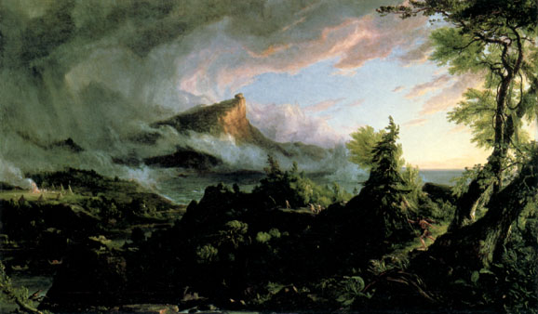
The Course of Empire: The Savage State Thomas Cole, 1834

Slide 3
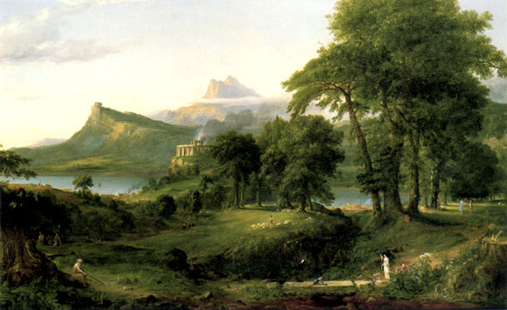
The Course of Empire: The Arcadian or The Pastoral State - Thomas Cole, 1836

Slide 4
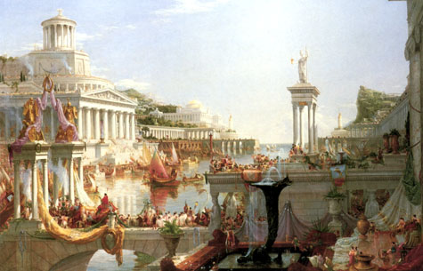
The Course of Empire: Consummation Thomas Cole, 1836

Slide 5
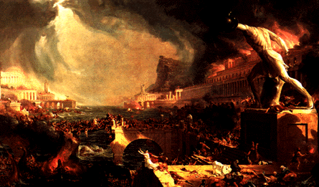
The Course of Empire: Destruction Thomas Cole, 1836

Slide 6
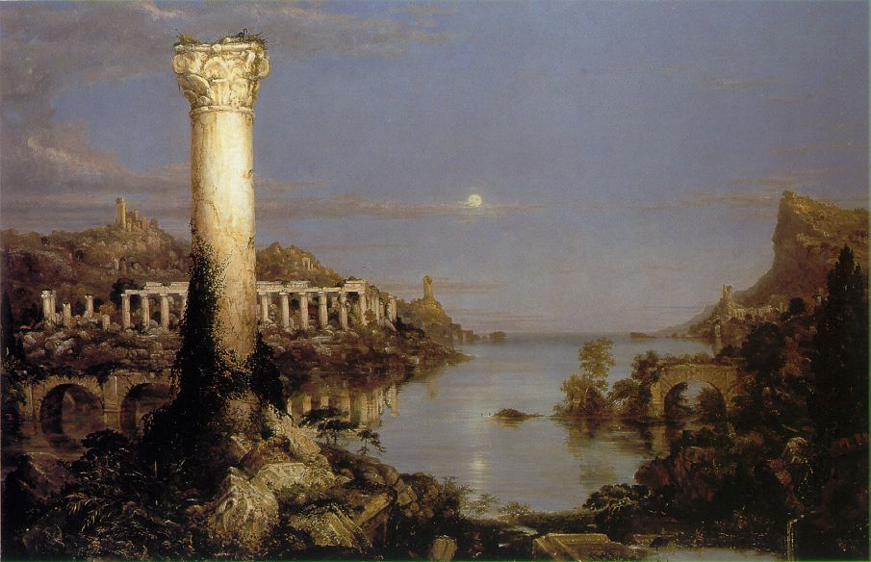
The Course of Empire: Desolation Thomas Cole, 1836

