Slide 1
A Brief History of Financial Panics
in the United States
AP U.S. History - Tan
January 17, 2018
By Samantha Kizner, Emma Mitchell, Luke Clark, and Christopher Bonis

Slide 2
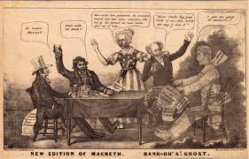
The Panic of 1819
Tindall and Shi: “Financial collapse brought on by sharply falling cotton prices, declining demand for American exports, and reckless western land speculation” (Glossary).
First major financial panic since the founding of the country and signaled the end of President James Monroe’s “Era of Good Feelings” along with the controversy over Missouri statehood
Both state banks and the second national Bank of the United States enlarged loans by issuing more banknotes than could be redeemed
Hard times lasted only about three years, but the American public lost faith in the banking system

Slide 3
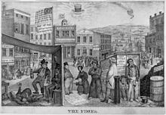
The Panic of 1837
Tindall and Shi: “Major economic depression lasting about six years; touched off by a British financial crisis and made worse by falling cotton prices, credit and currency problems, and speculation in land, canals, and railroads” (Glossary).
The impact of depression in England was coupled with failure of the what crop, one of the major American exports that offset payments abroad
One third of the workforce by late 1837 was unemployed and wages plummeted, but President Van Buren did not believe that the government held any responsibility to provide public relief

Slide 4
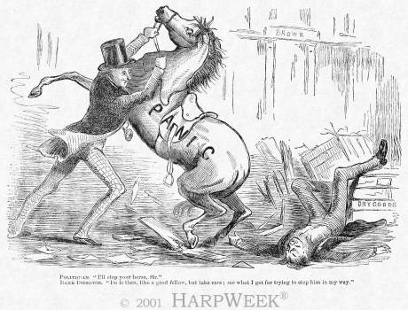
The Panic of 1857
Tindall and Shi: “Economic depression lasting about two years and brought on by falling grain prices and a weak financial system; the South was largely protected by international demand for its cotton” (Glossary).
The failure of the Ohio Life Insurance and Trust Company exacerbated the panic
Northern businessmen blamed the depression on Democrat tariffs that had aided the South
Because the South fared better, some concluded that the system of slave-based agriculture was superior to the free-labor system
Everything seemed to become a sectional conflict

Slide 5
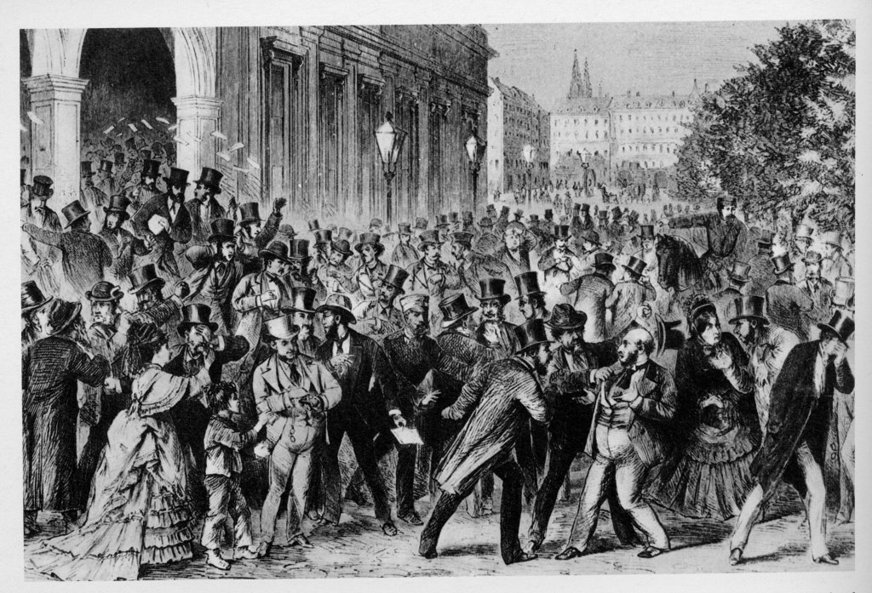
The Panic of 1873
Length: 6 Years
Many railroads began to fail as they did not pay interest payments to big banks
Investment bank Jay Cooke and Company went bankrupt September 18, 1873
Set off a chain reaction for many other banks to close
Investors rushed to exchange securities for cash and forced the Stock Market to close for 10 days
Panic was 6 years long
Effects: thousands of businesses went bankrupt and millions lost their jobs
The Republican party was in office and the panic hurt them in the midterm election of 1874
Unemployment reached 8.25%
After the panic, major railroad lines had steep wage cuts
This was a direct cause of the Railroad Strike of 1877
Notes:
“Exchange securities”--- “cash-in” or sell investments for a profit
This was a stock market crash
The panic was the longest to date (at 6 years)
R party: D won control in the HOR and gained more seats in the senate

Slide 6
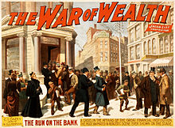
The Panic of 1893
Length: 4 Years
1893-1897
The collapse of the Philadelphia and Reading Railroad and the National Cordage Company led to an economic crisis
Panic in the stock market as business began borrowing money as their enterprises failed
Banks, railroads, and factories went bankrupt
Effects:
Unemployment of 20-25%
Stock prices declined
Cleveland and the Democratic party were all blamed for the depression
As he did little to try and support the unemployed
He believed that the business cycle should not be interfered with by politicians
Democrats took a huge loss in the 1894 elections
The National Gold Reserve began to drain
Notes:
Called in loans
Picture: a broadway play was inspired by the panic of 1893
National poll in 1894: for every 100 people almost 18 were unempolyed

Slide 7
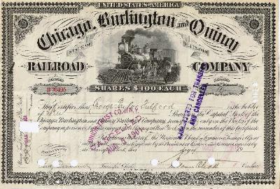
The Panic of 1901
Nicknamed “The Rich Man’s Panic”
Occurred in the midst of economic and industrial growth
Caused by fight for control over Northern Pacific Railway by big-shot financiers like John Pierpont Morgan and E. H. Harriman
Began as E. H. Harriman began buying Northern Pacific stocks in an attempt to gain financial control over the company from J. P. Morgan.
Stocks that had been doing well all morning began to fall and investors sold their stocks as hysteria and panic swept the floor of the Stock Exchange.
$40-75 million lost during the short slide, most of which belonged to small investors.
The rich men who fought over Northern Pacific saw an increase in their shares by the end of the panic

Slide 8
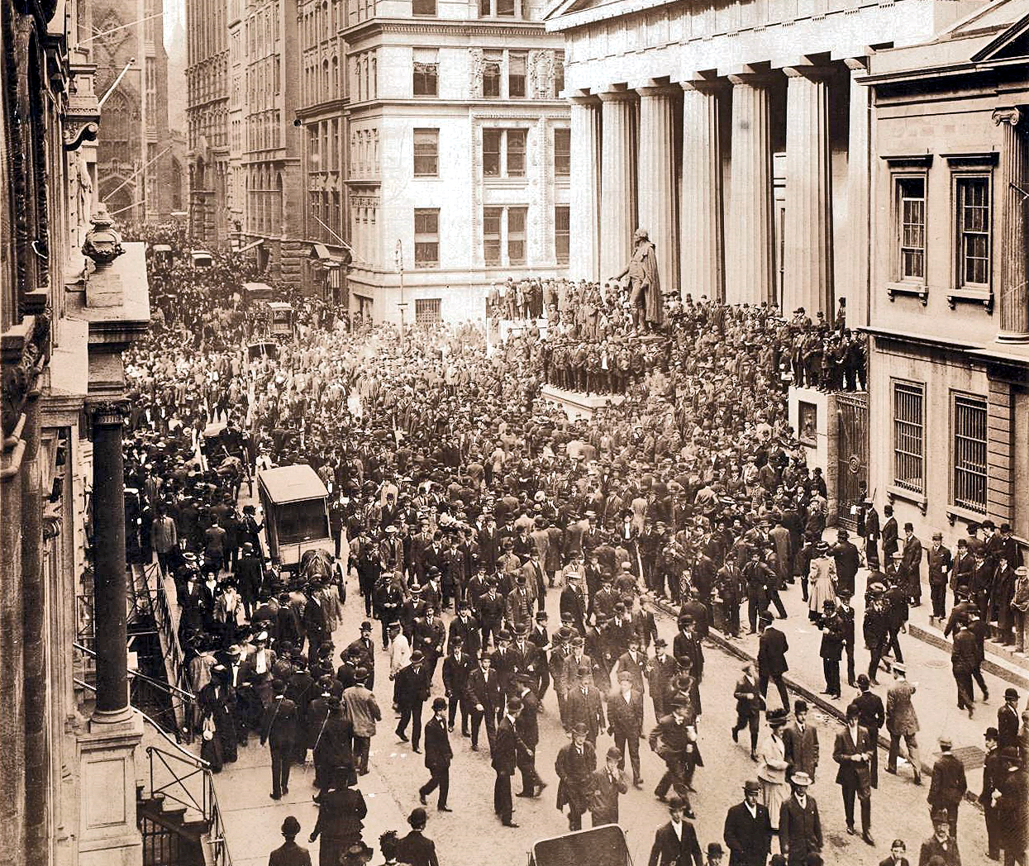
The Panic of 1907
NY stock exchange fell almost 50% from prior year and led to an economic recession that lasted throughout US for three weeks and pushed many businesses and banks into bankruptcy
First worldwide financial crisis of the twentieth century
The prestigious Knickerbocker Holding Company and Westinghouse Electric Company failed and caused people to panic and withdraw large sums of money from the nation's banks
J.P. Morgan gathered bankers and financial leaders together to solve the crises.
These men and the U.S. Government pumped money from stronger institutions into weakened ones to keep them afloat and put and end to the Panic
This panic spurred the establishment of the Federal Reserve System (Owen-Glass Federal Reserve Act) to respond to future panics and other government agencies to check and balance its power.

Slide 9
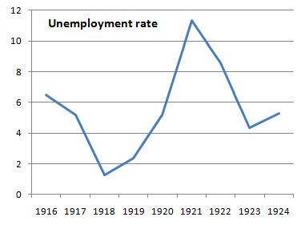
Economic Recession of 1920 (Post WWI Recession)
After WWI, there is a general lack in economic growth, partially resulting from US isolationism.
War-time economy had been great, but many of the programs sustaining this greatness were removed.
Passed the Budget and Accounting Act of 1921, which created the Bureau of the Budget and a General Accounting Office.
Fulfilled long held progressive desire to bring greater efficiency and nonpartisanship to the budget preparation process, but also helped the economy.
Andrew Mellon, Secretary of the Treasury, also combated issues by lowering the income tax from 65% to 50%, as well as raising tariffs with the Fordney-McCumber Tariff of 1922.

Slide 10
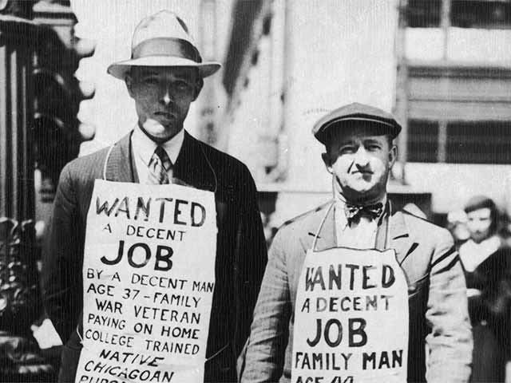
The Great Depression
Many factors that snowballed to cause the depression.
Among these factors are: monopolistic pricing, overspeculation in the stock market, maldistribution of incomes, overproduction, automation, and others.
A direct result of the depression, though often mistaken as the cause, was the stock market crash of 1929.
The depression took a huge toll on Americans, with the unemployment rate jumping drastically from 3% to 25% by 1933.
Americans economic distress translated to social distress, but Roosevelt’s fireside chats comforted them.
The Great Depression revealed the weak foundation of the economy that fostered prosperity in the 1920’s.
Hoover’s response created resentment of him among Americans, resulting in the election of Roosevelt in 1932.
The impacts of the depression were felt until the late 1930’s.
Roosevelt's Take on the Dust Bowl

Slide 11
Videos on the Great Depression

Slide 12
Sources (Chicago style):
"Panic of 1893." United States History. Accessed January 16, 2018.
http://www.u-s-history.com/pages/h792.html.
Moen, Jon R., and Ellis W. Tallman. "The Panic of 1907." Federal Reserve History. Accessed January 16, 2018. https://www.federalreservehistory.org/essays/panic_of_1907.
Pike, John. "Panic of 1901." Globalsecurity.org. Accessed January 16, 2018. https://www.globalsecurity.org/military/world/usa/history/panic-of-1901.htm.
Shi, David E., and George Brown Tindall. America: a narrative history. 7th ed. Vol. 2. New York, NY: W.W. Norton and Company, 2016.

