Slide 2
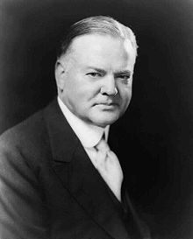
The “Fantasy” of the 1920s
1920s economic boom
Overproduction
  Supply has caught up to demand
Credit
Speculation
Unequal distribution of wealth
  Money kept in business and among the elite—not given to people
Tariffs
  Keeps domestic prices up
Stock market crash
  Stocks plunge as people/businesses take their money out
  Stocks worth less so could not possibly give back everything (margin)
Margin
Notes:
Speculation in realeastte—Florida 1926 florida real estate bubble had already burst. Bt 1927 things were looking good but only on speculation. Mellon’s tax reductions wad given people more income which pople were using to buy stocks on margin. Brokers have to loan money to cover their speculatiion when it failed. People wanred about this espcially in 1927 when automible sales were catching up tot demaind and residential construction. Consumer sending is slowing. By mid 1929 income, and eocnomic avtivity were decline everywhere except the stock market
The Crash: stocks tumble, stockholders unloaded their stocks and bankers hold of slide by buying excess but then could not to that when 16.4 m shares were sold (usually 3 million traded on a busy day_ and the value of Stock exchange fell by 37%.
Crash does not cause the depression—symptoimatic of the problems. Too may business had maintained retails prices and as public consumption of goods declined, the rest of the world declines as well. Busines sector brough on a growing imbalance between rising producitivty and declinding purchasing power. Flow aboard dried up.

Slide 3
It gets REAL
Banks made investments in the stock market
  People now need their money
    First come, first serve
  Banks do not have it
  Bye, bye savings
Tighten money supply
  Government has slowed economic growth
    More money in savings because of high taxes
    Prices high
    Speculation-swollen businesses
Hawley-Smoot Tariff
  Retaliatory tariffs

Slide 4
Tariffs
Fordney-McCumber Tariff of 1922:
  increased rates on chemical and metal products to safeguard against the rise in German industries
  to please farmers it extended duties on agricultural imports.
McNary-Haugen Bill, 1924:
  plan to dump farm surpluses on the world market to raise prices in the home market.
  It sought to secure “equality for agriculture in the benefits of the protective tariff” (1006)
  Vetoed by Coolidge
Hawley-Smoot Tariff, 1930:
  Increased rates: rates went up on more than 900 manufactured items.
Notes:
1007
1015
1012

Slide 5
Tariffs
Hawley-Smoot Tariff:
  over 1000 economists asked him not to
  They argued it would raise consumer prices, damage export trade and hurt farmers, and cause foreign reprisals (They were right.)
Consequences of high tariffs:
  US was creditor nation from the war.
  High tariffs made it harder for other nations to sell their products in the US and then acquire the money to repay their war loans.

Slide 6
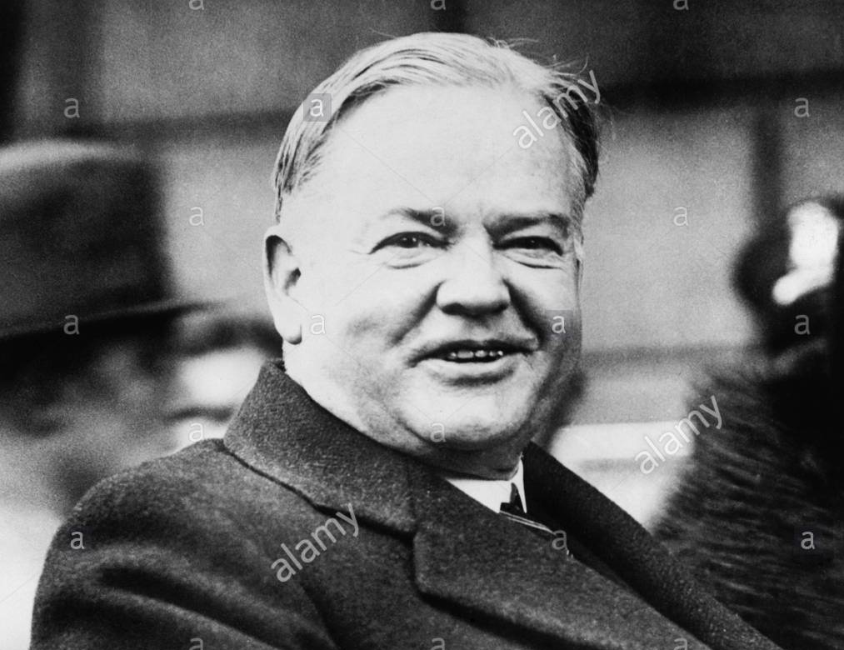
Hoover’s Early Response
At first: laissez-faire
  Natural cycles
  Hoover: “fundamentally sound”
3 step plan: Upbeat and confident
  1. Businesses should keep employment, wages and prices at current level.
  2. Government cuts taxes, lowers interest rates
  3. People should donate $
Why did Hoover expect this plan to work?
Plan fails…why?
Why is Hoover hesitant to have the Federal gov’t take action?
Notes:
When President Herbert Hoover took office, the unemployment rate was 4.4 percent. When he left office, it was 23.6 percent.Hoover’s efforts in providing relief during and after World War I saved millions of Europeans, including Germans and Russians, from starvation and made him an international hero. Yet little more than a decade later, many of his own countrymen regarded him as a heartless brute who would provide federal aid for banks but not for hungry Americans .Hoover was a proponent of "rugged individualism." But he also said, "The trouble with capitalism is capitalists; they're too damn greedy."Born into a hardworking Quaker family in Iowa, Hoover was orphaned before he was ten years old and was sent west to live with relatives. He was admitted to the first class at Stanford University, mainly because the new institution needed students. He rose quickly from mine worker to engineer and entrepreneur. He was worth $4 million by the age of 40, and then devoted himself to public service. He was elected president at the age of 54.In the speech that closed his successful 1928 presidential campaign, Hoover, a self-made millionaire, expressed his view that the American system was based on "rugged individualism" and "self-reliance." Government, which had assumed unprecedented economic powers during World War I, should, in his view, shrink back to its prewar size and avoid intervening with business.During the early days of the Great Depression, Hoover launched the largest public works projects. Yet, he continued to believe that problems of poverty and unemployment were best left to "voluntary organization and community service." He feared that federal relief programs would undermine individual character by making recipients dependent on the government. He did not recognize that the sheer size of the nation's economic problems had made the concept of "rugged individualism" meaningless.The president appealed to industry to keep wages high in order to maintain consumer purchasing power. Nevertheless, while businesses did maintain wages for skilled workers, it cut hours and wages for unskilled workers and installed restrictive hiring practices that made it more difficult for under qualified younger and older workers to get a job. By April 1, 1933, U.S. Steel did not have a single full-time employee.Many Republicans believed that a protective tariff would rescue the economy by keeping out foreign goods. The Smoot-Hawley tariff, signed by Hoover in 1930, raised rates but provoked retaliation from Britain, Canada, France, Germany, and other traditional trading partners. The United States found it much more difficult to export its products overseas.Hoover persuaded local and state governments to sharply increase public works spending. However, the practical effect was to exhaust state and local financial reserves, which led government by 1933 to slash unemployment relief programs and to impose sales taxes to cover their deficits.Hoover quickly developed a reputation as uncaring. He cut unemployment figures that reached his desk, eliminating those he thought were only temporarily jobless and not seriously looking for work. In June 1930 a delegation came to see him to request a federal public works program. Hoover responded to them by saying: "Gentlemen, you have come sixty days too late. The Depression is over." He insisted that "nobody is actually starving" and that "the hoboes...are better fed than they have ever been." He claimed that the vendors selling apples on street corners had "left their jobs for the more profitable one of selling apples."By 1932 comedians told the story of Hoover asking the treasury secretary for a nickel so he could call a friend. Mellon replies, "Here, take a dime and call all your friends."Hoover was a stubborn man who found it difficult to respond to the problems posed by the Depression. "There are some principles that cannot be compromised," Hoover remarked in 1936. "Either we shall have a society based upon ordered liberty and the initiative of the individual, or we shall have a planned society that means dictation no matter what you call it.... There is no half-way ground." He was convinced that the economy would fix itself. Only toward the end of his term in office did he recognize that the Depression called for unprecedented governmental action. In 1932 he created the Reconstruction Finance Corporation (RFC) to help save the banking and railroad systems. Loans offered under the program funded public works projects and the first federally-supported housing projects. Originally intended to combat the Depression, the RFC lasted 21 years and was authorized to finance public works projects, provide loans to farmers and victims of natural disasters, and assist school districts. When it was abolished in 1953, it had dispersed $40.6 billion. Its functions were taken over by the Small Business Administration, the Commodity Credit Corporation, and other housing, community development, and agricultural assistance programs. Herbert Hoover was not an insensitive man. He was the first president since Theodore Roosevelt to invite African American dinner guests to the White House. He said that the use of atomic bombs against Japan "revolts my soul." He played a key role in launching the United Nation's Children's Emergency Fund (UNICEF) and CARE. Despite his staunch anti-communism stand, he opposed U.S. involvement in Korea and Vietnam. Nevertheless, his reputation was forever clouded by the Depression. A dam that was to carry Hoover's name was rechristened Boulder Dam. Washington's airfield, which was to be named for Hoover, was renamed National Airport.

Slide 7
Hoover’s later response
Does more than any other president had ever done…still a Republican at heart
Breaks from laissez-faire….to help businesses mostly (2 billion)
  Rugged individualism
    $45 m to save cattle but not $25 million to save farmers
    Vetoed public works bill
Modest tax cuts, easier to get a loan
Federal Farm Board buys more…can’t buy all (bumper crops)
Hoover Dam
Things are looking good?........
Notes:
Since volunteerism and localism fails, Hoover moves to a new plan
In 1924, a grateful Congress voted to give a bonus to World War I veterans - $1.25 for each day served overseas, $1.00 for each day served in the States. The catch was that payment would not be made until 1945.
Bumper crops are surpluses.
Members of the Bonus Armyencamp within sight of theCapitol, 1932
However, by 1932 the nation had slipped into the dark days of the Depression and the unemployed veterans wanted their money immediately.
Hoover did more than any other president—but was still a republican and product of his time.
Creates some government projects like the Hoover dam but state and local governments are cutting so much that he cannot make up the difference. Keeper urges for confidence but upligitng words were not enough. VP says good times are just around the corner and becamce a joke about th admin.
Demaned asn easier credit policy and tax reduction for the middle class. Hawley Smoot tariffs effects are just strating to be felt.

Slide 8
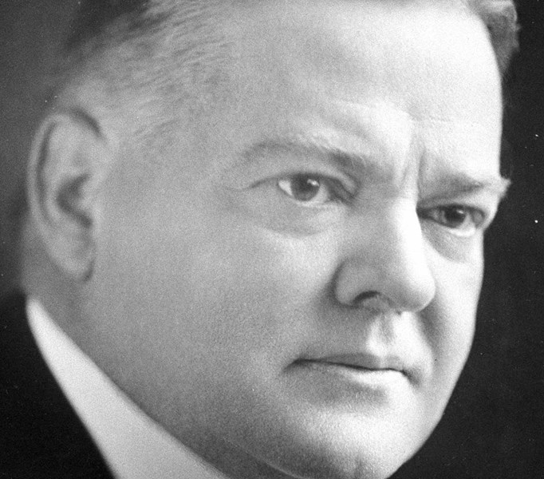
Not so much….
Slow movement by Hoover
  Despite urging by Congress
In response to failure of Austria’s largest bank, Hoover proposes moratorium on reparations and war-debt payments
  Shortage of money causes Europeans to pull money out of American banks
  Dumped American securities
Notes:
Austira’s largest bank fils which triggers a fincnaical pani in May of 1931 after a good start to the year. General shortage of money cuases Euopreans to pull of of Maerican banks and dump american secutiries.

Slide 9
Hoover’s Last Reforms
Reconstruction Finance Corporation (RFC)
    Trickle down economics
Glass Steagall Act, 1932: broadened the definition of commercial loans that the government would support. Released $750 m in gold to make up for foreign withdrawals
  Separated investment banks from commercial banks
Federal Loan Bank Act of 1932: Discount banks for home mortgages
Reluctantly signs Emergency Relief Act in 1932: gave RFC $300 m for relief to loans to the states and for public works (no direct aid)

Slide 10

Bonus Army
1932
Bonus Expeditionary Force
15,000 men who want their bonus early
WWI bonus approved by Congress in 1924 needed new bill to be paid early
Senate votes no so veterans who cannot go home
  Squat and then Hoover orders them to be cleared out (after persuading Congress to buy them bus tickets home)
Riots erupt, two veterans kills, 700 armed national soldiers drive out the veterans and their families (and killing 1 11 year old boy)
Notes:
Farming aid had been abandoned by this time. Prices slide down and angry mobs formed. In Nebraska crops were burne to heelp warm. In Iowan, they called a famers strike. Revolution is beeing called on and comunism is growing
Many of the war veterans had been out of work since the beginning of the Great Depression. The World War Adjusted Compensation Act of 1924 had awarded them bonuses in the form of certificates they could not redeem until 1945. Each service certificate, issued to a qualified veteran soldier, bore a face value equal to the soldier's promised payment plus compound interest. The principal demand of the Bonus Army was the immediate cash payment of their certificates.
Eisenhower and MacArthuer and Patton are there.

