Slide 1
0
8
An Introduction to Metabolism
Lecture Presentation by Nicole Tunbridge and
Kathleen Fitzpatrick

Slide 2
Concept 8.1: An organism’s metabolism transforms matter and energy, subject to the laws of thermodynamics
Metabolism is the totality of an organism’s chemical reactions
A metabolic pathway begins with a specific molecule and ends with a product
Each step is catalyzed by a specific enzyme

Slide 3
Catabolic pathways release energy by breaking down complex molecules into simpler compounds
Cellular respiration, the breakdown of glucose in the presence of oxygen, is an example of a pathway of catabolism
Anabolic pathways consume energy to build complex molecules from simpler ones
The synthesis of protein from amino acids is an example of anabolism

Slide 4
Forms of Energy
Kinetic energy is energy associated with motion
Heat (thermal energy) is kinetic energy associated with random movement of atoms or molecules
Potential energy is energy that matter possesses because of its location or structure
Chemical energy is potential energy available for release in a chemical reaction
Energy can be converted from one form to another

Slide 5
The First Law of Thermodynamics
Thermodynamics is the study of energy transformations
According to the first law of thermodynamics, the energy of the universe is constant
Energy can be transferred and transformed, but it cannot be created or destroyed
The first law is also called the principle of conservation of energy

Slide 6
The Second Law of Thermodynamics
During every energy transfer or transformation, some energy is unusable, and is often “lost” as heat
According to the second law of thermodynamics
Every energy transfer or transformation increases the entropy (disorder) of the universe
Very much applies to many cell processes, such as cellular respiration.
https://www.youtube.com/watch?v=i6rVHr6OwjI

Slide 7
The free-energy change of a reaction tells us whether or not the reaction occurs spontaneously
A living system’s free energy (or available energy) is energy that can do work when temperature and pressure are uniform, as in a living cell
The change in free energy (∆G) during a process is related to the change in enthalpy, or change in total energy (∆H), change in entropy (∆S), and temperature in Kelvin units (T)
∆G = ∆H − T∆S
Only processes with a negative ∆G are spontaneous (or exergonic) – can be used to perform work.

Slide 8
Free Energy, Stability, and Equilibrium
Free energy is a measure of a system’s instability, its tendency to change to a more stable state
During a spontaneous change, free energy decreases and the stability of a system increases
(∆G < 0) – ex. Cellular respiration (exergonic)
Equilibrium is a state of maximum stability
(∆G = 0) – rare in living systems
During a nonspontaneous change, what happens to the free energy and the stability of a system. Give an example.

Slide 9
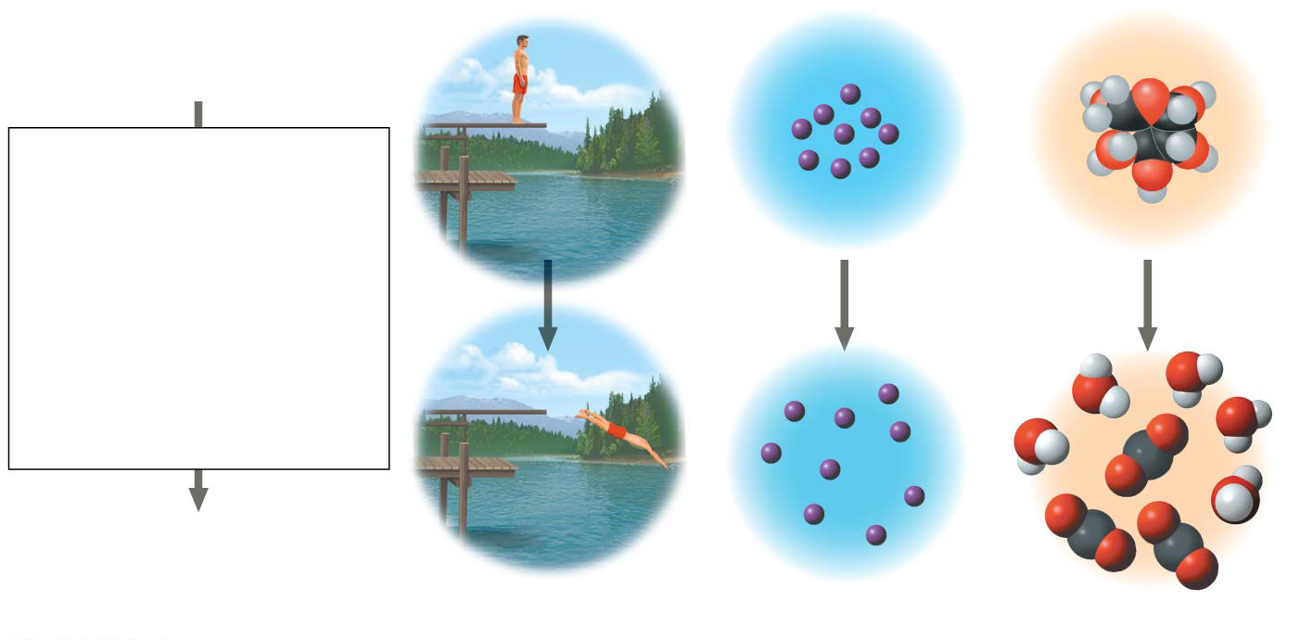
Figure 8.5
• More free energy (higher G)
• Less stable
• Greater work capacity
In a spontaneous change
•
The free energy of the
system decreases
(∆G < 0)
•
The system becomes
more stable
•
The released free
energy can be
harnessed to do
work
• Less free energy (lower G)
• More stable
• Less work capacity
(a) Gravitational motion
(b) Diffusion
(c) Chemical reaction
Notes:
Figure 8.5 The relationship of free energy to stability, work capacity, and spontaneous change

Slide 10
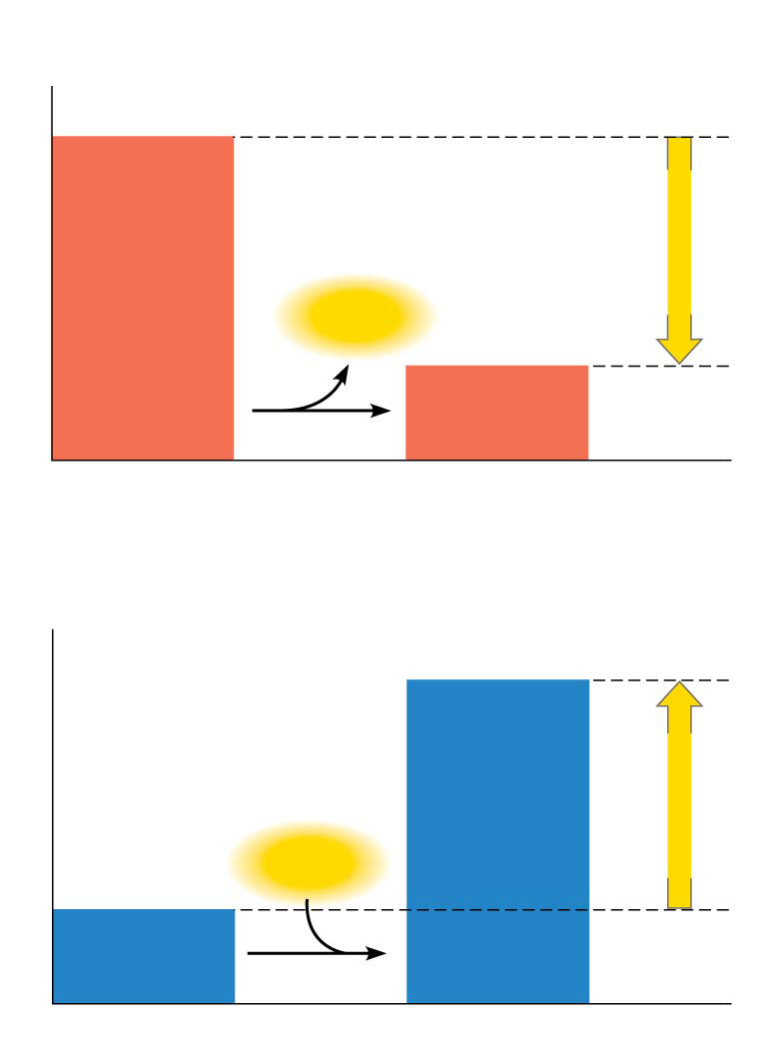
Figure 8.6
(a)
Exergonic reaction: energy released,
spontaneous
Reactants
Amount of
energy
released
(∆G < 0)
Free energy
Energy
Products
Progress of the reaction
(b)
Endergonic reaction: energy required,
nonspontaneous
Products
Amount of
energy
required
(∆G > 0)
Free energy
Energy
Reactants
Progress of the reaction
Notes:
Figure 8.6 Free energy changes (∆G) in exergonic and endergonic reactions

Slide 11
Concept 8.3: ATP powers cellular work by coupling exergonic reactions to endergonic reactions
A cell does three main kinds of work
Chemical
Transport
Mechanical
To do work, cells manage energy resources by energy coupling, the use of an exergonic process to drive an endergonic one
Most energy coupling in cells is mediated by ATP

Slide 12
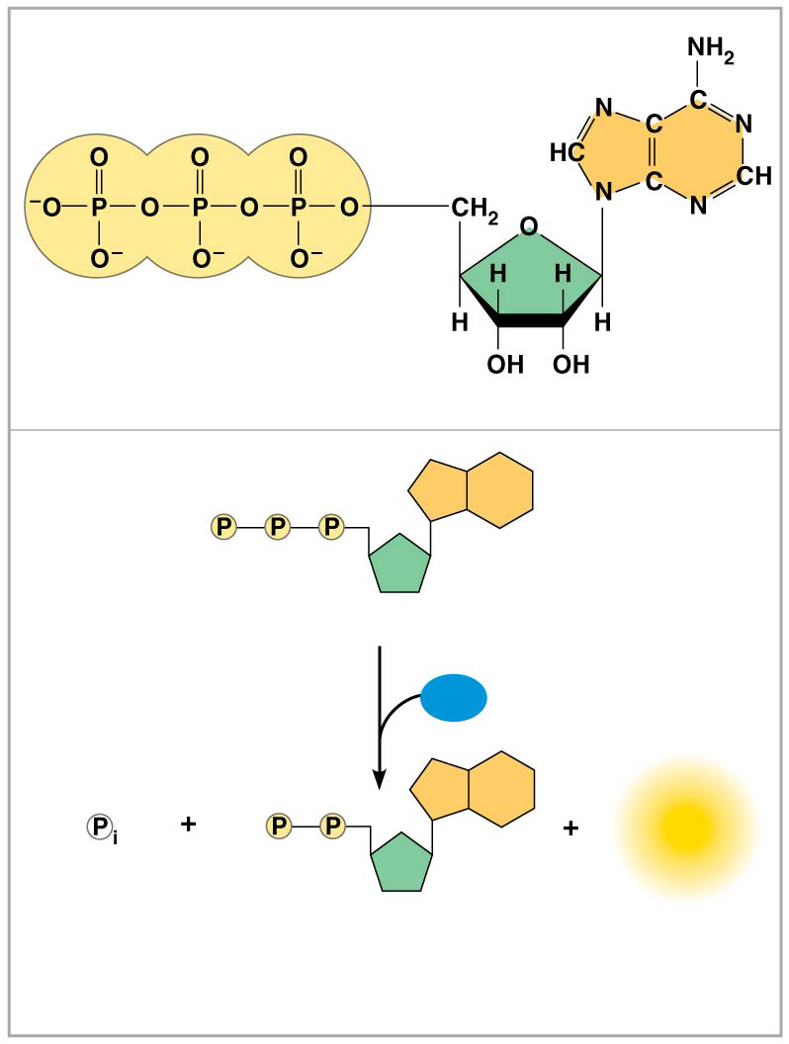
Figure 8.9
Adenine
Triphosphate group
(3 phosphate groups)
Ribose
(a) The structure of ATP
Adenosine triphosphate (ATP)
H₂O
Energy
Inorganic
phosphate
Adenosine diphosphate
(ADP)
(b) The hydrolysis of ATP
Notes:
Figure 8.9 The structure and hydrolysis of adenosine triphosphate (ATP)

Slide 13
How the Hydrolysis of ATP Performs Work
The three types of cellular work (mechanical, transport, and chemical) are powered by the hydrolysis of ATP
In the cell, the energy from the exergonic reaction of ATP hydrolysis can be used to drive an endergonic reaction
Overall, the coupled reactions are exergonic

Slide 14
ATP drives endergonic reactions by phosphorylation, transferring a phosphate group to some other molecule, such as a reactant
The recipient molecule is now called a phosphorylated intermediate

Slide 15
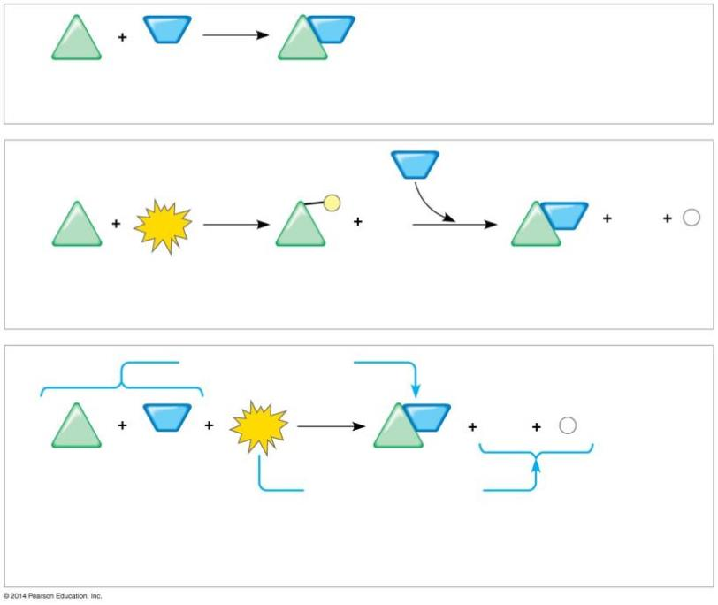
Figure 8.10
NH₃
NH₂
∆G_{Glu}
= +3.4 kcal/mol
Glu
Glu
Glutamic acid
Ammonia
Glutamine
(a) Glutamic acid conversion to glutamine
NH₃
1
P
2
NH₂
ADP
P
ATP
ADP
_{i}
Glu
Glu
Glu
Glutamic acid
Phosphorylated
intermediate
Glutamine
(b) Conversion reaction coupled with ATP hydrolysis
∆G_{Glu}
= +3.4 kcal/mol
NH₃
NH₂
ADP
P
Glu
ATP
Glu
_{i}
∆G_{Glu}
= +3.4 kcal/mol
∆G_{ATP}
= −7.3 kcal/mol
+ ∆G_{ATP}
= −7.3 kcal/mol
Net ∆G
= −3.9 kcal/mol
(c) Free-energy change for coupled reaction
Notes:
Figure 8.10 How ATP drives chemical work: energy coupling using ATP hydrolysis

Slide 16
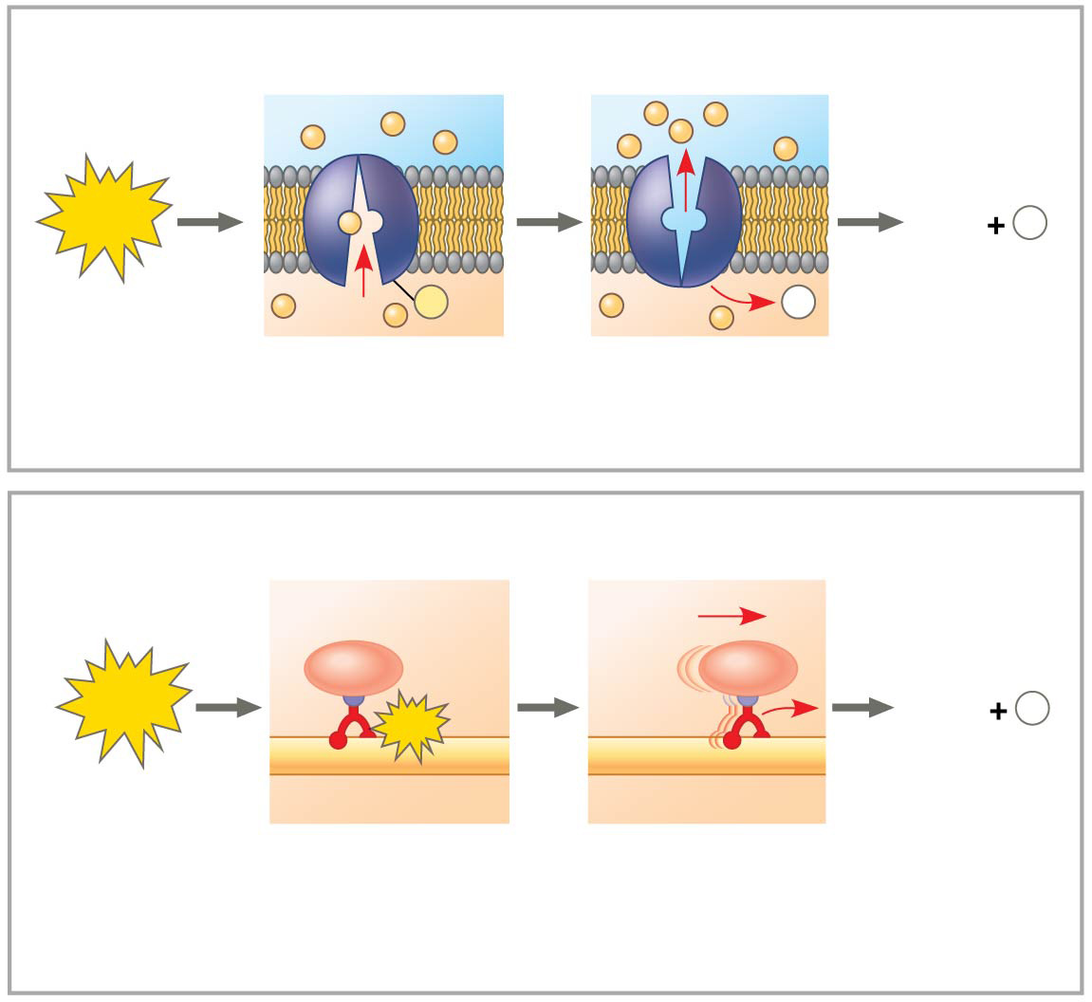
Figure 8.11
Transport protein
Solute
ATP
ADP
P
i
P
P
i
Solute transported
(a) Transport work: ATP phosphorylates transport proteins.
Vesicle
Cytoskeletal track
ATP
ADP
P
ATP
i
Motor protein
Protein and vesicle moved
(b)
Mechanical work: ATP binds noncovalently to motor
proteins and then is hydrolyzed.
Notes:
Figure 8.11 How ATP drives transport and mechanical work

Slide 17
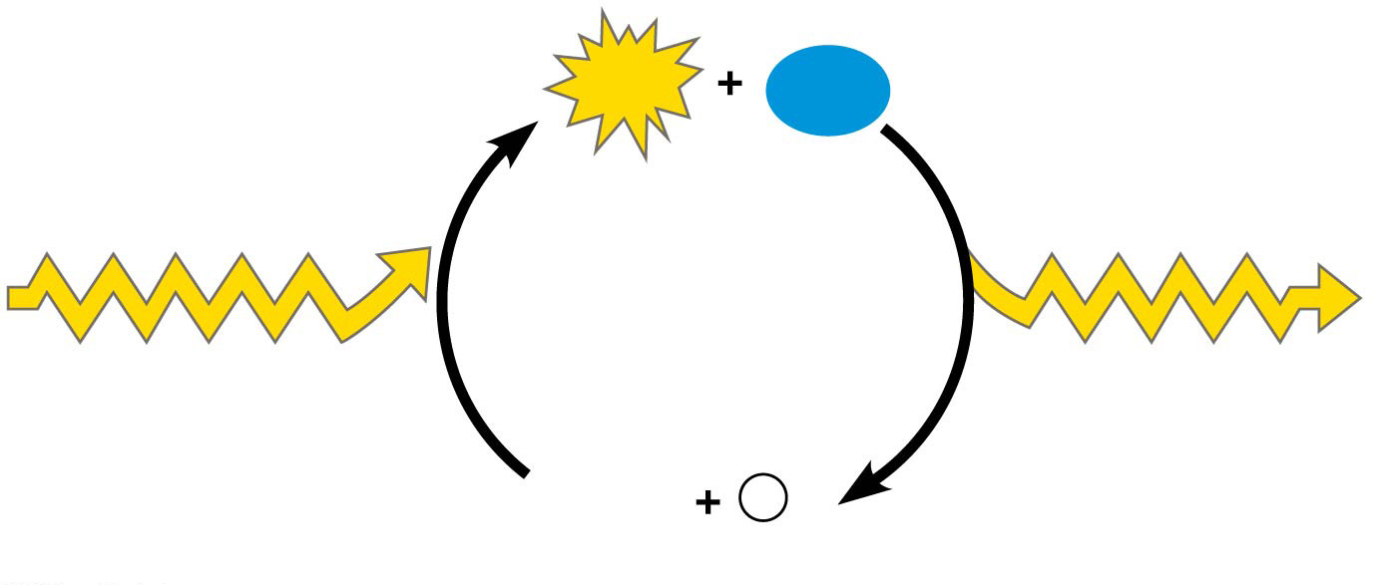
Figure 8.12
ATP
H₂O
Energy from
catabolism
(exergonic, energy-
releasing processes)
Energy for cellular
work (endergonic
energy-consuming
processes)
ADP
P
i
Notes:
Figure 8.12 The ATP cycle

Slide 18
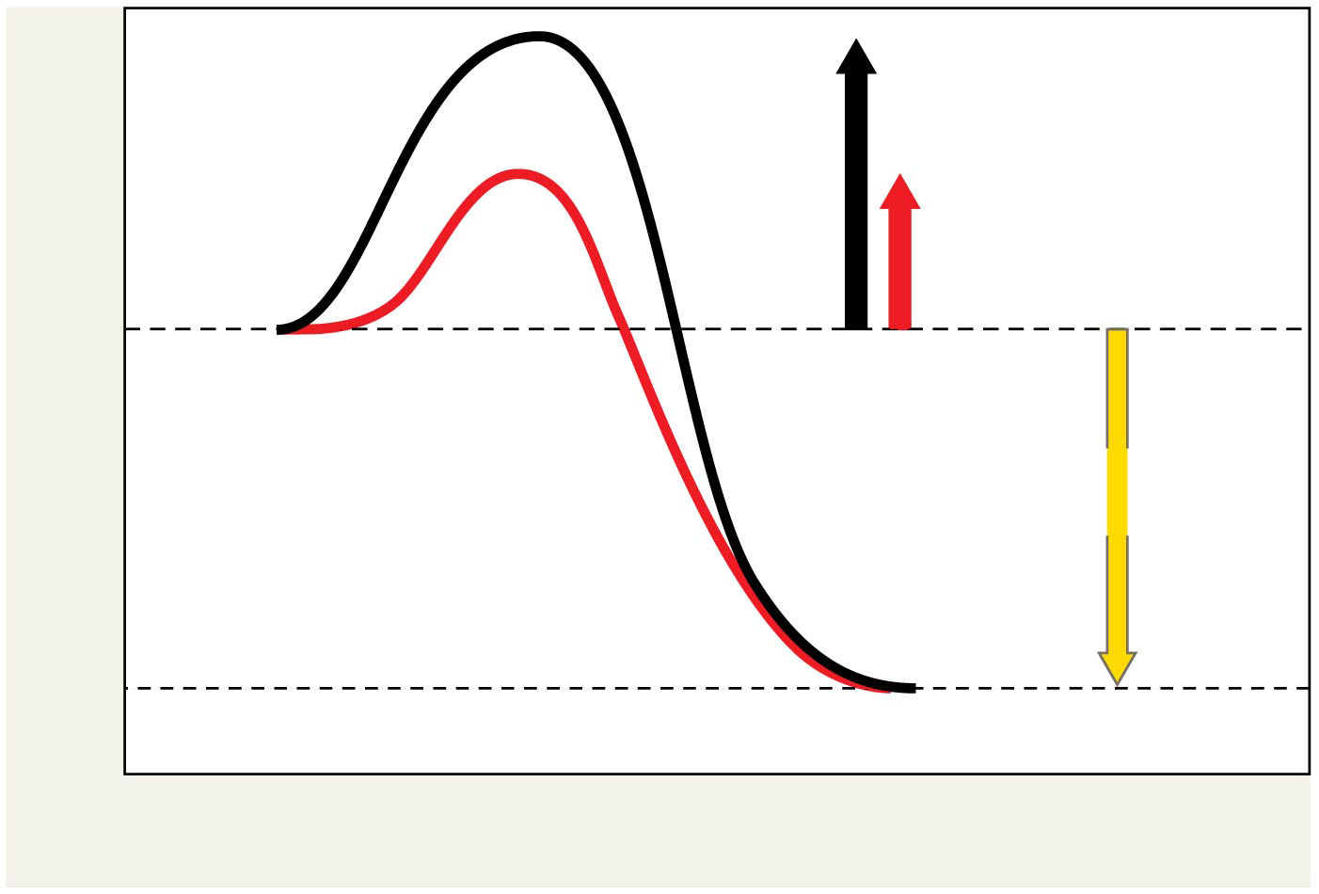
Figure 8.14
Course of
reaction
without
enzyme
E_{A}
without
enzyme
E_{A} with
enzyme
is lower
Reactants
Free energy
Course of
reaction
with enzyme
∆G is unaffected
by enzyme
Products
Progress of the reaction
Notes:
Figure 8.14 The effect of an enzyme on activation energy

Slide 19
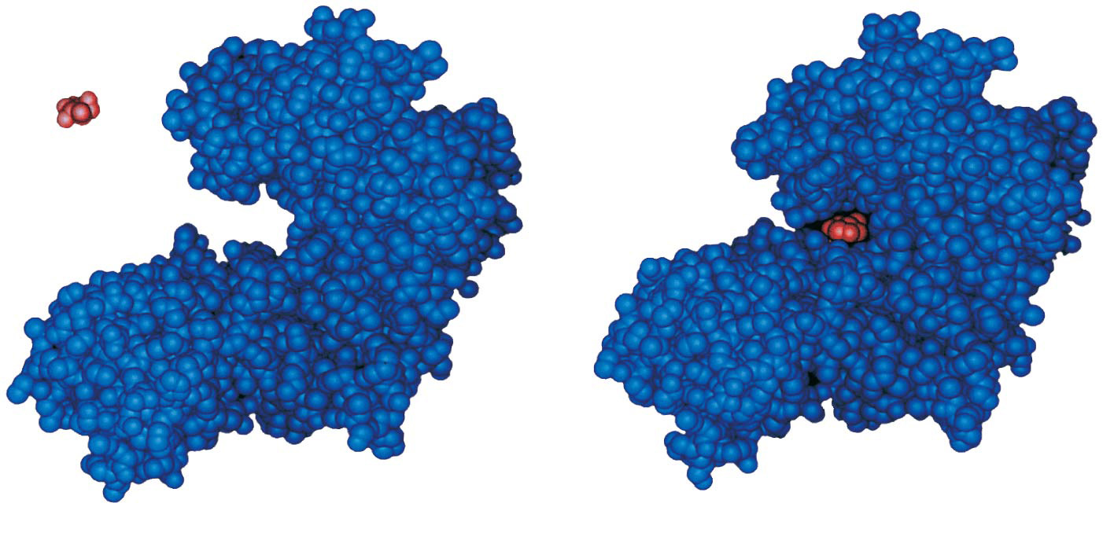
Figure 8.15
Substrate
Active site
Enzyme
Enzyme-substrate
complex
Notes:
Figure 8.15 Induced fit between an enzyme and its substrate

Slide 20
Catalysis in the Enzyme’s Active Site
In an enzymatic reaction, the substrate binds to the active site of the enzyme
The active site can lower an E_{A} barrier by
Orienting substrates correctly
Straining substrate bonds
Providing a favorable microenvironment
Covalently bonding to the substrate

Slide 21
Cofactors
Cofactors are nonprotein enzyme helpers
Cofactors may be inorganic (such as a metal in ionic form) or organic
An organic cofactor is called a coenzyme
Coenzymes include vitamins

Slide 22
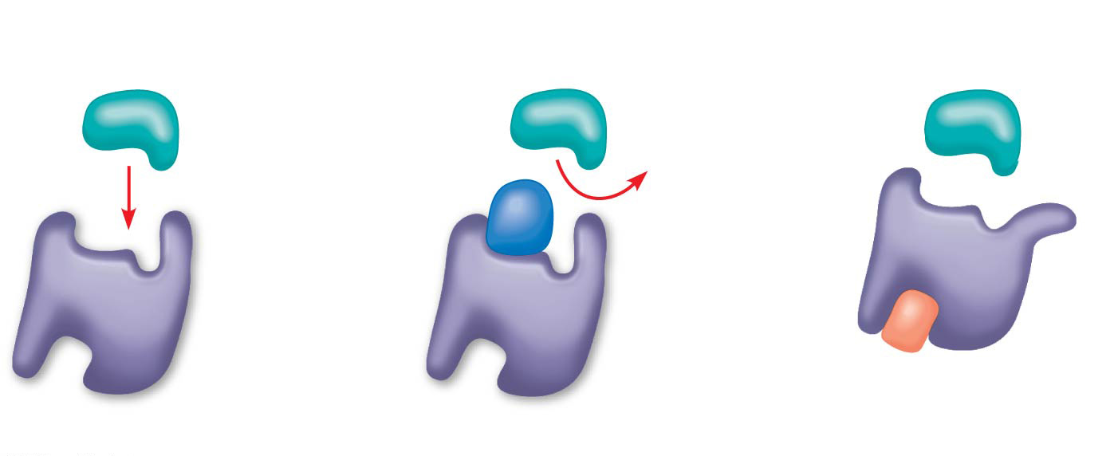
Figure 8.18
(a) Normal binding
(b) Competitive inhibition
(c)
Noncompetitive
inhibition
Substrate
Active site
Competitive
inhibitor
Enzyme
Noncompetitive
inhibitor
Notes:
Figure 8.18 Inhibition of enzyme activity

Slide 23
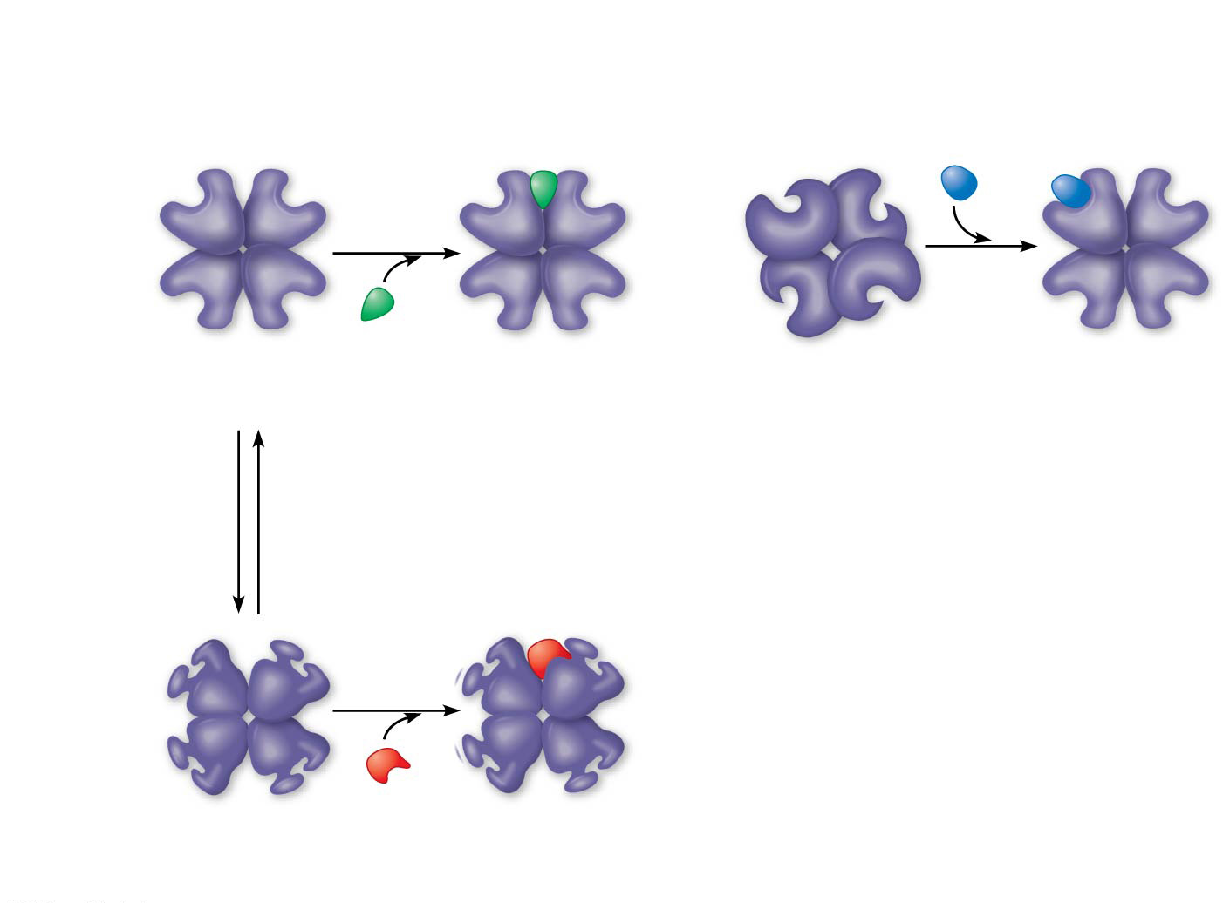
Figure 8.20
(a) Allosteric activators and inhibitors
(b) Cooperativity: another type of allosteric activation
Allosteric enzyme
with four subunits
Active site
(one of four)
Substrate
Regulatory
site (one
of four)
Activator
Active form
Stabilized
active form
Inactive form
Stabilized
active form
Oscillation
Non-
functional
active site
Inhibitor
Inactive form
Stabilized
inactive form
Notes:
Figure 8.20 Allosteric regulation of enzyme activity

Slide 24
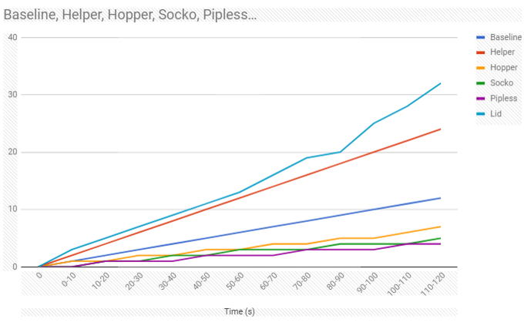
Trial 1: Baseline
This graph illustrates the enzymatic rate of normal enzyme activity. The graph hold fairly steady to around 1 bead per every 10 seconds. No other factors are influencing the rate of enzymatic activity. The other lines of the graph represent how other factors influence the rate of activity. Lines above the baseline indicate an increase in activity while lines below indicate a decrease in activity.

Slide 25
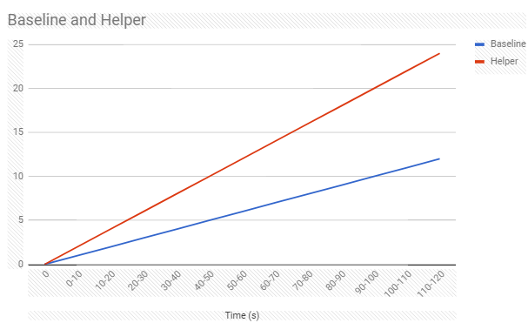
Trial 2: Helper Factor: Cofactors
This simulation relates to the cofactors that help enzyme rate in the cell. The graph shows an increase in the enzyme rate which correlates to the cofactors which are substances that help the enzyme work faster.

Slide 26
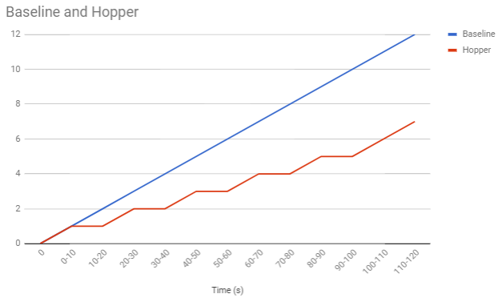
Trial 3: Hopper Factor: Allosteric Inhibition
The hopper trail was an analogy for the allosteric inhibition factor that decrease the enzyme rate. During the simulation, the person (enzyme) held their foot (allosteric site) which changed the overall reaction rate of the enzyme. The enzyme couldn’t react as quickly as it could during the baseline test.

Slide 27
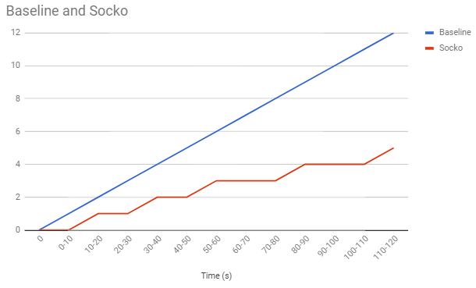
Trial 4: Socko Factor: Denaturation of Active Site
Placing the socks over the hands (active site) of the person (enzyme) simulated the denaturing of the enzyme in this trail. Students couldn’t put the beads together as fast as the baseline test and showed a decreased in enzyme rate. If the temperature increases past a certain point or the pH changes too drastically, the enzyme/active site begins to denature and break down so substrate can’t react with the enzyme.

Slide 28
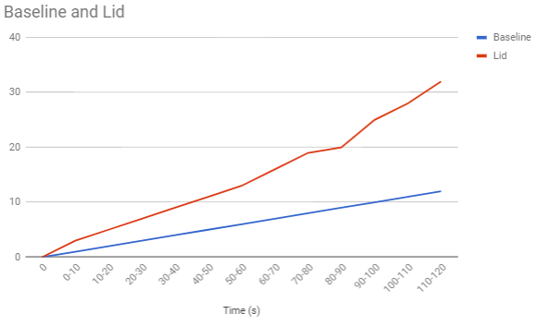
Trial 5: Weighboat/Container Factor: Organelle Compartmentalization/Concentration
This simulation correlates to organelles evolving in the cell. When we transferred the concentration of monomers from the bin in the middle of the room to the container at the lab station, we simulated the cell taking substances in the cell and transporting them around in a vacuole. Having organelles that transfer the concentration of materials in the cell make it more efficient at cellular process which make it more likely to have an evolutionary advantage.

Slide 29
Cooperativity is a form of allosteric regulation that can amplify enzyme activity
One substrate molecule primes an enzyme to act on additional substrate molecules more readily
Cooperativity is allosteric because binding by a substrate to one active site affects catalysis in a different active site
Most often found in multi-subunit enzymes where regulation of one subunit extends to the others.
Example is hemoglobin (although not a true enzyme)

Slide 30
Feedback Inhibition
In feedback inhibition, the end product of a metabolic pathway shuts down the pathway
Feedback inhibition prevents a cell from wasting chemical resources by synthesizing more product than is needed

Slide 31
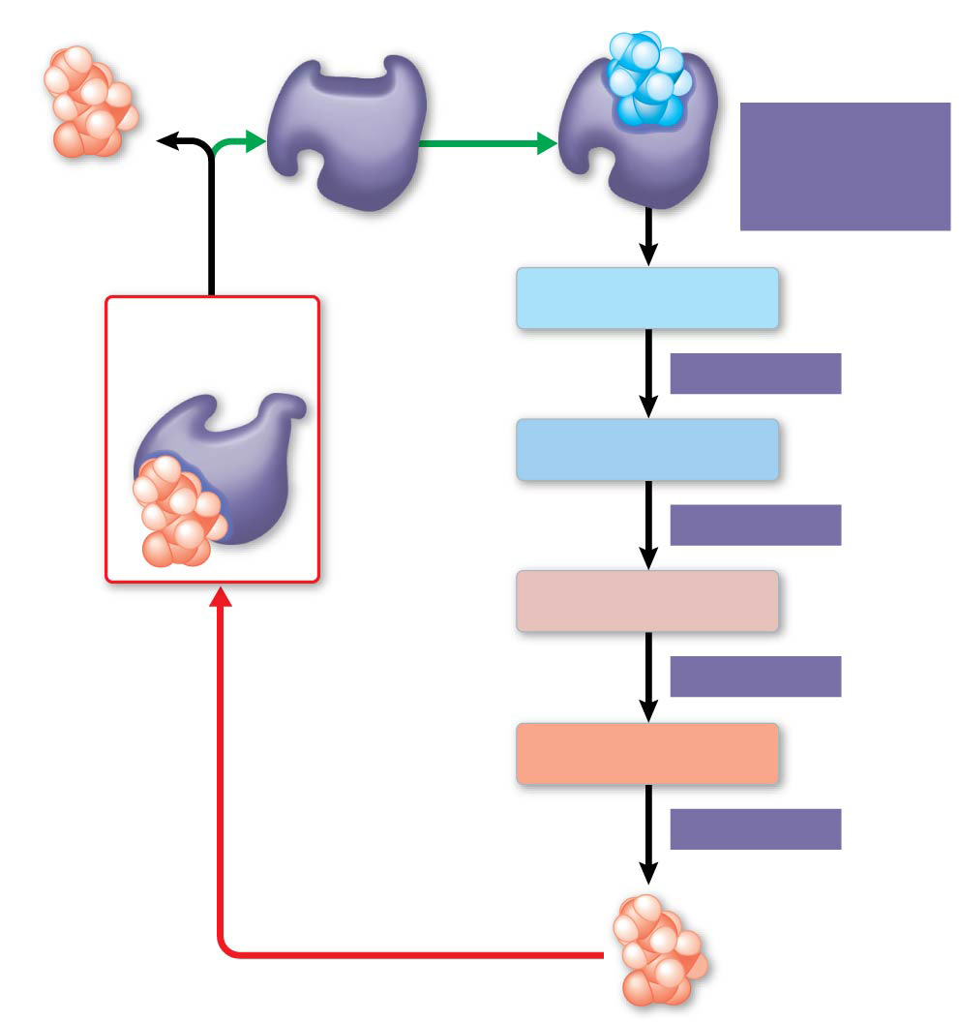
Figure 8.21
Active site available
Threonine
in active site
Enzyme 1
(threonine
deaminase)
Isoleucine
used up by
cell
Intermediate A
Feedback
inhibition
Active
site no
longer
available;
pathway
is halted.
Enzyme 2
Intermediate B
Enzyme 3
Intermediate C
Isoleucine
binds to
allosteric
site.
Enzyme 4
Intermediate D
Enzyme 5
End product
(isoleucine)
Notes:
Figure 8.21 Feedback inhibition in isoleucine synthesis

Slide 32
Good review of concepts
Gibbs Free Energy
https://paul-andersen.squarespace.com/gibbs-free-energy
Metabolism- check your flow chart
http://www.bozemanscience.com/012-life-requires-free-energy

