Slide 1
0
8
An Introduction to Metabolism
Lecture Presentation by Nicole Tunbridge and
Kathleen Fitzpatrick

Slide 2
Debrief Popbeadase activity
What properties of enzymes did you investigate in this activity?
Baseline
Helper
Hopper
Socko
Weigher

Slide 3
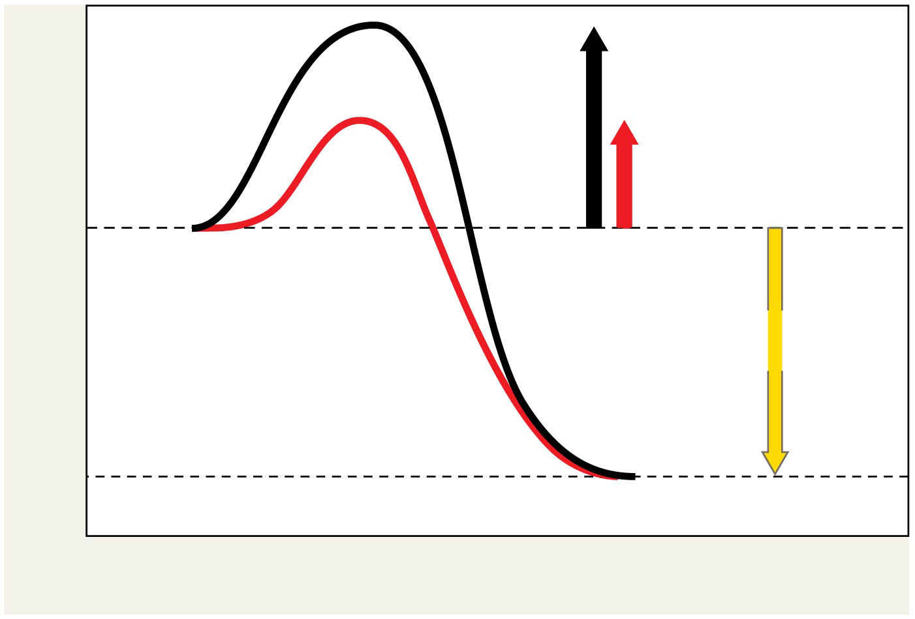
Figure 8.14
Course of
reaction
without
enzyme
E_{A}
without
enzyme
E_{A} with
enzyme
is lower
Reactants
Free energy
Course of
reaction
with enzyme
∆G is unaffected
by enzyme
Products
Progress of the reaction
Notes:
Figure 8.14 The effect of an enzyme on activation energy

Slide 4
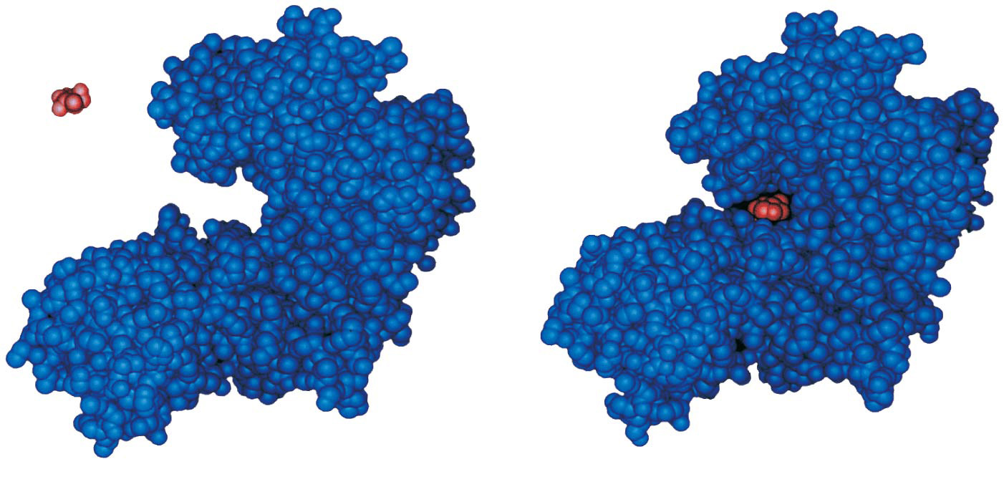
Figure 8.15
Substrate
Active site
Enzyme
Enzyme-substrate
complex
Notes:
Figure 8.15 Induced fit between an enzyme and its substrate

Slide 5
Catalysis in the Enzyme’s Active Site
In an enzymatic reaction, the substrate binds to the active site of the enzyme
The active site can lower an E_{A} barrier by
Orienting substrates correctly
Straining substrate bonds
Providing a favorable microenvironment
Covalently bonding to the substrate

Slide 6
Cofactors
Cofactors are nonprotein enzyme helpers
Cofactors may be inorganic (such as a metal in ionic form) or organic
An organic cofactor is called a coenzyme
Coenzymes include vitamins

Slide 7
Enzyme Inhibitors
Competitive inhibitors bind to the active site of an enzyme, competing with the substrate
Noncompetitive inhibitors bind to another part of an enzyme, causing the enzyme to change shape and making the active site less effective
Examples of inhibitors include toxins, poisons, pesticides, and antibiotics

Slide 8
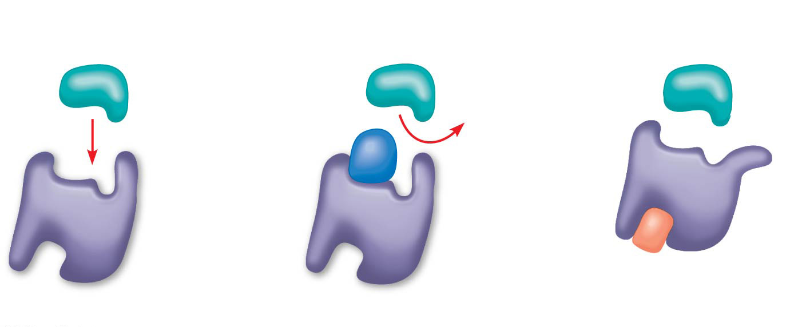
Figure 8.18
(a) Normal binding
(b) Competitive inhibition
(c)
Noncompetitive
inhibition
Substrate
Active site
Competitive
inhibitor
Enzyme
Noncompetitive
inhibitor
Notes:
Figure 8.18 Inhibition of enzyme activity

Slide 9
Allosteric Regulation of Enzymes
Allosteric regulation may either inhibit or stimulate an enzyme’s activity
Allosteric regulation occurs when a regulatory molecule binds to a protein at one site and affects the protein’s function at another site

Slide 10
Allosteric Activation and Inhibition
Most allosterically regulated enzymes are made from polypeptide subunits
Each enzyme has active and inactive forms
The binding of an activator stabilizes the active form of the enzyme
The binding of an inhibitor stabilizes the inactive form of the enzyme

Slide 11
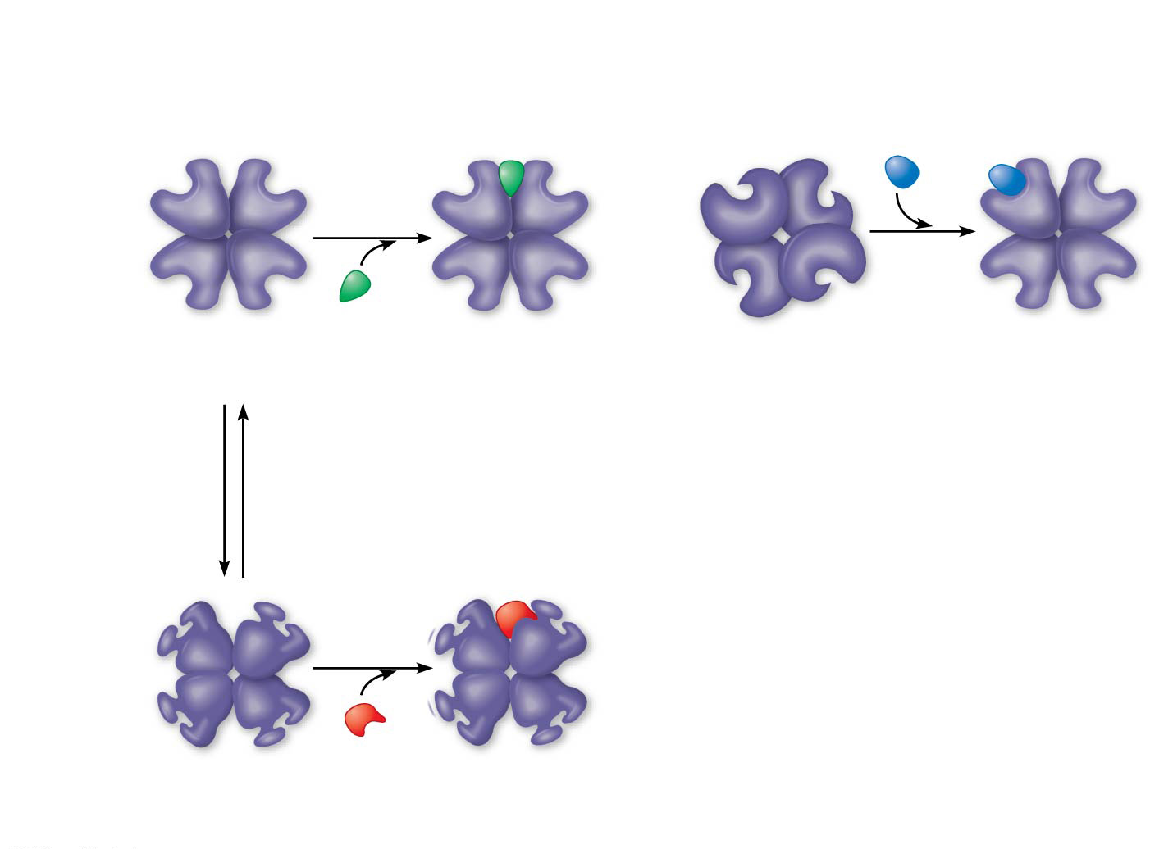
Figure 8.20
(a) Allosteric activators and inhibitors
(b) Cooperativity: another type of allosteric activation
Allosteric enzyme
with four subunits
Active site
(one of four)
Substrate
Regulatory
site (one
of four)
Activator
Active form
Stabilized
active form
Inactive form
Stabilized
active form
Oscillation
Non-
functional
active site
Inhibitor
Inactive form
Stabilized
inactive form
Notes:
Figure 8.20 Allosteric regulation of enzyme activity

Slide 12
Cooperativity is a form of allosteric regulation that can amplify enzyme activity
One substrate molecule primes an enzyme to act on additional substrate molecules more readily
Cooperativity is allosteric because binding by a substrate to one active site affects catalysis in a different active site
Most often found in multi-subunit enzymes where regulation of one subunit extends to the others.
Example is hemoglobin (although not a true enzyme)

Slide 13
Feedback Inhibition
In feedback inhibition, the end product of a metabolic pathway shuts down the pathway
Feedback inhibition prevents a cell from wasting chemical resources by synthesizing more product than is needed

Slide 14
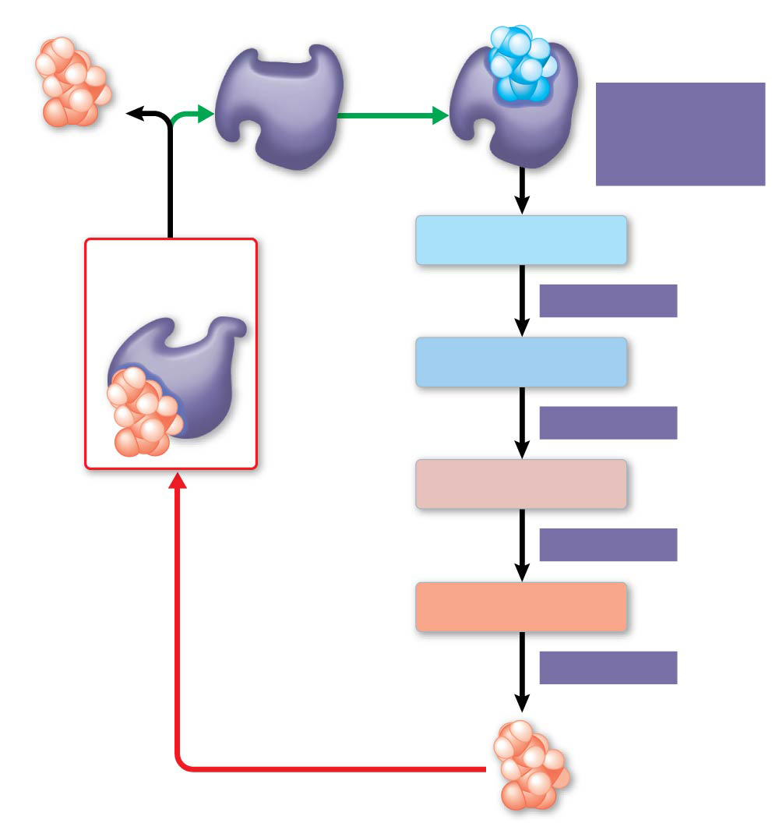
Figure 8.21
Active site available
Threonine
in active site
Enzyme 1
(threonine
deaminase)
Isoleucine
used up by
cell
Intermediate A
Feedback
inhibition
Active
site no
longer
available;
pathway
is halted.
Enzyme 2
Intermediate B
Enzyme 3
Intermediate C
Isoleucine
binds to
allosteric
site.
Enzyme 4
Intermediate D
Enzyme 5
End product
(isoleucine)
Notes:
Figure 8.21 Feedback inhibition in isoleucine synthesis

Slide 15
Potato Peroxidase Lab
Peroxidase is an enzyme in the potato which removes destructive peroxides that are a product of normal metabolism.
The enzyme catalase performs this function in almost all animals.
Hydrogen peroxide is highly poisonous to cells. Peroxidase speeds up the chemical breakdown of hydrogen peroxide into water and oxygen.
The equation for this reaction is written below:
2 H₂O₂ (aq) → 2 H₂O (l) + O₂ (g)

Slide 16
Concept 8.1: An organism’s metabolism transforms matter and energy, subject to the laws of thermodynamics
Metabolism is the totality of an organism’s chemical reactions
A metabolic pathway begins with a specific molecule and ends with a product
Each step is catalyzed by a specific enzyme
Enzyme 1
Enzyme 2
Enzyme 3
A
B
C
D
Reaction 1
Reaction 2
Reaction 3
Starting
molecule
Product

Slide 17
Catabolic pathways release energy by breaking down complex molecules into simpler compounds
Cellular respiration, the breakdown of glucose in the presence of oxygen, is an example of a pathway of catabolism
Anabolic pathways consume energy to build complex molecules from simpler ones
The synthesis of protein from amino acids is an example of anabolism

Slide 18
Forms of Energy
Kinetic energy is energy associated with motion
Heat (thermal energy) is kinetic energy associated with random movement of atoms or molecules
Potential energy is energy that matter possesses because of its location or structure
Chemical energy is potential energy available for release in a chemical reaction
Energy can be converted from one form to another

Slide 19
The First Law of Thermodynamics
Thermodynamics is the study of energy transformations
According to the first law of thermodynamics, the energy of the universe is constant
Energy can be transferred and transformed, but it cannot be created or destroyed
The first law is also called the principle of conservation of energy

Slide 20
The Second Law of Thermodynamics
During every energy transfer or transformation, some energy is unusable, and is often “lost” as heat
According to the second law of thermodynamics
Every energy transfer or transformation increases the entropy (disorder) of the universe
Very much applies to many cell processes, such as cellular respiration.
https://www.youtube.com/watch?v=i6rVHr6OwjI

Slide 21
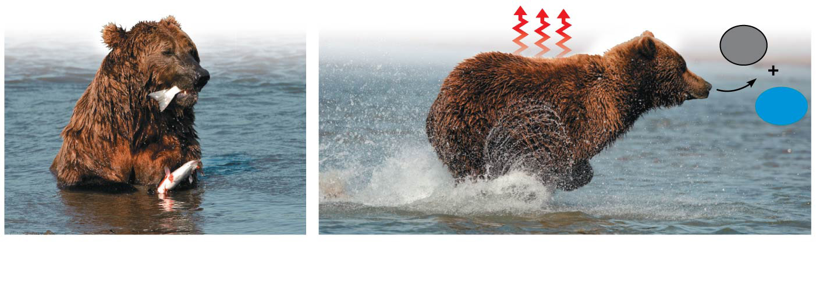
Figure 8.3
Heat
CO₂
H₂O
Chemical
energy
(a)
First law of thermo-
dynamics
(b)
Second law of thermodynamics
Notes:
Figure 8.3 The two laws of thermodynamics

Slide 22
Concept 8.2: The free-energy change of a reaction tells us whether or not the reaction occurs spontaneously
A living system’s free energy (or available energy) is energy that can do work when temperature and pressure are uniform, as in a living cell
The change in free energy (∆G) during a process is related to the change in enthalpy, or change in total energy (∆H), change in entropy (∆S), and temperature in Kelvin units (T)
∆G = ∆H − T∆S
Only processes with a negative ∆G are spontaneous (or exergonic)
Spontaneous processes can be harnessed to perform work

Slide 23
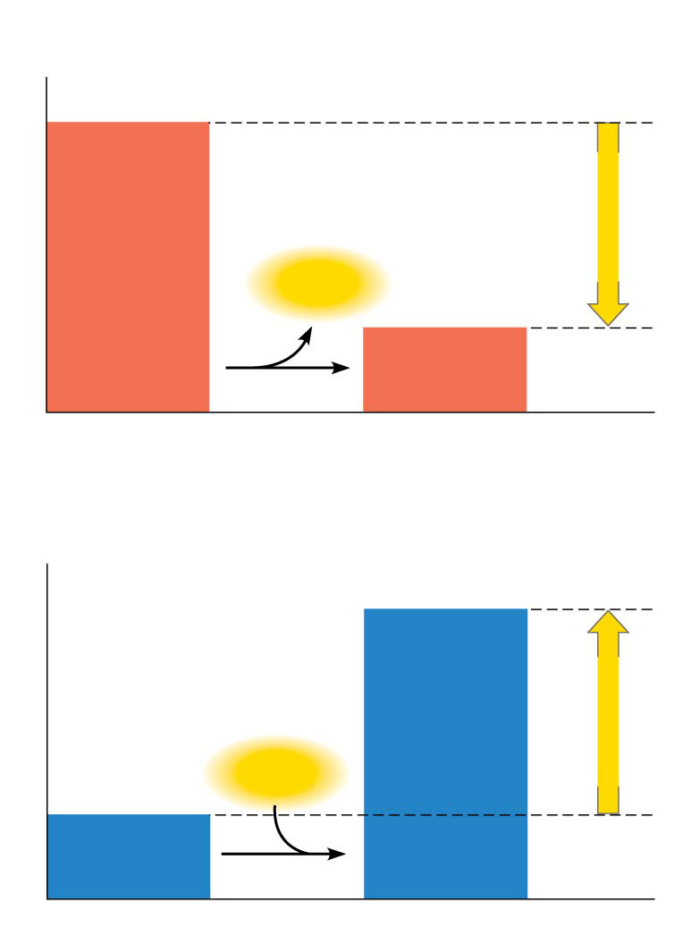
Figure 8.6
(a)
Exergonic reaction: energy released,
spontaneous
Reactants
Amount of
energy
released
(∆G < 0)
Free energy
Energy
Products
Progress of the reaction
(b)
Endergonic reaction: energy required,
nonspontaneous
Products
Amount of
energy
required
(∆G > 0)
Free energy
Energy
Reactants
Progress of the reaction
Notes:
Figure 8.6 Free energy changes (∆G) in exergonic and endergonic reactions

Slide 24
Concept 8.3: ATP powers cellular work by coupling exergonic reactions to endergonic reactions
A cell does three main kinds of work
Chemical
Transport
Mechanical
To do work, cells manage energy resources by energy coupling, the use of an exergonic process to drive an endergonic one
Most energy coupling in cells is mediated by ATP

Slide 25
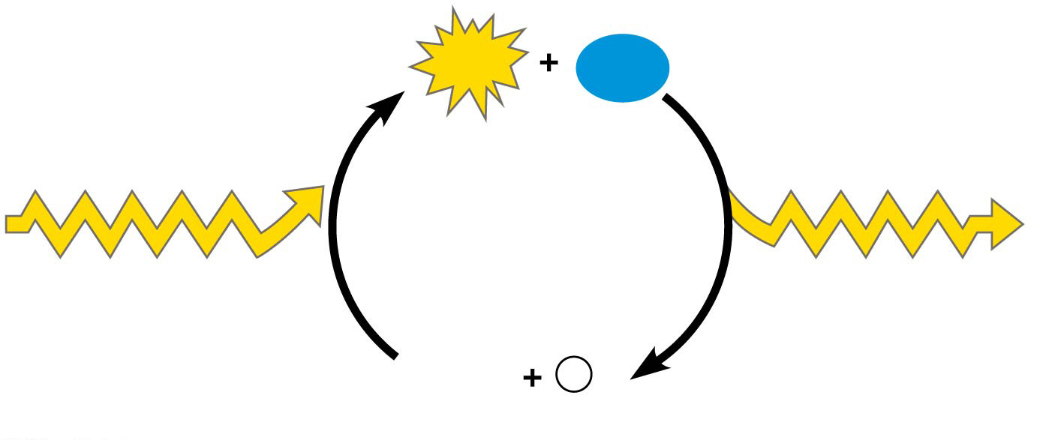
Figure 8.12
ATP
H₂O
Energy from
catabolism
(exergonic, energy-
releasing processes)
Energy for cellular
work (endergonic
energy-consuming
processes)
ADP
P
i
Notes:
Figure 8.12 The ATP cycle

Slide 26
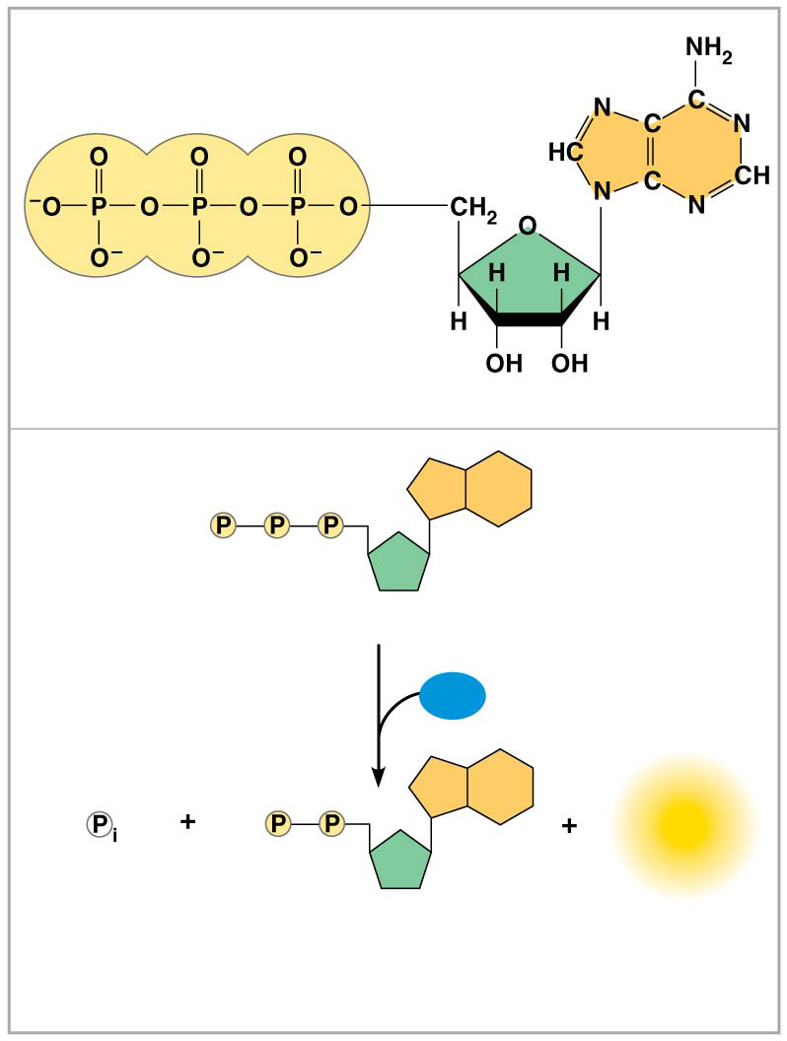
Figure 8.9
Adenine
Triphosphate group
(3 phosphate groups)
Ribose
(a) The structure of ATP
Adenosine triphosphate (ATP)
H₂O
Energy
Inorganic
phosphate
Adenosine diphosphate
(ADP)
(b) The hydrolysis of ATP
Notes:
Figure 8.9 The structure and hydrolysis of adenosine triphosphate (ATP)

Slide 27
How the Hydrolysis of ATP Performs Work
The three types of cellular work (mechanical, transport, and chemical) are powered by the hydrolysis of ATP
In the cell, the energy from the exergonic reaction of ATP hydrolysis can be used to drive an endergonic reaction
Overall, the coupled reactions are exergonic

Slide 28
ATP drives endergonic reactions by phosphorylation, transferring a phosphate group to some other molecule, such as a reactant
The recipient molecule is now called a phosphorylated intermediate

Slide 29
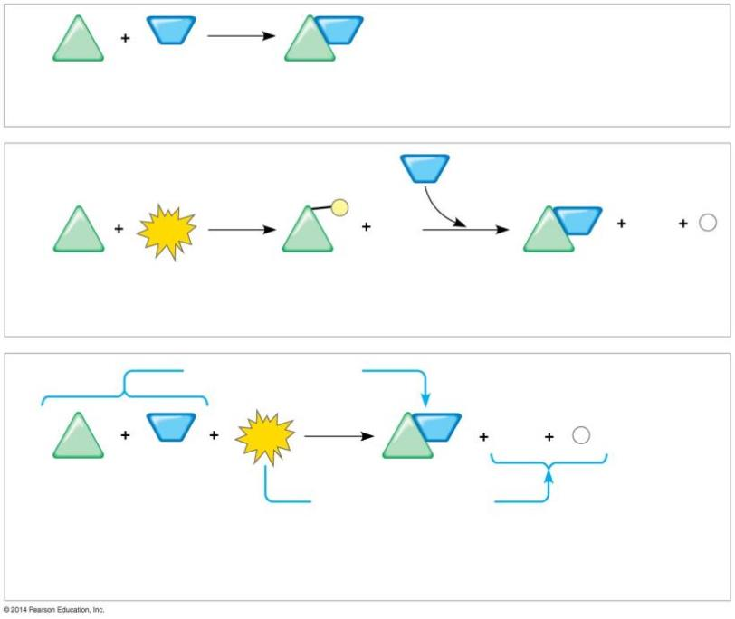
Figure 8.10
NH₃
NH₂
∆G_{Glu}
= +3.4 kcal/mol
Glu
Glu
Glutamic acid
Ammonia
Glutamine
(a) Glutamic acid conversion to glutamine
NH₃
1
P
2
NH₂
ADP
P
ATP
ADP
_{i}
Glu
Glu
Glu
Glutamic acid
Phosphorylated
intermediate
Glutamine
(b) Conversion reaction coupled with ATP hydrolysis
∆G_{Glu}
= +3.4 kcal/mol
NH₃
NH₂
ADP
P
Glu
ATP
Glu
_{i}
∆G_{Glu}
= +3.4 kcal/mol
∆G_{ATP}
= −7.3 kcal/mol
+ ∆G_{ATP}
= −7.3 kcal/mol
Net ∆G
= −3.9 kcal/mol
(c) Free-energy change for coupled reaction
Notes:
Figure 8.10 How ATP drives chemical work: energy coupling using ATP hydrolysis

Slide 30
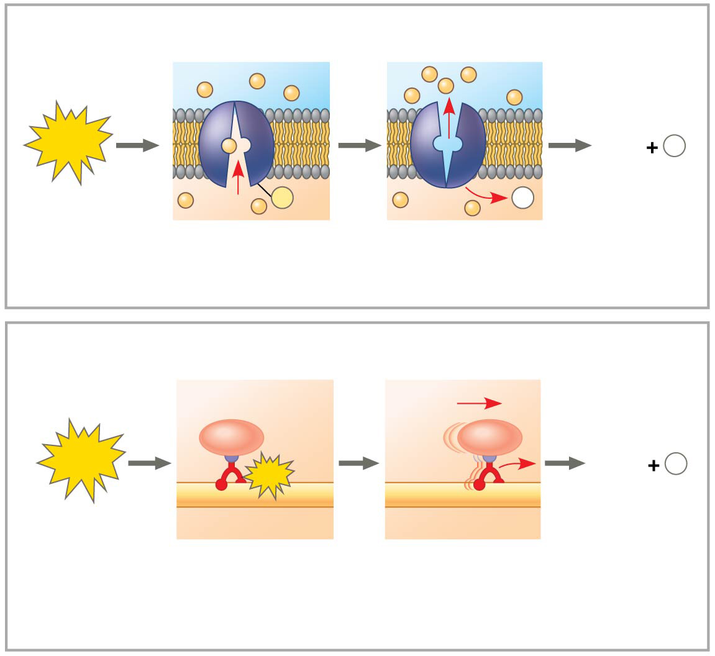
Figure 8.11
Transport protein
Solute
ATP
ADP
P
i
P
P
i
Solute transported
(a) Transport work: ATP phosphorylates transport proteins.
Vesicle
Cytoskeletal track
ATP
ADP
P
ATP
i
Motor protein
Protein and vesicle moved
(b)
Mechanical work: ATP binds noncovalently to motor
proteins and then is hydrolyzed.
Notes:
Figure 8.11 How ATP drives transport and mechanical work

Slide 31
Figure 8.14
Course of
reaction
without
enzyme
E_{A}
without
enzyme
E_{A} with
enzyme
is lower
Reactants
Free energy
Course of
reaction
with enzyme
∆G is unaffected
by enzyme
Products
Progress of the reaction
Notes:
Figure 8.14 The effect of an enzyme on activation energy

