Slide 1
0
9
Cellular Respiration and Fermentation
Lecture Presentation by Nicole Tunbridge and
Kathleen Fitzpatrick

Slide 2
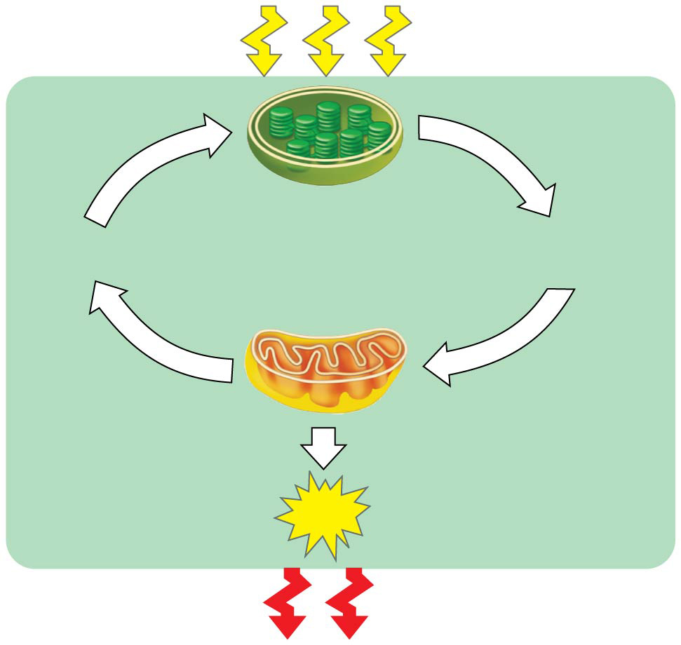
Figure 9.2
Light
energy
ECOSYSTEM
Photosynthesis
in chloroplasts
CO₂
+
H₂O
Organic
molecules
O₂
+
Cellular respiration
in mitochondria
ATP powers
most cellular work
ATP
Heat
energy
Notes:
Figure 9.2 Energy flow and chemical recycling in ecosystems

Slide 3
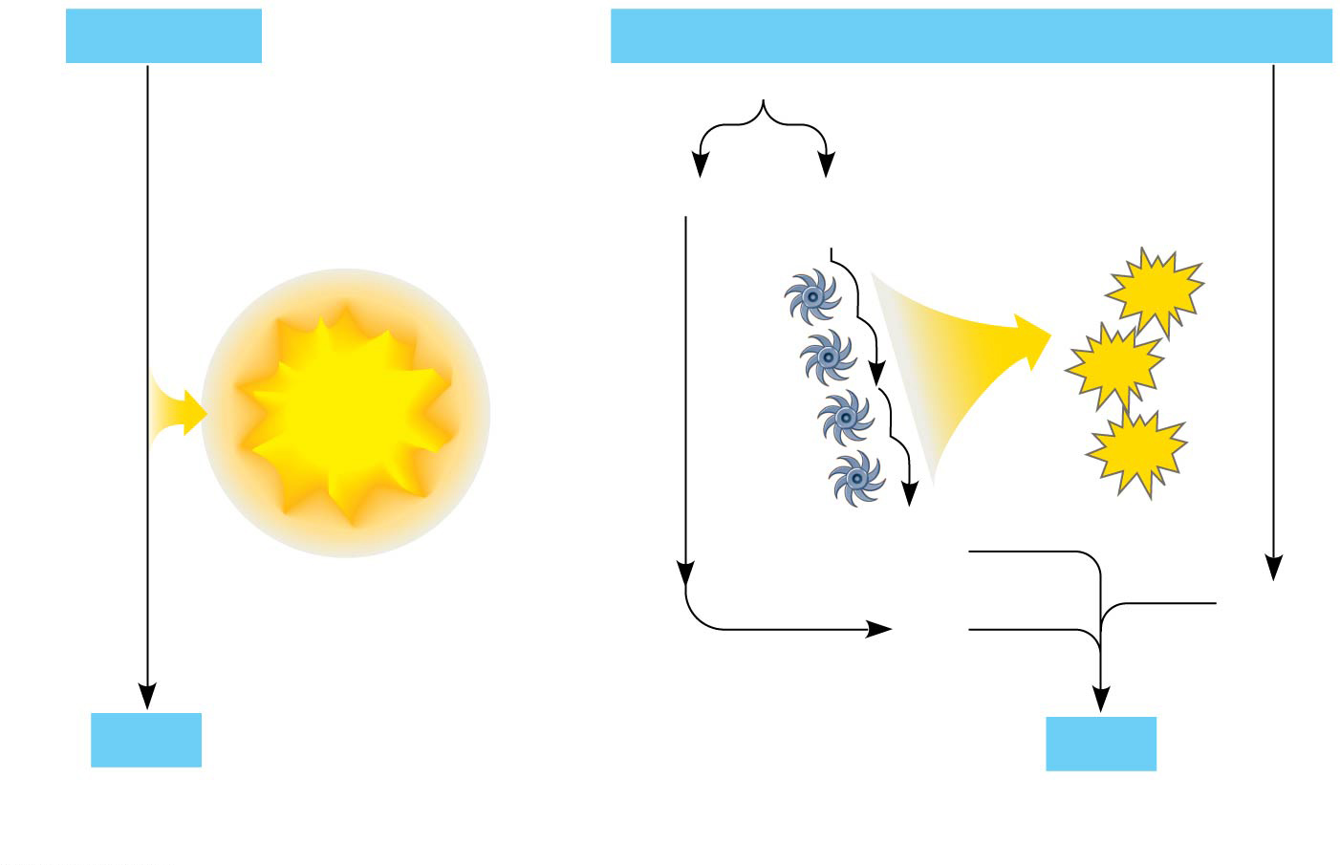
Figure 9.5
H₂
+
½ O₂
2 H
+
½ O₂
Controlled
release of
energy
2 H⁺
+
2 e⁻
ATP
ATP
Free energy, G
Explosive
release
Free energy, G
Electron transport
chain
ATP
2 e⁻
½ O₂
2 H⁺
H₂O
H₂O
(a)
Uncontrolled reaction
(b)
Cellular respiration
Notes:
Figure 9.5 An introduction to electron transport chains

Slide 4
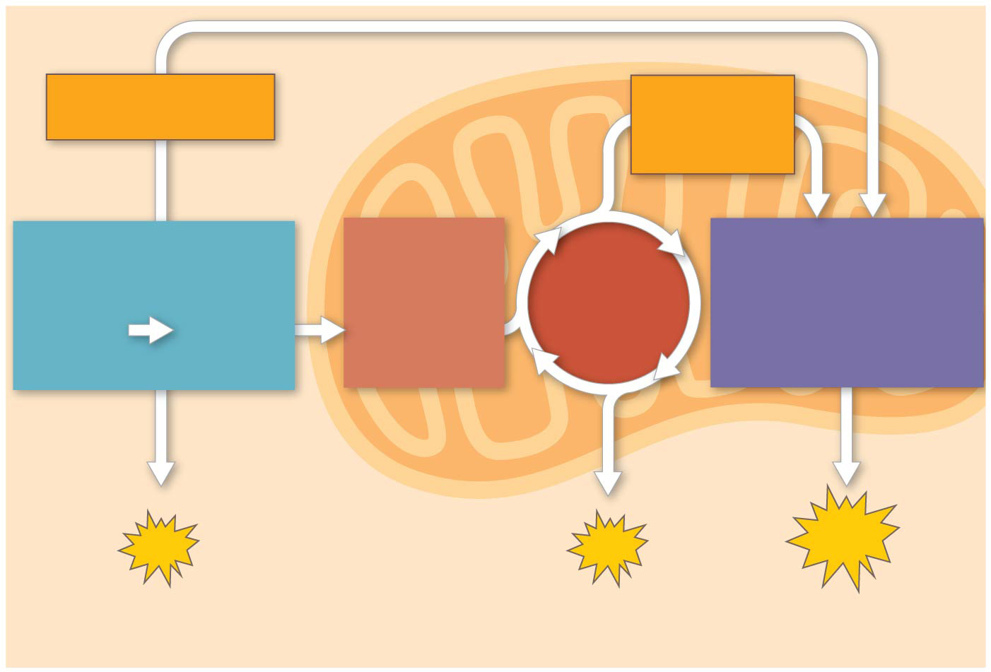
Figure 9.6-3
Electrons
via NADH
Electrons
via NADH
and FADH₂
GLYCOLYSIS
PYRUVATE
OXIDATION
OXIDATIVE
PHOSPHORYLATION
CITRIC
ACID
CYCLE
Glucose
Pyruvate
Acetyl CoA
(Electron transport
and chemiosmosis)
CYTOSOL
MITOCHONDRION
ATP
ATP
ATP
Substrate-level
Substrate-level
Oxidative
Notes:
Figure 9.6-3 An overview of cellular respiration (step 3)

Slide 5
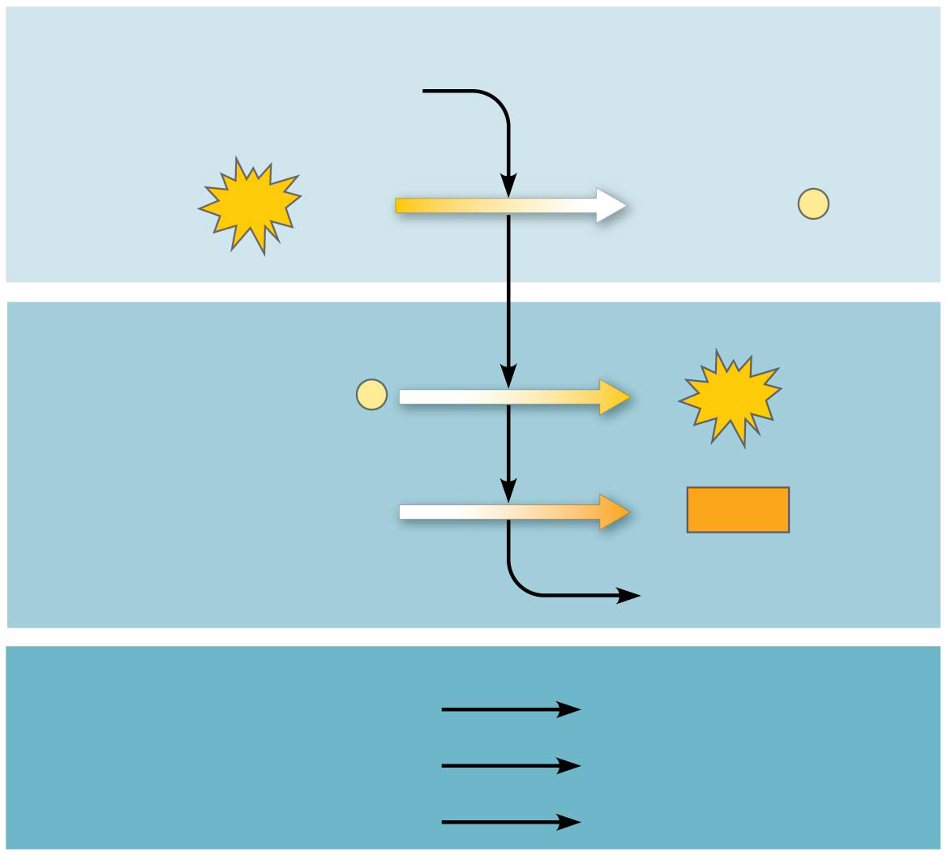
Figure 9.8
Energy Investment Phase
Glucose
2
ATP
used
2 ADP
+
2
P
Energy Payoff Phase
4
ADP
+
4
P
4
ATP
formed
2
NAD⁺
+
4 e⁻
+
4 H⁺
2
NADH
+
2 H⁺
2
Pyruvate
+
2
H₂O
Net
Glucose
2
Pyruvate
+
2
H₂O
4
ATP formed
−
2
ATP used
2
ATP
2
4
e⁻
4
H⁺
2
2 NAD⁺
+
+
NADH
+
2
H⁺
Notes:
Figure 9.8 The energy input and output of glycolysis

Slide 6
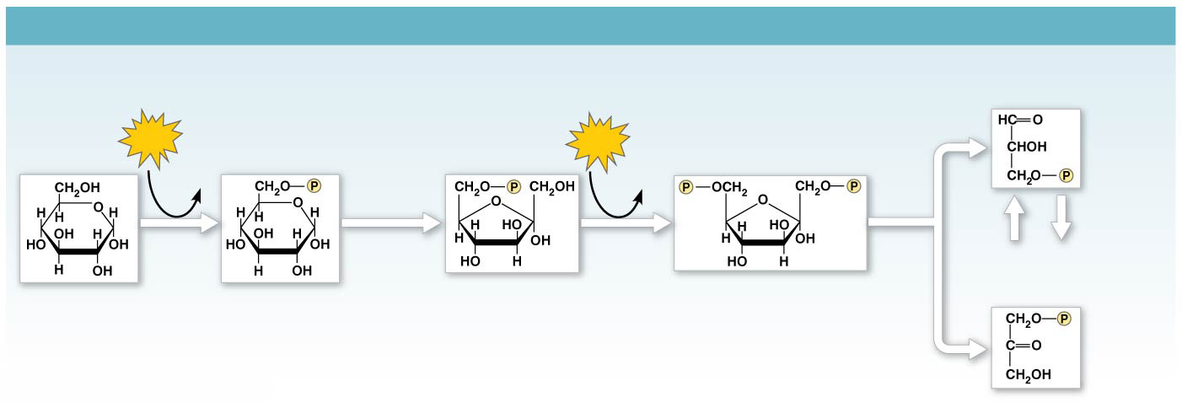
Figure 9.9a
GLYCOLYSIS: Energy Investment Phase
Glyceraldehyde
3-phosphate (G3P)
ATP
Glucose
6-phosphate
Fructose
6-phosphate
ATP
Fructose
1,6-bisphosphate
Glucose
ADP
ADP
Isomerase
Hexokinase
Phosphogluco-
isomerase
Phospho-
fructokinase
Aldolase
5
Dihydroxyacetone
phosphate (DHAP)
1
2
3
4
Notes:
Figure 9.9a A closer look at glycolysis (part 1: investment phase)

Slide 7
Figure 9.9b
GLYCOLYSIS: Energy Payoff Phase
2
ATP
2
2
ATP
2
NADH
H₂O
2
ADP
ADP
2 NAD⁺
+
2 H⁺
2
2
2
2
2
2
Triose
phosphate
dehydrogenase
Phospho-
glycerokinase
Phospho-
glyceromutase
Enolase
Pyruvate
kinase
2
9
7
8
10
Glycer-
aldehyde
3-phosphate
(G3P)
6
1,3-Bisphospho-
glycerate
3-Phospho-
glycerate
2-Phospho-
glycerate
Phosphoenol-
pyruvate (PEP)
Pyruvate
Notes:
Figure 9.9b A closer look at glycolysis (part 2: payoff phase)

Slide 8
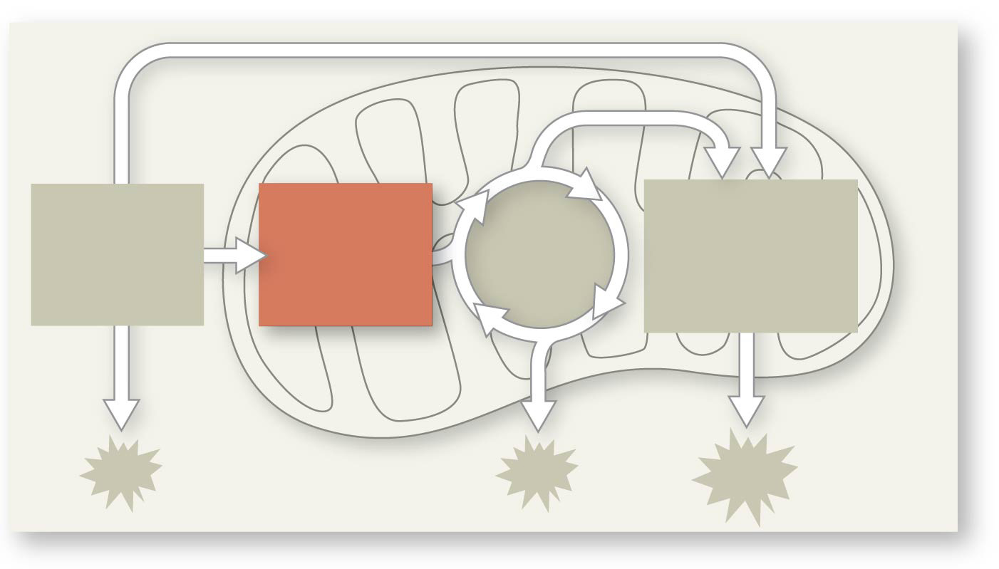
Figure 9.UN07
PYRUVATE
OXIDATION
CITRIC
ACID
CYCLE
OXIDATIVE
PHOSPHORYL-
ATION
GLYCOLYSIS
Notes:
Figure 9.UN07 In-text figure, mini-map, pyruvate oxidation, p. 169

Slide 9
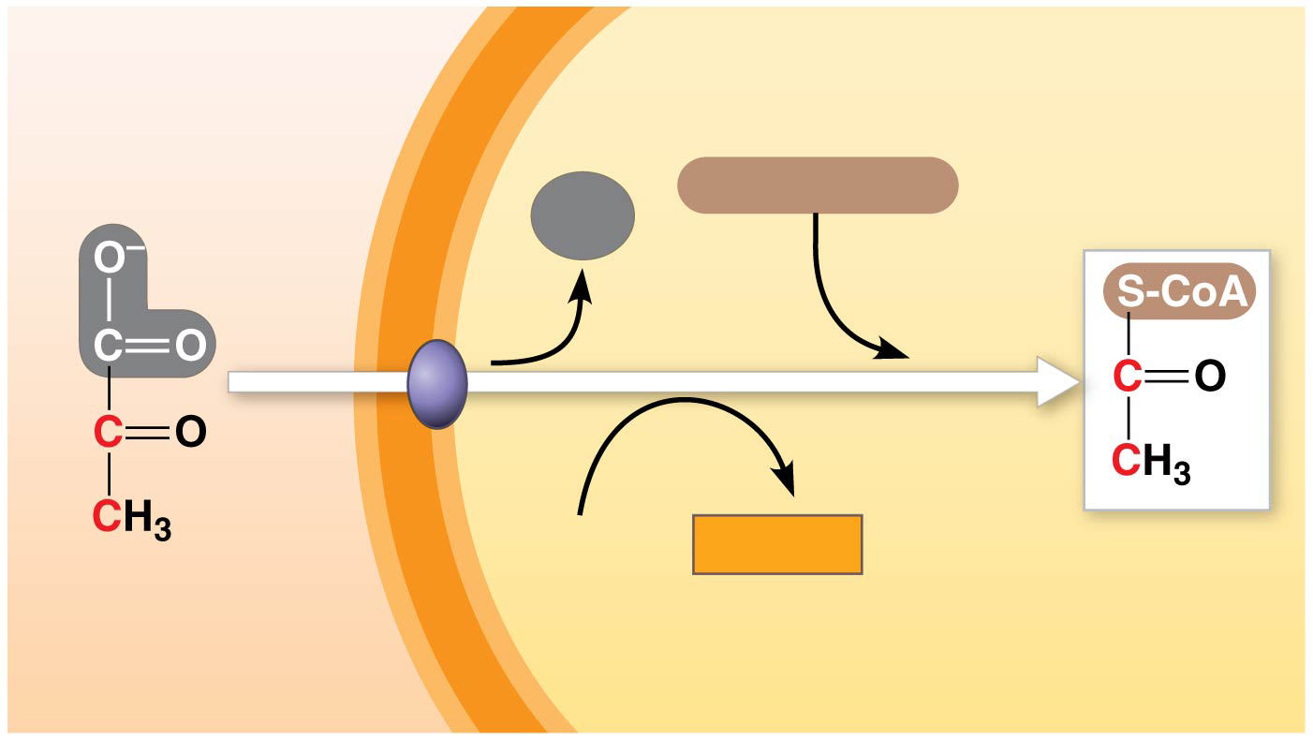
Figure 9.10
MITOCHONDRION
CYTOSOL
Coenzyme A
CO₂
1
3
2
NAD⁺
NADH
+
H⁺
Acetyl CoA
Pyruvate
Transport protein
Notes:
Figure 9.10 Oxidation of pyruvate to acetyl CoA, the step before the citric acid cycle

Slide 10
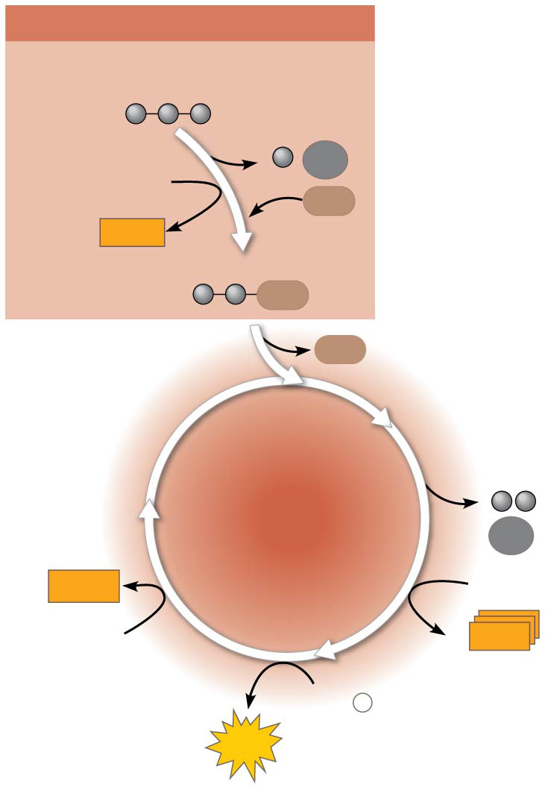
Figure 9.11
PYRUVATE OXIDATION
Pyruvate (from glycolysis,
2 molecules per glucose)
CO₂
NAD⁺
CoA
NADH
+ H⁺
Acetyl CoA
CoA
CoA
CITRIC
ACID
CYCLE
CO₂
2
FADH₂
3
NAD⁺
FAD
CoA
3
NADH
+
3 H⁺
ADP
+
P
i
ATP
Notes:
Figure 9.11 An overview of pyruvate oxidation and the citric acid cycle

Slide 11
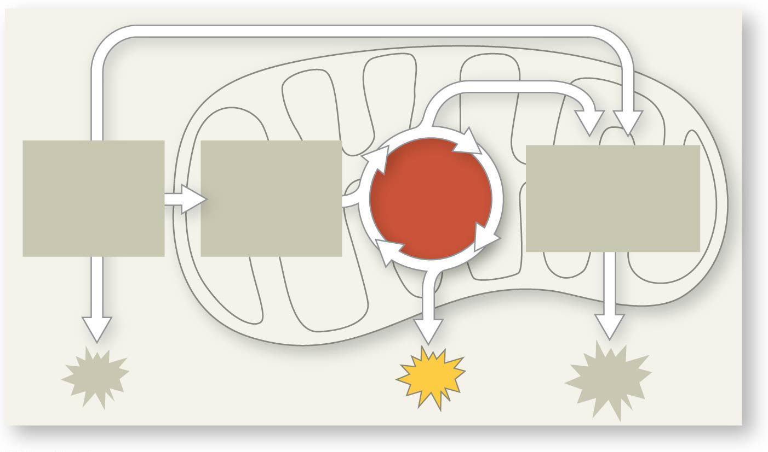
Figure 9.UN08
PYRUVATE
OXIDATION
CITRIC
ACID
CYCLE
OXIDATIVE
PHOSPHORYL-
ATION
GLYCOLYSIS
ATP
Notes:
Figure 9.UN08 In-text figure, mini-map, citric acid cycle, p. 171

Slide 12
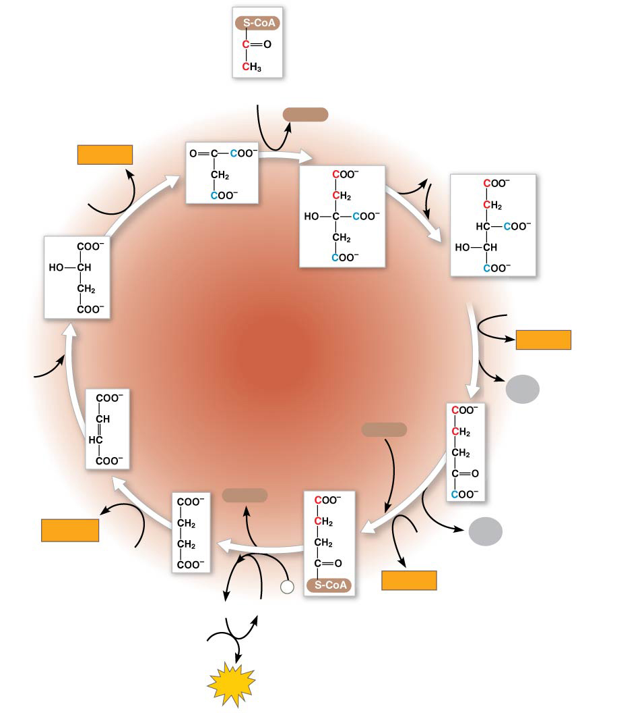
Figure 9.12-8
Acetyl CoA
CoA-SH
NADH
H₂O
+ H⁺
1
NAD⁺
Oxaloacetate
8
2
Malate
Citrate
Isocitrate
CITRIC
ACID
CYCLE
NAD⁺
3
NADH
7
+ H⁺
H₂O
CO₂
Fumarate
CoA-SH
α-Ketoglutarate
6
4
CoA-SH
FADH₂
5
NAD⁺
CO₂
FAD
Succinate
P
NADH
GTP
GDP
i
+ H⁺
Succinyl
CoA
ADP
ATP
Notes:
Figure 9.12-8 A closer look at the citric acid cycle (step 8)

Slide 13
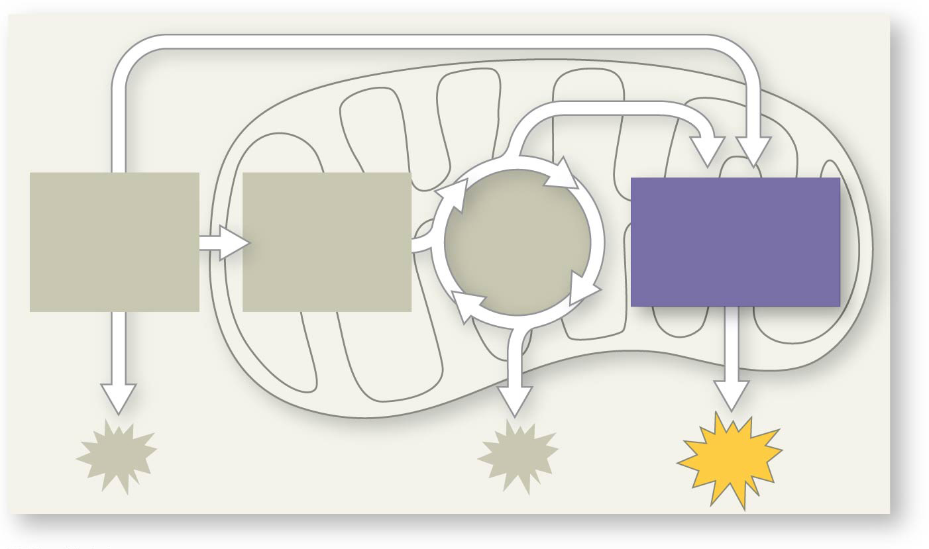
Figure 9.UN09
PYRUVATE
OXIDATION
CITRIC
ACID
CYCLE
OXIDATIVE
PHOSPHORYL-
ATION
GLYCOLYSIS
ATP
Notes:
Figure 9.UN09 In-text figure, mini-map, oxidative phosphorylation, p. 172

Slide 14
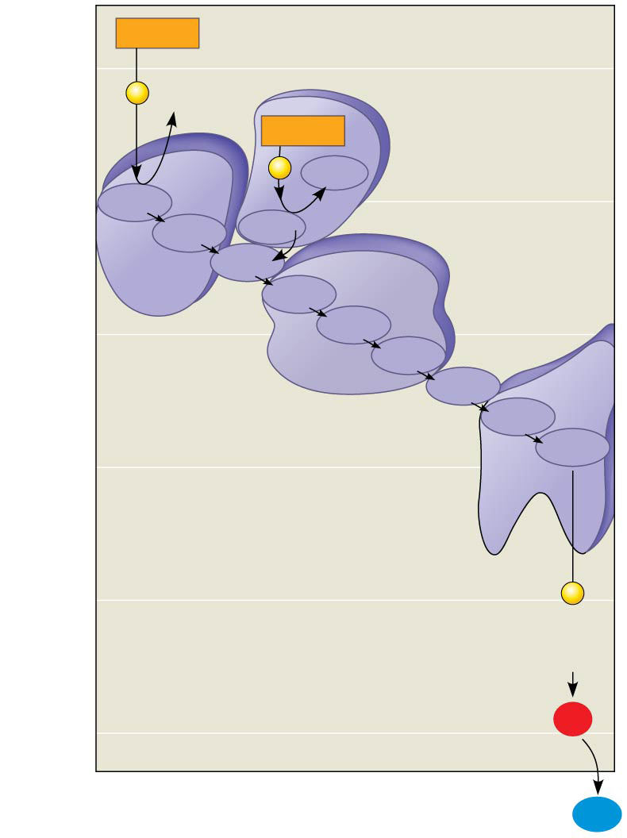
Figure 9.13
NADH
50
e⁻
2
NAD⁺
FADH₂
2
e⁻
Multiprotein
complexes
I
FAD
40
FMN
II
Fe•S
Fe•S
Q
III
Cyt b
30
Fe•S
Cyt c₁
Free energy (G) relative to O₂ (kcal/mol)
Cyt c
IV
Cyt a
20
Cyt a₃
10
2
e⁻
(originally from
NADH or FADH₂)
0
2 H⁺ + ½
O₂
H₂O
Notes:
Figure 9.13 Free-energy change during electron transport

Slide 15
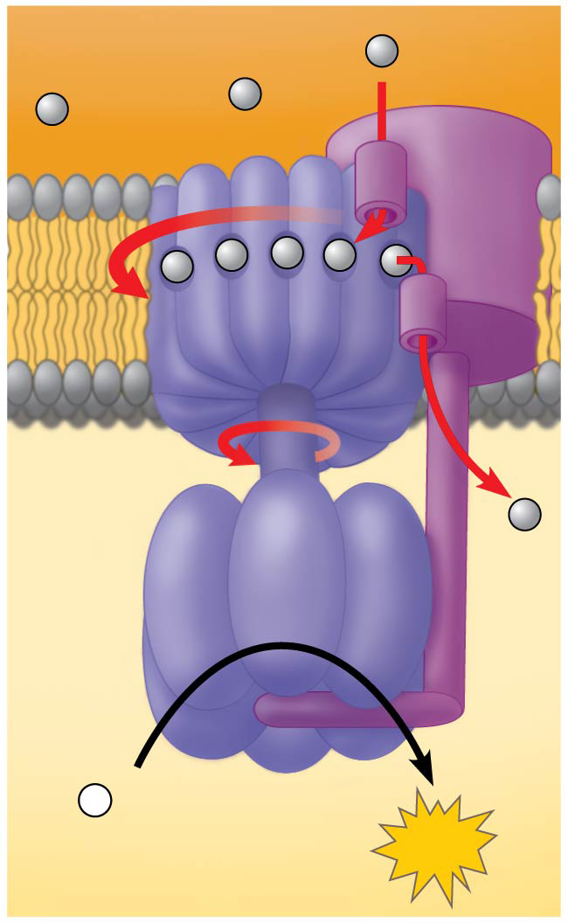
Figure 9.14
INTERMEMBRANE
SPACE
H⁺
Stator
Rotor
Internal rod
Catalytic
knob
ADP
+
P
i
MITOCHONDRIAL
MATRIX
ATP
Notes:
Figure 9.14 ATP synthase, a molecular mill

Slide 16
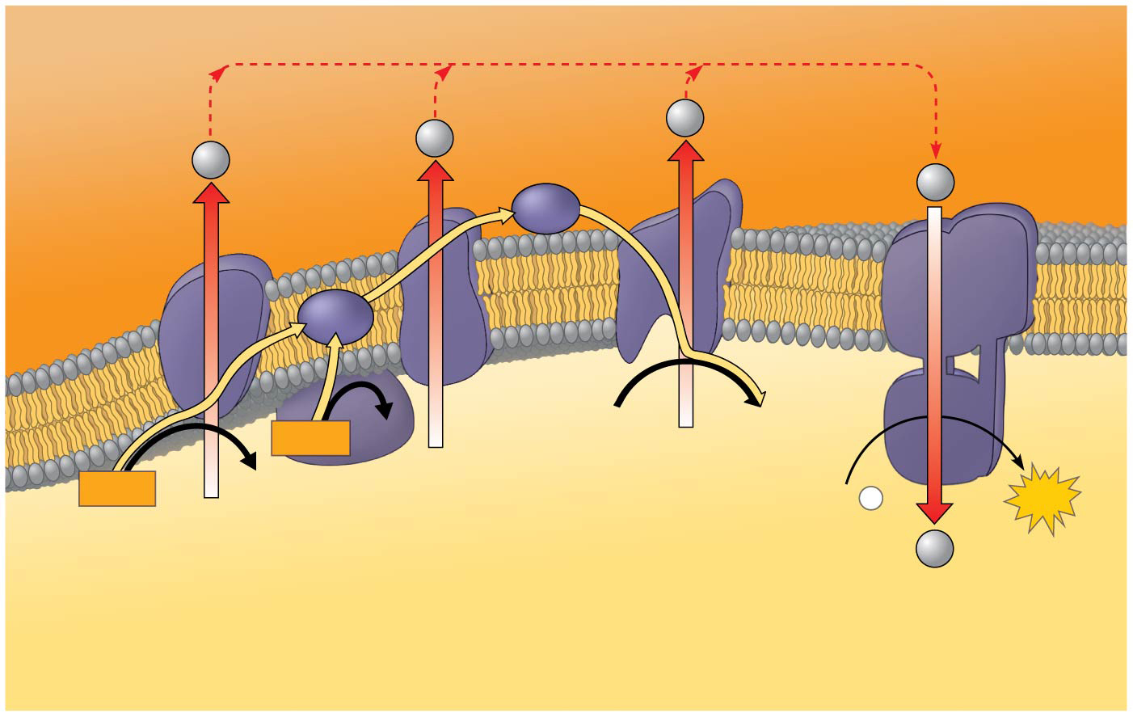
Figure 9.15
H⁺
ATP
synthase
Protein
complex
of electron
carriers
H⁺
H⁺
H⁺
Cyt c
Q
IV
I
III
II
2 H⁺ + ½ O₂
H₂O
FADH₂
FAD
NADH
NAD⁺
ADP
+
P
ATP
(carrying
electrons
from
food)
i
H⁺
1
Electron transport chain
2
Chemiosmosis
Oxidative phosphorylation
Notes:
Figure 9.15 Chemiosmosis couples the electron transport chain to ATP synthesis

Slide 17
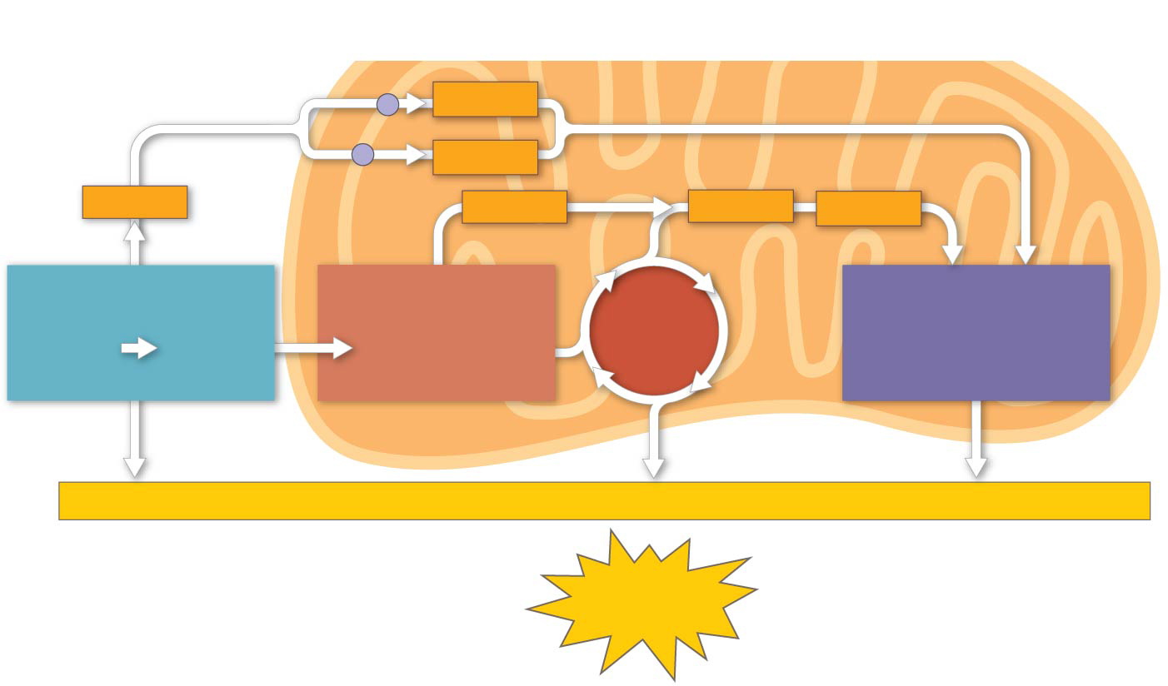
Figure 9.16
Electron shuttles
span membrane
CYTOSOL
2 NADH
MITOCHONDRION
or
2 FADH₂
2 NADH
2 NADH
6 NADH
2 FADH₂
GLYCOLYSIS
PYRUVATE
OXIDATION
2 Acetyl CoA
CITRIC
ACID
CYCLE
OXIDATIVE
PHOSPHORYLATION
(Electron transport
and chemiosmosis)
Glucose
2
Pyruvate
+ 2 ATP
+ 2 ATP
+ about 26 or 28 ATP
Maximum per glucose:
About
30 or 32 ATP
Notes:
Figure 9.16 ATP yield per molecule of glucose at each stage of cellular respiration

Slide 18
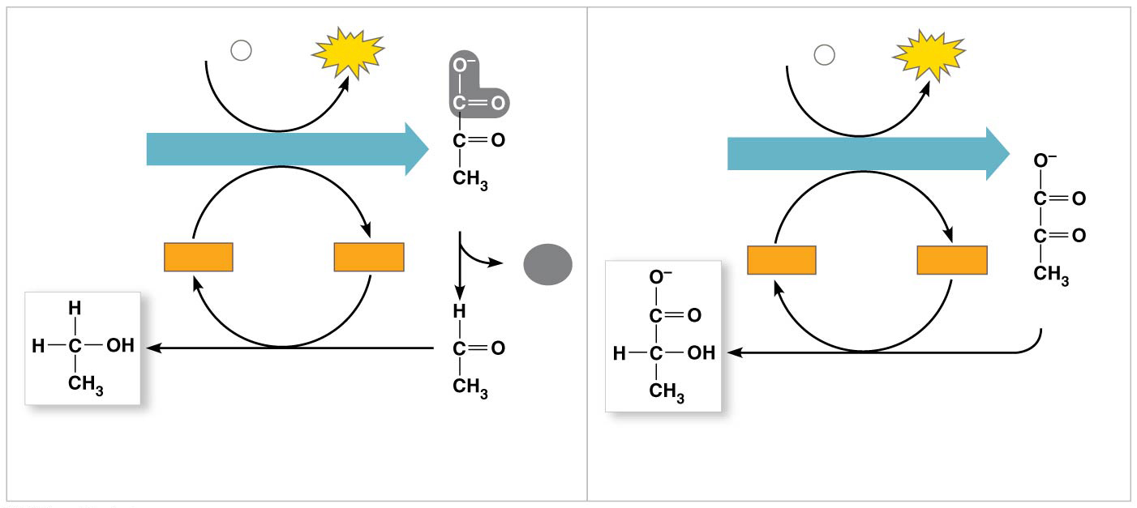
Figure 9.17
2 ADP + 2
P
2
ATP
2 ADP + 2
2
ATP
i
P
i
Glucose
GLYCOLYSIS
Glucose
GLYCOLYSIS
2 Pyruvate
2
NAD⁺
2
NADH
CO₂
2
NAD⁺
2
NADH
2
+ 2 H⁺
+ 2 H⁺
2
Pyruvate
2 Ethanol
2 Acetaldehyde
2 Lactate
(a)
Alcohol fermentation
(b)
Lactic acid fermentation
Notes:
Figure 9.17 Fermentation

Slide 19
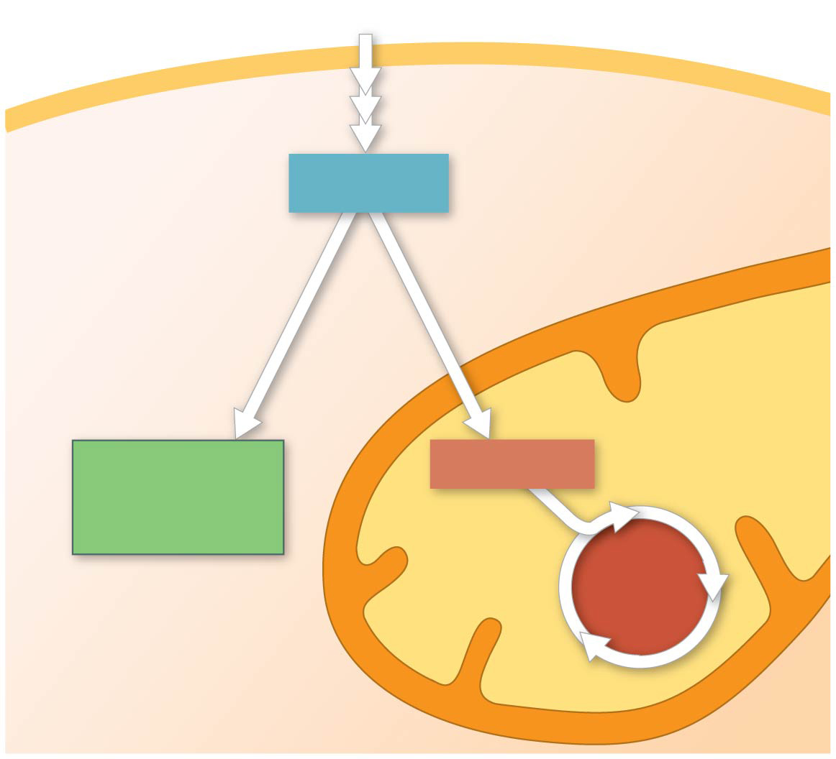
Figure 9.18
Glucose
Glycolysis
CYTOSOL
Pyruvate
No O₂ present:
Fermentation
O₂ present:
Aerobic cellular
respiration
MITOCHONDRION
Ethanol,
lactate, or
other products
Acetyl CoA
CITRIC
ACID
CYCLE
Notes:
Figure 9.18 Pyruvate as a key juncture in catabolism

Slide 20
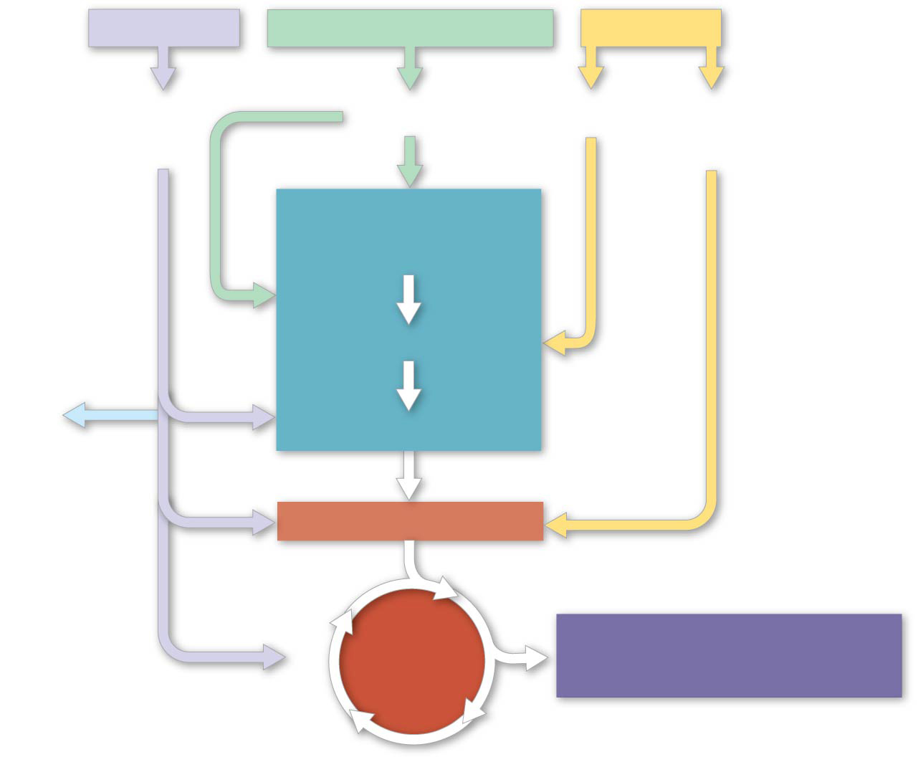
Figure 9.19-5
Proteins
Carbohydrates
Fats
Amino
acids
Sugars
Glycerol
Fatty
acids
GLYCOLYSIS
Glucose
Glyceraldehyde 3-
P
NH₃
Pyruvate
Acetyl CoA
CITRIC
ACID
CYCLE
OXIDATIVE
PHOSPHORYLATION
Notes:
Figure 9.19-5 The catabolism of various molecules from food (step 5)

